Slide 1
Research Methods in Computer Science
CSCI 6530
“If I have seen further it is by standing on the shoulders of giants” - Sir Isaac Newton

Slide 2
Research
What exactly is research?
Any creative effort to increase knowledge and understanding
Kinds of research
Qualitative
Predominantly used in social sciences
Broad-based theories may be utilized and tested
More a study of why and how rather than how much or when
Quantitative
Use of mathematical models and theories
Development of measurable hypotheses
Quantitative data collected and analyzed
Observations and measurements taken
Hypotheses and assumptions evaluated and confirmed or possibly refuted and/or revised

Slide 3
What is Pure Research?
What is the purpose of pure research? What are the effects, results, or uses of pure research?
Discover, explain, and learn more about the universe (i.e., expand the limits of knowledge)
A direct descendent of philosophy
Indirectly affects and benefits our lives
For example, pure research in nuclear physics has led to applications such as x-rays, nuclear power, silicon chips, radiation shielding technology, etc.

Slide 4
What is Applied Research?
What is the purpose of applied research? What are the effects, results, or uses of applied research?
Asks a particular question; tries to discover a definite, complete, and comprehensive answer
Applications to real-life problems and situations
Can lead to unique or novel inventions, useful devices, innovative improvements to existing ones
Exploration and development can be profitable

Slide 5
Measuring the Benefits of Research
“There is increasing recognition that funders of public research — in areas ranging from music to microbiology or from economics to engineering—need to justify their expenditure and demonstrate added value to the community”
From “Measuring the Benefits from Research,” RB-9202-RE,
a report from the RAND Corporation, 2006 .

Slide 6
Why Conduct Research?
Joy or thrill of discovery and learning
Discover things for the betterment and enhancement of the human race
Can lead to inventions, patents, copyrights, manufacturing of devices, or development of new methods that can make life easier for all of us, can make money for the inventor , and can generally help people lead healthier and more productive lives

Slide 7
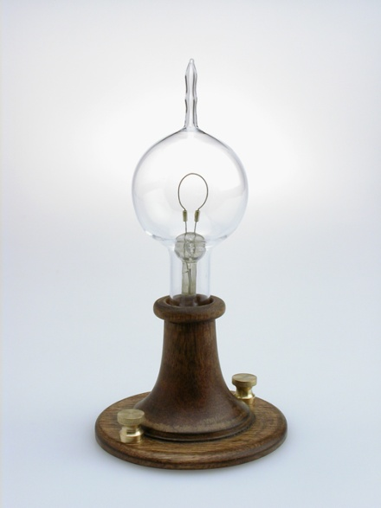
Examples of Inventions – The Light Bulb
“Humphrey Davy, an English scientist, conducted research and experiments in 1809 that formed the impetus of the creation of incandescent light sources, like the light bulb. Around ten years later, Warren de la Rue built upon Davy's findings and attempted to craft a light source. The individual most associated with the advent of the light bulb is Thomas Edison.
He indeed created the first incandescent
lamp that could provide light and sustain it.
From: Inventions to Help People, www.eHow.com/info_8123858_inventions-people.html

Slide 8
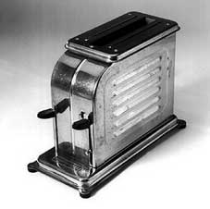
Examples of Inventions – The Toaster
Albert Marsh and William Hoskins invented nichrome in 1905 , a key alloy in electronic heating devices.
Charles Strite ushered in a major improvement in toast technology with his 1919 automatic pop-up toaster
From: Inventions to Help People,
www.eHow.com/info_8123858_inventions-people.html

Slide 9
Research Methods
What exactly are research methods?
Processes, techniques, approaches, and mechanisms used in conducting research
Examples of research methods are:
Literature searches, surveys, and interviews
Ways of collecting, organizing, and interpreting data
Problem solving techniques
Gaining support for the research
Creative investigation approaches
Processes for dissemination of research results

Slide 10
Being Creative
What does mean to be creative?
How is it related to conducting research?
Why is it important to be creative?
Creativity: Is it learned or is it inborn?
Is it an essential part of a research effort?
Is it more important when conducting theoretical or experimental research?

