Slide 1
Introduction to LiFi
Anonymous

Slide 2
Outline
Worldwide debut
The vacuum it fills
Capabilities
Implementation
Complications
Misconceptions
Current Developments
2

Slide 3
Introduction to the World
Who
What
When
Where
Why
3
Notes:
Who: Harald Haas, Professor of Mobile Communications at the University of Edinburgh
What: LiFi, the use of the light spectrum to transmit data
When: 2011
Where: Ted Global talk
Why: To help with the ever saturating RF spectrum

Slide 4
IoT’s Dilemma
Annual growth rate of 60%
In 20 years’ time, demand of 6 THz
RF spectrum maximum capacity of 0.3 THz
4
Notes:
The current state of the Internet of Things is a saturated one. At its current growth rate of 60%, in 20 years the demand will be 12,000 times the current bandwidth [9]. In other words, future wireless systems would be 12,000 x 500 MHz, coming to a demand of 6 THz of bandwidth [1,9]. With the entire RF spectrum only capable of holding 0.3 THz (including the reserves put in place by organization such as the Wireless Gigabit Alliance), there is much to be desired in just 2 decades.

Slide 5
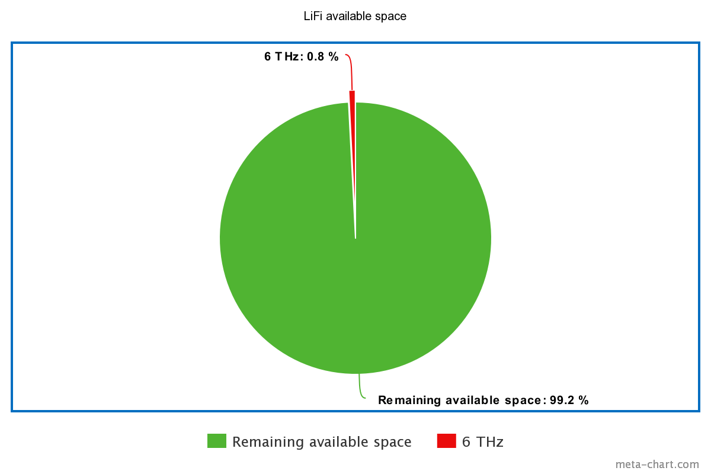
5
Notes:
Luckily, the demand of 6 THz is just 0.8% of the entire IR and visible light spectrum, which LiFi utilizes. This comparison is shown in Figure 1.

Slide 6
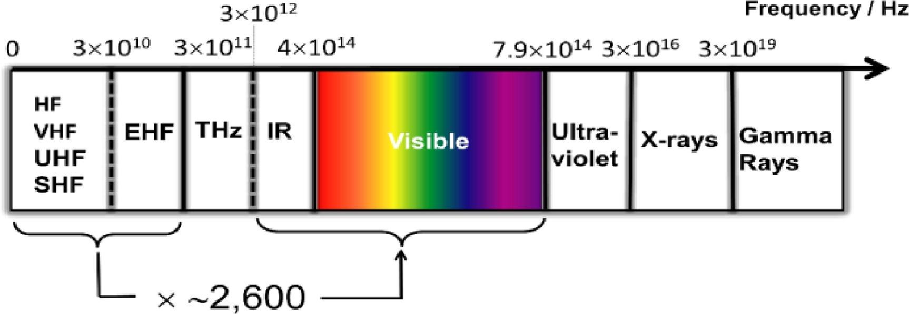
6
Notes:
Luckily, the demand of 6 THz is just 0.8% of the entire IR and visible light spectrum, which LiFi utilizes. This comparison is shown in Figure 1.

Slide 7
The Possibilities of LiFi

Slide 8
The Speed of Li(Fi)ght
Speed
Security
Versatility
Industry collaboration potential
8
Notes:
300 Mbps - 100Gbps
The distance in which the signal can be picked up from a LiFi AP can be measured down to the centimeter, which sharply contrasts that of an RF network
Can be used in areas where RF can’t, like petrochemical plants, and oil platforms
Potential collaboration between the wireless communications industry, and the lighting industry, In 25 years from now the LED lightbulb will serve thousands of applications and will be an integral part of the emerging smart cities, smart homes and the loT”
LaaS in the future

Slide 9
Implementation

Slide 10
Where to Begin
Replacing existing infrastructure
Complimenting WiFi
Heterogenous Networks (HetNets)
10

Slide 11
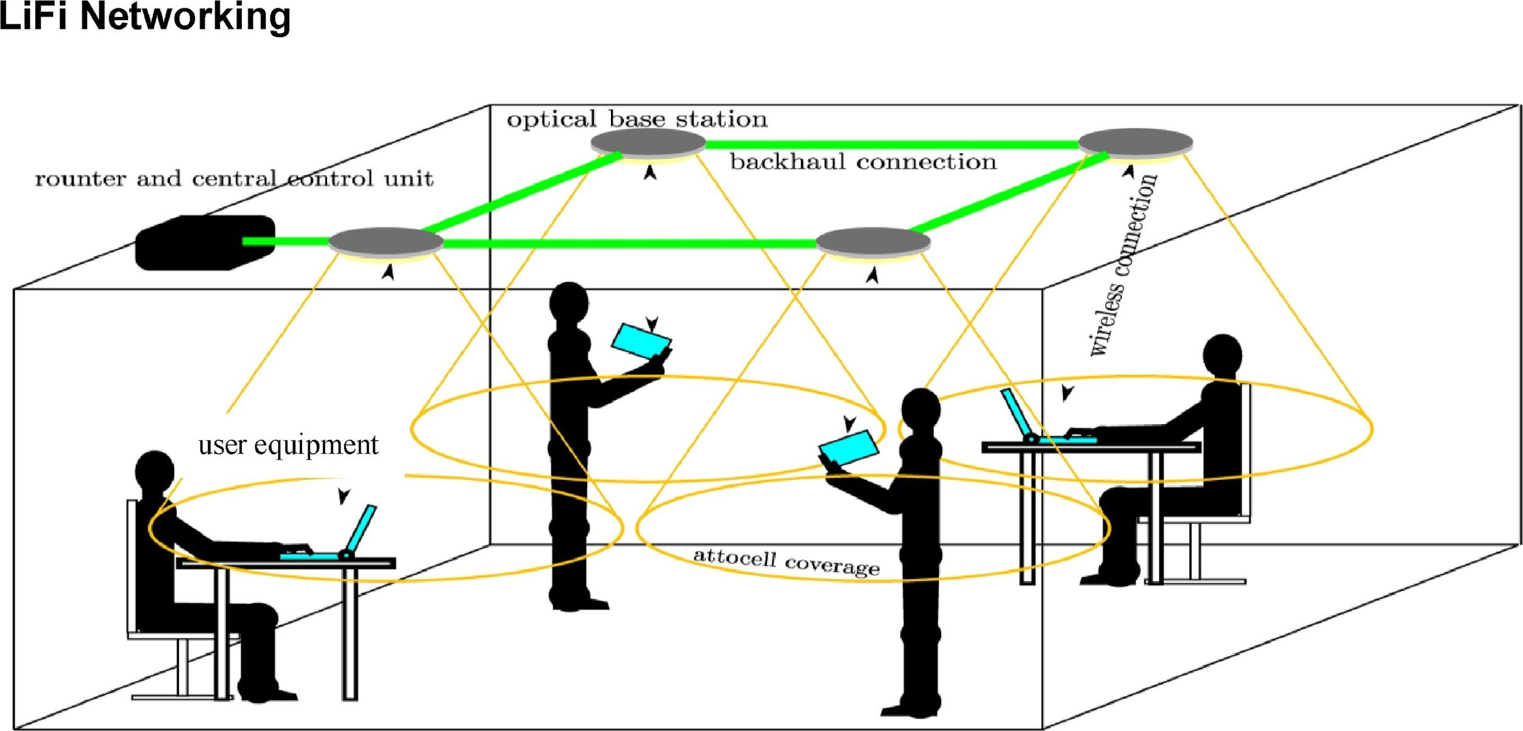
Example of a LiFi network
11

Slide 12
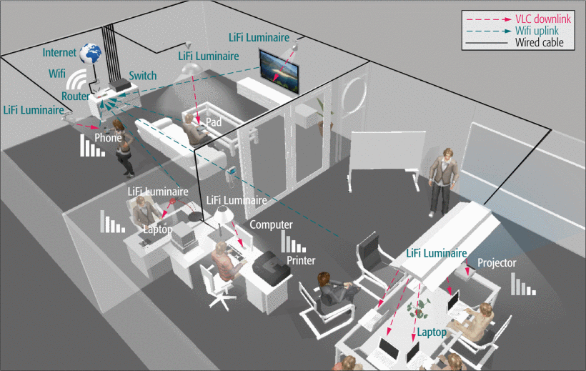
Example of a WiFi/LiFi HetNet
12

Slide 13
Complications with Implementation
Interference within itself
Optimal AP setup locations
Interference in HetNets
13
Notes:
Each AP operates at own frequency for optimal bandwidth, leading to interference of different frequencies

Slide 14
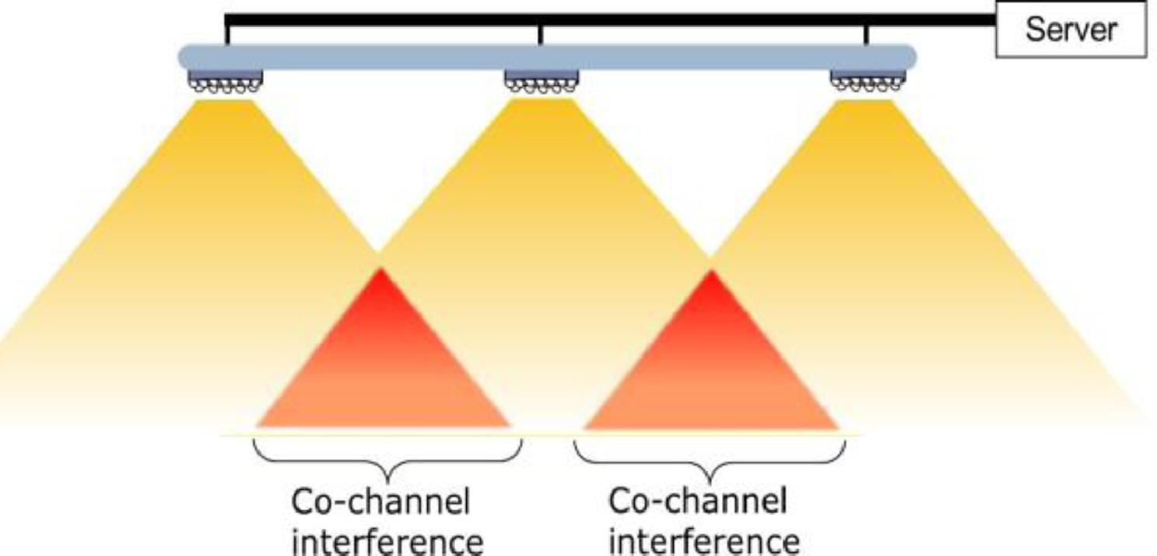
Interfering APs
14
Notes:
Because each AP can cause interference with its neighbors, which limits the signal-to-interference-plus-noise ratio (SINR), a driving factor in transmission rate. If each AP is on a different frequency, and the field of view (FOV) of the LiFi LED overlaps with another AP, this leads to interference, and a drop in the SINR.

Slide 15
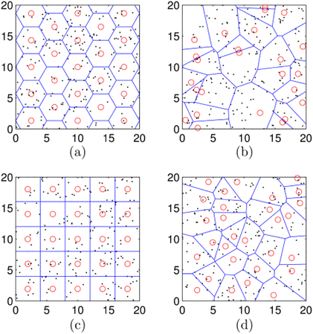
Different AP location topologies
15
Notes:
A traditional hexagonal pattern that is used in RF technologies (a), a random deployment of APs using the Poisson point process (PPP) model that is used in cellular deployments (b), a traditional office light placement pattern (c), and a “Matérn type I hardcore point process (HCPP) deployment scenario which includes an additional parameter c that controls the minimum separation distance between any two APs” [7] (d). The red circles in the figures show the actual location of the APs, and the black dots represent end user devices, such as smartphones and smart watches [7].

Slide 16
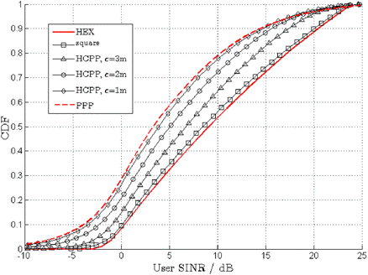
End results of testing
16
Notes:
The calculation for the most optimal topology is shown in Figure 3, by comparing the cumulative density function (CDF) of the SINR of each model. Each variable was set to the same value (AP density, optical output power), which yielded the hexagonal deployment as the most optimal topology. The PPP model gave the worst results, but when the HCPPP model was enforced with a minimum distance variable, the SINR performance improved [7].

Slide 17
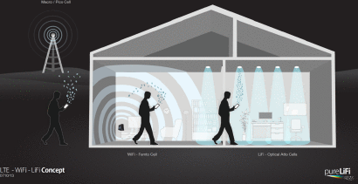
LTE - WiFi - LiFi concept
17
Notes:
How interference can be seen in a hetnet

Slide 18
Misconceptions

Slide 19
LiFi is a LoS technology
Blockages can occur, data will still pass
19
Notes:
In a typical office room environment where the minimum level of illumination for reading purposes is 500 lux, the [signal-to-noise ratio] at table height is between 40 dB and 60 dB. This means higher order digital modulation schemes can be used in conjunction with [orthogonal frequency division multiplexing] to harness the available channel capacity. By using adaptive modulation and coding (AMC) it is possible to transmit data at SNRs as low as − 6 dB. This means signal blockages between 46 dB − 66 dB can be tolerated [6].

Slide 20
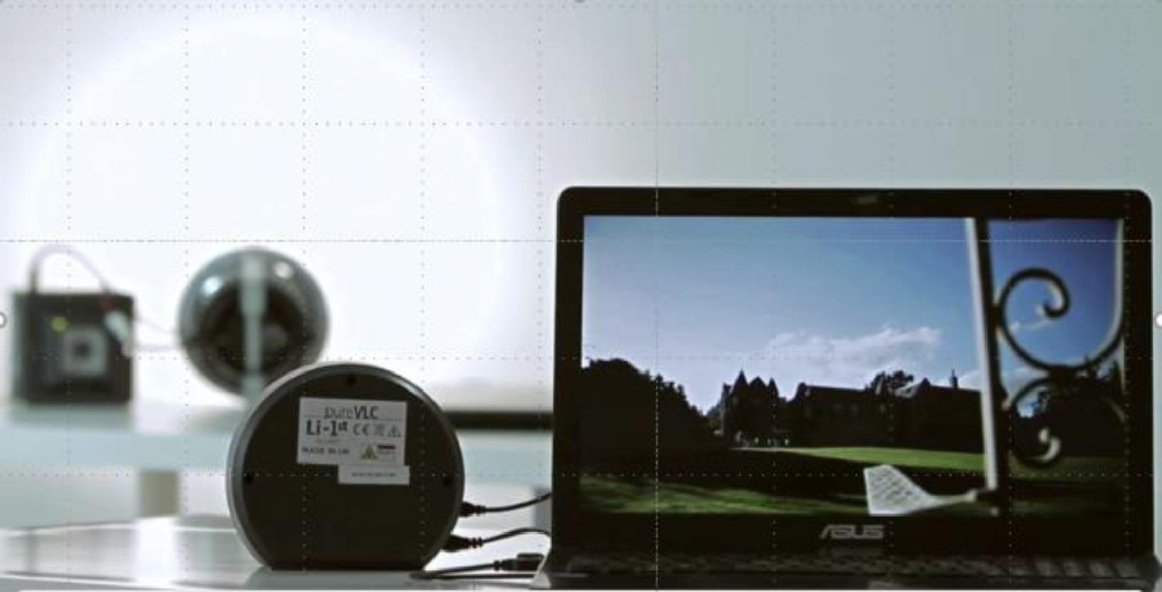
Successful LiFi video transmission in a non-LoS situation
20

Slide 21
LiFi fixtures flicker
Lowest frequency is 1 MHz, 10,000 times higher than refresh rate of computer monitor
21

Slide 22
LiFi fixtures cannot be dimmed
Lights can be dimmed to very low levels, or resort to IR
22

Slide 23
LiFi cannot be used in the sunlight
LiFi frequencies are different
Sunlight can be filtered
23

Slide 24
LiFi is downlink only
Entire IR spectrum available
10 meters at 1.1 Gbps
24

Slide 25
Current Developments
&
Future

Slide 26
Standardization
IEEE 802.11bb Task Force
Ability to expand standards with technology
26

Slide 27
PureLiFi
Harald Haas, Co-Founder
Leader of LiFi development
27

Slide 28
The future of LiFi
New potential uses
Car headlights
Continuing research
Collision detection/avoidance improvement
Network management devices
28
Notes:
Autonomous cars with LiFi = faster response time and more communication with cars

Slide 29
Conclusion

Slide 30
Conclusion
Worldwide debut
The vacuum it fills
Capabilities
Implementation
Complications
Misconceptions
Current Developments
30

Slide 31
Questions?

Slide 32
References
[1] Harald Haas, LiFi is a paradigm-shifting 5G technology, Reviews in Physics, Volume 3, 2018, Pages 26-31, ISSN 2405-4283, https://doi.org/10.1016/j.revip.2017.10.001.
(http://www.sciencedirect.com/science/article/pii/S2405428317300151)
[2] M. Ayyash et al., "Coexistence of WiFi and LiFi toward 5G: concepts, opportunities, and challenges," in IEEE Communications Magazine, vol. 54, no. 2, pp. 64-71, February 2016. doi: 10.1109/MCOM.2016.7402263,
URL: http://ieeexplore.ieee.org/stamp/stamp.jsp?tp=&arnumber=7402263&isnumber=7402249
[3] I. Demirkol, D. Camps-Mur, J. Paradells, M. Combalia, W. Popoola and H. Haas, "Powering the Internet of Things through Light Communication," in IEEE Communications Magazine, vol. 57, no. 6, pp. 107-113, June 2019.
doi: 10.1109/MCOM.2019.1800429, URL: http://ieeexplore.ieee.org/stamp/stamp.jsp?tp=&arnumber=8722596&isnumber=8740774
[4] PureLifi: https://purelifi.com/lifi-is-getting-a-global-standard/
[5] G. Albert, G. Dekel, S. Kurland, M. Ran, D. Malka and G. Katz, "Which LiFi's apps may fit mostly to 5G and beyond-5G Technology?," 2019 Global LIFI Congress (GLC), Paris, France, 2019, pp. 1-5. doi: 10.1109/GLC.2019.8864118,
URL: http://ieeexplore.ieee.org/stamp/stamp.jsp?tp=&arnumber=8864118&isnumber=8864112
[6] H. Haas, "LiFi: Conceptions, misconceptions and opportunities," 2016 IEEE Photonics Conference (IPC), Waikoloa, HI, 2016, pp. 680-681.
doi: 10.1109/IPCon.2016.7831279,
URL: http://ieeexplore.ieee.org/stamp/stamp.jsp?tp=&arnumber=7831279&isnumber=7830944

Slide 33
References
[7] H. Haas and C. Chen, "What is LiFi?," 2015 European Conference on Optical Communication (ECOC), Valencia, 2015, pp. 1-3.
doi: 10.1109/ECOC.2015.7341879,
URL: http://ieeexplore.ieee.org/stamp/stamp.jsp?tp=&arnumber=7341879&isnumber=7341603
[8] X. Wu and H. Haas, "Access point assignment in hybrid LiFi and WiFi networks in consideration of LiFi channel blockage," 2017 IEEE 18th International Workshop on Signal Processing Advances in Wireless Communications (SPAWC), Sapporo, 2017, pp. 1-5. doi: 10.1109/SPAWC.2017.8227704,
URL: http://ieeexplore.ieee.org/stamp/stamp.jsp?tp=&arnumber=8227704&isnumber=8227634
[9] P.J. Winzer, D.T. Neilson
From scaling disparities to integrated parallelism: a decathlon for a decade
IEEE J. Light. Technol., 35 (5) (2017), pp. 1099-1115
[10] L. Huang, Y. Ji, "Design and Demonstration of Room Division Multi-plexing-Based Hybrid VLC Network", Chinese Optics Lett., vol. 11, no. 6, pp. 1671-7694, 2013.
[11] D. Tsonev, S. Videv, H. Haas
Towards a 100 Gb/s visible light wireless access network
Opt. Express, 23 (2) (2015), pp. 1627-1637
[12] M.S. Islim, et al.
Towards 10 Gb/s orthogonal frequency division multiplexing-based visible light communication using a GaN violet micro-LED
Photon. Res., 5 (2) (2017), pp. A35-A43

