Slide 1
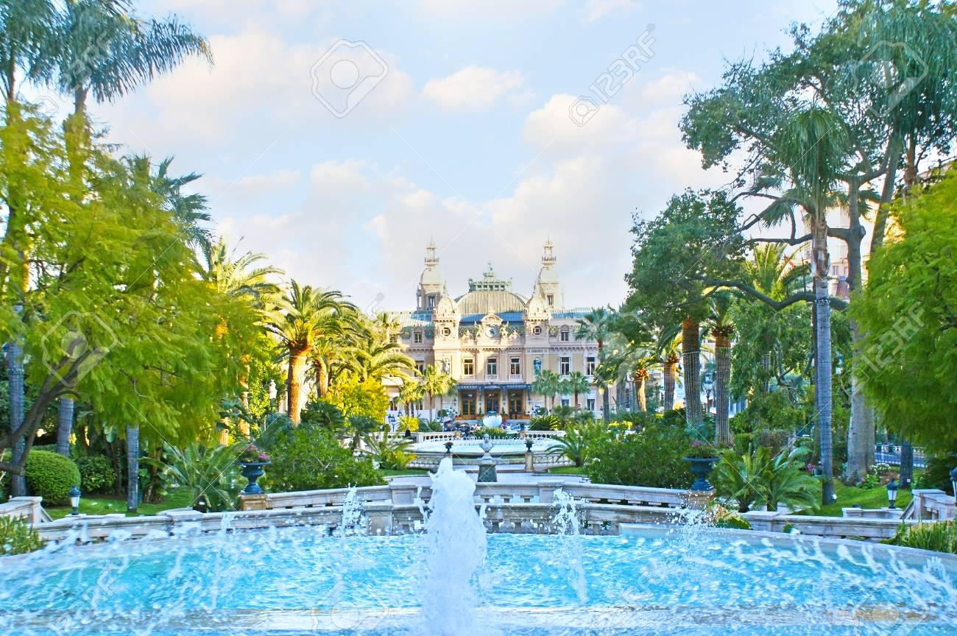
Random Numbers and Monte Carlo Methods
This presentation covers material
from the Chapter 10 in our text

Slide 2
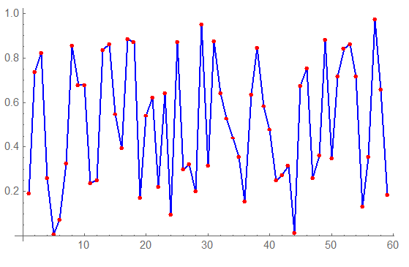
Pseudo-Random Number Generators
$2^{31}$-1 = 2147483647 is a Mersenne prime

Slide 3
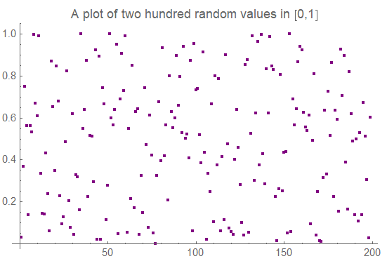
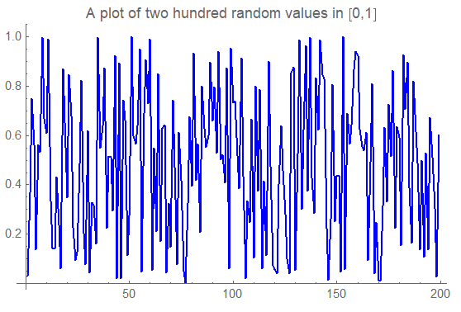
Another Popular Random Number Generator Lewis, Goodman, and Miller (1969)
$2^{31}$-1 = 2147483647 is a Mersenne prime

Slide 4
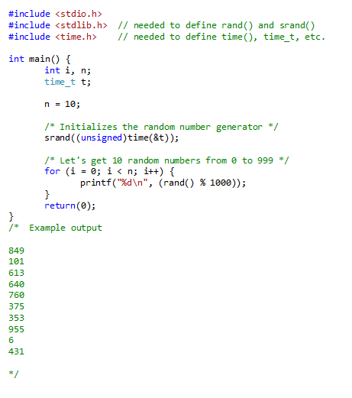
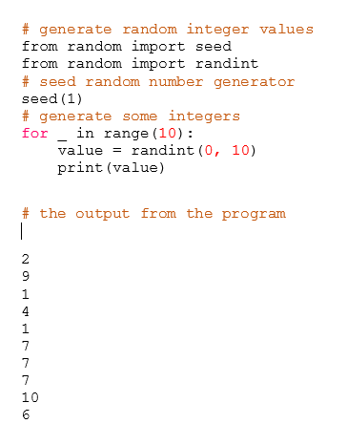
Using Random Numbers in a Program
Using in a
C/C++ Program
Using in a
Python Program

Slide 5
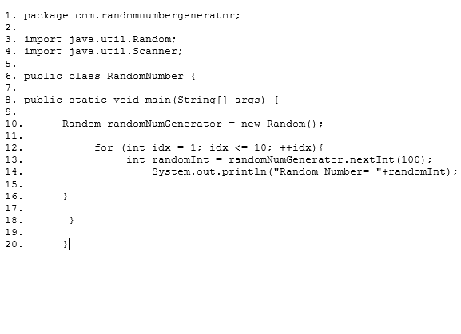
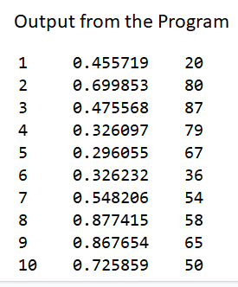
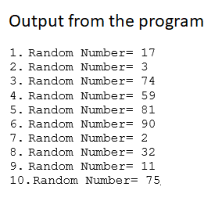
Using Random Numbers in a Program
Using in a
Mathematica
Program
Using in a
Java Program

Slide 6
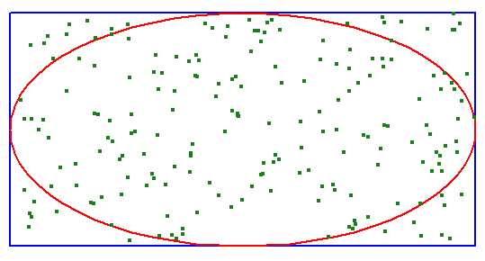
Using Random Numbers to Calculate Areas
Let us now look at how we can use random numbers to calculate the areas (or volumes) of unusual shapes. To illustrate the idea, let’s take an ellipse and see if we can calculate the area using random numbers.
semi-minor
axis is 1
semi-major axis is 2
So area of the ellipse is 2π $≅$ 6.283
And when 200 points were generated at random (x,y) positions, 156 of the points were inside the ellipse. The area of the enclosing rectangle was 4 X 2 = 8, so
8 X 156 / 200 = 6.24 was our estimate of the area of the enclosed ellipse.

Slide 7
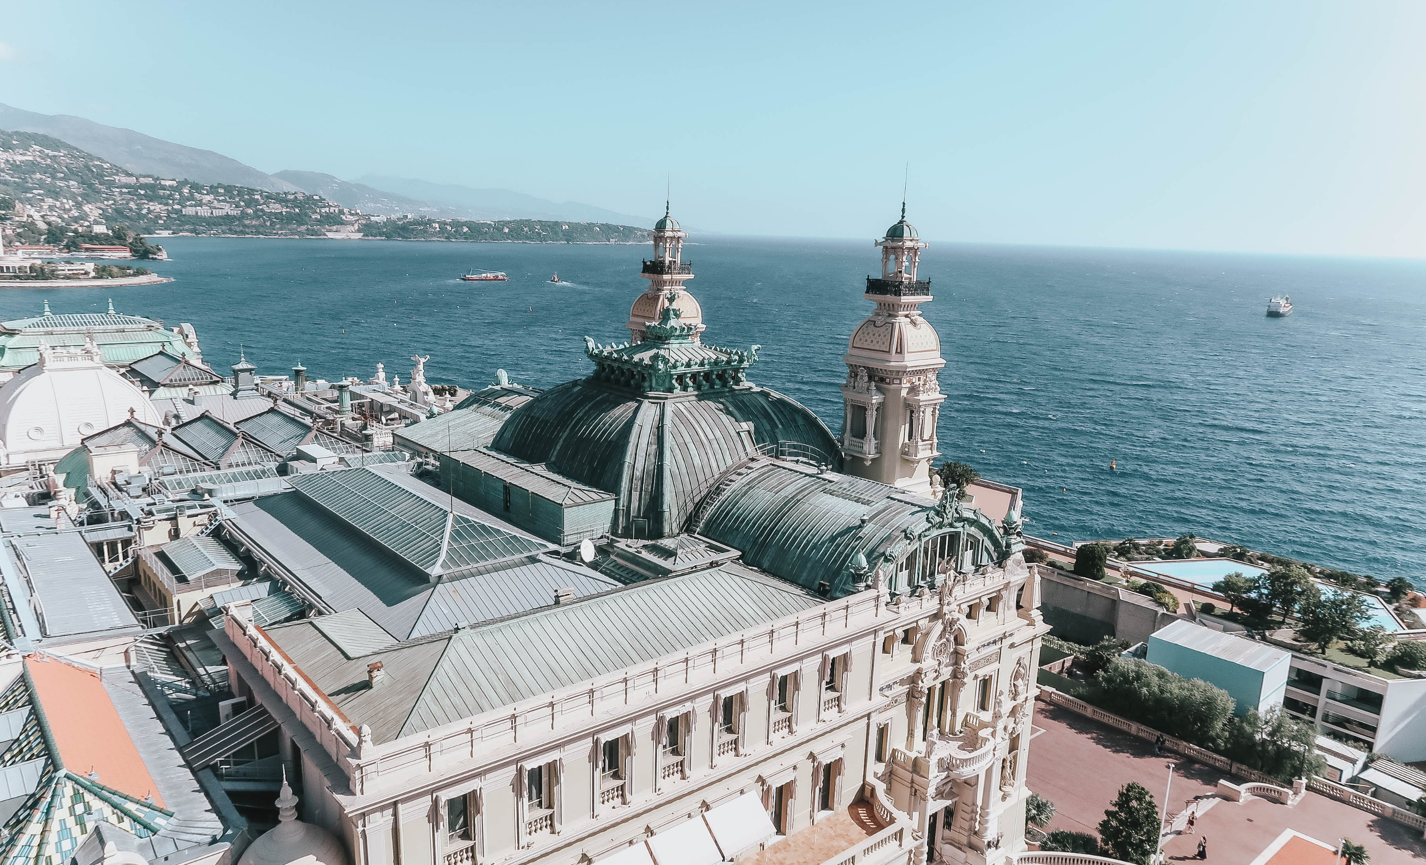
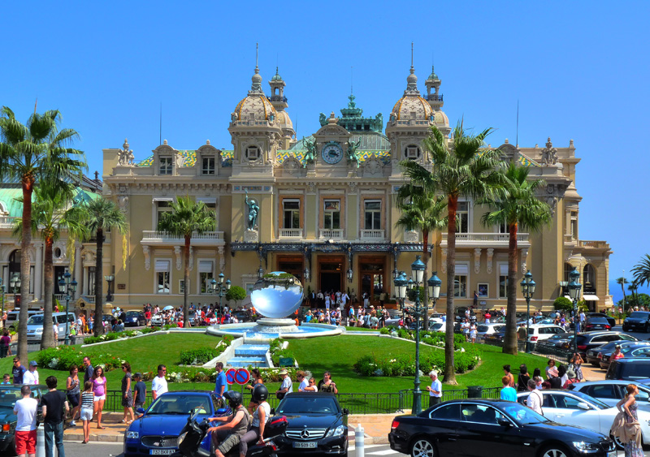
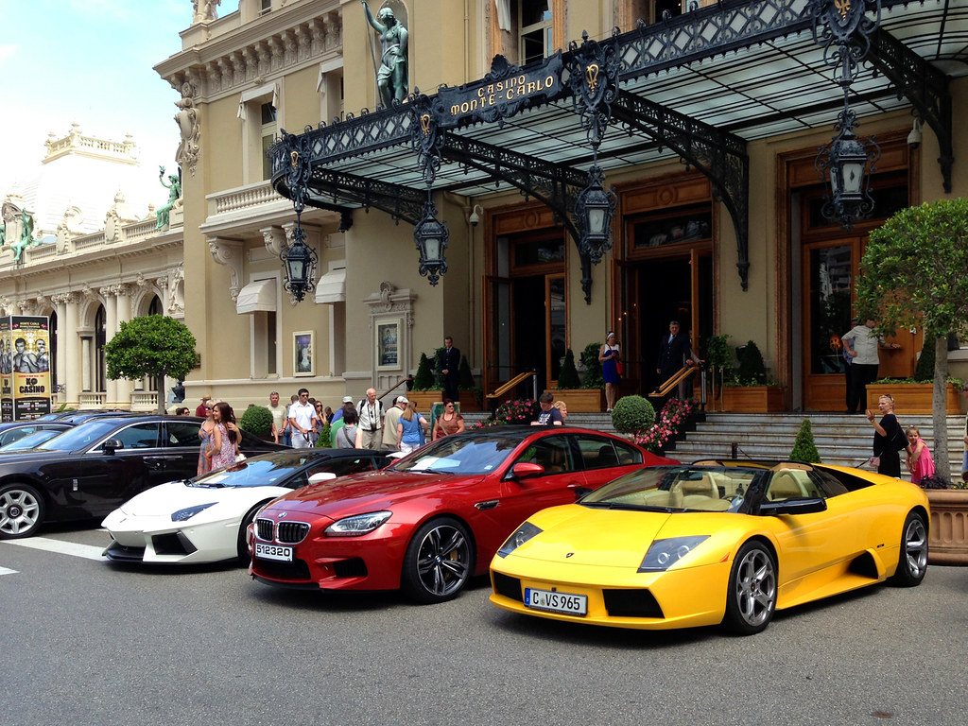
Monte Carlo Methods
Named after the Casino de Monte-Carlo
These are pictures of the Casino de Monte-Carlo, often cited as the most prestigious casino in the world. It was designed by Jules Touzet and later redesigned by Charles Garnier. It was founded in the 1860’s. People often say that the casino is a must-see when you're in Monaco, citing its grand decor, variety of gaming options and plentiful people-watching as prime reasons you'll enjoy your visit. The casino was named in honor of Prince Charles III of Monaco.

Slide 8
Monte Carlo Methods
Monte Carlo simulation is a computerized mathematical technique that allows people to account for risk in quantitative analysis and decision making. The technique is used by professionals in such widely disparate fields as finance, project management, energy, manufacturing, engineering, research and development, insurance, oil & gas, transportation, and the environment.
Monte Carlo simulation furnishes the decision-maker with a range of possible outcomes and the probabilities they will occur for any choice of action. It shows the extreme possibilities—the outcomes of going for broke and for the most conservative decision—along with all possible consequences for middle-of-the-road decisions.

Slide 9
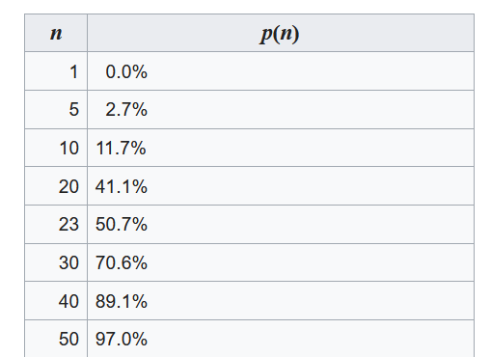
The Birthday Problem
The Birthday Problem
What is the probability that two of
Snoopy’s friends have the same birthday?
See p. 499
In text
https://sceweb.uhcl.edu/feagin/courses/birthdayProblem.nb

Slide 10
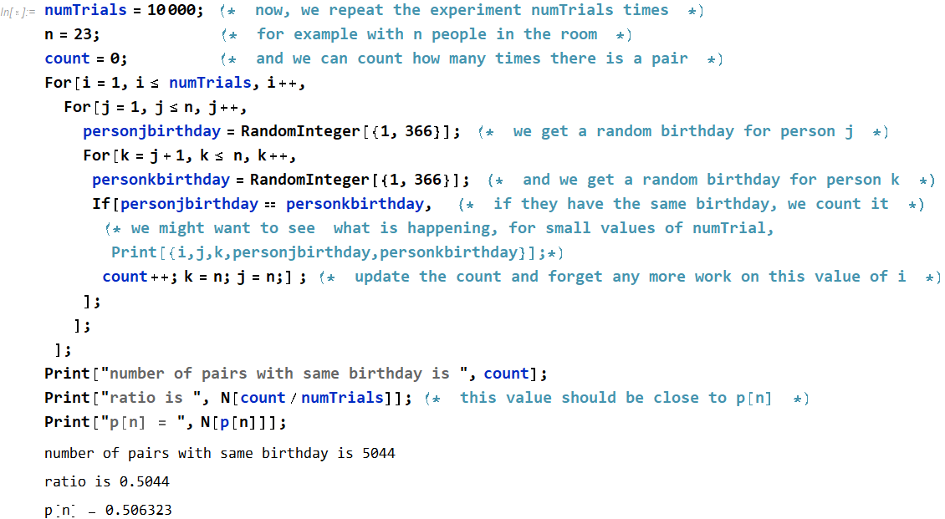
The Birthday Problem
https://sceweb.uhcl.edu/feagin/courses/birthdayProblem.nb

Slide 11
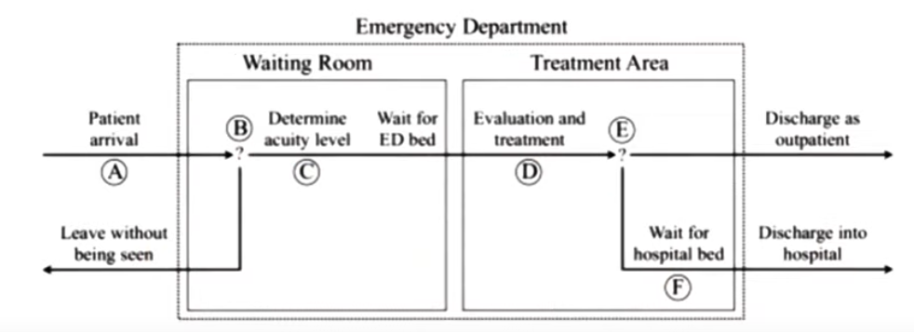
Monte Carlo Methods
A Discrete Event Simulation

Slide 12
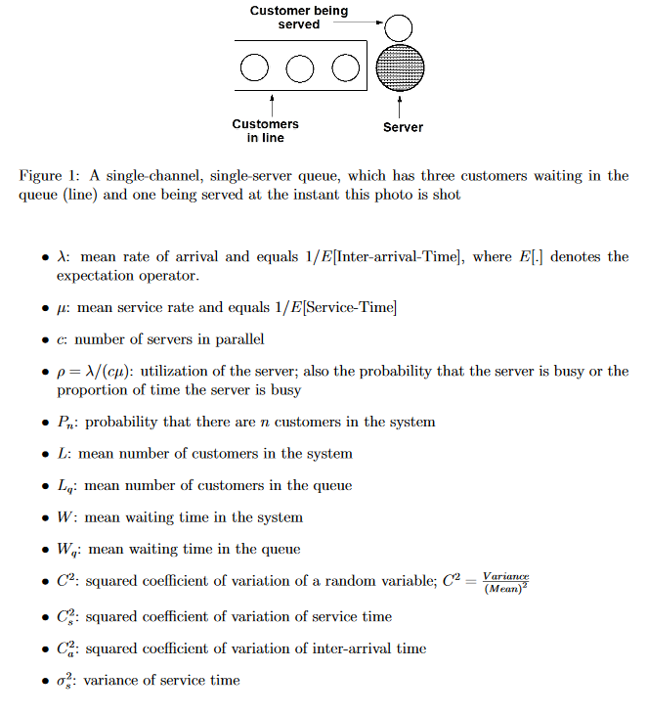
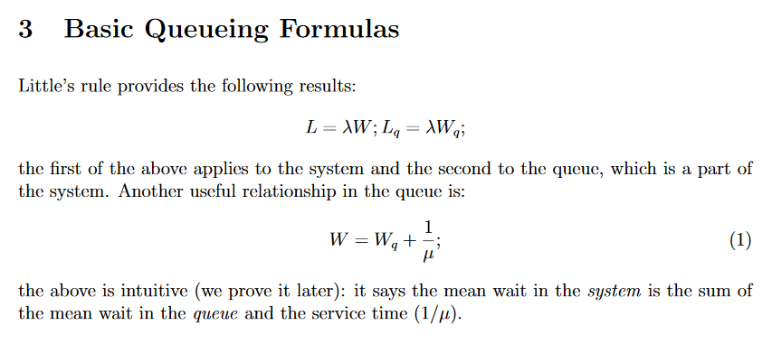
A Discrete Event Simulation
By A. Gosavi
Missouri University of Science and Technology
http://web.mst.edu/~gosavia/queuing_formulas.pdf

Slide 13
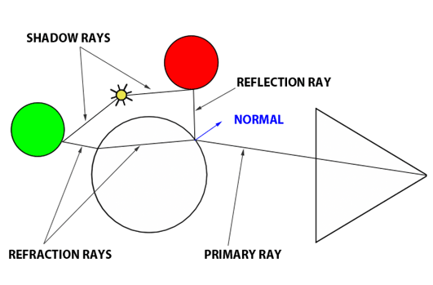
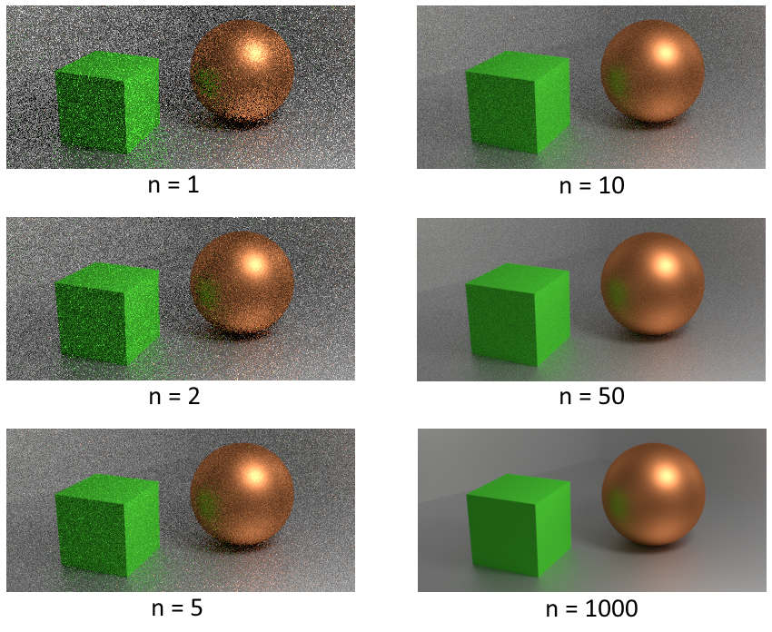
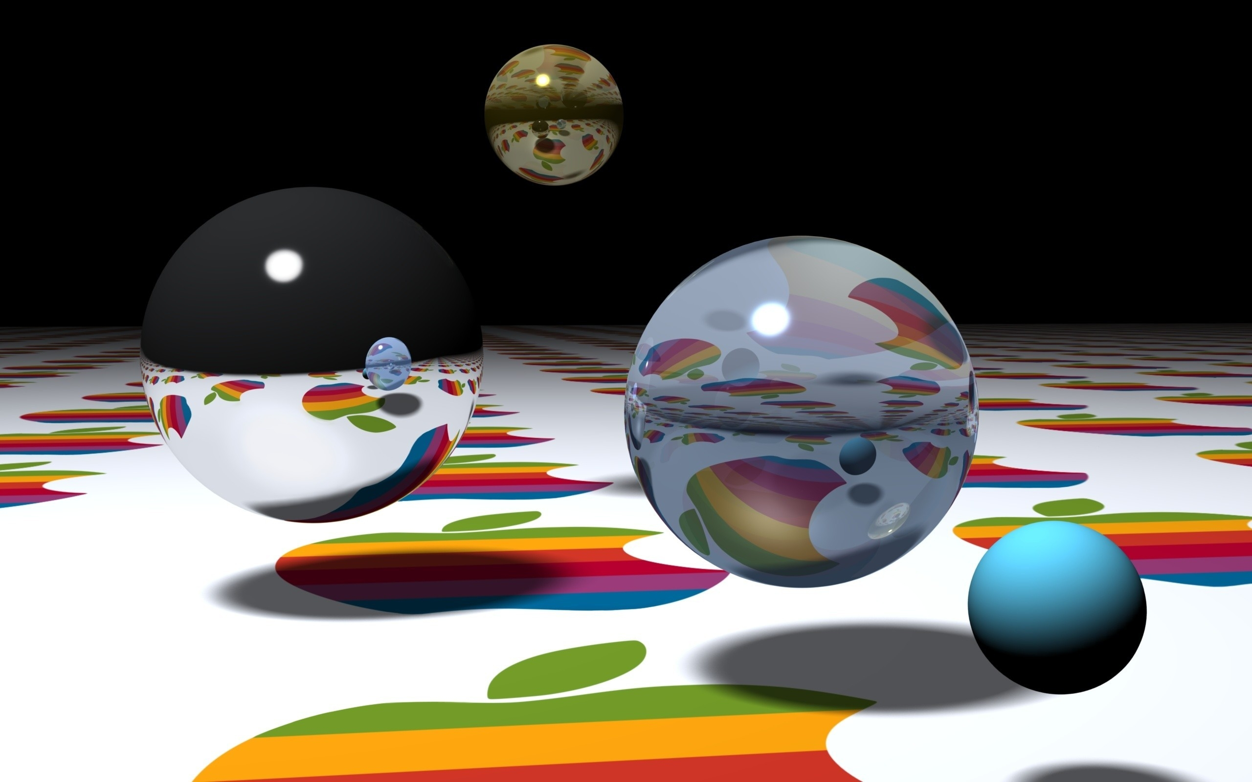
Monte Carlo Methods
Used for Ray Tracing in Computer Graphics
Thanks to Wikipedia for this image of ray tracing
These images illustrate how the realism and accuracy of raytracing improves as the sample count increases
Thanks to Daniel J. Williams and Apple Computer, Inc. for these images of ray tracing

Slide 14
Random Numbers and Monte Carlo Methods
If you have any questions or comments about the material in this presentation, please send them to me in an email. I will gather the questions and answers over the next few days and then send them to each member of the class.
Visit the following site if you want to see more about using ray tracing on a GPU
https://www.engadget.com/2019-04-11-nvidia-shows-how-much-ray-tracing-sucks-on-older-gpus.html

