Slide 1
Numerical Solution of Nonlinear Two-Point Boundary Value Problems
Example Problem
From Point Near Earth to Point Near the Moon

Slide 2
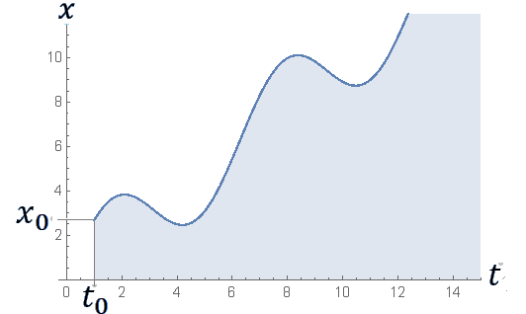
Numerical Solution of Nonlinear Two-Point Boundary Value Problems
$$x\left(t_{f}\right)$$
Two Point
Boundary
Value
Problem
Initial
Value
Problem
$$x\left(t_{0}\right)$$
$$t_{f}$$
$$\frac{dx}{dt}=f\left(t,x\right)$$
$\text{subject} \text{to} \text{the} \text{initial} \text{condition}$
$$x(t_{0})=x_{0}$$
$$\frac{dx}{dt}=f\left(t,x\right)$$
$\text{subject} \text{to} \text{the} \text{two}\text{−}\text{point} \text{boundary} \text{condition}$
$$\text{g}[x\left(t_{0}\right),x(t_{f})]=0$$
Initial Condition
Boundary Condition

Slide 3
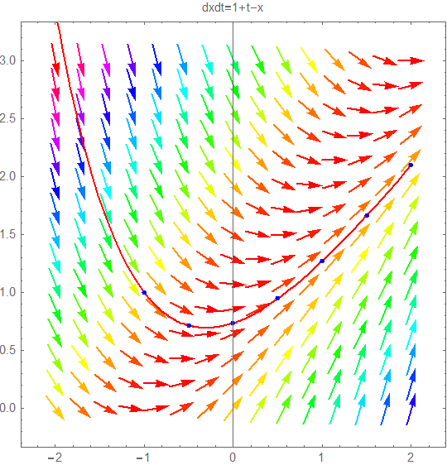
The Big Questions
When you are solving a nonlinear two-point boundary value problem
Exactly, what information is given?
What do you need to solve for?
What you are given
A solution
An ordinary differential equation
A function of t that we call
$$x(t)$$
A set of constraints or conditions
Or we could say it is the path that satisfies some other constraints or boundary conditions (TPBVP)
We can think of the set of all solutions to the differential equation as a vector field
We just don’t know which of the paths through this field should be chosen
We could just say it is the path that goes through a particular point (IVP)

Slide 4
Numerical Solution of Nonlinear Two-Point Boundary Value Problems
$$x\left(t_{f}\right)$$
$$\frac{dx}{dt}=f\left(t,x\right)$$
$\text{subject} \text{to} \text{the} \text{two}\text{−}\text{point} \text{boundary} \text{condition}$
$$\text{g}[x\left(t_{0}\right),x(t_{f})]=0$$
Boundary
Value
Problem
$$x\left(t_{0}\right)$$
$$t_{f}$$
$\frac{d^{2}x}{{dt}^{2} }$ = $f(t,x,x^{′})$
subject to the boundary conditions
$x$($t_{0}$ )=$x_{0}$ and $x$($t_{f}$ )=$x_{f}$
We will describe the problem using a first-order differential equation
The textbook describes the problem using a second-order differential equation
These problems are more difficult to
solve than initial value problems

Slide 5
An Initial Value Method Also Known as the Shooting Method
Solves the differential equation at each iteration and solves the boundary conditions only after the iterations converge

Slide 6
A Boundary Value Method
The boundary conditions
Solves the boundary conditions at each iteration and solves the differential equation only after the iterations converge
Note: You will not be responsible for Section 11.2 topics or boundary value methods on the final exam

Slide 7
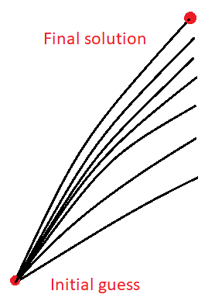
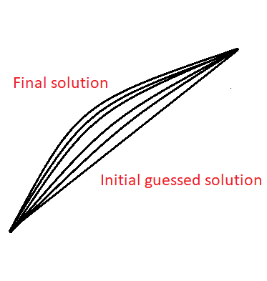
The Two Approaches to Solving a Nonlinear Two-Point Boundary Value Problem
The Shooting Method Approach
The Boundary Value Method Approach

Slide 8
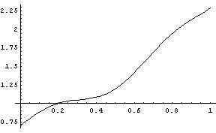
Programming Assignment #5
Numerical Solution of a Two-Point Boundary-Value Problem
differential equation
$\frac{dx}{dt}=f\left(t,x\right)$ = $x+0.09 x^{2}+cos⁡(10 t)$
$$g\left(x(t_{0}),x(t_{f})\right)=x\left(0\right)+x\left(1\right)−3.0=0$$
boundary condition
Note: Please consult
the following webpage
for details about
the assignment
https://sceweb.uhcl.edu/feagin/courses/tpbvp.html

Slide 9
Implementation of a Shooting Method
$\frac{dx}{dt}=f\left(t,x\right)$ = $x+0.09 x^{2}+cos⁡(10 t)$
Start
Set the tolerance
ε = ${10}^{−4}$ as
described in the assignment
$$g\left(x(t_{0}),x(t_{f})\right)=x\left(0\right)+x\left(1\right)−3.0=0$$
Some advice from your instructor:
To accomplish Programming Assignment #5 successfully, you should think about the problem as primarily a problem of finding a zero
(and you should make use of your Assignment #2 Secant method program to find the zero).
Let s represent the initial value of x, i.e., x(0).
Now, with two guessed values for s, (s1 and s2)
Now, what will the function
$\text{g}\text{(}\text{s}\text{) }$ look like?
Call your secant method to find the zero of g to within the tolerance of ε = ${10}^{−4}$
What is meant by $\text{rk}\text{4(}\text{s}\text{) ?}$
When your secant method succeeds, have it return the value of s that made
$\left| \text{g}\text{(}\text{s}\text{) }\right|$ < ε
H$ow should you use your rk4$
$$program from assignment \#4\text{ ?}$$
double $\text{g}\text{(}\text{s}\text{) \{ }\text{return} \text{s}\text{ + }\text{rk}\text{4(}\text{s}\text{) − 3 \}}$

Slide 10
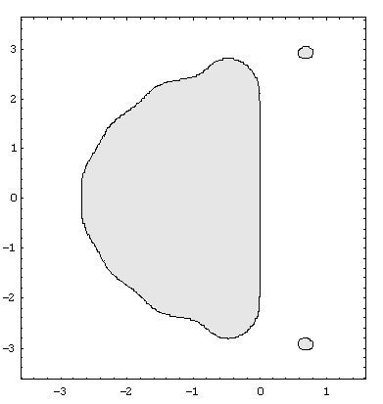
Numerical Stability of Explicit Runge-Kutta Methods
This slide was added at the last minute to answer some of your questions about numerical stability
The Stability Region of the Classical RK4 Method
The Stability Region of My RK12(10) Method
The Stability Region of Runge-Kutta Methods Does Not Shrink Appreciably with the Order of the Method
(Unlike Most Multistep Methods

Slide 11
CSCI 3321
Numerical Solution of Nonlinear Two-Point Boundary Value Problems
If you have any questions or comments about the material in this presentation, please send them to me in an email. I will gather the questions and answers over the next few days and then send them to each member of the class.
The next presentation will cover Least Squares Methods in Chapter 9 of the textbook. So it might be good to look over that chapter. That next presentation will be available soon.

