Slide 1
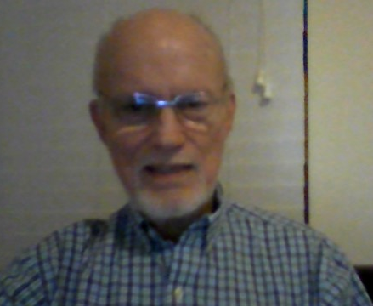
CSCI 3321 FALL 2021
At any point in the presentation, you may advance to the next slide by hitting the space bar, the right arrow key, or the n key.
Introduction to the course
CSCI 3321 Numerical Methods
https://sceweb.uhcl.edu/feagin/courses/csci3321.html
Dr. Terry Feagin, Professor, Computer Science, UHCL
feagin@uhcl.edu

Slide 2
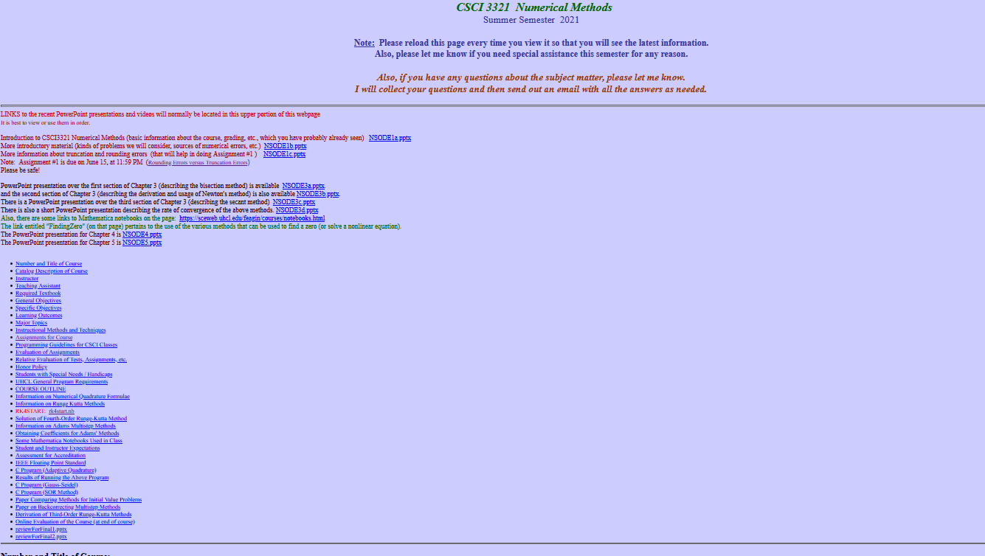
Our HOMEPAGE https://sceweb.uhcl.edu/feagin/courses/csci3321.html
Fall Semester 2021

Slide 3
Consult Our Homepage at https://sceweb.uhcl.edu/feagin/courses/csci3321.html for the latest information

Slide 5
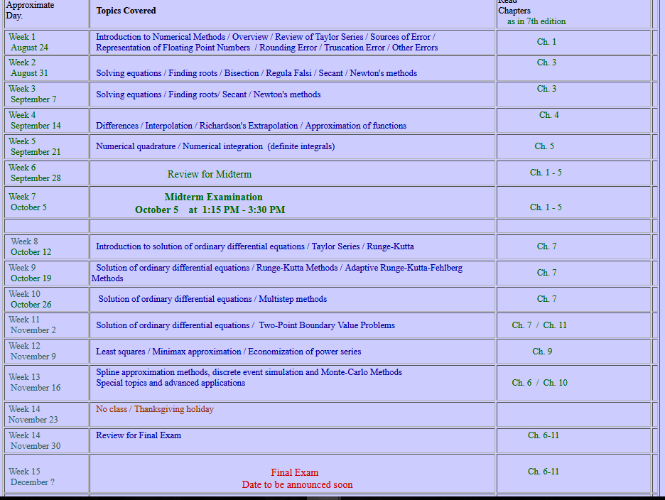
Our HOME PAGE (near bottom of the page)
Approximate dates are shown in this leftmost column
Chapters in book are shown in this rightmost column

