Slide 1
At any point in the presentation, you may advance to the next slide by hitting the space bar, the right arrow key, or the n key.
CSCI 3321 Numerical Methods
Truncation errors
Rounding errors
Computer representability
Loss of significance
Assignment #1
If you have not already viewed the PowerPoint presentation entitled
NSODE1a.pptx
Please view that presentation first for an overview of the course, then
NSODE1b.pptx
And then, this one

Slide 2
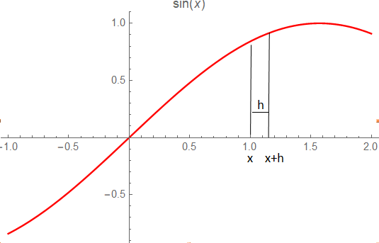
CSCI 3321 Numerical Methods
Truncation Errors
Once again, truncation errors occur when obtain an approximating expression by truncating an infinite expression or series after a finite number of terms. So consider the following example. Suppose we want to approximate the derivative of a function at some point on the x-axis. One way is to use the Taylor series:
f(x+h) = f(x) + h f’(x) + ${\text{h}}^{2}$ f’’(ξ)/2 ,
solve for f’(x) and thereby get the expression:
f’(x) ≃ ( f(x+h) – f(x) ) / h
And the error would be -h f’’(ξ)/2

Slide 3
CSCI 3321 Numerical Methods
Rounding Errors – Loss of Significance
As an example of loss of significance, consider the subtraction of two decimal numbers:
$$\frac{\begin{aligned} 0.7593 \\ − 0.7589\end{aligned}}{ 0.0004}$$
So, what is going to happen when we subtract f(x+h) – f(x) as h gets smaller and smaller?
4 significant
digits
1 significant
digit
Be sure to follow the programming
policies when writing your programs
Assignment #1
Link to the Programming Policies

