Slide 1
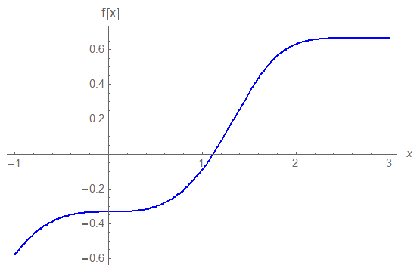
CSCI 3321
Solving nonlinear equations
What do we need to know in order to solve an equation
Examples of a nonlinear equation
Bisection method
Newton’s method
Secant method
Other methods

Slide 2
Solving nonlinear equations (using an iteration)
What do we need to know in order to solve an equation ?
(e.g., or ) )
So, we need to know the equation ( usually rewritten to be f(x) = 0 )
Certain starting information (depends on the method used)
We need one or more guessed solutions
We need some idea of the accuracy desired
We need to know when to quit
It helps to know of any unusual behavior or f(x)

Slide 3
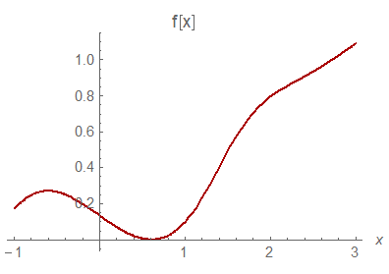
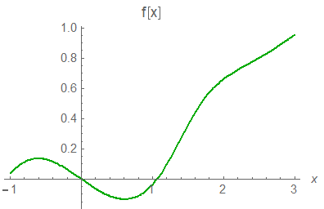
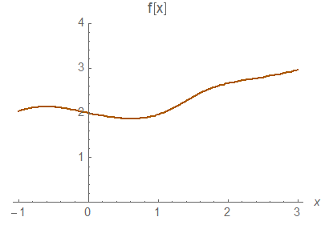
CSCI 3321 Numerical Methods
The function f(x) might
have a multiple root
The function f(x) might have
several distinct roots
The function f(x) might
not have any roots

Slide 4
Finding a Zero using the Bisection Method
What do we need to know in
order to use the bisection method ?
We need to know the equation f(x) = 0
We need some starting information,
namely two points, a and b, such that: f(a) f(b) ≤ 0
We need to know when to stop the iteration
*

Slide 5
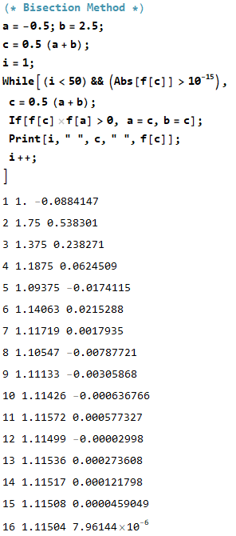
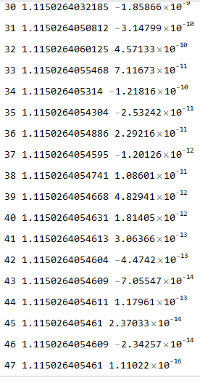
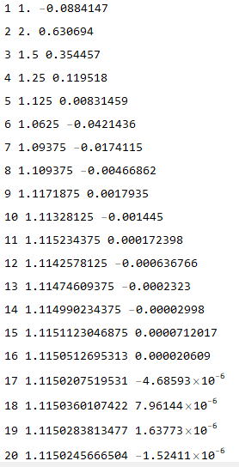
Example of the Bisection
Method
This iteration will terminate when
|f(c )| ≤ ${ 10}^{−15}$ or when the number of iterations is 50
Finding a zero of
This is the plot from the first slide
To save space, we are not showing all of the iterations here
The true answer is about
$$1.1150264054609520712674176770870281$$

Slide 6
Example of the Bisection
Method
This iteration will terminate when
|f(c )| ≤ ${ 10}^{−15}$ or when the number of iterations is 50
Finding a zero of
This is the plot from the first slide
To save space, we are not showing all of the iterations here
The true answer is about
$$1.1150264054609520712674176770870281$$

Slide 7
Terminating the Iterations for the Bisection Method
We could have terminated on another
condition
namely two points, a and b, such that
|a-b| ≤ ε
a
b

Slide 8
The Next Presentation will be
on using Newton’s Method
to find the root of f(x)
(i.e., find the zero)

