Slide 1
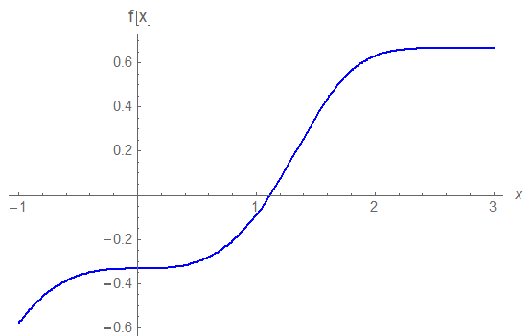
CSCI 3321
Solving nonlinear equations using
Newton’s method
Slope is f’(x0)
f(x0)
x0
x1

Slide 2
xnp1= xn – f[xn]
CSCI 3321
Derivation of Newton’s method
Slope is f’(x0)
f(x0)
Setting f[x] equal to zero and solving for x, then we get
or since it is the next approximation, just call it x1
x0
x1

Slide 3
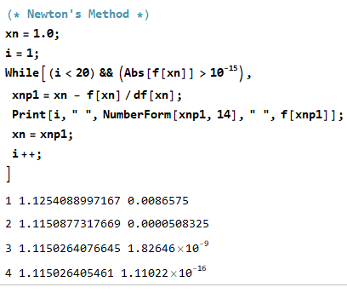
Example of Newton’s Method
Finding a zero of
This is plot from first slide
Slope is f’(x0)
f(x0)
x0
Note: This iteration terminates when
|f(c )| ≤ ${ 10}^{−15}$ or when the number of iterations is 20
x1
The true answer is about
$$1.1150264054609520712674176770870281$$

Slide 4
The Next Presentation will be
on using the Secant Method
to find the root of f(x)
(i.e., find the zero)

