Slide 1
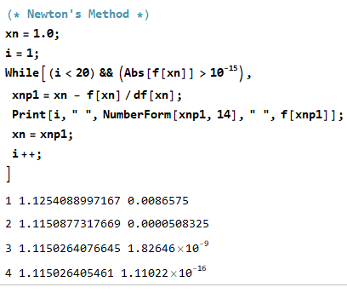
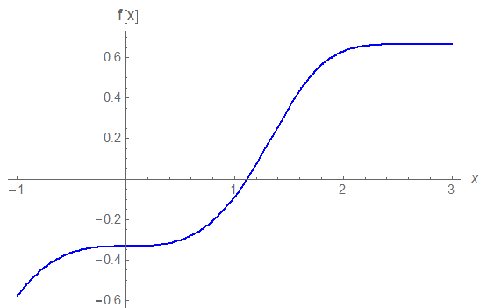
When solving problems with iterative methods …
$$x_{n+1} g(x_{n})$$
$$x_{n+1} x_{n}−f(x_{n})/f′(x_{n})$$
A general iterative method
e.g., Newton’s method
$$x_{0}{, x}_{1},x_{2},x_{3}$$
?
Is the iterative method converging ?
f(x0)
How fast is the method converging ?
x0
x1

Slide 2
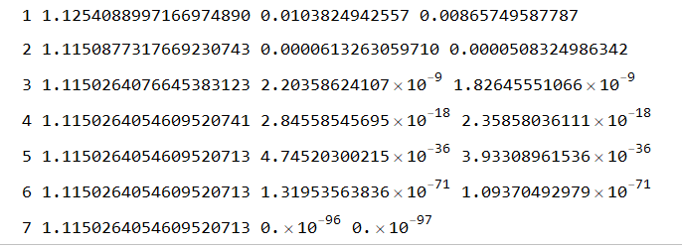
When solving problems with iterative methods …
$$x_{n+1} g(x_{n})$$
$$x_{n+1} x_{n}−f(x_{n})/f′(x_{n})$$
A general iterative method
e.g., Newton’s method
$$x_{0}{, x}_{1},x_{2},x_{3}$$
?
Is the iterative method converging ?
f(x0)
x0
x1

Slide 3
What is the error at each iteration ?
$$ε_{n} ≡ x_{n}−r$$
$${|ε}_{n+1}|≤C{ {|ε}_{n}|}^{p}$$
p is the rate of convergence
When solving nonlinear equations using
Bisection, Newton’s, and Secant Methods
What are the rates of convergence?
Bisection method – the rate of convergence, p, is approximately 1 and $C$ is 1/2
Newton’s method – the rate of convergence, p, is normally 2
Secant method – the rate of convergence is normally$p=\frac{1+ \sqrt{5}}{2}$, which is about $1.61803398875$

Slide 4
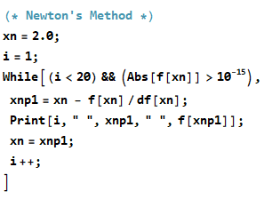
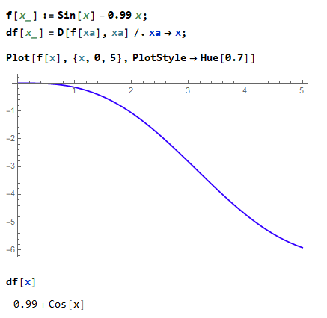
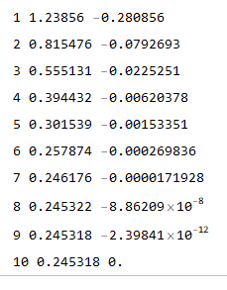
Newton’s method when there is a multiple root or almost a multiple root

