Slide 1
Polynomial Interpolation
What is an interpolating polynomial ?
Newton form of the interpolating polynomial
Lagrange form of the interpolating polynomial
Choice of the data points to improve the approximation
Richardson extrapolation for approximating derivatives

Slide 2
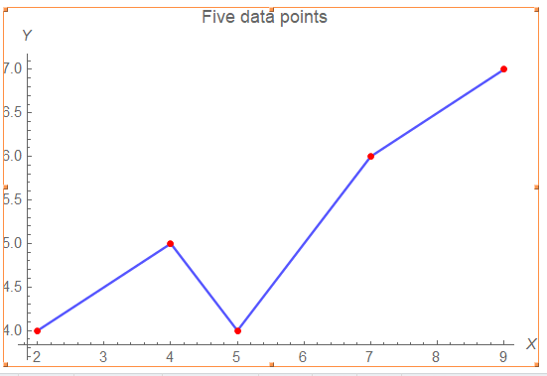
Suppose we have a set of data
i | X | Y
1 | 2 | 4
2 | 4 | 5
3 | 5 | 4
4 | 7 | 6
5 | 9 | 7

Slide 3
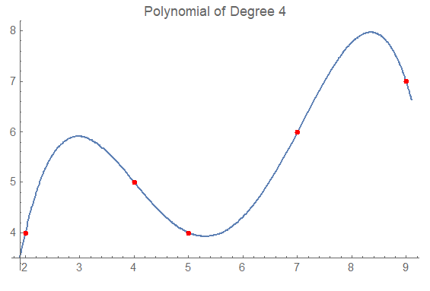
Find the interpolating polynomial
i | X | Y
1 | 2 | 4
2 | 4 | 5
3 | 5 | 4
4 | 7 | 6
5 | 9 | 7

Slide 4
Lagrange form of the interpolating polynomial
i | X | Y
1 | 2 | 4
2 | 4 | 5
3 | 5 | 4
4 | 7 | 6
5 | 9 | 7

Slide 5
Newton form of the interpolating polynomial
i | X | Y
1 | 2 | 4
2 | 4 | 5
3 | 5 | 4
4 | 7 | 6
5 | 9 | 7
k
k

Slide 6
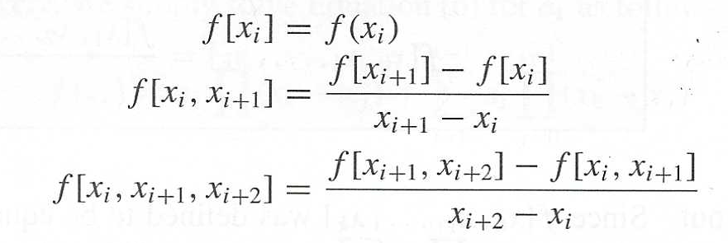
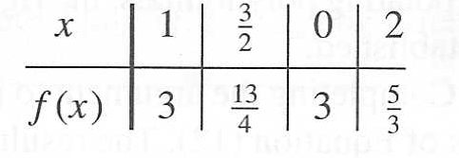
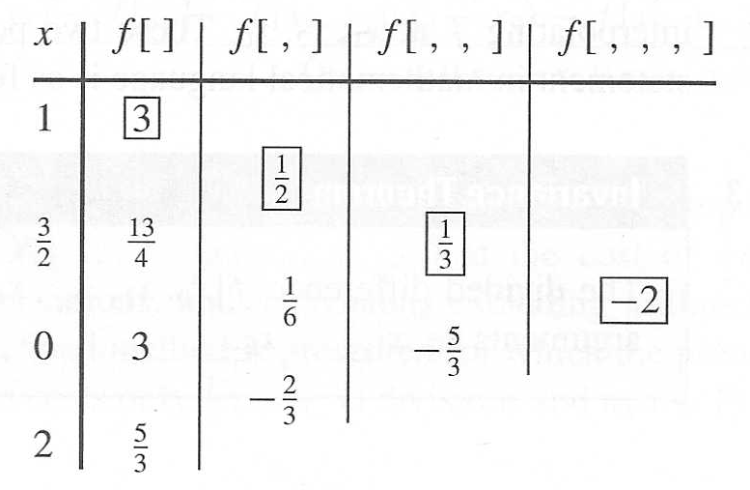
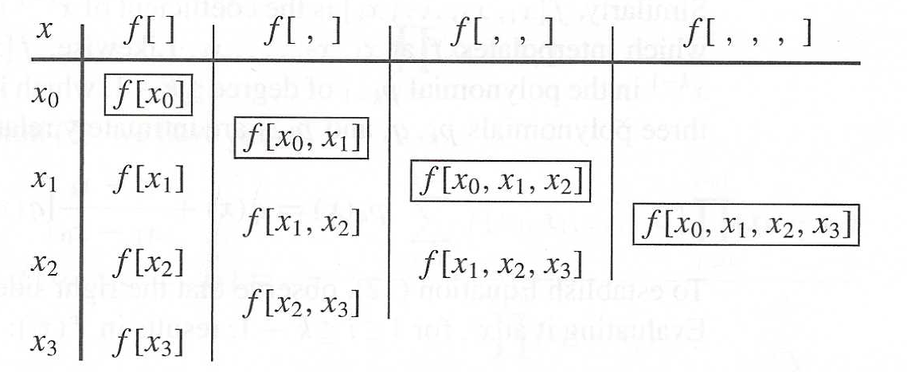
Newton form of the interpolating polynomial

Slide 7
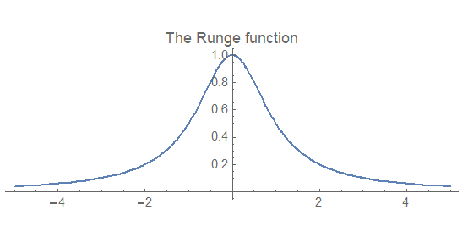
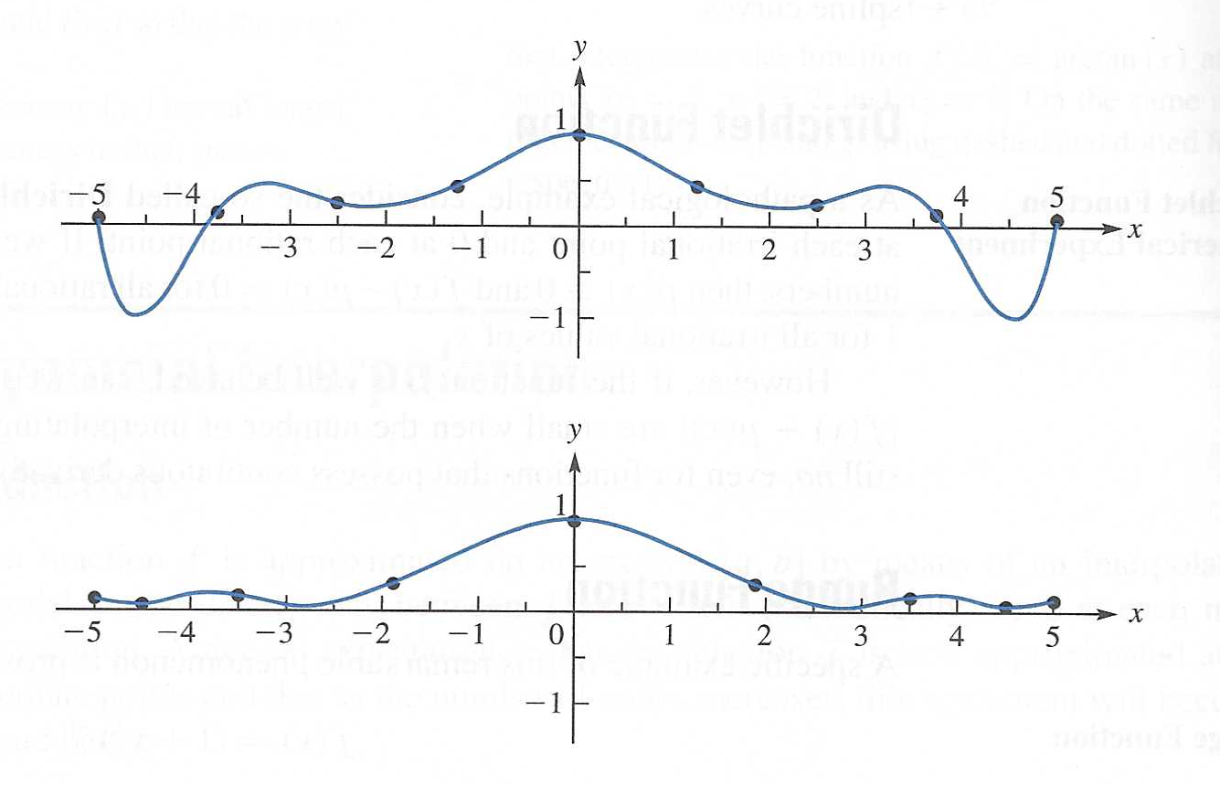
Chebyshev spacing of the data points
Choice of the data points to improve the approximation

Slide 8
Richardson’s extrapolation

Slide 9
Richardson extrapolation

Slide 10
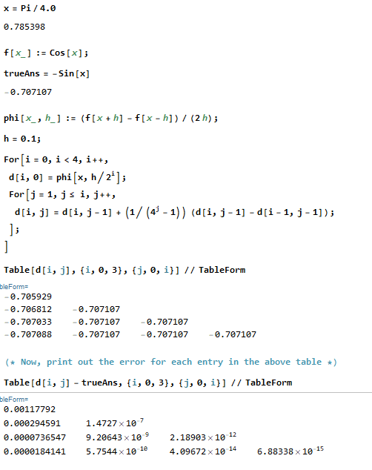
Richardson extrapolation Example using Mathematica

Slide 11
CSCI 3321
Polynomial Interpolation
and
Richardson Extrapolation
If you have any questions or comments about the material in this presentation, please send them to me in an email. I will gather the questions and answers over the next few days and then send them to each member of the class.

