Slide 1
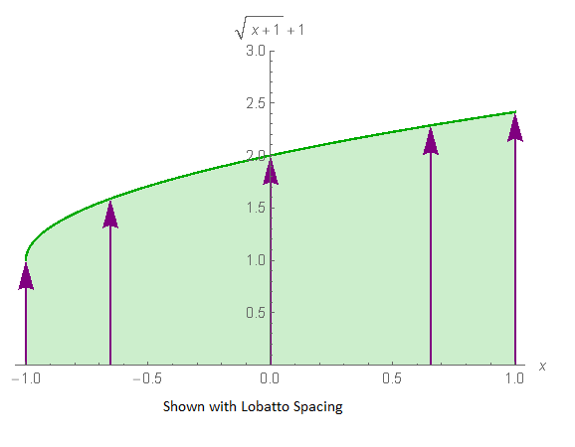
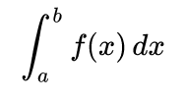

Numerical Quadrature
A Numerical Method for Determining a Definite Integral

Slide 2
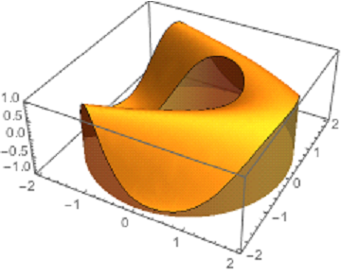
Numerical quadrature is used for lots of things
Calculating the area of an unusual region
Can also be generalized to calculate a volume in higher dimensions
Finding the average value of a function
Sometimes used for implicit Runge-Kutta methods for solving ordinary differential equation
Ancient Babylonian astronomers calculated Jupiter's position from the area under a time-velocity graph
Calculate the density of a body if the mass is known or calculate the mass of a given volume if the density is known

Slide 3
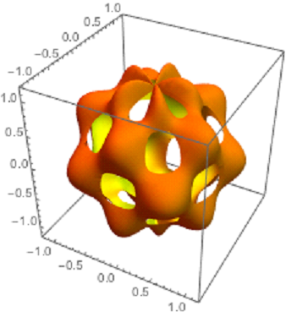
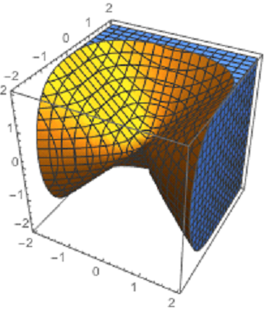
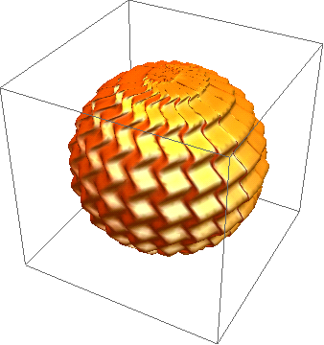
Numerical Cubature
Getting volumes of various shaped objects

Slide 4
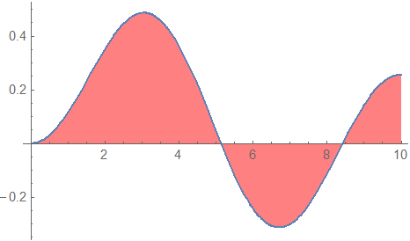





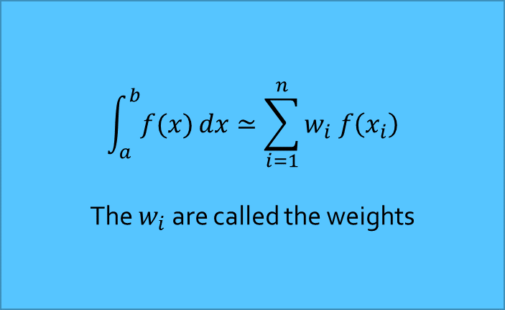


Numerical Quadrature
One-dimensional quadrature
As treated in our textbook
$$\int_{a}^{b}{f(x)}dx≃\sum_{i=1}^{n}{w_{i} f\left(x_{i}\right)}$$
The $w_{i}$are called the weights
The $x_{i}$are called the nodes
$$x_{4}$$
$$x_{5}$$
$$x_{1}$$
$$x_{2}$$
$$x_{3}$$
$$x_{6}$$

Slide 5
Obtaining a Numerical Quadrature Formula

Slide 6
Obtaining a Numerical Quadrature Formula

Slide 7
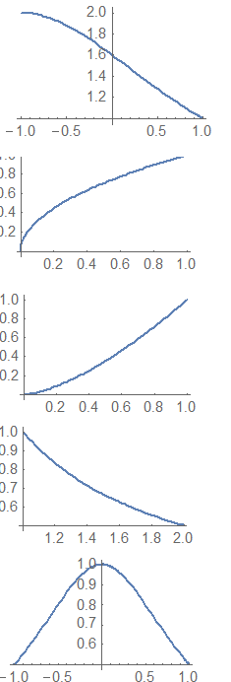
Obtaining a Numerical Quadrature Formula

Slide 8
Obtaining a Numerical Quadrature Formula

Slide 9
Obtaining a Numerical Quadrature Formula

Slide 10
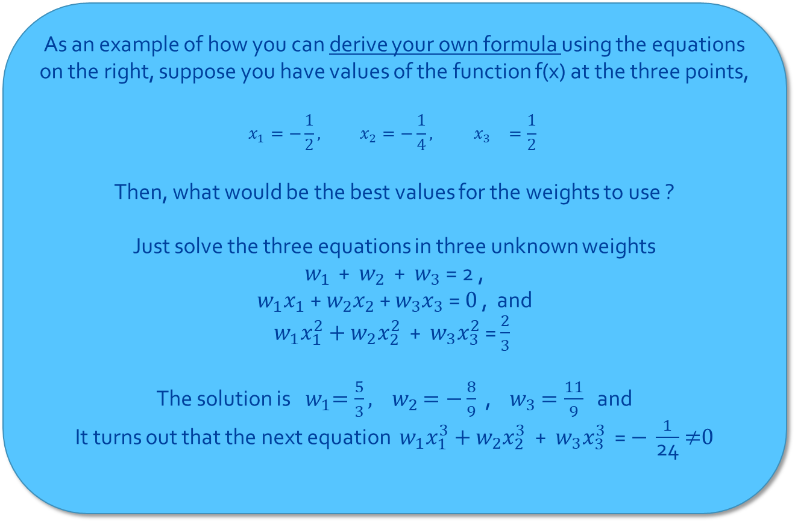
Obtaining a quadrature formula
As an example of how you can derive your own formula using the equations on the right, suppose you have values of the function f(x) at the three points,
$$x_{1}=−\frac{1}{2}, x_{2}=−\frac{1}{4}, { x}_{3}=\frac{1}{2}$$
Then, what would be the best values for the weights to use ?
Just solve the three equations in three unknown weights
$w_{1 }\text{+} w_{2}$ + $w_{3}$ = 2 ,
$w_{1}x_{1} \text{+} w_{2}x_{2}$ + $w_{3}x_{3}$ = 0 , and
$w_{1}x_{1}^{2}+$ $w_{2}x_{2}^{2}$ + $w_{3}x_{3}^{2}$ = $\frac{2}{3}$
The solution is ${ w}_{1}=\frac{5}{3}\text{, } w_{2}$ $=−\frac{8}{9}$ , $w_{3}$ $=\frac{11}{9}$ and
It turns out that the next equation $w_{1}x_{1}^{3}+$ $w_{2}x_{2}^{3}$ + $w_{3}x_{3}^{3}$ = $− \frac{1}{\text{24}}$ ≠0

Slide 11
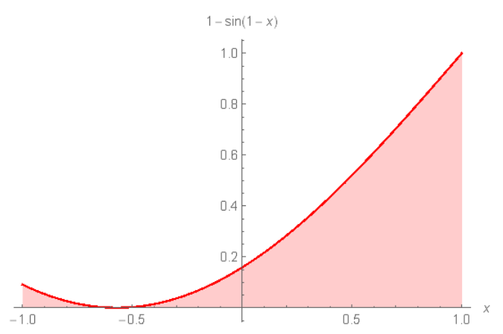
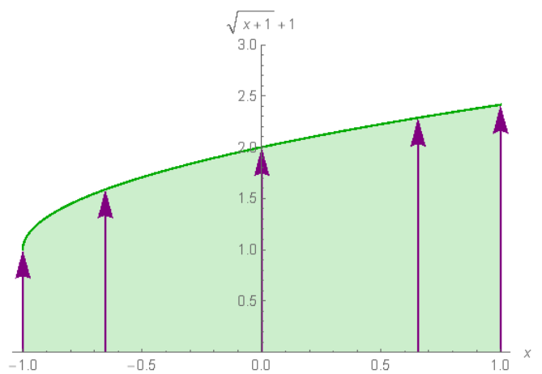
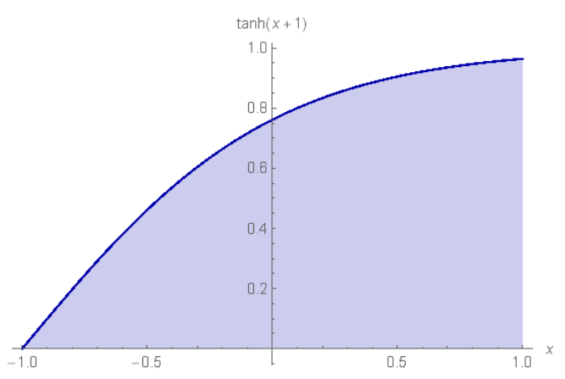
Programming Assignment #3
You will be testing three different five-point quadrature methods: Closed Newton Cotes, Gaussian Quadrature, and Lobatto Quadrature
For Closed Newton Cotes, the five-point formula is called Boole’s Rule (on the bottom of page 235)
For Gaussian quadrature, the nodes for the five=point Gaussian quadrature formula are given on the bottom of page 245 (remember the book labels those values as n=4 in their table, and we are saying those coefficients are for n=5)
For Lobatto quadrature, the nodes are x1 = -1, x2 = -sqrt(3/7), x3 = 0, x4 = sqrt(3/7), and x5 = 1.
The weights are w1 = 1/10, w2 = 49/90, w3 = 32/45, w4 = 49/90, and w5 = 1/10.

