Slide 1
Numerical Methods
CSCI 3321
CSCI 3321
Numerical Solution of
Ordinary Differential Equations
using
Runge-Kutta Methods
Dr. T. Feagin
Note: You may need to click your left mouse button or hit the spacebar to begin or to advance the slides during the slide show

Slide 2
Overview of Runge-Kutta Methods
Background and Introduction
The Runge-Kutta Ansatz
The History of Runge-Kutta Methods
Derivation of Runge-Kutta Methods
The Equations of Condition
Solving the Equations of Condition
Implementation of Runge-Kutta Methods
Numerical experiments

Slide 3
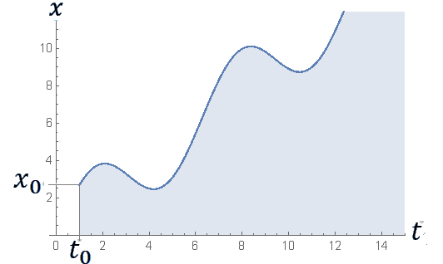
Background and Introduction
How to solve the initial value problem
using Runge-Kutta Methods
$$\frac{dx}{dt}=f\left(t,x\right)$$
$\text{subject} \text{to} \text{the} \text{initial} \text{condition}$
$$x(t_{0})=x_{0}$$

Slide 4
The Runge-Kutta Ansatz
t₀
t₀
t₀+ h
t₀+ h
h - the stepsize
h - the stepsize
where
where

Slide 5
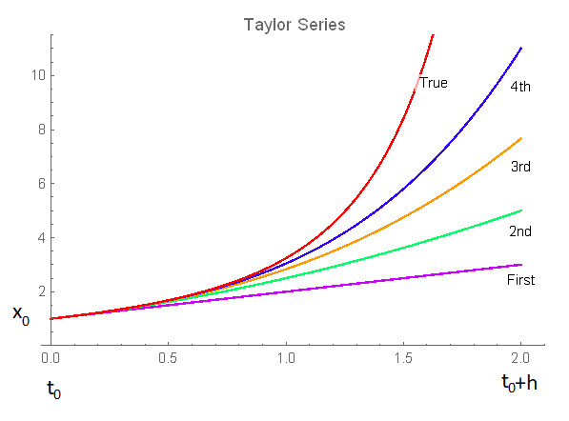
Taylor Series versus Runge-Kutta
These are the ${\text{x}}_{k}$ values
t₀
t₀
t₀+ h
t₀+ h
h - the stepsize
Only need to evaluate f(t,x)
A Taylor Series method evaluates the higher order derivatives of x at t₀ in order to obtain a higher order solution
h is the
stepsize
A Runge-Kutta method evaluates only the first derivative, but at multiple points to get high order result at t₀+ h

Slide 6
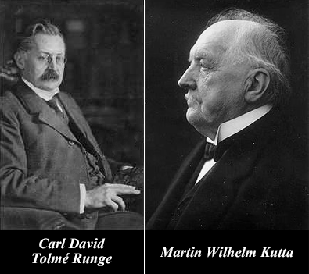
The History of Runge-Kutta Methods
The order of the formula m | The number of new equations of order m | The total number of equations for order m | Number of stages n | The number of unknowns n (n+1)/2
1 | 1 | 1 | 1 | 1
2 | 1 | 2 | 2 | 3
3 | 2 | 4 | 3 | 6
4 | 4 | 8 | 4 | 10
5 | 9 | 17 | 6 | 21
6 | 20 | 37 | 7 | 28
7 | 48 | 85 | 9 | 45
8 | 115 | 200 | 11 | 66
9 | 286 | 486 | 15 | 120
10 | 719 | 1205 | 17 | 153
11 | 1842 | 3047 | - | -
12 | 4766 | 7813 | 25 | 325
13 | 12486 | 20299 | - | -
14 | 32973 | 53272 | 35 | 630
15 | 87811 | 141083
Euler’s method
Your 4th-order Runge-Kutta method
Cooper and Verner’s 8th-order Runge-Kutta method
Harrier’s 10th-order Runge-Kutta method
Feagin’s 12th-order Runge-Kutta method
Feagin’s 14th-order Runge-Kutta method

Slide 7
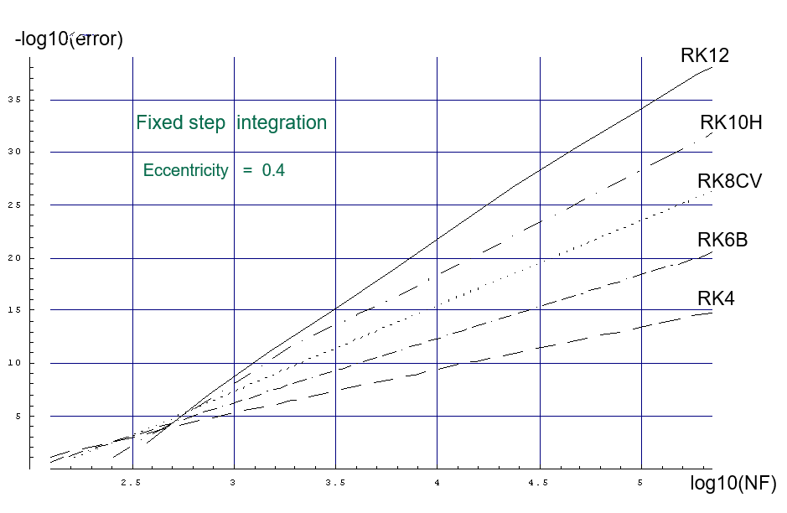
An Efficiency Diagram
An Efficiency Diagram for the Kepler problem (Eccentricity of 0.4) for Several Popular
Runge-Kutta methods of Different Orders

Slide 8
End of NSODE7.2a.pptx
Now you can download and view the second half of the
presentation which is called NSODE7.2b.pptx
htpps://sceweb.uhcl.edu/feagin/courses/NSODE7.2b.pptx

