Slide 1

This is the second half of the presentation NSODE7.2 which is called NSODE7.2b
If you missed it, please download and view the first half of the presentation which is called NSODE7.2a from
https://sceweb.uhcl.edu/feagin/courses/NSODE7.2a.pptx
before viewing this half

Slide 2
Derivation of Runge-Kutta Methods
Please Ctrl+Click to follow link below
https://sceweb.uhcl.edu/feagin/courses/rk3.pdf
Hopefully, you can now view the file showing the Derivation of Third-Order Runge-Kutta Methods in an Adobe Acrobat Reader window.
Then return to this presentation to continue

Slide 3
The Equations of Condition
For Third-Order Runge-Kutta
$$\sum_{k=1}^{n−1}{c_{k}}$$
Need this for first-Order
$$= 1$$
When n=3, these four equations in six unknowns become:
$c_{0}$+ $c_{1}$+ $c_{2}$= 1
$c_{1}α_{1}$+ $c_{2}α_{2}$ $= \frac{1}{2}$
$c_{2}β_{21}α_{1}$ $= \frac{1}{6}$
$c_{1}α_{1}2$+ $c_{2}α_{2}2= \frac{1}{3}$
So, we need to satisfy all four of these equations for the method to be third-order
$$\sum_{k=1}^{n−1}{c_{k}}α_{k}$$
Plus
need this for second-Order
$$= \frac{1}{2}$$
$$\sum_{k=2}^{n−1}{c_{k}}\sum_{j=1}^{k−1}{β_{kj}α_{j}}$$
$$= \frac{1}{6}$$
Plus need both of these for third-Order
$$\sum_{k=1}^{n−1}{c_{k}}α_{k}2$$
$$= \frac{1}{3}$$

Slide 4
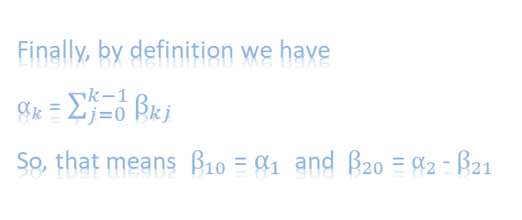



Solving the Equations of Condition
For Three-Stage Third-Order Runge-Kutta
The six unknowns are $α_{1}$, $α_{2}$, $c_{0}$, $c_{1}$, $c_{2}$, and $β_{21}$.
So, we have two degrees of freedom.
First, we carefully choose values for $α_{1}$ and $α_{2}$.
(for example, we cannot choose $α_{1}$ to be zero)
$c_{1}α_{1}$ + $c_{2}α_{2}$ $= \frac{1}{2}$
$c_{1}α_{1}2$+ $c_{2}α_{2}2= \frac{1}{3}$
When n=3, these four equations in six unknowns become:
1) $c_{0}$+ $c_{1}$+ $c_{2}$= 1
$2) c_{1}α_{1}$+ $c_{2}α_{2}$ $= \frac{1}{2}$
3) $c_{2}β_{21}α_{1}$ $= \frac{1}{6}$
$4) c_{1}α_{1}2$+ $c_{2}α_{2}2= \frac{1}{3}$
Then these two linear equations can be solved for $c_{1} \text{and} c_{2}$.
Then we can get $c_{0}$from the equation 1).
And then, we can solve the equation 3) for $β_{21}$
Finally, by definition we have
$α_{k}$ = $\sum_{j=0}^{k−1}{β_{kj}}$
So, that means $β_{10}$ = $α_{1}$ and $β_{20}$ = $α_{2}$- $β_{21}$

Slide 5
Solving the Equations of Condition
For Four-Stage Fourth-Order Runge-Kutta
The following link is to the solution of the fourth-order equations in a pdf
https://sceweb.uhcl.edu/feagin/courses/rk4.pdf
The following link is to a Mathematica notebook that should provide an easier way to get the coefficients for your method
https://sceweb.uhcl.edu/feagin/courses/rk4Start.nb
The following link is to the fourth programming assignment itself
https://sceweb.uhcl.edu/feagin/courses/rk4.html

Slide 6
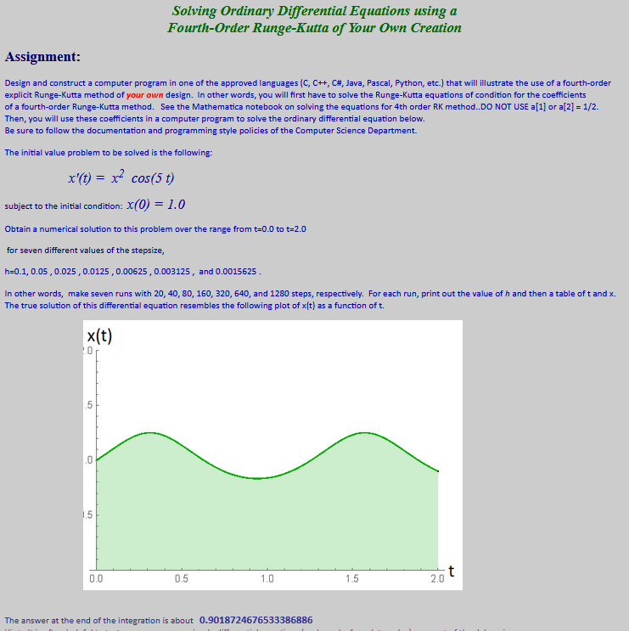
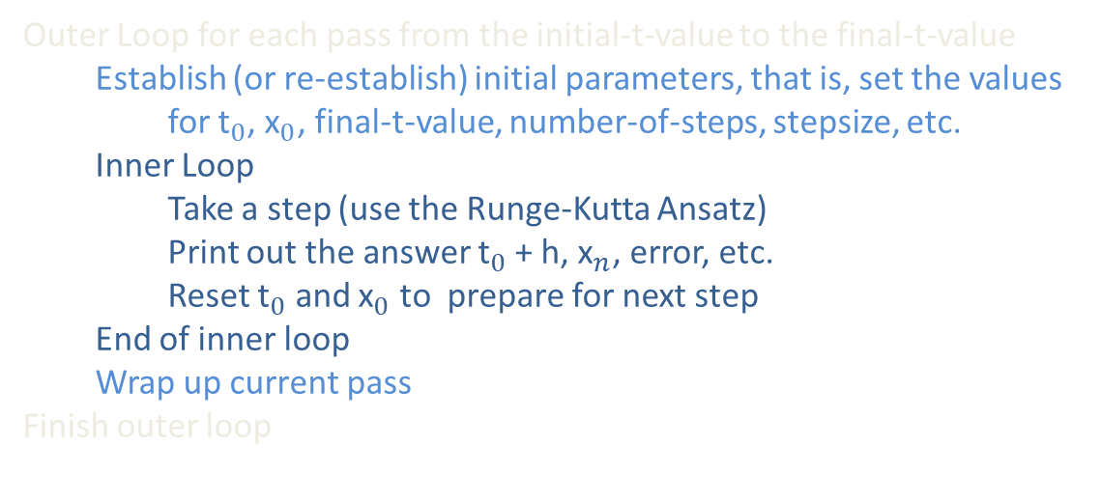
An Outline of How to Implement
Your Runge-Kutta Method for Assignment #4
Outer Loop for each pass from the initial-t-value to the final-t-value
  Establish (or re-establish) initial parameters, that is, set the values
    for ${\text{t}}_{0}$, ${\text{x}}_{0}$, final-t-value, number-of-steps, stepsize, etc.
  Inner Loop
    Take a step (use the Runge-Kutta Ansatz)
    Print out the answer ${\text{t}}_{0}$+ h, ${\text{x}}_{n}$, error, etc.
    Reset ${\text{t}}_{0}$ and ${\text{x}}_{0}$ to prepare for next step
  End of inner loop
  Wrap up current pass
Finish outer loop

Slide 7
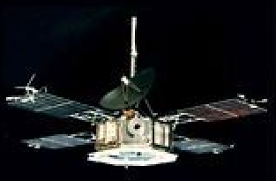
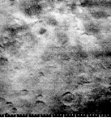
An Example of a Practical Application
How One Might Use a Numerical Method for
Solving a System of
Ordinary Differential Equations
November, 1964
The Mariner Mission
Image Taken of the Craters on Mars during the Mission

Slide 8
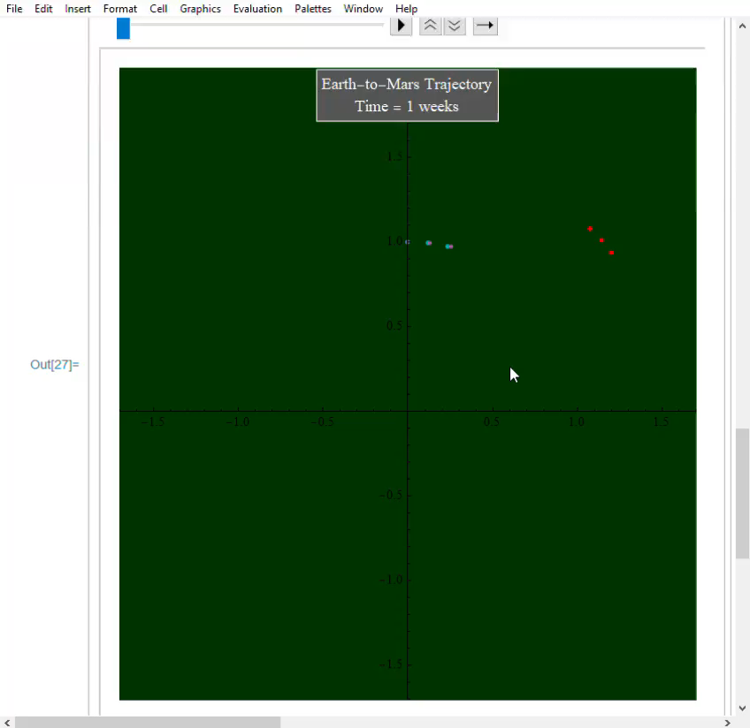
November, 1964
The Mariner Mission
You may need to click your
left mouse button or hit the
spacebar to advance the slide
The Mathematica notebook that is used here is at:
https://sceweb.uhcl.edu/Feagin/courses/rk4EarthMars.nb

Slide 9
CSCI 3321
Numerical Solution of
Ordinary Differential Equations
Dr. T. Feagin
If you have any questions or comments about the material in this presentation, please send them to me in an email. I will gather the questions and answers over the next few days and then send them to each member of the class.
The next presentation will cover adaptive Runge-Kutta methods
and then multistep methods, which are also covered in the Section 7.3 of the textbook. So it might be good to look over section 7.3.
I will let you know when that next presentation is available.

