Slide 1
This presentation (NSODE7.3a) covers the topic of Adaptive Runge-Kutta methods from section 7.3 in our textbook
If you missed them, please download and view the earlier presentations on the numerical solution of ordinary differential equations
NSODE7.1 and NSODE7.2
The next presentation (NSODE7.3b) covers Multistep methods and will be available soon

Slide 2
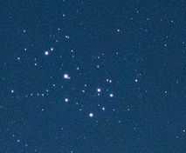
Derivation of Adaptive Runge-Kutta Methods
The Pleiades Problem
Seven stars (or point masses),
which are initially at rest, are
released from random positions
in a plane and their subsequent
motion is tracked (i.e., their
positions in the plane are
computed using a numerical
method such as Runge-Kutta) over a given period of time
Pleiades is an open star cluster containing middle-aged, hot B-type stars located in the constellation of Taurus
The problem involves solving a first-order system of twenty-eight ordinary differential equations since there are two position and two velocity components for each body

Slide 3
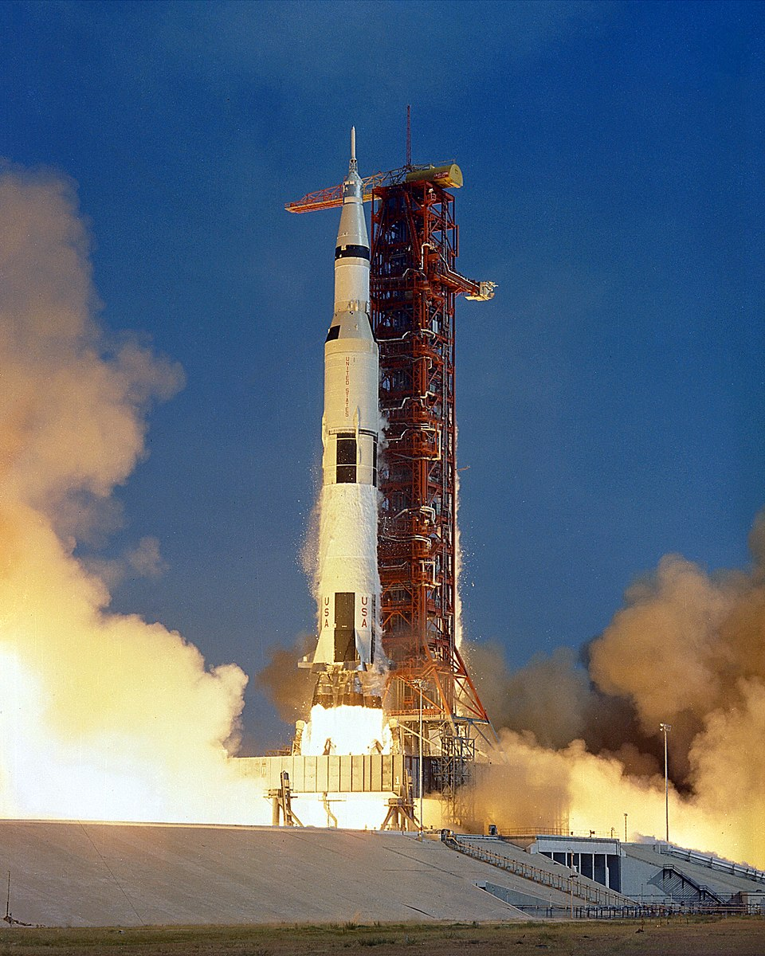
Runge-Kutta-Fehlberg Methods
Erwin Fehlberg was a mathematician and scientist that came to the United States in the mid-1940’s along with
Wernher von Braun and other Germans after World War II
Wernher von Braun was a German-born space scientist whose rocketry enabled the United States to make the first manned landing on the moon.

Slide 4
Runge-Kutta-Fehlberg Methods
Fehlberg’s Methods
RK1(2)
RK2(3)
RK3(4)
RK4(5)
------
RK5(6)
RK6(7)
RK7(8)
RK8(9)
These last four are described in
his NASA technical report at:
Fehlberg’s idea was to develop a number of special $m^{th}$-order Runge-Kutta methods each of which contained an embedded method of order $m−1$.
At the end of each step, his methods would allow one to calculate an estimate of the local truncation error which, in turn, could be used to control the stepsize.
The pseudocode for his RK4(5) method appears as “RK45” in our textbook on page 321.
NASA-TR-R-287

Slide 5
Runge-Kutta-Fehlberg Methods
Fifth-order result
Fourth-order result
$$x$$
$$x_{4}$$
t₀
t₀+ h
h - the stepsize
At the end of each step, one has two results, a fifth-order and a fourth-order result. In the text, the fourth-order result is called $x_{4}$ and the fifth-order result is simply called $x_{ }$ in the text.
So, one could use
ε =$\left|x−x_{4}\right|$ as an
estimate of the local truncation error

Slide 6
Runge-Kutta-Fehlberg Methods
So Fehlberg’s methods are an efficient way to obtain an estimate of the local truncation error at each step. If the error is too large, one can reject the step and repeat the algorithm with a smaller stepsize. Otherwise one can either keep the same stepsize or choose a larger stepsize for the next step in the integration.

Slide 7
CSCI 3321
Numerical Solution of
Ordinary Differential Equations
Dr. T. Feagin
If you have any questions or comments about the material in this presentation, please send them to me in an email. I will gather the questions and answers over the next few days and then send them to each member of the class.
The next presentation will cover Multistep Methods
which are also covered in the Section 7.3 of the textbook.
So it might be good to look over that part of section 7.3.
That next presentation will be available soon.

