Slide 1
This presentation (NSODE7.3b) covers the topic of Multistep Methods from section 7.3 and 7.5 in our textbook
If you missed them, please download and view the earlier presentations on the numerical solution of ordinary differential equations
NSODE7.1, NSODE7.2a, NSODE7.2b, and NSODE7.3a

Slide 2
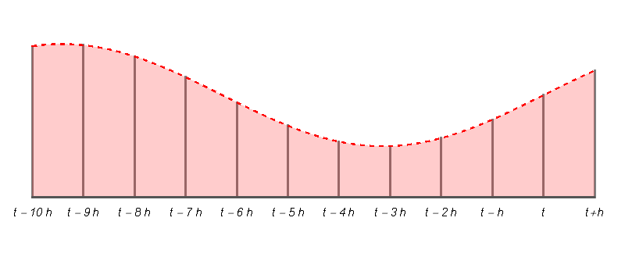
Multistep Methods
Adams-Bashforth-Adams-Moulton Methods
A single-step method only uses information that is internal to the current step in the integration of the ordinary differential equation
Multistep methods use information about the solution that is available from certain previous steps as well as information in the current step
The
current
step
The previous steps
t₀
t₀+ h
h
h - the stepsize
h - the stepsize

Slide 3
Adams-Bashforth-Adams-Moulton Methods
The Adams-Bashforth Predictor Formula
$\tilde{x}\left(t+h\right)$ = $x\left(t\right)$ + $h$ $\left\{b_{1}f\left[x\left(t\right)\right]+b_{2}f\left[x\left(t−h\right)\right]+b_{3}f\left[x\left(t−2h\right)\right]+b_{4}f\left[x\left(t−3h\right)\right]+…\right\}$
where $b_{1}$= 55/24, $b_{2}$= -59/24, $b_{3}$=37/24, $b_{4}$=-3/8 for 4th order (see p.347 in text)
The Adams-Moulton Corrector Formula
$x\left(t+h\right)$ = $x\left(t\right)$ + $h$ $\left\{c_{0}f\left[\tilde{x}\left(t+h\right)\right]+c_{1}f\left[x\left(t\right)\right]+c_{2}f\left[x\left(t−h\right)\right]+c_{3}f\left[x\left(t−2h\right)\right]]+…\right\}$
where $c_{0}$=3/8, $c_{1}$=19/24, $c_{2}$=-5/24, $c_{3}$=1/24 for 4th order (see p.348 in text)
$x\left(t+h\right)$
$$\tilde{x}\left(t+h\right)$$
h
h - the stepsize

Slide 4
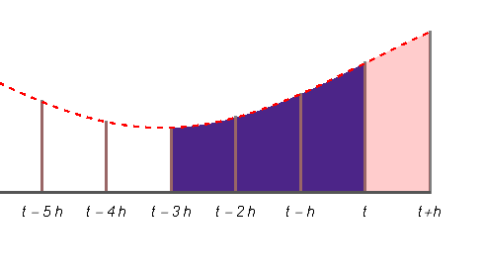
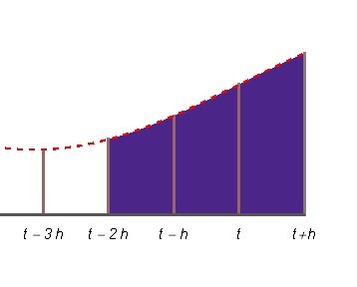
Adams-Bashforth-Adams-Moulton Methods
The Adams-Bashforth Predictor Formula
$\tilde{x}\left(t+h\right)$ = $x\left(t\right)$ + $h$ $\left\{b_{1}f\left[x\left(t\right)\right]+b_{2}f\left[x\left(t−h\right)\right]+b_{3}f\left[x\left(t−2h\right)\right]+b_{4}f\left[x\left(t−3h\right)\right]+…\right\}$
where $b_{1}$= 55/24, $b_{2}$= -59/24, $b_{3}$=37/24, $b_{4}$=-3/8 for 4th order (see p.347 in text)
The Adams-Moulton Corrector Formula
$x\left(t+h\right)$ = $x\left(t\right)$ + $h$ $\left\{c_{0}f\left[\tilde{x}\left(t+h\right)\right]+c_{1}f\left[x\left(t\right)\right]+c_{2}f\left[x\left(t−h\right)\right]+c_{3}f\left[x\left(t−2h\right)\right]]+…\right\}$
where $c_{0}$=3/8, $c_{1}$=19/24, $c_{2}$=-5/24, $c_{3}$=1/24 for 4th order (see p.348 in text)
Predictor
provides a tentative value for the solution at t+h
Corrector
provides a more accurate
value at t+h
$x\left(t+h\right)$
$$\tilde{x}\left(t+h\right)$$
h
The formula involves these points
The formula involves these points

Slide 5
A Comparison of the Three Methods
Advantages and disadvantages of the methods
 | Preparing to use the method | Starting the method | Problems with numerical instability | Varying the stepsize | Difficult to program | Overall efficiency
Taylor Series methods | Get higher derivatives | Self-starting | Never | Easy | Usually easy | Depends
Runge-Kutta methods | Get RK coefficients | Self-starting | Very rarely | Easy with Fehlberg | Easy | Good
Adams methods | Get Adams coefficients | Needs a starter method | Frequently for high-orders | Relatively expensive | More work | Often the best
$x\left(t+h\right)$
$$\tilde{x}\left(t+h\right)$$
h

Slide 6
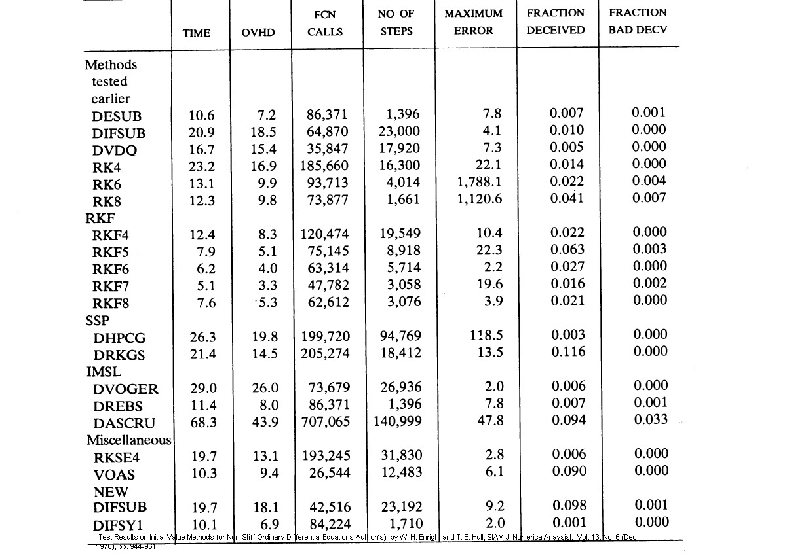
A Comparison of the Performance of Methods
$x\left(t+h\right)$
$$\tilde{x}\left(t+h\right)$$
h

Slide 7
CSCI 3321
Numerical Solution of
Ordinary Differential Equations
Dr. T. Feagin
If you have any questions or comments about the material in this presentation, please send them to me in an email. I will gather the questions and answers over the next few days and then send them to each member of the class.
The next presentation will cover nonlinear Two-Point Boundary Value Problems which are covered in the Chapter 11 of the textbook. That presentation should be available soon.

