Slide 1
Least Squares Methods
What is least squares?
Why least squares?
How is it used?
Physics
Experimental Science
Environmental Science
Information Science
Aeronautics
Astronautics
Marine Science
Chemistry
Sociology
Mathematics
Business Modeling
Political Science
Geology
Biology
Behavioral Science
Medical Science
Image from ssrn.com
Image from shutterstock.com
Image from ssrn.com
Image from ssrn.com
Helps you focus
on the big picture
Reduces the noise
in the data
Analysis
Modeling
Simulation
Predicting

Slide 2
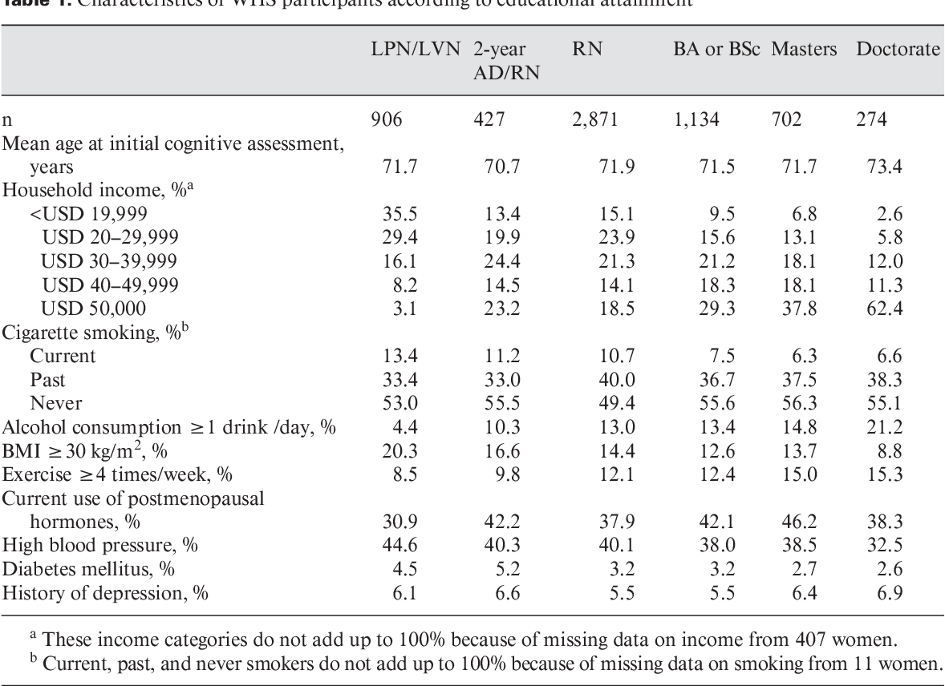
Statistics and Modeling

Slide 3
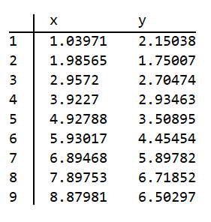
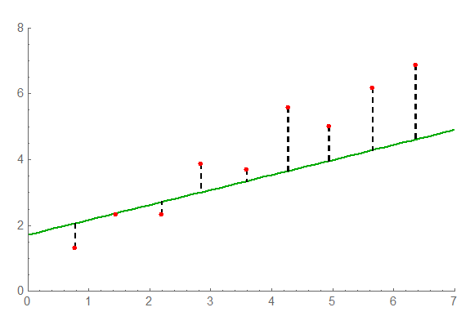
How to Obtain a Curve that Fits the Data in the Least Squares Sense
Some Data Values
One of the best ways to pick an
initial model is to plot the data
These are
the $y_{k}$ values
These are
the $x_{k}$ values
The green line is
not such a good fit
$$y=g(x,a,b,c,…)$$
a model function
$$y=a x+b$$
a linear model

Slide 4
How Do We Measure the Errors in the Data
We typically measure the errors in the fit vertically. So for a linear model, we would use the following:
${\text{ε}}_{k}$ = $\left| ax_{k}+b −y_{k} \right|$
Or for a general model, just:
${\text{ε}}_{k}$ = $\left| g\left(x_{k},a,b,c,…\right) −y_{k} \right|$
The location of ($x_{k}$, $y_{k}$) is denoted by the red dot
$$y_{k}$$
$$ax_{k}+b$$
${\text{ε}}_{k}$ is just the length of the dashed line
.
$$x_{k}$$
T$he green line has equation$
$$y=a x+b$$

Slide 5
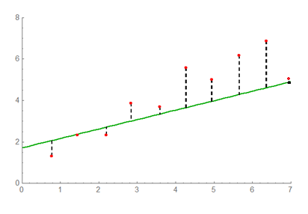
How Do We Decide What Values Would Be Optimal for the Constants in the Model (e.g., the constants $a$ and $b$) ?
${\text{ε}}_{8}$
${\text{ε}}_{k}$ = $\left| ax_{k}+b −y_{k} \right|$
$$k goes from 0 to m$$
${\text{ε}}_{7}$
${\text{ε}}_{5}$
${\text{ε}}_{6}$
${\text{ε}}_{9}$
${\text{ε}}_{3}$
${\text{ε}}_{4}$
We want to minimize all of the ${\text{ε}}_{k}$ errors
${\text{ε}}_{1}$
${\text{ε}}_{2}$
${\text{ε}}_{0}$
One way would be to minimize the sum of all of the ${\text{ε}}_{k}$ errors
Another way would be to minimize the sum of the squares of the ${\text{ε}}_{k}$ errors
($\text{i}\text{.}\text{e}\text{., }\text{use} \text{Least} \text{Squares}\text{)}$
Yet another way would be to minimize
$$=\sum_{k=0}^{m}{{\text{ε}}_{k}}$$
$$=\sum_{k=0}^{m}{{{\text{ε}}_{k}}^{2}}$$
$${\left(\sum_{k=0}^{m}{{{\text{ε}}_{k}}^{p}}\right)}^{1/p}$$
$${\text{the} \text{ℓ}}_{1} \text{norm}$$
${\text{the}\text{ ℓ}}_{2} \text{norm}\text{, }$ $\text{ϕ}\text{(}a\text{,}b$)
$${\text{the}\text{ ℓ}}_{p} \text{norm} =$$

Slide 6
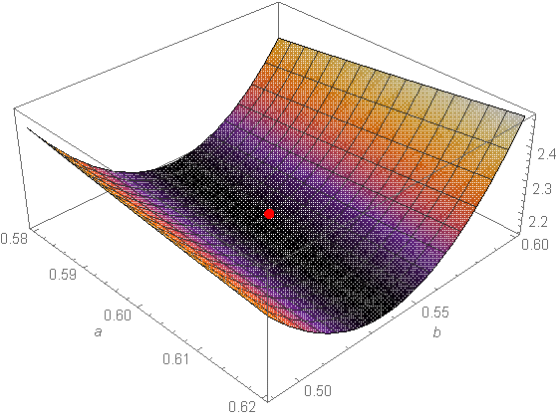
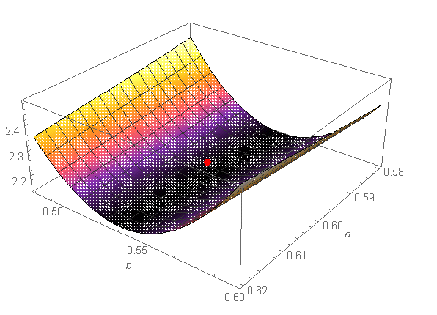
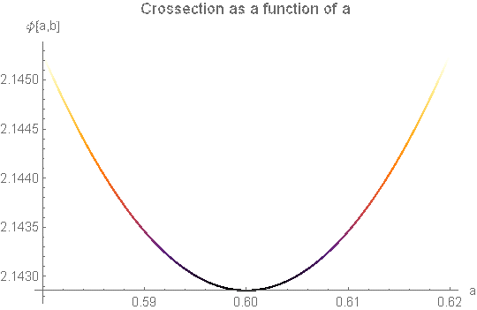
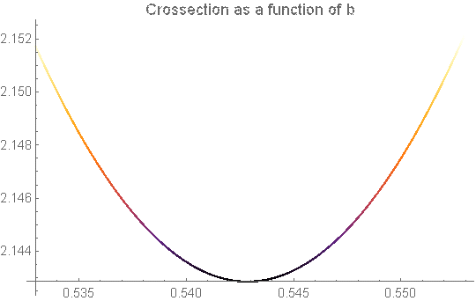
How Do We Minimize $\text{ϕ}\text{(}a\text{,}b$) with Respect to the Constants $a$ and $b$ ?
${\text{ε}}_{k}$ = $\left| ax_{k}+b −y_{k} \right|$
${\text{ε}}_{8}$
$\text{ϕ}\text{(}a\text{,}b$)
$\text{ϕ}\text{(}a\text{,}b$)
${\text{ε}}_{5}$
${\text{ε}}_{7}$
${\text{ε}}_{6}$
${\text{ε}}_{3}$
${\text{ε}}_{4}$
${\text{ε}}_{1}$
For more information, see p. 427 in the text
${\text{ε}}_{2}$
${\text{ε}}_{0}$
$$b$$
$$a$$
$$=\sum_{k=0}^{m}{{{\text{ε}}_{k}}^{2}}$$
$\text{ϕ}\text{(}a\text{,}b$)
$$\frac{∂\text{ϕ}}{∂a}\text{ = 0}$$
$$\frac{∂\text{ϕ}}{∂b}\text{ = 0}$$
$$\frac{∂\text{ϕ}}{∂a}\text{ = 0}$$

Slide 7
Least Squares Solution for the Straight Line $y=a x+b$
$\text{ϕ}\text{(}a\text{,}b$)
$\text{ϕ}\text{(}a\text{,}b$)
$$a$$
$$b$$
$$\frac{∂\text{ϕ}}{∂a}\text{ = 0}$$
$$\frac{∂\text{ϕ}}{∂b}\text{ = 0}$$
$\frac{∂\text{ϕ}}{∂a}$ $=\sum_{k=0}^{m}{ 2\left(ax_{k}+b −y_{k}\right)}x_{k}=$ 0
$\frac{∂\text{ϕ}}{∂b}$ $= \sum_{k=0}^{m}{ \left(ax_{k}+b −y_{k}\right) = 0}$
$$=\sum_{k=0}^{m}{{{\text{ε}}_{k}}^{2}}=\sum_{k=0}^{m}{{\left(ax_{k}+b −y_{k}\right)}^{2}}$$
$\text{ϕ}\text{(}a\text{,}b$)
The Normal Equations
$\left(\sum_{k=0}^{m}{x_{k}^{2}}\right)$ $a$ + $\left(\sum_{k=0}^{m}{x_{k}}\right)$ $b$ = $\sum_{k=0}^{m}{{y_{k}x}_{k}}$
$\left(\sum_{k=0}^{m}{x_{k}}\right)$ $a$ + $\left(m+1\right)$ $b$ = $\sum_{k=0}^{m}{y_{k}}$
Solution of the Normal Equations
$a$= $\frac{1}{d}$ $\left[\left(m+1\right)\sum_{k=0}^{m}{{x_{k}y}_{k}−\left(\sum_{k=0}^{m}{x_{k}}\right)\left(\sum_{k=0}^{m}{y_{k}}\right)}\right]$
$b$= $\frac{1}{d}\left[\left(\sum_{k=0}^{m}{x_{k}^{2}}\right)\left(\sum_{k=0}^{m}{y_{k}}\right)−\left(\sum_{k=0}^{m}{x_{k}}\right)\left(\sum_{k=0}^{m}{{x_{k}y}_{k}}\right)\right]$
where
d = $\left(m+1\right)\left(\sum_{k=0}^{m}{x_{k}^{2}}\right)−{\left(\sum_{k=0}^{m}{x_{k}}\right)}^{2}$
$$y=a x+b$$

Slide 8
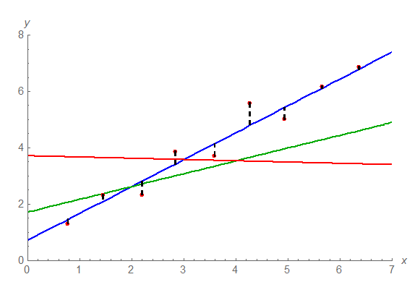
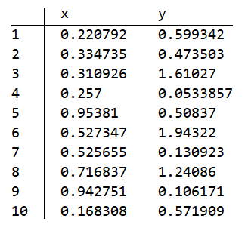
Fitting the Data in the Least Squares Sense
Some Data Values
$$maximum error$$

Slide 9
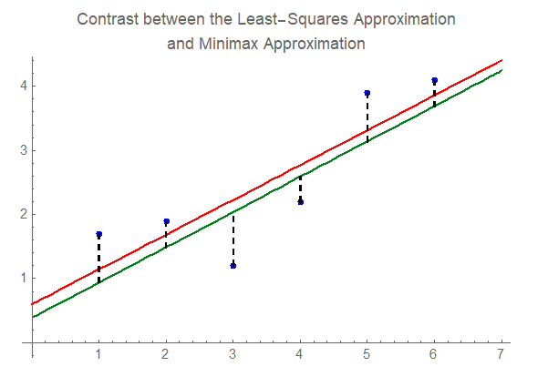
Minimax Approximation
${\text{ε}}_{k}$ = $\left| ax_{k}+b −y_{k} \right|$
$$Minimax Approximation is shown in Green and$$
$$the Least Squares Approximation in Red$$
$$Green$$
$${\left(\sum_{k=0}^{m}{{{\text{ε}}_{k}}^{p}}\right)}^{1/p}$$
$$Red$$
$${\text{the}\text{ ℓ}}_{p} \text{norm} =$$
$${\lim_{p→∞}\left(\sum_{k=0}^{m}{{{\text{ε}}_{k}}^{p}}\right)}^{1/p}$$
$${\text{the}\text{ ℓ}}_{∞} \text{norm} =$$
$$\min_{\{a,b\}}\underset{ k}{\max{ }}{ (\text{ε}}_{k})$$
$$maximum errors$$

Slide 10
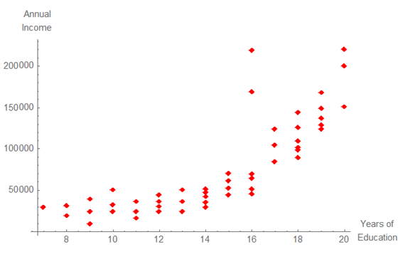
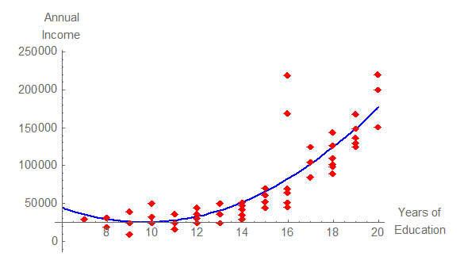
Fitting the Data with Other Model Functions
Income versus Years of Education
The Data
Income versus Years of Education
Fitting the Data with a Quadratic

Slide 11
Fitting the Data with Polynomials
$y(x)=$ $a$ + $b$ $x$
$y(x)=$ $a$ + $b$ $x$ + $c$ $x^{2}$
$y(x)=$ $a$ + $b$ $x$ + $c$ $x^{2}$ + $d$ $x^{3}$
Fitting different models to the data

Slide 12
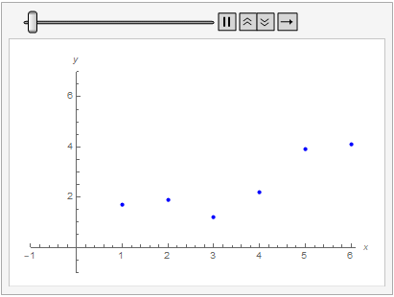
CSCI 3321
Least Squares Methods
If you have any questions or comments about the material in this presentation, please send them to me in an email. I will gather the questions and answers over the next few days and then send them to each member of the class.
The next presentation will cover Spline Functions in Chapter 6 of the textbook. It might be good to look over the first part of that chapter. That next presentation will be available soon.

