Slide 1
Final Exam Review Part One

Slide 2
What chapters and sections of the textbook will be covered on the Final Exam
Chapter 6: Sections 6.1, 6.2
Chapter 7 : Sections 7.1, 7.2, 7.3, 7.5
Chapter 9 : Sections 9.1
Chapter 10 : Sections 10.1, 10.2, 10.3
Chapter 11 : Sections 11.1
You should also review the PowerPoint presentations and review the following linked materials:
Information on Runge Kutta methods
Obtaining coefficients for 4th-order Adams methods

Slide 3
Understand vector fields (section7.1)
and be able to trace the solution of an
initial value problem in a diagram like
the one on the left.

Slide 4
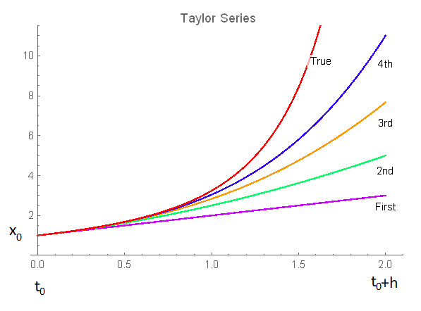
TAYLOR SERIES METHODS
Understand what a Taylor Series method is and how to use it to integrate an ordinary differential equations
Euler’s Method
Understand how to take a couple of steps for a particular, simple initial value problem
Taylor series methods evaluate the higher order derivatives of x at t₀ in order to obtain a higher order solution

Slide 5
Third Order Runge-Kutta
The equations of Condition
Know how to solve the equations of condition for a third-order three-stage method. See the following for hints:
Information on Runge Kutta methods
Also be able to take a couple of steps for a particular, simple initial value problem with a given ordinary differential equation and a given initial value.

Slide 6
higher Order Runge-Kutta methods
The equations of Condition
Know that solving the equations of condition for high-order RK methods is extremely difficult
The order of the formula m | The number of new equations of order m | The total number of equations for order m | Number of stages n | The number of unknowns n (n+1)/2
1 | 1 | 1 | 1 | 1
2 | 1 | 2 | 2 | 3
3 | 2 | 4 | 3 | 6
4 | 4 | 8 | 4 | 10
5 | 9 | 17 | 6 | 21
6 | 20 | 37 | 7 | 28
7 | 48 | 85 | 9 | 45
8 | 115 | 200 | 11 | 66
9 | 286 | 486 | 15 | 120
10 | 719 | 1205 | 17 | 153
11 | 1842 | 3047 | - | -
12 | 4766 | 7813 | 25 | 325
13 | 12486 | 20299 | - | -
14 | 32973 | 53272 | 35 | 630
15 | 87811 | 141083
t₀
t₀+ h
Be able to explain how easy or difficult it is to solve the nonlinear algebraic equations of condition for Runge-Kutta.
h - the stepsize

Slide 7
Runge-Kutta-Fehlberg methods
RK45 (see p.321 in text)
RK45 (see p.321 in text)
Know how to use Fehlberg’s RK45 method
Understand how to take a couple of steps for a particular, simple initial value problem with a given ordinary differential equation and a given initial value. Understand how the local truncation error can be estimated. Understand how that estimate can be used to vary the stepsize and why that could help achieve greater accuracy
$$\hat{x_{n}}$$
5th order
4th order
t₀
t₀+ h
h - the stepsize

Slide 8
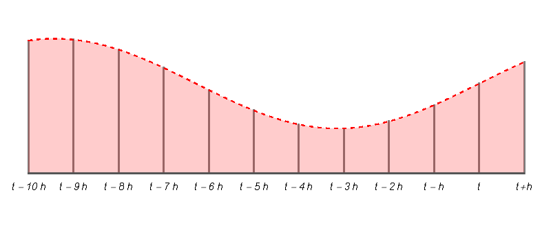
Adams methods See pages 347-348
$$\tilde{x}\left(t+h\right)$$
P redict
E valuate
C orrect
E valuate
$x\left(t+h\right)$
h
Know about the basic
Predict-Evaluate-Correct-Evaluate
algorithm and how it might be used
h - the stepsize

Slide 9
Comparison of Taylor Series,
Runge-Kutta, and Adams Methods
 | Overall efficiency | Self-Starting | Changing Stepsize | Getting coefficients | Numerical Instability | Hard to program
Taylor Series | Depends on difficulty of the derivative evaluations | Yes | Easy | N/A | No problem at all | Depends
Runge-Kutta | Good | Yes | Easy | Difficult for high-orders | Not usually a problem | Easy to program
Adams | Better for 80% of the problems | No | More Difficult | Easy | Often a problem | Harder to program

Slide 10
Final Exam Review End of Part One
https://sceweb.uhcl.edu/feagin/courses/moreAboutFinal.doc
https://sceweb.uhcl.edu/feagin/courses/finalreview.doc

