Slide 1
SENG 5130 systems engineering processes Module 4

Slide 2
Recap of Last Week

Slide 3
MODULE 4
Preliminary System Design

Slide 4
Objectives of this Module
Conceptual
design
Preliminary
system design
Detail design and
development
Production and/or
construction
System operation
and support
Retirement and
phase-out

Slide 5
Preliminary Design
Translate system-level functional requirements into design requirements for subsystems
Specific requirements
Hardware
Software
Personnel
Trade-off studies

Slide 6
February 1, 2011
http://lockheedartin.mobi/news/press_releases/2011/0201_ss_goesr-pdr.html
Lockheed Martin Team Completes GOES-R Weather Satellite Preliminary Design Review
“The Lockheed Martin team designing NASA and NOAA’s Geostationary Operational Environmental Satellite R-series (GOES-R) weather satellite has successfully completed its system Preliminary Design Review, a major milestone in the program’s development. GOES-R is the nation’s next generation geostationary weather satellite.
The GOES-R team will now proceed with detailed design work for the spacecraft that will lead to the Critical Design Review scheduled for early 2012”
FINAL UPDATE: Launched November 19, 2016, now in orbit.
http://news.lockheedmartin.com/2016-11-19-Better-Forecasts-Ahead-Lockheed-Martin-Built-GOES-R-Weather-Satellite-Launched
UPDATE (Jan. 7, 2013): Lockheed Martin Delivers GOES-R Weather Satellite Core Structure for Propulsion System Integration
(http://www.lockheedmartin.com/us/news/press-releases/2013/january/0107-ss-goesr.html)

Slide 7
February 8, 2012
UPDATE (January 22, 2013): Engineers are putting their final touches on design plans for a new $58 million Broadway Bridge. The bridge, built 90 years ago, connects Little Rock and North Little Rock. Although the bridge is not a safety risk, engineers who conducted a study of the structure have determined it is deteriorating and needs to be replaced. The Arkansas Highway and Transportation Department expects to hold a public hearing on the new design plans in late winter or early spring. The new bridge will consist of five traffic lanes and a pedestrian walkway. Construction could last as long as two years.
(http://arkansasmatters.com/fulltext?nxd_id=630502)
February 6, 2016 update:
Current budget: $98.4 million, expected to be completed this spring.
http://www.nwaonline.com/news/2017/feb/06/rolling-right-along-20170206/
The Arkansas Highway and Transportation Department has released preliminary design ideas for a replacement for the Broadway Bridge. Among other details, the Highway Department said its initial commitment of $45 million for the bridge will be increased to $58 million, based on preliminary engineering studies. Twin-tied arch and cable-stayed designs (the latter of which won favor in an unofficial bridge design contest that Metroplan sponsored) were also considered, but deemed more expensive or more time-consuming to build than the designs below.

Slide 8
Preliminary Design
Responsibility: Contractor
(whose responsibility was Conceptual Design?)
Customer’s role:
Monitoring
Reviewing
Supporting contractor progress

Slide 9
Ex: Underground Mining Equipment
Conceptual Design:
Initial concept for new machine/system
User needs/performance requirements defined
Preliminary R&D efforts
Questions:
Why is this equipment being sought?
What mission is the equipment expected to fulfill?
Who will benefit? Who will use?

Slide 10
Ex: Underground Mining Equipment
Preliminary Design:
Overall system requirements are integrated with available technology
Output: Set of working system specifications
Questions:
What functions should be assigned to operators/support?
What conditions will impose peak task loads on operator?
How many people to operate/support?
Is there training required/available?
System Functional Analysis:
Coal-cutting head design
Coal-gathering mechanism
Coal-loading or transfer functions
Operator and maintainer interface

Slide 11
Preliminary Design Criteria
Basic design objective(s) for the system and its elements must:
Be compatible with system operational requirements, maintenance and support, and prioritized TPMs
Comply with allocated design-to-criteria
Meet all requirements in various applicable specifications

Slide 12
Preliminary Design Criteria
Design for functional capability
Design for interoperability
Design for sustainability
Design for reliability
Design for maintainability
Design for usability and safety
Design for security
Design for supportability and serviceability
Design for producibility and disposability
Design for affordability

Slide 13
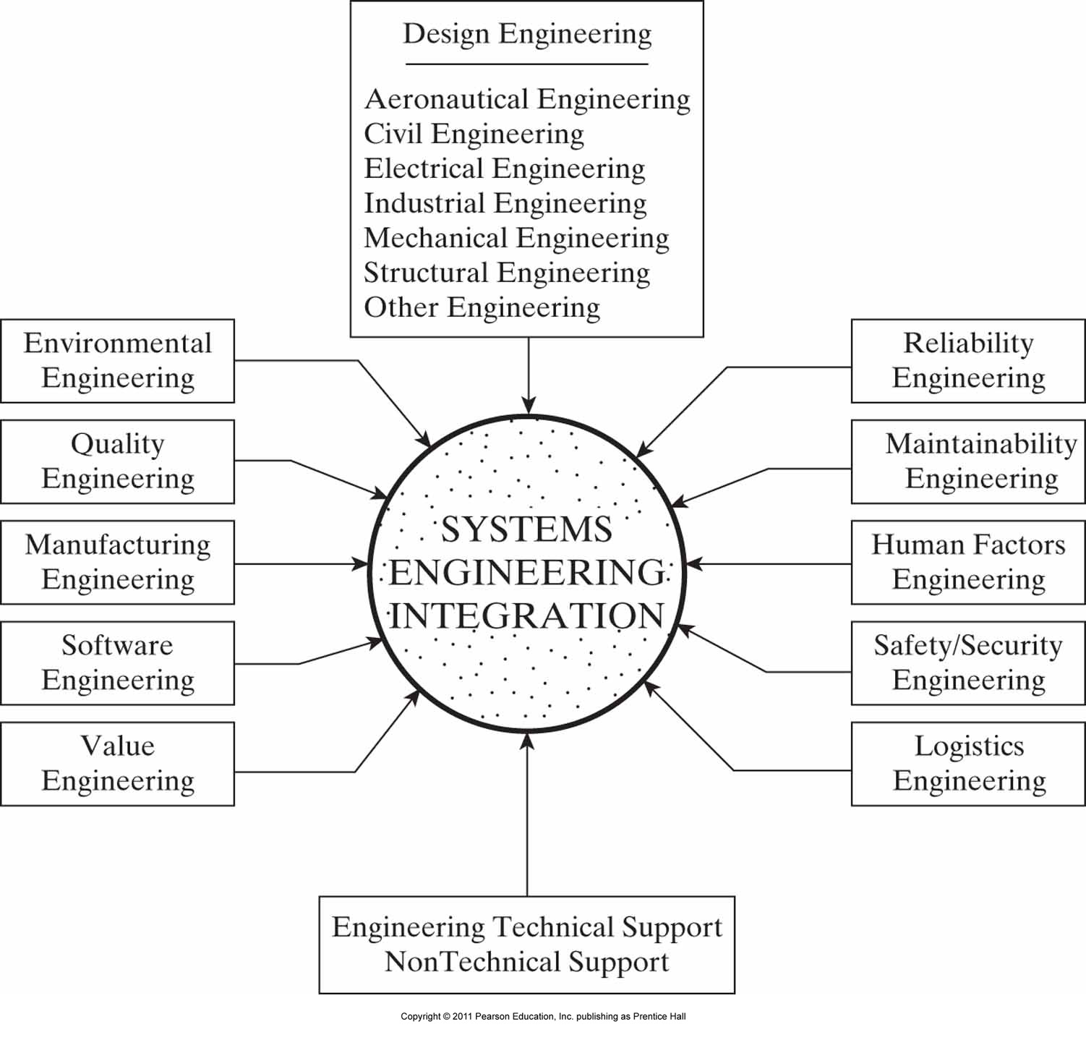
The integration of engineering disciplines.

Slide 14
Preliminary Design
1. Subsystem requirements analysis
5. Preliminary design review
2. Requirements allocation
3. Interface identification/design
4. Subsystem-level synthesis

Slide 15
1. Subsystem-Requirements Analysis
Continuing the efforts during conceptual design
Next level of detail
Contractor, rather than customer
Review of system specifications
Review of relevant TPMs

Slide 16
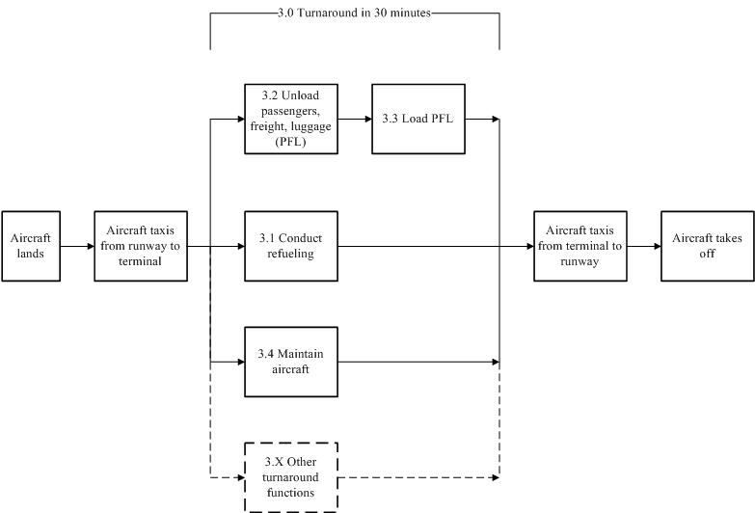
Detailed Aircraft System FFBD
Conceptual Design Phase

Slide 17
Detailed Aircraft System FFBD
Preliminary Design Phase

Slide 18
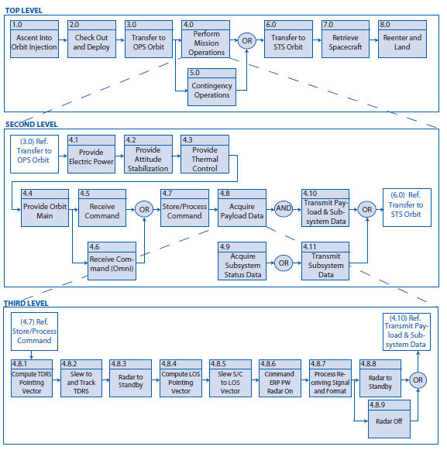
FFBD Example
NASA SE Handbook (2007), Appendix F

Slide 19
Class Exercise: FFBD for 2 levels
SYSTEMS:
Online Library for a University
Internet-based Travel Web Site
Multi-story Parking Garage
Hospital for a Small Community
Two-way Traffic System Across a River

Slide 20
2. Requirements Allocation
Grouping or combining similar functions into logical subdivisions
Translation from functional design to physical design
During conceptual design, groups were based around functional RBS
During preliminary design, groups are based around preliminary physical architecture formulated by designers
Focus is on assignment/allocation of functions to physical configuration items (CIs)

Slide 21
Aircraft Example
Identify subsystems (CIs):
Undercarriage subsystem
Wings/Fuselage
Fuel
Hydraulic
Flight Control
Engine
Avionics
Interior

Slide 22
Aircraft Example
These subsystems are CIs because they represent hardware, software, or a combination of both designed to satisfy an allocated group of functions and requirements.

Slide 23
Physical Representation (CIs)
Aircraft | Undercarriage | Wings/fuelusage | Fuel | Hydraulic | Flight controls | Engine | Avionics | Interior
1. Functional
1.1 Runway length |  | x |  |  | x | x
1.2 Seat support |  |  |  |  |  |  |  | x
1.3 Entertainment |  |  |  |  |  |  |  | x
1.4 Facilities |  |  |  |  |  |  |  | x
1.5 Catering |  |  |  |  |  |  |  | x
1.6 Refueling |  |  | x
1.7 Loading |  | x
1.8 Unloading |  | x
1.9 Range |  | x | x
1.10 Cruising speed |  | x |  |  |  | x
1.11 Economy |  | x |  |  |  | x
1.12 Rates of climb/descent |  | x |  |  | x | x
1.13 Flight recording |  |  |  |  |  |  | x
2. Configuration
2.1 Safety equipment |  |  |  |  |  |  |  | x
2.2 Egress requirements |  | x
3. Interface
3.1 Navigation aids |  |  |  |  |  |  | x
3.2 Landing systems |  |  |  |  |  |  | x
3.3 Communications systems |  |  |  |  |  |  | x
4. Physical
4.1 Aircraft weight | x | x | x | x | x | x | x | x
4.2 Leg room |  |  |  |  |  |  |  | x
4.3 Seat dimensions |  |  |  |  |  |  |  | x
4.4 Locker space |  |  |  |  |  |  |  | x
4.5 Passenger/cargo capacity |  | x |  |  |  |  |  | x
5. Environmental
5.1 Runway surface | x
6. Quality
6.1 Operational maintenance | x | x | x | x | x | x | x | x
6.2 Numbers of personnel |  |  |  |  |  |  | x | x
7. Constraints
7.1 Number of engines |  | x | x
Functional Representation
Allocation Matrix
(Traceability Matrix)
Sometimes, some functional requirements are assigned to more than one physical CI. In this case, the collection of CIs is jointly responsible for satisfying that requirement.

Slide 24
3. RBS Versus WBS
WBS within systems engineering
WBS is similar to the allocation matrix
WBS documents work packages and products necessary to produce the (aircraft) system
WBS adds to the CIs the work required to design, develop, integrate and test these CIs.

Slide 25
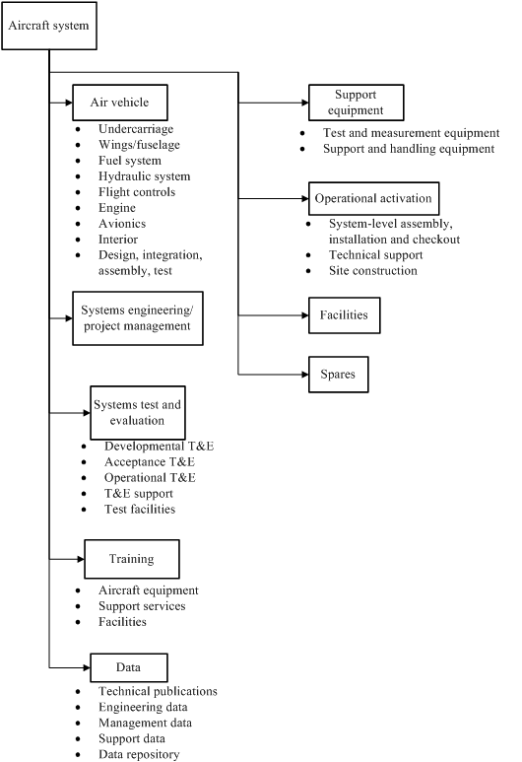
Aircraft System WBS
The RBS framework was grouped by function, whereas the WBS is structured by physical project elements and contains other project-related information.

Slide 26
3. Interface Identification and Design
Critical part of Preliminary Design
Determine successful operation of system once integrated
Place additional limitations and requirements on design of individual subsystems
Interface: Connection resource for hooking to another system’s interface (external interface) or for hooking one system’s component to another (internal interface).

Slide 27
3. Interface Identification and Design
System engineer’s design problems:
Identifying interfaces (ext. and int.)
Allocating items (input and output) to defined interfaces
Requirements for each interface must be derived from existing system-level requirements
Alternative interface architecture alternatives must be examined
Needed functions
Most cost-effective alternative chosen

Slide 28
3. Interface Identification and Design
Interface Design Process
Bounding the interface design problem: Defining components to be addressed, items that are transferred between them, any interfaces that have already been specified
Identify items to be included in the interface of concern
Derive requirements from current requirements specifications (performance, cost, trade-off important)

Slide 29
3. Interface Identification and Design
Interface-control document (ICD): Contains sufficient details to completely define the interfaces between different subsystems
Physical interfaces: Pipe (diameter)
Electronic interfaces: Signal (analog/digital)
Electrical interfaces: Power cable, data cable, voltage
Hydraulic/pneumatic interfaces: Flow rate, pressure
Software interfaces: data between computer software
Environmental interfaces: vibration, acoustics

Slide 30
Class Exercise: Choose 2 subsystems, identify interfaces
SYSTEMS:
Online Library for a University
Internet-based Travel Web Site
Multi-story Parking Garage
Hospital for a Small Community
Two-way Traffic System Across a River

Slide 31
4. Subsystem-Level Synthesis and Evaluation
Review sources of subsystem requirements
Investigate preliminary design alternatives
COTS, modified COTS, developmental items
Make optimal use of design space
Seat size, passenger capacity
Select preferred solution

Slide 32
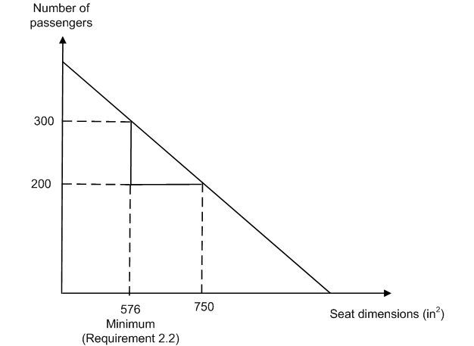
Ex: Design Space for Aircraft
Design Space

Slide 33
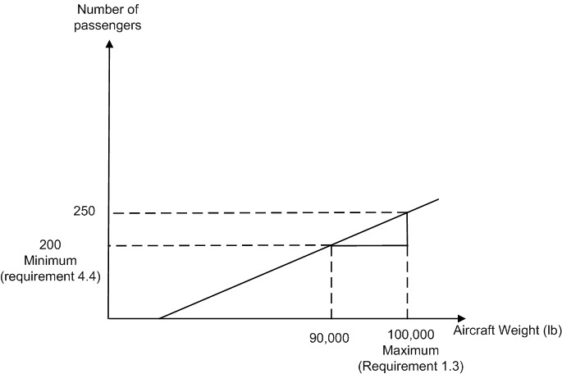
Ex: Design Space for Aircraft
Design Space

Slide 34
5. Preliminary Design Review
Aims:
Evaluation of preliminary design
Approval of development specifications
Assessment of traceability
Adequacy of preliminary design effort before detailed design
Assess technical adequacy of proposed solution in terms of risk
Identification of subsystem interfaces
Conducted only when customer is satisfied

Slide 35
Engineering Design Tools and Technologies
Selection and application of proper analytical models and computer-based tools is crucial
Application of Computer-Aided Tools
Analytical Models and Modeling

Slide 36
1. Application of Computer-Aided Tools
Used to generate drawings, 3D graphic displays, generate materials and parts lists
Computer-aided engineering
Computer-aided design
Computer-aided design data
Computer-aided manufacturing
Computer-aided support
Computer Geometric Modeling
Integrated life-cycle approach is required (Macro-CAD)

Slide 37
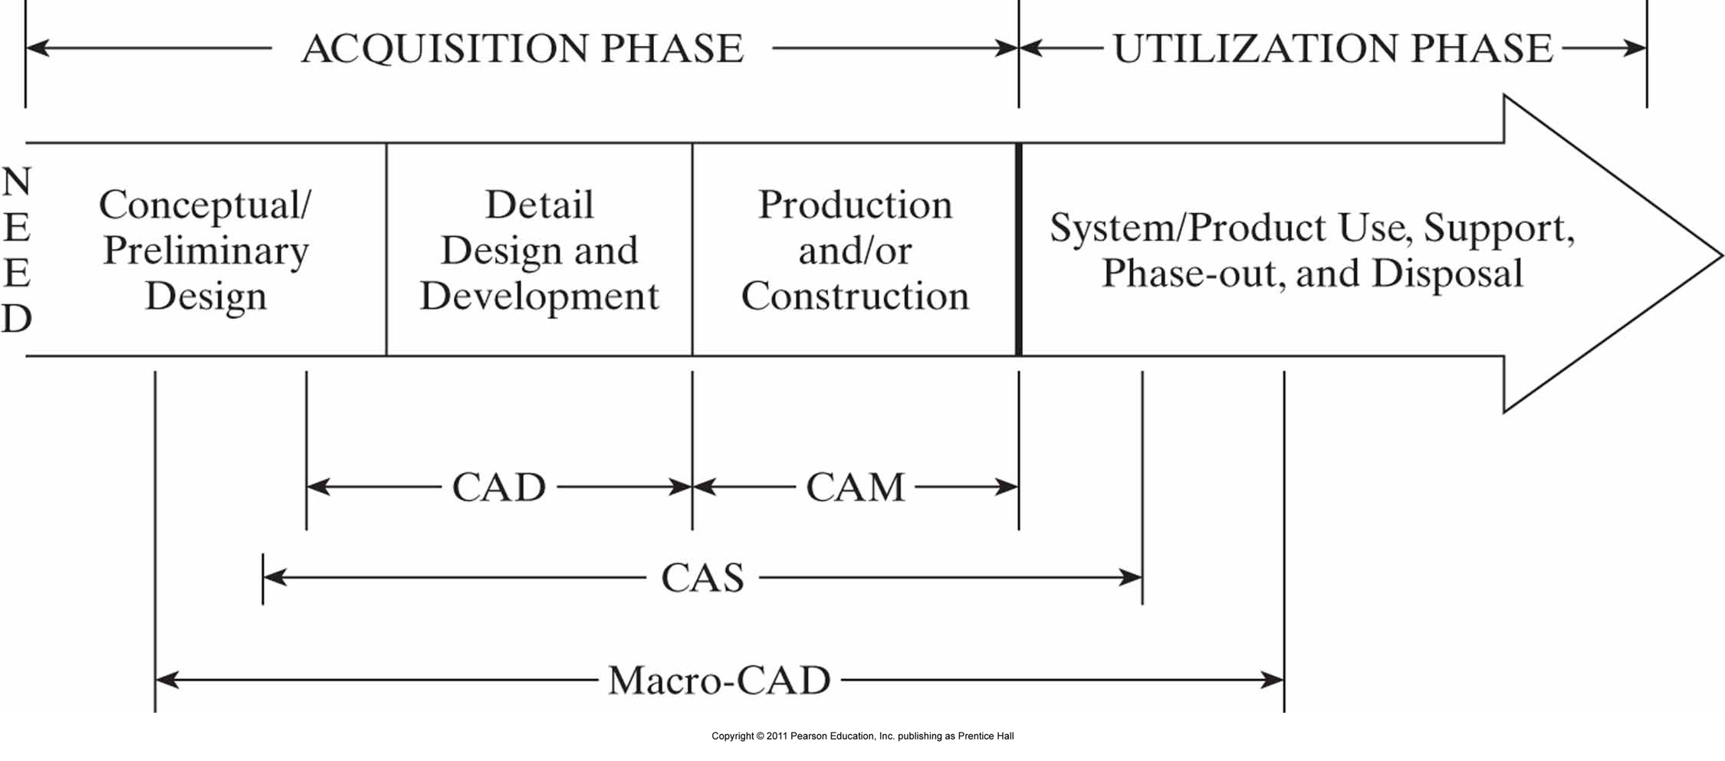
The relationship of CAD, CAM, CAS, and Macro-CAD.

Slide 38
Class Exercise
What are some advantages and disadvantages of computer-aided tools?

Slide 39
2. Analytical Models and Modeling
Model: Simplified representation of real world that abstracts features of the situation relative to the problem being analyzed
We’ll come back to this in Module 8.

Slide 40
Concept
design
Preliminary
system design
Detail design and
development
Production and/or
construction
System operation
and support
Retirement and
phase-out

Slide 41
Questions?

Slide 42
Next Week:
Detailed Design and Development

Slide 43
References
The following references are used to compile the slides for this module:
Blanchard and Fabrycky (2010). Systems Engineering and Analysis (5th Edition). Published by Prentice Hall.
Faulconbridge and Ryan (2003). Managing Complex Technical Projects: A Systems Engineering Approach. Published by Artech House, Inc.
Blanchard (2008). Systems Engineering Management. 4th Ed., Published by Wiley Series
Kossiakoff, Sweet, Seymour and Biemer (2011). Systems Engineering Principles and Practice. Wiley.
INCOSE Systems Engineering Handbook, v.3.2
Buede (2009). The Engineering Design of Systems: Models and Methods. Wiley.
Sage and Armstrong (2000). Introduction to Systems Engineering. Wiley.

