Slide 1
SENG 5130 systems engineering processes Module 6

Slide 2
MODULE 6
System Test, Evaluation and Validation

Slide 3
Objectives of this Module
Systems Engineering Management/SEMP
Risk Management
System Test, Evaluation and Validation

Slide 4
1. Systems Engineering Management

Slide 5
Systems Engineering Management
Systems engineering management focuses on overall effort to be accomplished
“… employs systems engineering principles throughout the management of the process, or product line, efforts that result in a reliable, trustworthy, responsive, and high quality system.” (Sage & Armstrong, 2000, p. x)

Slide 6
Emotional Levels in Poorly Managed Systems Engineering Projects

Slide 7
Management and Technology Applied to the Systems Engineering Process
Concept
design
SE Management
Preliminary
system design
Detail design and
development
Production and/or
construction
SE Technology
System operation
and support
Retirement and
phase-out

Slide 8
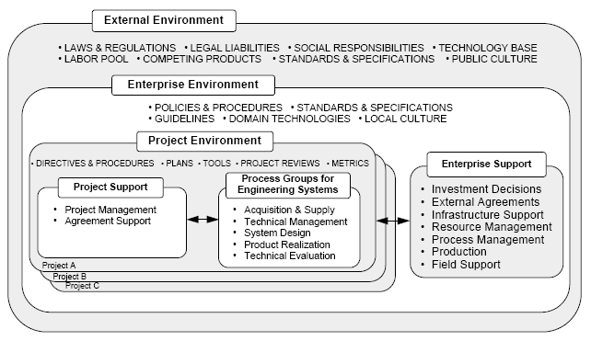
Systems Engineering Management: Contextual Environment
Figure 5.0 from ANSI/EIA-632-1998 Processes for Engineering a System, p. 43

Slide 9
Elements of SEM
Planning
Organizing
Staffing
Directing
Coordinating
Reporting
Budgeting
⇒ To meet customer requirements

Slide 10
System Engineering Management Plan
SEMP

Slide 11
System Engineering Management Plan
Key management document
Contains all activities and milestones
Promotes integration for system design and development
Provides structure, policies, and procedures
Integration of design-related program plans
Provides communication links with other top-level planning documentation

Slide 12
SEMP Example
Florida Department of Transportation SEMP
(File in Blackboard Folder)

Slide 13
SEMP – Generic Approach

Slide 14
Objectives of this Module
Systems Engineering Management/SEMP
Risk Management
System Test, Evaluation and Validation

Slide 15
2. Risk Management

Slide 16
Risk Definition
Risk is the possibility of suffering loss
Definition from the Software Engineering Institute’s Risk Program web site at http://www.sei.cmu.edu/programs/sepm/risk

Slide 17
Risk Definition
Risk is the potential for realization of unwanted, negative consequences of an event.
from Rowe, William D.(1988), Anatomy of Risk, Krieger Publishing Co.

Slide 18
A Comprehensive Risk Definition
Charette states that “for an event, action, thing, etc., to be considered a risk, there must be:
a loss associated with it
uncertainty or chance involved
some choice involved”
from Charette, Robert N. (1989), Software Engineering Risk Analysis and Management, McGraw Hill, p.55

Slide 19
More Risk Definitions
Risk Probability (P): the degree to which the risk event is likely to occur.
Amount at Stake (L): the loss if the outcome is unsatisfactory.
Risk Exposure (RE): the overall liability potential of the risk; the formula for this is:
RE = P x L

Slide 20
Risk Categorization
Risk can be categorized as either:
Internal: within the control of the project manager
External: outside the control of the project manger

Slide 21
Risk Uncertainty Spectrum
Contingency
Budget
Risk Management
Plan
Project
Management Plan
No information
(Unknown Unknowns)
Partial information
(Known Unknowns)
Full information
(Known Knowns)
Realm of Project Management in Managing Risk
Complete
Uncertainty
General
Uncertainty
Specific
Uncertainty
No
Uncertainty

Slide 22
Boehm’s Model Parameters
Risk Identification
Checklists
Decision-driver analysis
Decomposition
Performance models
Cost models
Network analysis
Decision analysis
Quality-factor analysis
Risk exposure
Risk leverage
Compound-risk reduction
Buying information
Risk avoidance
Risk transfer
Risk reduction
Risk-element planning
Risk-plan integration
Prototypes
Simulations
Benchmarks
Analyses
Staffing
Milestone tracking
Top 10 tracking
Risk reassessment
Corrective action
Risk Assessment
Risk Analysis
Risk Prioritization
Risk
Management
Risk Mgt Planning
Risk Control
Risk Resolution
Risk Monitoring
Source: Boehm, B. (1991). "Software Risk Management: Principles and Practices" IEEE Software, 8 (1), 32-41.

Slide 23
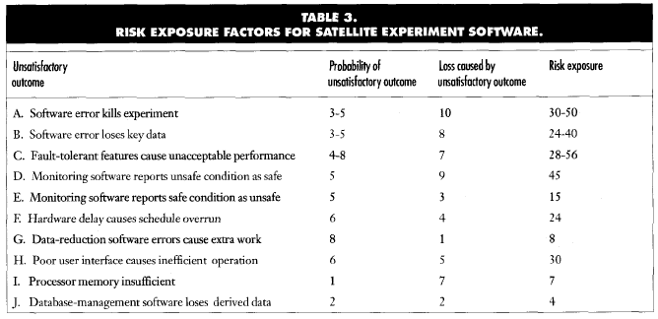
Example: Satellite Experiment Software
Source: Boehm, B. (1991). "Software Risk Management: Principles and Practices" IEEE Software, 8 (1), 32-41.

Slide 24
The Systems Engineering Integration (SEI) Risk Management Model
Identify: Search for all the risks before they become problems adversely affecting your program
Analyze: Process risk data into decision making information
Plan: Translate risk information into decisions and actions (both present and future) and implement those actions
Track: Monitor the risk indicators and actions taken against risks
Control: Correct for deviations from planned risk actions
Communicate: Provide visibility and feedback data internal and external to your program on current and emerging risk activities
from Williams, R., Walker, J. & Dorofee, A. (1997) "Putting Risk Management into Practice" IEEE Software, 14 (3), 75-82.

Slide 25
PMBOK Project Risk Management Model
Project Risk
Management
Risk
Identification
Risk
Quantification
Risk
Response
Development
Risk
Response
Control
from PMI (1996). A Guide to the Project Management Body of Knowledge, p. 112

Slide 26
Which One?
Okay, fine, but
which one do
I use?
Project Risk
Management
Risk
Identification
Risk
Quantification
Risk
Response
Development
Risk
Response
Control
Answer: Any one, just do it!

Slide 27
Risk Identification
Determining which risks are likely to affect the project and documenting the characteristics of each.
Risk identification is not a one-time event; it should be performed on a regular basis throughout the project.
Should address both internal and external risks.
Is concerned with both opportunities and threats

Slide 28
Risk Quantification
Risk Quantification: involves evaluating risks and risk interactions to assess the range of possible outcomes.
Opportunities and threats can interact in unanticipated ways.
A single risk event can cause multiple effects.
Opportunities for one stakeholder may be threats to another
The use of mathematical techniques may create a false impression of precision and reliability.

Slide 29
How to Score Risks
Team members then rate their top three risks on probability of occurrence and severity of outcome using the following table:
Ranking = severity of outcome X probability of occurrence
All project team risks are then tabulated and a prioritized list of project risks is developed

Slide 30
Risk Identification Worksheet

Slide 31
Risk Mitigation
Once the project risks are identified and prioritized a detailed mitigation plan is developed:
develop a list of action items
assign end dates and a responsible person
develop a contingency plan
review plans for economies of scale

Slide 32
Risk Mitigation Worksheet

Slide 33
Class Exercise
Conduct Risk Identification and Mitigation for your system
SYSTEMS:
Online Library for a University
Internet-based Travel Web Site
Multi-story Parking Garage
Hospital for a Small Community
Two-way Traffic System Across a River

Slide 34
Objectives of this Module
Systems Engineering Management/SEMP
Risk Management
System Test, Evaluation and Validation

Slide 35
3. System Test, Evaluation and Validation

Slide 36
System Test & Evaluation
Systems Engineering Management function
Ensures that coordinated and consistent testing effort is applied to the system for the entire life cycle.
Involves both the customer and the contractor
Evaluating the system progressively as it passes through acquisition and utilization phases to avoid last minute modifications
Risk-mitigation measure

Slide 37
System Test, Evaluation and Validation
Validation
Steps and processes needed to ensure that system configuration (as designed) meets all initial customer requirements
Final system validation: system performs effectively and efficiently when operating within associated higher-level SoS configuration

Slide 38
Stages of System Test and Evaluation
When can we have a true system validation?
At the end of the life-cycle
When system is fully operational in user’s environment
Progressive test and evaluation plan
Gain confidence in each step
If a requirement is not met, take corrective action
Waiting until later may be costly!

Slide 39
Process of System Test, Evaluation and Validation
How do I know system-level requirements are met?
What test and evaluation approach should I implement to verify this?
Technical Performance Measures
Test and Evaluation Master Plan (TEMP)

Slide 40
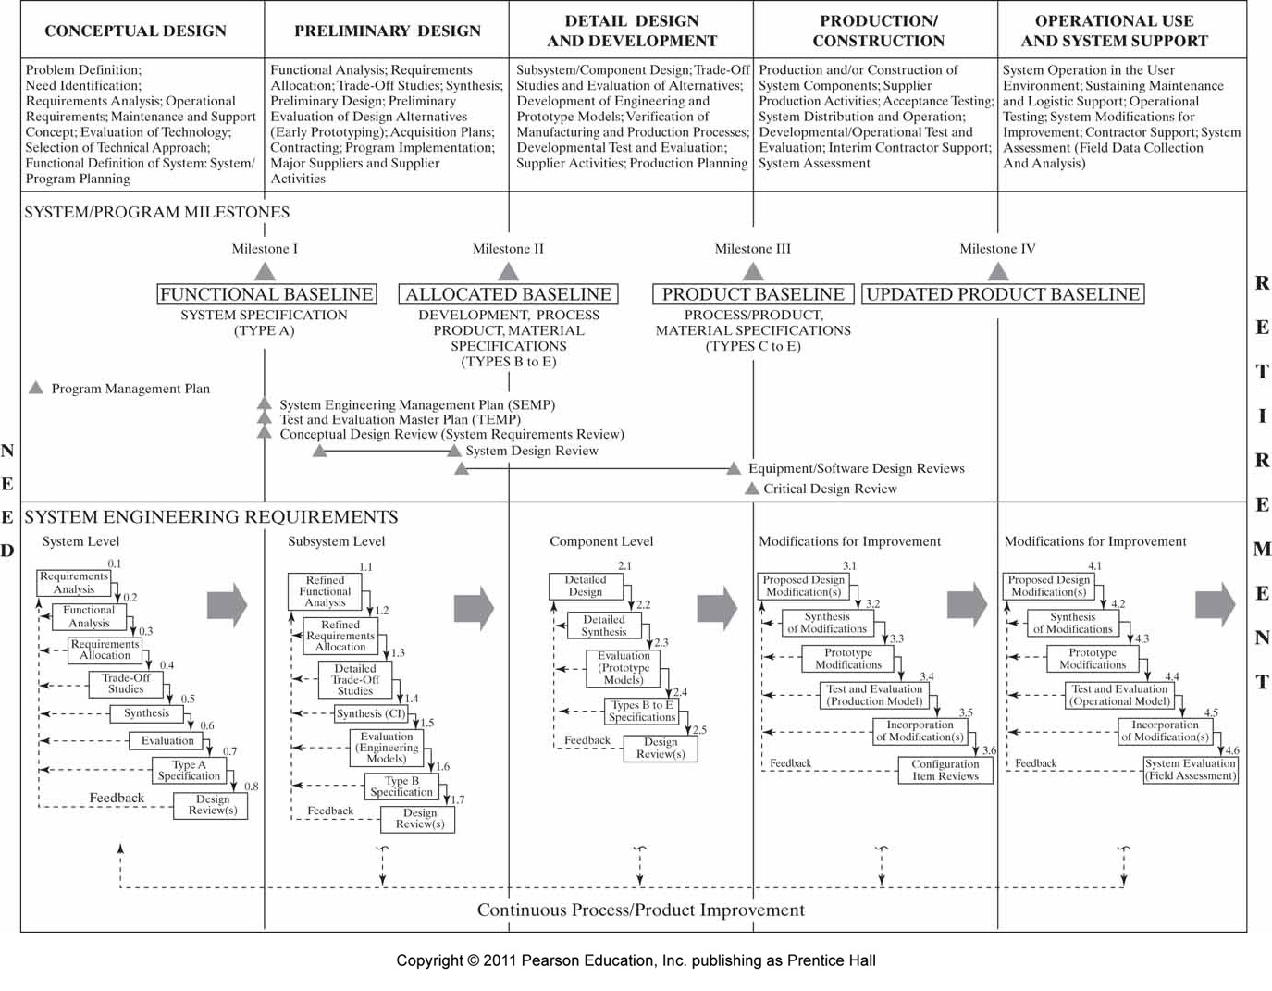
(from chapter 2)

Slide 41
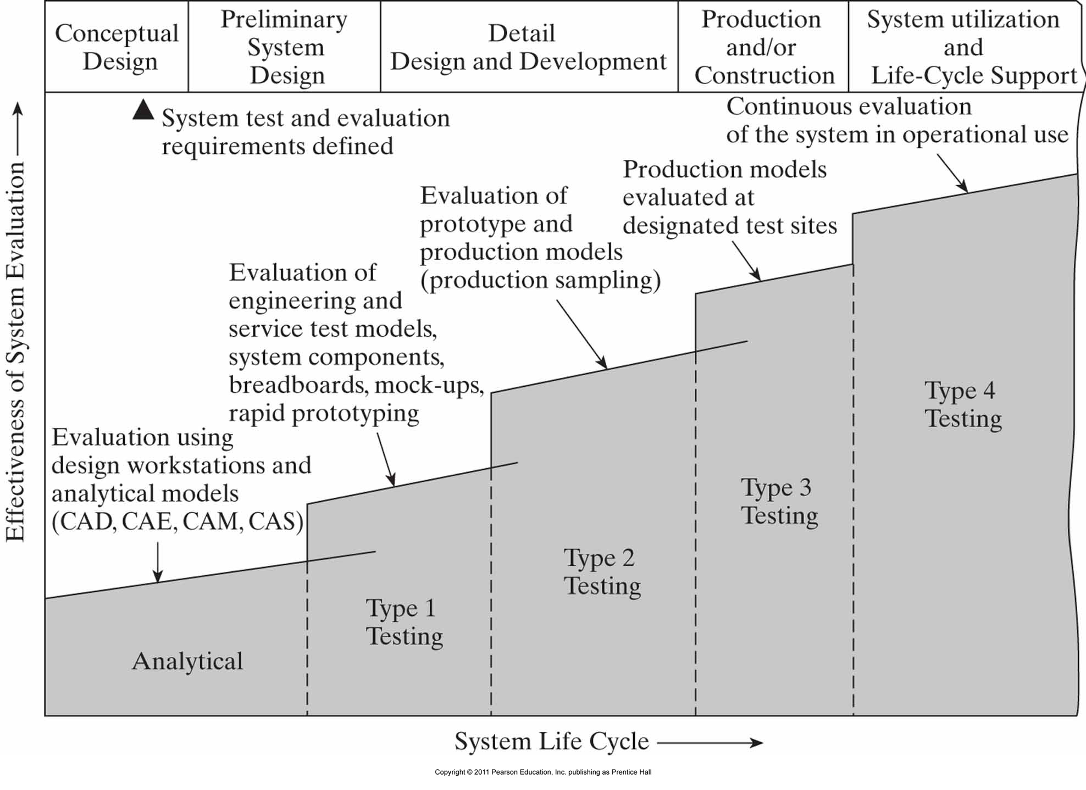
Stages of system test and evaluation during the life cycle.
5
4
3
2
1

Slide 42
1. Analytical Models
Analytical and simulation models are necessary in the initial phase. Why?
Lack of tangible entities
Conceptual phase: Everything is conceptual!
Computer graphics, development of 3D models
Other simulation tools

Slide 43
2. Type 1 Testing
End of preliminary design, initial stages of detailed design
Bench-test models, engineering models, engineering software and service test models
Verify physical design, performance and operational characteristics
Operate functionally (electrically and mechanically) but do not represent production equipment
Rapid prototyping may be used to verify design adequacy

Slide 44
3. Type 2 Testing
Latter stages of detailed design
Formal tests and demonstrations
Performance tests
Environmental qualification (shock and vibration, humidity, etc)
Structural tests (stress, fatigue, etc)
Reliability qualification (determine MTBF)
Maintainability
Personnel test and evaluation
Supply chain
Sampling tests when multiple quantities are produced

Slide 45
4. Type 3 Testing
Before completing Production/Construction
By user personnel at operational test site
Operational test and support equipment
Operational software
Formal system operating and maintenance procedures
First time in lifecycle where all elements of system can be operated and evaluated

Slide 46
5. Type 4 Testing
During system utilization and support phase
Evaluate alternative support policies
Whether availability can be improved
Select a different supply chain?
First time assessing true capability

Slide 47
Class Exercise
Identify specific tests you would conduct for all phases of your system life cycle.
SYSTEMS:
Online Library for a University
Internet-based Travel Web Site
Multi-story Parking Garage
Hospital for a Small Community
Two-way Traffic System Across a River

Slide 48
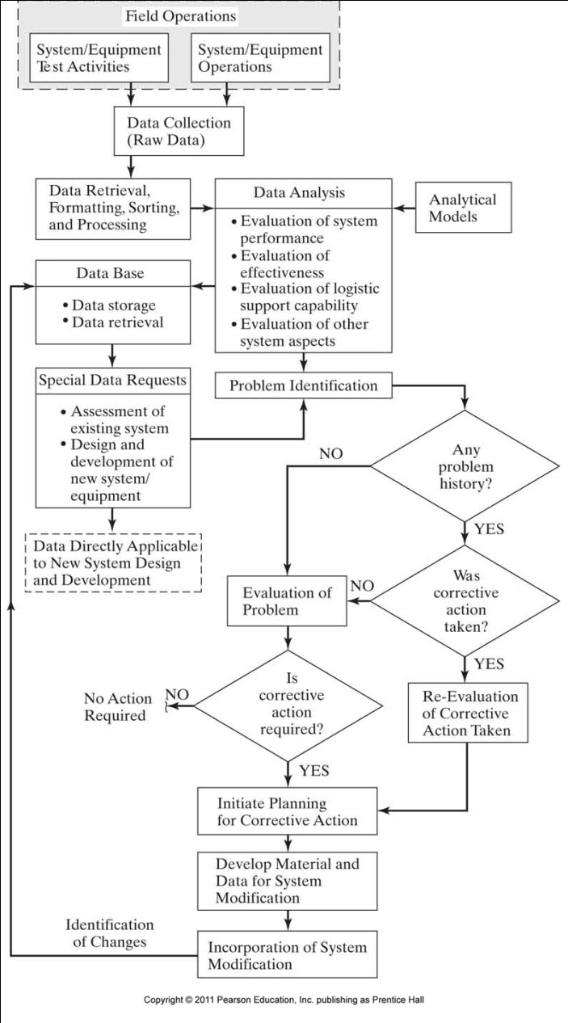
System evaluation and corrective action loop

Slide 49
Questions?

Slide 50
References
The following references are used to compile the slides for this module:
Blanchard and Fabrycky (2010). Systems Engineering and Analysis (5th Edition). Published by Prentice Hall.
Faulconbridge and Ryan (2003). Managing Complex Technical Projects: A Systems Engineering Approach. Published by Artech House, Inc.
Blanchard (2008). Systems Engineering Management. 4th Ed., Published by Wiley Series
Kossiakoff, Sweet, Seymour and Biemer (2011). Systems Engineering Principles and Practice. Wiley.
INCOSE Systems Engineering Handbook, v.3.2
Buede (2009). The Engineering Design of Systems: Models and Methods. Wiley.
Sage and Armstrong (2000). Introduction to Systems Engineering. Wiley.

