Slide 1
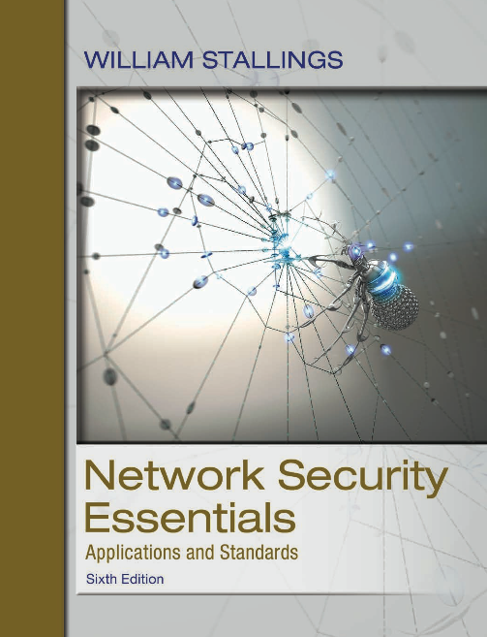
Network Security Essentials
Sixth Edition
by William Stallings
Notes:
Lecture slides prepared for “Network Security Essentials”, 6/e, by William Stallings, Chapter 11 – “Intruders”.

Slide 2
Chapter 11
Intrusion Detection
Type of intrusions
Type of intruders
Statistical anomaly detection
Rule-based anomaly detection
Distributed Intrusion Detection
Honeypots, Honeynets
Notes:
A significant security problem for networked systems is hostile, or at least unwanted,
trespass by users or software. User trespass can take the form of unauthorized logon
to a machine or, in the case of an authorized user, acquisition of privileges or performance
of actions beyond those that have been authorized. Software trespass can take
the form of a virus, worm, or Trojan horse.
All these attacks relate to network security because system entry can be achieved
by means of a network. However, these attacks are not confined to network-based
attacks. A user with access to a local terminal may attempt trespass without using an
intermediate network. A virus or Trojan horse may be introduced into a system by
means of an optical disc. Only the worm is a uniquely network phenomenon. Thus,
system trespass is an area in which the concerns of network security and computer
security overlap.
Because the focus of this book is network security, we do not attempt a comprehensive
analysis of either the attacks or the security countermeasures related to system
trespass. Instead, in this Part we present a broad overview of these concerns.
This chapter covers the subject of intruders. First, we examine the nature of the
attack and then look at strategies intended for prevention and, failing that, detection.
Next we examine the related topic of password management.

Slide 3
Intruders
Three classes of intruders (or intrusion activities):
Masquerader
An individual who is not authorized to use the computer and who penetrates a system’s access controls to exploit a legitimate user’s account
Misfeasor
A legitimate user who accesses data, programs, or resources for which such access is not authorized, or who is authorized for such access but misuses his or her privileges
Clandestine user
An individual who seizes supervisory control of the system and uses this control to evade auditing and access controls or to suppress audit collection
Notes:
One of the two most publicized threats to security is the intruder (the other is
viruses), often referred to as a hacker or cracker. In an important early study of
intrusion, Anderson [ANDE80] identified three classes of intruders:
• Masquerader: An individual who is not authorized to use the computer and
who penetrates a system’s access controls to exploit a legitimate user’s account
• Misfeasor: A legitimate user who accesses data, programs, or resources for
which such access is not authorized, or who is authorized for such access but
misuses his or her privileges
• Clandestine user: An individual who seizes supervisory control of the system
and uses this control to evade auditing and access controls or to suppress audit
collection
The masquerader is likely to be an outsider, the misfeasor generally is an insider,
and the clandestine user can be either an outsider or an insider.

Slide 4
Examples of Intrusion
Performing a remote root compromise of an e-mail server
Defacing a Web server
Guessing and cracking passwords
Copying a database containing credit card numbers
Viewing sensitive data, including payroll records and medical information, without authorization
Running a packet sniffer on a workstation to capture usernames and passwords
Using a permission error on an anonymous FTP server to distribute pirated software and music files
Dialing into an unsecured modem and gaining internal network access
Posing as an executive, calling the help desk, resetting the executive’s e-mail password, and learning the new password
Using an unattended, logged-in workstation without permission
Notes:
Intruder attacks range from the benign to the serious. At the benign end of the
scale, there are many people who simply wish to explore internets and see what is
out there. At the serious end are individuals who are attempting to read privileged
data, perform unauthorized modifications to data, or disrupt the system.
[GRAN04] lists the following examples of intrusion:
• Performing a remote root compromise of an e-mail server
• Defacing a Web server
• Guessing and cracking passwords
• Copying a database containing credit card numbers
• Viewing sensitive data, including payroll records and medical information,
without authorization
• Running a packet sniffer on a workstation to capture usernames and passwords
• Using a permission error on an anonymous FTP server to distribute pirated
software and music files
• Dialing into an unsecured modem and gaining internal network access
• Posing as an executive, calling the help desk, resetting the executive’s e-mail
password, and learning the new password
• Using an unattended, logged-in workstation without permission

Slide 5
Types of intruders
Traditional Hackers (aka benign intruders)
  Traditionally, those who hack into computers do so for the thrill of it or for status.
  Intrusion detection systems (IDSs) and intrusion prevention systems (IPSs) are designed to counter hacker threats.
    In addition to using such systems, organizations can consider restricting remote logons to specific IP addresses and/or use virtual private network technology.
Criminal Hackers
Inside Attackers
Notes:
Traditionally, those who hack into computers do so for the thrill
of it or for status. The hacking community is a strong meritocracy in which status
is determined by level of competence. Thus, attackers often look for targets
of opportunity and then share the information with others. A typical example is a
break-in at a large financial institution reported in [RADC04]. The intruder took
advantage of the fact that the corporate network was running unprotected services,
some of which were not even needed. In this case, the key to the break-in was the
pcAnywhere application. The manufacturer, Symantec, advertises this program as
a remote control solution that enables secure connection to remote devices. But the
attacker had an easy time gaining access to pcAnywhere; the administrator used the
same three-letter username and password for the program. In this case, there was
no intrusion detection system on the 700-node corporate network. The intruder was
only discovered when a vice-president walked into her office and saw the cursor
moving files around on her Windows workstation.
Benign intruders might be tolerable, although they do consume resources and
may slow performance for legitimate users. However, there is no way in advance to
know whether an intruder will be benign or malign. Consequently, even for systems
with no particularly sensitive resources, there is a motivation to control this problem.
Intrusion detection systems (IDSs) and intrusion prevention systems (IPSs)
are designed to counter this type of hacker threat. In addition to using such systems,
organizations can consider restricting remote logons to specific IP addresses and/or
use virtual private network technology.

Slide 6
Collections of vulnerabilities
- National vulnerability database (NVD), CERT, …
NIST NVD: https://nvd.nist.gov/
CERTs (Computer emergency response teams)
  These cooperative ventures collect information about system vulnerabilities and disseminate it to systems managers.
  Hackers also routinely read CERT reports.
  It is important for system administrators to quickly insert all software patches to discovered vulnerabilities.
Notes:
One of the results of the growing awareness of the intruder problem has been
the establishment of a number of computer emergency response teams (CERTs).
These cooperative ventures collect information about system vulnerabilities and disseminate
it to systems managers. Hackers also routinely read CERT reports. Thus,
it is important for system administrators to quickly insert all software patches to
discovered vulnerabilities. Unfortunately, given the complexity of many IT systems,
and the rate at which patches are released, this is increasingly difficult to achieve
without automated updating. Even then, there are problems caused by incompatibilities
resulting from the updated software. Hence the need for multiple layers of
defense in managing security threats to IT systems.

Slide 7
CERT/CC
The CERT Coordination Center (CERT/CC) is the coordination center of the computer emergency response team (CERT) for the Software Engineering Institute (SEI), a non-profit United States federally funded research and development center.
The CERT/CC researches software bugs that impact software and internet security, publishes research and information on its findings, and works with business and government to improve security of software and the internet as a whole. (https://en.wikipedia.org/wiki/CERT_Coordination_Center)
  https://www.sei.cmu.edu/about/divisions/cert/
Vulnerability Notes Database: https://www.kb.cert.org/vuls/

Slide 8
Criminal hackers
Organized groups of hackers
  Sponsored by criminal organizations, nations, states
Usually have specific targets, or at least classes of targets in mind
Once a site is penetrated, the attacker acts quickly, scooping up as much valuable information as possible and exiting.
IDSs and IPSs can be used for these types of attackers, but may be less effective because of the quick in-and-out nature of the attack.
Notes:
Organized groups of hackers have become a widespread and common
threat to Internet-based systems. These groups can be in the employ of a corporation
or government but often are loosely affiliated gangs of hackers. Typically, these gangs
are young, often Eastern European, Russian, or southeast Asian hackers who do
business on the Web [ANTE06]. They meet in underground forums with names like
DarkMarket.org and theftservices.com to trade tips and data and coordinate attacks.
A common target is a credit card file at an e-commerce server. Attackers attempt to
gain root access. The card numbers are used by organized crime gangs to purchase
expensive items and are then posted to carder sites, where others can access and use
the account numbers; this obscures usage patterns and complicates investigation.
Whereas traditional hackers look for targets of opportunity, criminal hackers
usually have specific targets, or at least classes of targets in mind. Once a site
is penetrated, the attacker acts quickly, scooping up as much valuable information as
possible and exiting.
IDSs and IPSs can also be used for these types of attackers, but may be less
effective because of the quick in-and-out nature of the attack. For e-commerce
sites, database encryption should be used for sensitive customer information, especially
credit cards. For hosted e-commerce sites (provided by an outsider service),
the e-commerce organization should make use of a dedicated server (not used to
support multiple customers) and closely monitor the provider’s security services.

Slide 9
Insider Attacks
Among the most difficult to detect and prevent
Can be motivated by revenge or simply a feeling of entitlement
Countermeasures: Q: Any other measures?
Enforce least privilege, only allowing access to the resources employees need to do their job
Set logs to see what users access and what commands they are entering
Protect sensitive resources with strong authentication
Upon termination, delete employee’s computer and network access
Upon termination, make a mirror image of employee’s hard drive before reissuing it (used as evidence if your company information turns up at a competitor
Notes:
Insider attacks are among the most difficult to detect and prevent.
Employees already have access and knowledge about the structure and content of
corporate databases. Insider attacks can be motivated by revenge or simply a feeling
of entitlement. An example of the former is the case of Kenneth Patterson, fired
from his position as data communications manager for American Eagle Outfitters.
Patterson disabled the company’s ability to process credit card purchases during
five days of the holiday season of 2002. As for a sense of entitlement, there have
always been many employees who felt entitled to take extra office supplies for home
use, but this now extends to corporate data. An example is that of a vice-president
of sales for a stock analysis firm who quit to go to a competitor. Before she left, she
copied the customer database to take with her. The offender reported feeling no
animus toward her former employee; she simply wanted the data because it would
be useful to her.
Although IDS and IPS facilities can be useful in countering insider attacks,
other more direct approaches are of higher priority. Examples include the
following:
• Enforce least privilege, only allowing access to the resources employees need
to do their job.
• Set logs to see what users access and what commands they are entering.
• Protect sensitive resources with strong authentication.
• Upon termination, delete employee’s computer and network access.
• Upon termination, make a mirror image of employee’s hard drive before reissuing
it. That evidence might be needed if your company information turns up
at a competitor.
In this section, we look at the techniques used for intrusion. Then we examine
ways to detect intrusion.

Slide 10
Intrusion Techniques
Objective of the intruder is to gain access to a system or to increase the range of privileges accessible on a system.
Most initial attacks use system or software vulnerabilities that allow a user to execute code that opens a backdoor into the system.
Ways to protect a password file:
One-way functioning
The system stores only the value of a function based on the user’s password.
Access control
Access to the password file is limited to one or a very few accounts.
Notes:
The objective of the intruder is to gain access to a system or to increase the range of
privileges accessible on a system. Most initial attacks use system or software vulnerabilities
that allow a user to execute code that opens a backdoor into the system.
Alternatively, the intruder attempts to acquire information that should have been
protected. In some cases, this information is in the form of a user password. With
knowledge of some other user’s password, an intruder can log in to a system and
exercise all the privileges accorded to the legitimate user.
Typically, a system must maintain a file that associates a password with each
authorized user. If such a file is stored with no protection, then it is an easy matter
to gain access to it and learn passwords. The password file can be protected in one
of two ways:
• One-way function: The system stores only the value of a function based on the
user’s password. When the user presents a password, the system transforms
that password and compares it with the stored value. In practice, the system
usually performs a one-way transformation (not reversible), in which the password
is used to generate a key for the one-way function and in which a fixed length
output is produced.
• Access control: Access to the password file is limited to one or a very few
accounts.

Slide 11
Password Guessing
1. Try default passwords used with standard accounts that are shipped with the system. Many administrators do not bother to change these defaults.
2. Exhaustively try all short passwords (those of one to three characters).
3. Try words in the system’s online dictionary or a list of likely passwords.
Examples of the latter are readily available on hacker bulletin boards.
4. Collect information about users, such as their full names, the names of their
spouse and children, pictures in their office, and books in their office that are
related to hobbies.
5. Try users’ phone numbers, Social Security numbers, and room numbers.
6. Try all legitimate license plate numbers for this state.
7. Use a Trojan horse to bypass restrictions on access.
8. Tap the line between a remote user and the host system.
Q: What technique(s) would you use to counter password guessing?
Notes:
On the basis of a survey of the literature
and interviews with a number of password crackers, [ALVA90] reports the following
techniques for learning passwords:
1. Try default passwords used with standard accounts that are shipped with the
system. Many administrators do not bother to change these defaults.
2. Exhaustively try all short passwords (those of one to three characters).
3. Try words in the system’s online dictionary or a list of likely passwords.
Examples of the latter are readily available on hacker bulletin boards.
4. Collect information about users, such as their full names, the names of their
spouse and children, pictures in their office, and books in their office that are
related to hobbies.
5. Try users’ phone numbers, Social Security numbers, and room numbers.
6. Try all legitimate license plate numbers for this state.
7. Use a Trojan horse (described in Chapter 10) to bypass restrictions on access.
8. Tap the line between a remote user and the host system.
The first six methods are various ways of guessing a password. If an intruder has
to verify the guess by attempting to log in, it is a tedious and easily countered means
of attack. For example, a system can simply reject any login after three password attempts,
thus requiring the intruder to reconnect to the host to try again. Under these
circumstances, it is not practical to try more than a handful of passwords. However,
the intruder is unlikely to try such crude methods. For example, if an intruder can gain
access with a low level of privileges to an encrypted password file, then the strategy
would be to capture that file and then use the encryption mechanism of that particular
system at leisure until a valid password that provided greater privileges was discovered.
Guessing attacks are feasible, and indeed highly effective, when a large number
of guesses can be attempted automatically and each guess verified, without the
guessing process being detectable. Later in this chapter, we have much to say about
thwarting guessing attacks.
The seventh method of attack listed earlier, the Trojan horse, can be particularly
difficult to counter. An example of a program that bypasses access controls has
been cited in [ALVA90]. A low-privilege user produced a game program and invited
the system operator to use it in his or her spare time. The program did indeed play a
game, but in the background it also contained code to copy the password file, which
was unencrypted but access protected, into the user’s file. Because the game was
running under the operator’s high-privilege mode, it was able to gain access to the
password file.
The eighth attack listed, line tapping, is a matter of physical security.
Other intrusion techniques do not require learning a password. Intruders can
get access to a system by exploiting attacks such as buffer overflows on a program
that runs with certain privileges. Privilege escalation can be done this way as well.

Slide 12

Intrusion Detection
A system’s second line of defense
Is based on the assumption that the behavior of the intruder differs from that of a legitimate user in ways that can be quantified
Considerations:
  If an intrusion is detected quickly enough, the intruder can be identified and ejected from the system before any damage is done or any data are compromised.
  An effective intrusion detection system can serve as a deterrent, so acting to prevent intrusions.
  Intrusion detection enables the collection of information about intrusion techniques that can be used to strengthen the intrusion prevention facility.
Notes:
Inevitably, the best intrusion prevention system will fail. A system’s second line
of defense is intrusion detection, and this has been the focus of much research in
recent years. This interest is motivated by a number of considerations, including the
following:
1. If an intrusion is detected quickly enough, the intruder can be identified and
ejected from the system before any damage is done or any data are compromised.
Even if the detection is not sufficiently timely to preempt the intruder,
the sooner that the intrusion is detected, the less the amount of damage and
the more quickly that recovery can be achieved.
2. An effective intrusion detection system can serve as a deterrent, so acting to
prevent intrusions.
3. Intrusion detection enables the collection of information about intrusion techniques
that can be used to strengthen the intrusion prevention facility.
Intrusion detection is based on the assumption that the behavior of the
intruder differs from that of a legitimate user in ways that can be quantified. Of
course, we cannot expect that there will be a crisp, exact distinction between an
attack by an intruder and the normal use of resources by an authorized user. Rather,
we must expect that there will be some overlap.

Slide 13
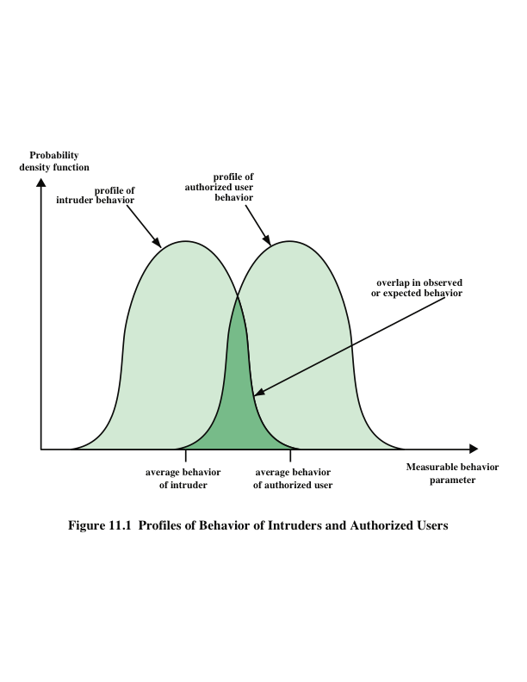
Notes:
Figure 11.1 suggests, in very abstract terms, the nature of the task confronting
the designer of an intrusion detection system. Although the typical behavior of an
intruder differs from the typical behavior of an authorized user, there is an overlap
in these behaviors. Thus, a loose interpretation of intruder behavior, which will catch
more intruders, will also lead to a number of false positives , or authorized users
identified as intruders. On the other hand, an attempt to limit false positives by a
tight interpretation of intruder behavior will lead to an increase in false negatives ,
or intruders not identified as intruders. Thus, there is an element of compromise and
art in the practice of intrusion detection.
In Anderson’s study [ANDE80], it was postulated that one could, with reasonable
confidence, distinguish between a masquerader and a legitimate user. Patterns
of legitimate user behavior can be established by observing past history, and significant
deviation from such patterns can be detected. Anderson suggests that the task
of detecting a misfeasor (legitimate user performing in an unauthorized fashion) is
more difficult, in that the distinction between abnormal and normal behavior may
be small. Anderson concluded that such violations would be undetectable solely
through the search for anomalous behavior. However, misfeasor behavior might
nevertheless be detectable by intelligent definition of the class of conditions that
suggest unauthorized use. Finally, the detection of the clandestine user was felt to
be beyond the scope of purely automated techniques. These observations, which
were made in 1980, remain true today.

Slide 14
Audit Records
A fundamental tool for intrusion detection
Native audit records
Virtually all multiuser operating systems include accounting software that collects information on user activity
The advantage of using this information is that no additional collection software is needed
The disadvantage is that the native audit records may not contain the needed information or may not contain it in a convenient form
Detection-specific audit records
A collection facility can be implemented that generates audit records containing only that information required by the intrusion detection system
One advantage of such an approach is that it could be made vendor independent and ported to a variety of systems
The disadvantage is the extra overhead involved in having two accounting packages running on a machine
Notes:
A fundamental tool for intrusion detection is the audit record. Some record of
ongoing activity by users must be maintained as input to an intrusion detection
system. Basically, two plans are used:
• Native audit records: Virtually all multiuser operating systems include
accounting software that collects information on user activity. The advantage
of using this information is that no additional collection software is needed.
The disadvantage is that the native audit records may not contain the needed
information or may not contain it in a convenient form.
• Detection-specific audit records: A collection facility can be implemented that
generates audit records containing only that information required by the intrusion
detection system. One advantage of such an approach is that it could
be made vendor independent and ported to a variety of systems. The disadvantage
is the extra overhead involved in having, in effect, two accounting
packages running on a machine.

Slide 15
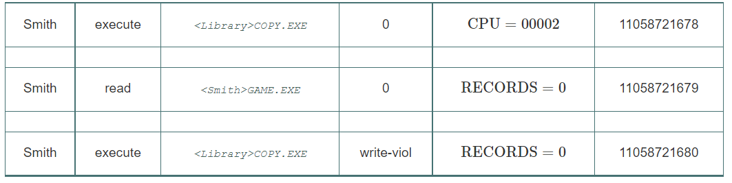
Audit Records (cont.)
An audit record may contain the following fields:
Subject | Action | Object | exception | Resource-usage | Time-stamp
An audit record generated by the user Smith trying to issue the command: copy game.exe to <library>game.exe
Notes:
A fundamental tool for intrusion detection is the audit record. Some record of
ongoing activity by users must be maintained as input to an intrusion detection
system. Basically, two plans are used:
• Native audit records: Virtually all multiuser operating systems include
accounting software that collects information on user activity. The advantage
of using this information is that no additional collection software is needed.
The disadvantage is that the native audit records may not contain the needed
information or may not contain it in a convenient form.
• Detection-specific audit records: A collection facility can be implemented that
generates audit records containing only that information required by the intrusion
detection system. One advantage of such an approach is that it could
be made vendor independent and ported to a variety of systems. The disadvantage
is the extra overhead involved in having, in effect, two accounting
packages running on a machine.

Slide 16
Approaches to Intrusion Detection
Statistical anomaly detection
  Involves the collection of data relating to the behavior of legitimate users over a period of time → thresholds, baseline
  Then statistical tests are applied to observed behavior to determine whether that behavior is not legitimate user behavior.
  Two types of statistical anomaly detection:
    Threshold detection
      This approach involves defining thresholds, independent of user, for the frequency of occurrence of various events.
    Profile based
      A profile of the activity of each user is developed and used to detect changes in the behavior of individual accounts.
Rule-based detection
  Involves an attempt to define a set of rules or attack patterns that can be used to decide that a given behavior is that of an intruder.
  Often referred to as signature detection
Notes:
[PORR92] identifies the following approaches to intrusion detection:
1. Statistical anomaly detection: Involves the collection of data relating to the
behavior of legitimate users over a period of time. Then statistical tests are
applied to observed behavior to determine with a high level of confidence
whether that behavior is not legitimate user behavior.
a. Threshold detection: This approach involves defining thresholds, independent
of user, for the frequency of occurrence of various events.
b. Profile based: A profile of the activity of each user is developed and used to
detect changes in the behavior of individual accounts.
In essence, anomaly approaches attempt to define normal, or expected,
behavior, whereas signature-based approaches attempt to define proper behavior.
In terms of the types of attackers listed earlier, statistical anomaly detection is
effective against masqueraders, who are unlikely to mimic the behavior patterns of
the accounts they appropriate. On the other hand, such techniques may be unable to
deal with misfeasors. For such attacks, rule-based approaches may be able to recognize
events and sequences that, in context, reveal penetration. In practice, a system may exhibit
a combination of both approaches to be effective against a broad range of attacks.

Slide 17
Statistical Anomaly Detection
Threshold detection
  Involves counting the number of occurrences of a specific event type over an interval of time
  If the count surpasses what is considered a reasonable number that one might expect to occur, then intrusion is assumed
  By itself is a crude and ineffective detector of even moderately sophisticated attacks
Profile-based
  Focuses on characterizing the past behavior of individual users or related groups of users and then detecting significant deviations
  A profile may consist of a set of parameters, so that deviation on just a single parameter may not be sufficient in itself to signal an alert
Notes:
As was mentioned, statistical anomaly detection techniques fall into two broad categories:
threshold detection and profile-based systems. Threshold detection involves
counting the number of occurrences of a specific event type over an interval of
time. If the count surpasses what is considered a reasonable number that one might
expect to occur, then intrusion is assumed.
Threshold analysis, by itself, is a crude and ineffective detector of even moderately
sophisticated attacks. Both the threshold and the time interval must be
determined. Because of the variability across users, such thresholds are likely to
generate either a lot of false positives or a lot of false negatives. However, simple
threshold detectors may be useful in conjunction with more sophisticated
techniques.
Profile-based anomaly detection focuses on characterizing the past behavior
of individual users or related groups of users and then detecting significant deviations.
A profile may consist of a set of parameters, so that deviation on just a single
parameter may not be sufficient in itself to signal an alert.
The foundation of this approach is an analysis of audit records. The audit
records provide input to the intrusion detection function in two ways. First, the
designer must decide on a number of quantitative metrics that can be used to measure
user behavior. An analysis of audit records over a period of time can be used to
determine the activity profile of the average user. Thus, the audit records serve to
define typical behavior. Second, current audit records are the input used to detect
intrusion. That is, the intrusion detection model analyzes incoming audit records to
determine deviation from average behavior.

Slide 18
Profile-based intrusion detection
Example metrics
  Counter: a count of certain event type over a particular period of time
    e.g., the number of logins by a single user during an hour
  Gauge: a number used to measure the current value of some entity
  e.g., the number of outgoing messages queued for a user process
  Interval timer: the length of time between two related events
    e.g., the length of time between successive logins to an account
  Resource utilization: Quantity of resources consumed during a specified period
  e.g., the total time consumed by a program execution
  EX: Come up with one additional metric for each example type.

Slide 19
Profile-based intrusion detection (cont.)
Example statistical tests/models to be applied to those metrics:
  Mean and standard deviation
    - to measure the average behavior and its variability
  Multivariate calculation
  - to determine a correlate between two or more variables
  Markov process
    - to estimate transition probabilities among various states
  Time series
  - to calculate values based on a sequence of events over time
  Operational model
    - to characterize what is considered abnormal, as opposed to performing an automated analysis of past audit records

Slide 20
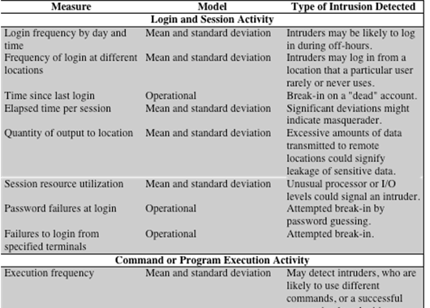
Table 11.1 Measures That May Be Used For Intrusion Detection (A)
Notes:
As an example of the use of these various metrics and models, Table 11.1
shows various measures considered or tested for the Stanford Research Institute
(SRI) Intrusion Detection System (IDES) [ANDE95, JAVI91] and the follow-on
program Emerald [NEUM99].
The main advantage of the use of statistical profiles is that a prior knowledge
of security flaws is not required. The detector program learns what is “normal” behavior
and then looks for deviations. The approach is not based on system-dependent
characteristics and vulnerabilities. Thus, it should be readily portable among a
variety of systems.

Slide 21
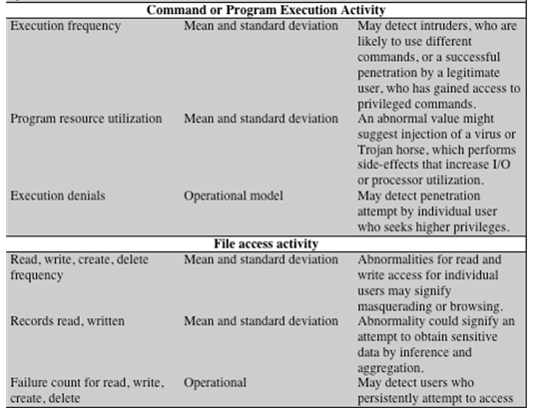
Table 11.1 Measures That May Be Used For Intrusion Detection (B)
Notes:
As an example of the use of these various metrics and models, Table 11.1
shows various measures considered or tested for the Stanford Research Institute
(SRI) Intrusion Detection System (IDES) [ANDE95, JAVI91] and the follow-on
program Emerald [NEUM99].
The main advantage of the use of statistical profiles is that a prior knowledge
of security flaws is not required. The detector program learns what is “normal” behavior
and then looks for deviations. The approach is not based on system-dependent
characteristics and vulnerabilities. Thus, it should be readily portable among a
variety of systems.

Slide 22
Rule-Based Intrusion Detection
Techniques that detect intrusion by observing events in the system and applying a set of rules that lead to a decision regarding whether a given pattern of activity is or is not suspicious. if … then …
Rule-based anomaly detection
  Is similar in terms of its approach and strengths to statistical anomaly detection. c.f.,
    A statistical anomaly detection (aka anomaly-based) IDS focuses on identifying deviations from normal behavior within a network or system.
    A rule-based (aka signature-based) IDS relies on a predefined database of attack signatures to identify malicious activity.
  Historical audit records are analyzed to identify usage patterns and to automatically generate rules that describe those patterns.
  Current behavior is then observed, and each transaction is matched against the set of rules to determine if it conforms to any historically observed pattern of behavior.
  In order for this approach to be effective, a rather large database of rules will be needed.
Notes:
Rule-based techniques detect intrusion by observing events in the system and applying
a set of rules that lead to a decision regarding whether a given pattern of activity
is or is not suspicious. In very general terms, we can characterize all approaches as
focusing on either anomaly detection or penetration identification, although there is
some overlap in these approaches.
Rule-based anomaly detection is similar in terms of its approach and strengths
to statistical anomaly detection. With the rule-based approach, historical audit
records are analyzed to identify usage patterns and to automatically generate rules
that describe those patterns. Rules may represent past behavior patterns of users,
programs, privileges, time slots, terminals, and so on. Current behavior is then
observed, and each transaction is matched against the set of rules to determine if it
conforms to any historically observed pattern of behavior.
As with statistical anomaly detection, rule-based anomaly detection does not
require knowledge of security vulnerabilities within the system. Rather, the scheme
is based on observing past behavior and, in effect, assuming that the future will be
like the past. In order for this approach to be effective, a rather large database of
rules will be needed.

Slide 23
Rule-Based Intrusion Detection
Rule-based penetration identification
  Using rules to identify known penetrations or penetrations that would exploit known weaknesses
  Typically, the rules used in these systems are specific to the machine and operating system.
  The most fruitful approach to developing such rules is to analyze attack tools and scripts collected on the Internet.
  These rules can be supplemented with rules generated by knowledgeable security personnel (that is, heuristic rules).
    Example heuristics:
      Expected activity: A user logs in after hours and accesses the same file he or she accessed during business hours.
      Suspicious activity: A user opens a disk devices directly rather than relying on higher-level operating system utilities.
Notes:
Rule-based penetration identification takes a very different approach to
intrusion detection. The key feature of such systems is the use of rules for identifying
known penetrations or penetrations that would exploit known weaknesses.
Rules can also be defined that identify suspicious behavior, even when the behavior
is within the bounds of established patterns of usage. Typically, the rules
used in these systems are specific to the machine and operating system. The most
fruitful approach to developing such rules is to analyze attack tools and scripts
collected on the Internet. These rules can be supplemented with rules generated
by knowledgeable security personnel. In this latter case, the normal procedure
is to interview system administrators and security analysts to collect a suite of
known penetration scenarios and key events that threaten the security of the
target system.
The penetration identification scheme used in IDES is representative of the
strategy followed. Audit records are examined as they are generated, and they are
matched against the rule base. If a match is found, then the user’s suspicion rating
is increased. If enough rules are matched, then the rating will pass a threshold that
results in the reporting of an anomaly.
The IDES approach is based on an examination of audit records. A weakness
of this plan is its lack of flexibility. For a given penetration scenario, there may
be a number of alternative audit record sequences that could be produced, each
varying from the others slightly or in subtle ways. It may be difficult to pin down
all these variations in explicit rules. Another method is to develop a higher-level
model independent of specific audit records. An example of this is a state transition
model known as USTAT [VIGN02, ILGU95]. USTAT deals in general actions
rather than the detailed specific actions recorded by the UNIX auditing mechanism.
USTAT is implemented on a SunOS system that provides audit records on
239 events. Of these, only 28 are used by a preprocessor, which maps these onto 10
general actions (Table 11.2). Using just these actions and the parameters that are
invoked with each action, a state transition diagram is developed that characterizes
suspicious activity. Because a number of different auditable events map into a
smaller number of actions, the rule-creation process is simpler. Furthermore, the
state transition diagram model is easily modified to accommodate newly learned
intrusion behaviors.

Slide 24
Rule-Based Intrusion Detection
  USTAT - a real-time intrusion detection system
  “The University of California, Santa Barbara's State Transition Analysis Tool for UNIX” (source: [Ilgun, 1993])
  A state transition model independent of specific audit records
  Deals in general actions rather than the detailed specific actions recorded by the UNIX auditing mechanism
  Implemented on a SunOS system that provides audit records on 239 events
  Events are mapped to 10 general actions (Table 11.2)
  From https://ieeexplore.ieee.org/document/287646:
    In STAT (1992), a penetration is identified as a sequence of state changes that take the computer system from some initial state to a target compromised state.
    USTAT is a UNIX-specific implementation based on the generic design of STAT.
Notes:
Source of USTAT: https://www.semanticscholar.org/paper/USTAT%3A-a-real-time-intrusion-detection-system-for-Ilgun/b6886408c9d0fe97dc728306d0e5c116db7c6814#:~:text=The%20author%20presents%20the%20design%20and%20implementation,a%20state%20transition%20analysis%20tool%20for%20UNIX%2C
Rule-based penetration identification takes a very different approach to
intrusion detection. The key feature of such systems is the use of rules for identifying
known penetrations or penetrations that would exploit known weaknesses.
Rules can also be defined that identify suspicious behavior, even when the behavior
is within the bounds of established patterns of usage. Typically, the rules
used in these systems are specific to the machine and operating system. The most
fruitful approach to developing such rules is to analyze attack tools and scripts
collected on the Internet. These rules can be supplemented with rules generated
by knowledgeable security personnel. In this latter case, the normal procedure
is to interview system administrators and security analysts to collect a suite of
known penetration scenarios and key events that threaten the security of the
target system.
The penetration identification scheme used in IDES is representative of the
strategy followed. Audit records are examined as they are generated, and they are
matched against the rule base. If a match is found, then the user’s suspicion rating
is increased. If enough rules are matched, then the rating will pass a threshold that
results in the reporting of an anomaly.
The IDES approach is based on an examination of audit records. A weakness
of this plan is its lack of flexibility. For a given penetration scenario, there may
be a number of alternative audit record sequences that could be produced, each
varying from the others slightly or in subtle ways. It may be difficult to pin down
all these variations in explicit rules. Another method is to develop a higher-level
model independent of specific audit records. An example of this is a state transition
model known as USTAT [VIGN02, ILGU95]. USTAT deals in general actions
rather than the detailed specific actions recorded by the UNIX auditing mechanism.
USTAT is implemented on a SunOS system that provides audit records on
239 events. Of these, only 28 are used by a preprocessor, which maps these onto 10
general actions (Table 11.2). Using just these actions and the parameters that are
invoked with each action, a state transition diagram is developed that characterizes
suspicious activity. Because a number of different auditable events map into a
smaller number of actions, the rule-creation process is simpler. Furthermore, the
state transition diagram model is easily modified to accommodate newly learned
intrusion behaviors.

Slide 25
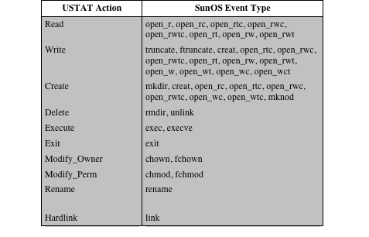
Table 11.2
USTAT Actions versus SunOS Event Types
Notes:
USTAT Actions versus SunOS Event Types

Slide 26
Rule-Based Intrusion Detection
- Base-Rate Fallacy
c.f., false negatives vs false positives
To be of practical use, an intrusion detection system should detect a substantial percentage of intrusions while keeping the false alarm rate at an acceptable level.
  If only a modest percentage of actual intrusions are detected, the system provides a false sense of security. ← high ‘false negatives’
  If the system frequently triggers an alert when there is no intrusion, then either system managers will begin to ignore the alarms or much time will be wasted analyzing the false alarms. ← high ‘false positives’
Because of the nature of the probabilities involved, it is very difficult to meet the standard of high rate of detections with a low rate of false alarms.
  The base-rate fallacy phenomenon: If the actual numbers of intrusions is low compared to the number of legitimate uses of a system, then the false alarm rate will be high unless the test is extremely discriminating.
  [AXEL00] indicated that current systems have not overcome the problem of the base-rate fallacy.
Notes:
To be of practical use, an intrusion detection system should detect a substantial
percentage of intrusions while keeping the false alarm rate at an acceptable
level. If only a modest percentage of actual intrusions are detected, the system
provides a false sense of security. On the other hand, if the system frequently
triggers an alert when there is no intrusion (a false alarm), then either system
managers will begin to ignore the alarms or much time will be wasted analyzing
the false alarms.
Unfortunately, because of the nature of the probabilities involved, it is very difficult
to meet the standard of high rate of detections with a low rate of false alarms.
In general, if the actual numbers of intrusions is low compared to the number of
legitimate uses of a system, then the false alarm rate will be high unless the test is
extremely discriminating. This is an example of a phenomenon known as the base rate
fallacy . A study of existing intrusion detection systems, reported in [AXEL00],
indicated that current systems have not overcome the problem of the base-rate fallacy.
See Appendix J for a brief background on the mathematics of this problem.

Slide 27
BAse rate fallacy
(base rate neglect, base rate bias)
Source: Investopedia
Base rate fallacy, or base rate neglect, is a cognitive error whereby too little weight is placed on the base, or original rate, of possibility (e.g., the probability of A given B).
    In behavioral finance, base rate fallacy is the tendency for people to erroneously judge the likelihood of a situation by not taking into account all relevant data.
    Instead, investors might focus more heavily on new information without acknowledging how this impacts original assumptions.
    e.g., Investors may focus on recent news or company-specific details, instead of considering market trends and historical data.
Other examples of ‘base rate fallacy’?
  Medical misdiagnoses: over-diagnosing rare conditions while overlooking common ones
  Overestimating dramatic events (like airplane crashes) while underestimating more common risks (like car accidents)

Slide 28
False positive paradox
Source: Wikipedia
An example of the base rate fallacy is the false positive paradox (also known as accuracy paradox).
This paradox describes situations where there are more false positive test results than true positives (this means the classifier has a low precision).

Slide 29
Distributed Intrusion Detection
Traditional systems focused on single-system stand-alone facilities.
  The typical organization, however, needs to defend a distributed collection of hosts supported by a LAN or internetwork.
  A more effective defense can be achieved by coordination and cooperation among intrusion detection systems across the network.
Major design issues:
A distributed intrusion detection system may need to deal with different audit record formats.
Data security: One or more nodes in the network will serve as collection and analysis points for the data from the systems on the network.
Either a centralized or decentralized architecture can be used.
Notes:
Traditionally, work on intrusion detection systems focused on single-system standalone
facilities. The typical organization, however, needs to defend a distributed
collection of hosts supported by a LAN or internetwork. Although it is possible to
mount a defense by using stand-alone intrusion detection systems on each host, a
more effective defense can be achieved by coordination and cooperation among
intrusion detection systems across the network.
Porras points out the following major issues in the design of a distributed
intrusion detection system [PORR92]:
• A distributed intrusion detection system may need to deal with different
audit record formats. In a heterogeneous environment, different systems will
employ different native audit collection systems and, if using intrusion
detection, may employ different formats for security-related audit records.
• One or more nodes in the network will serve as collection and analysis points
for the data from the systems on the network. Thus, either raw audit data or
summary data must be transmitted across the network. Therefore, there is a
requirement to assure the integrity and confidentiality of these data. Integrity
is required to prevent an intruder from masking his or her activities by altering
the transmitted audit information. Confidentiality is required because the
transmitted audit information could be valuable.
• Either a centralized or decentralized architecture can be used. With a centralized
architecture, there is a single central point of collection and analysis of all
audit data. This eases the task of correlating incoming reports but creates a
potential bottleneck and single point of failure. With a decentralized architecture,
there are more than one analysis centers, but these must coordinate their
activities and exchange information.

Slide 30
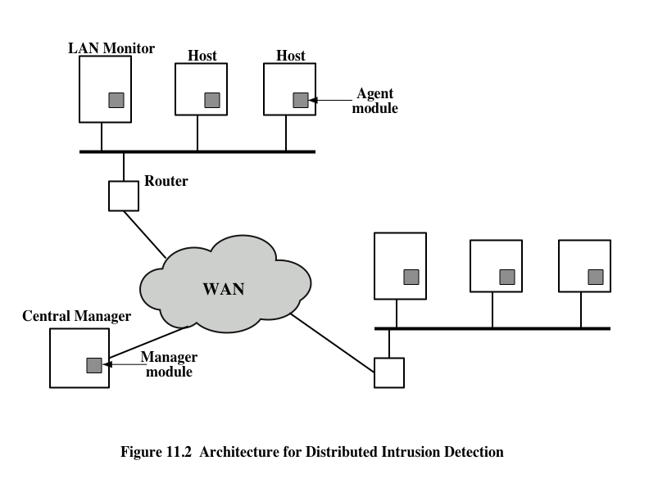
Host agent module
  Runs on a monitored host
  Collects data on security –related events on the host and transmit those data to the central manager
Lan monitor agent module
  Analyses LAN traffic and reports the results to the central manager.
Central manager module
  Receives reports from LAN monitor and host agents
  Processes and correlates those reports to detect intrusion
Notes:
A good example of a distributed intrusion detection system is one developed
at the University of California at Davis [HEBE92, SNAP91]. A similar approach
has been taken for a project at Purdue [SPAF00, BALA98]. Figure 11.2 shows the
overall architecture, which consists of three main components:
• Host agent module: An audit collection module operating as a background
process on a monitored system. Its purpose is to collect data on security related
events on the host and transmit these to the central manager.
• LAN monitor agent module: Operates in the same fashion as a host agent
module except that it analyzes LAN traffic and reports the results to the central
manager.
• Central manager module: Receives reports from LAN monitor and host
agents, and processes and correlates these reports to detect intrusion.

Slide 31
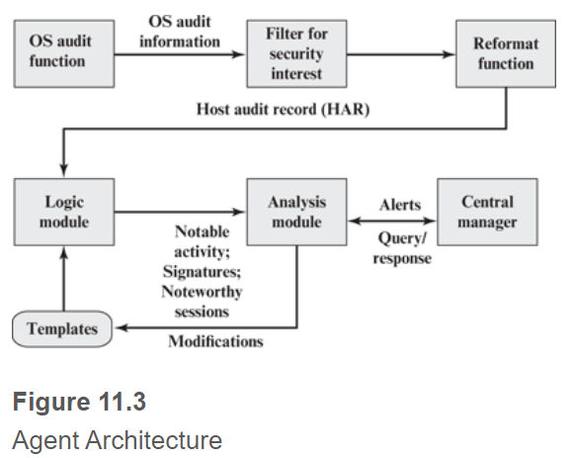
At the lowest level, the agent scans for notable events that are of interest independent of any past events.
  Examples include failed file accesses, accessing system files, and changing a file’s access control.
At the next higher level, the agent looks for sequences of events, such as known attack patterns (signatures).
Finally, the agent looks for anomalous behavior of an individual user based on a historical profile of that user, such as number of programs executed, number of files accessed, and the like.
Notes:
The scheme is designed to be independent of any operating system or system
auditing implementation. Figure 11.3 shows the general approach that is taken. The
agent captures each audit record produced by the native audit collection system. A
filter is applied that retains only those records that are of security interest. These
records are then reformatted into a standardized format referred to as the host
audit record (HAR). Next, a template-driven logic module analyzes the records for
suspicious activity. At the lowest level, the agent scans for notable events that are
of interest independent of any past events. Examples include failed file accesses,
accessing system files, and changing a file’s access control. At the next higher level,
the agent looks for sequences of events, such as known attack patterns (signatures).
Finally, the agent looks for anomalous behavior of an individual user based on a
historical profile of that user, such as number of programs executed, number of files
accessed, and the like.
When suspicious activity is detected, an alert is sent to the central manager.
The central manager includes an expert system that can draw inferences from
received data. The manager may also query individual systems for copies of HARs
to correlate with those from other agents.
The LAN monitor agent also supplies information to the central manager.
The LAN monitor agent audits host-host connections, services used, and
volume of traffic. It searches for significant events, such as sudden changes in
network load, the use of security-related services, and network activities such
as rlogin .
The architecture depicted in Figures 11.2 and 11.3 is quite general and flexible.
It offers a foundation for a machine-independent approach that can expand from
stand-alone intrusion detection to a system that is able to correlate activity from
a number of sites and networks to detect suspicious activity that would otherwise
remain undetected.

Slide 32
Honeypots
Decoy systems that are designed to lure a potential attacker away from critical systems
Because any attack against the honeypot is made to seem successful, administrators have time to mobilize and log and track the attacker without ever exposing productive systems.
Recent research has focused on building entire honeypot networks (honeynets) that emulate an enterprise, possible with actual or simulated traffic and data.
Has no production value
These systems are filled with fabricated information designed to appear valuable but that a legitimate user of the system wouldn’t access.
Thus, any attempt to communicate with the system is most likely a probe, scan, or attack.
Designed to:
Divert an attacker from accessing critical systems
Collect information about the attacker’s activity
Encourage the attacker to stay on the system long enough for administrators to respond
Notes:
A relatively recent innovation in intrusion detection technology is the honeypot.
Honeypots are decoy systems that are designed to lure a potential attacker away
from critical systems. Honeypots are designed to
• divert an attacker from accessing critical systems
• collect information about the attacker’s activity
• encourage the attacker to stay on the system long enough for administrators
to respond
These systems are filled with fabricated information designed to appear valuable
but that a legitimate user of the system wouldn’t access. Thus, any access to
the honeypot is suspect. The system is instrumented with sensitive monitors and
event loggers that detect these accesses and collect information about the attacker’s
activities. Because any attack against the honeypot is made to seem successful,
administrators have time to mobilize and log and track the attacker without ever
exposing productive systems.
The honeypot is a resource that has no production value. There is no legitimate
reason for anyone outside the network to interact with a honeypot. Thus, any
attempt to communicate with the system is most likely a probe, scan, or attack.
Conversely, if a honeypot initiates outbound communication, the system has probably
been compromised.
Initial efforts involved a single honeypot computer with IP addresses designed
to attract hackers. More recent research has focused on building entire honeypot networks
that emulate an enterprise, possibly with actual or simulated traffic and data.
Once hackers are within the network, administrators can observe their behavior
in detail and figure out defenses.

Slide 33
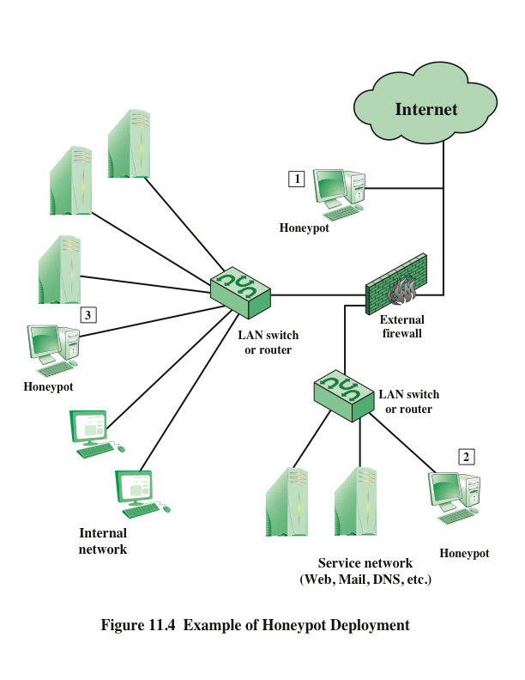
Honeypots can be deployed in a variety of locations.
Notes:
Honeypots can be deployed in a variety of locations. Figure 11.4 illustrates
some possibilities. The location depends on a number of factors, such as the type
of information the organization is interested in gathering and the level of risk that
organizations can tolerate to obtain the maximum amount of data.
A honeypot outside the external firewall (location 1 ) is useful for tracking
attempts to connect to unused IP addresses within the scope of the network.
A honeypot at this location does not increase the risk for the internal network. The
danger of having a compromised system behind the firewall is avoided. Further,
because the honeypot attracts many potential attacks, it reduces the alerts issued
by the firewall and by internal IDS sensors, easing the management burden. The
disadvantage of an external honeypot is that it has little or no ability to trap internal
attackers, especially if the external firewall filters traffic in both directions.
The network of externally available services, such as Web and mail, often
called the DMZ (demilitarized zone), is another candidate for locating a honeypot
(location 2 ). The security administrator must assure that the other systems in the
DMZ are secure against any activity generated by the honeypot. A disadvantage of
this location is that a typical DMZ is not fully accessible, and the firewall typically
blocks traffic to the DMZ that attempts to access unneeded services. Thus, the firewall
either has to open up the traffic beyond what is permissible, which is risky, or
limit the effectiveness of the honeypot.
A fully internal honeypot (location 3 ) has several advantages. Its most important
advantage is that it can catch internal attacks. A honeypot at this location can
also detect a misconfigured firewall that forwards impermissible traffic from the
Internet to the internal network. There are several disadvantages. The most serious
of these is if the honeypot is compromised so that it can attack other internal
systems. Any further traffic from the Internet to the attacker is not blocked by the
firewall because it is regarded as traffic to the honeypot only. Another difficulty for
this honeypot location is that, as with location 2, the firewall must adjust its filtering
to allow traffic to the honeypot, thus complicating firewall configuration and potentially
compromising the internal network.

Slide 34
Intrusion detection exchange format
To facilitate the development of distributed intrusion detection systems that can function across a wide range of platforms and environments
  Standards are needed to support interoperability.
IETF Intrusion Detection Working Group
  Purpose of the group is to define data formats and exchange procedures for sharing information of interest to intrusion detection with response systems and to management systems that may need to interact with them.
  Have issued the following RFCs:
    The Intrusion Detection Message Exchange Format (RFC 4765) – status: experimental
    Intrusion Detection Message Exchange Requirements (RFC 4766) - status: informational
    The Intrusion Detection Exchange Protocol (RFC 4767) - status: experimental
Notes:
To facilitate the development of distributed intrusion detection systems that can
function across a wide range of platforms and environments, standards are needed
to support interoperability. Such standards are the focus of the IETF Intrusion
Detection Working Group. The purpose of the working group is to define data
formats and exchange procedures for sharing information of interest to intrusion
detection and response systems and to management systems that may need to
interact with them.
The working group issued the following RFCs in 2007:
• Intrusion Detection Message Exchange Requirements (RFC 4766): This document
defines requirements for the Intrusion Detection Message Exchange
Format (IDMEF). The document also specifies requirements for a communication
protocol for communicating IDMEF.
• The Intrusion Detection Message Exchange Format (RFC 4765): This document
describes a data model to represent information exported by intrusion
detection systems and explains the rationale for using this model. An implementation
of the data model in the Extensible Markup Language (XML) is
presented, an XML Document Type Definition is developed, and examples
are provided.
• The Intrusion Detection Exchange Protocol (RFC 4767): This document
describes the Intrusion Detection Exchange Protocol (IDXP), an application level
protocol for exchanging data between intrusion detection entities. IDXP
supports mutual authentication, integrity, and confidentiality over a connection-
oriented protocol.

Slide 35
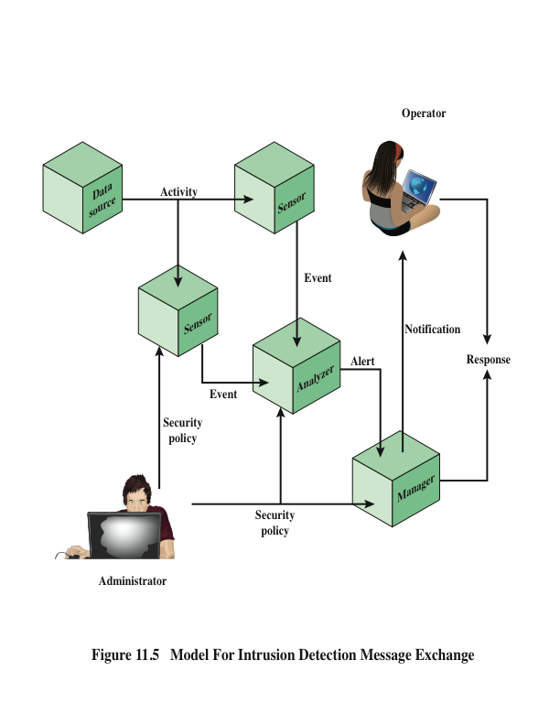
Sensors collect data from the data source.
Analyzers analyze the data collected by the sensor for signs of unauthorized or undesired activity or for events that might be of interest to the security administrator.
Notes:
Figure 11.5 illustrates the key elements of the model on which the intrusion
detection message exchange approach is based. This model does not correspond
to any particular product or implementation, but its functional components are the
key elements of any IDS. The functional components are as follows:
• Data source: The raw data that an IDS uses to detect unauthorized or undesired
activity. Common data sources include network packets, operating system
audit logs, application audit logs, and system-generated checksum data.
• Sensor: Collects data from the data source. The sensor forwards events to the
analyzer.
Analyzer: The ID component or process that analyzes the data collected by
the sensor for signs of unauthorized or undesired activity or for events that
might be of interest to the security administrator. In many existing IDSs, the
sensor and the analyzer are part of the same component.
• Administrator: The human with overall responsibility for setting the security
policy of the organization, and, thus, for decisions about deploying and configuring
the IDS. This may or may not be the same person as the operator of the
IDS. In some organizations, the administrator is associated with the network or
systems administration groups. In other organizations, it’s an independent
position.
• Manager: The ID component or process from which the operator manages
the various components of the ID system. Management functions typically
include sensor configuration, analyzer configuration, event notification management,
data consolidation, and reporting.
• Operator: The human that is the primary user of the IDS manager. The operator
often monitors the output of the IDS and initiates or recommends further
action.
In this model, intrusion detection proceeds in the following manner. The sensor
monitors data sources looking for suspicious activity , such as network sessions
showing unexpected telnet activity, operating system log file entries showing a user
attempting to access files to which he or she is not authorized to have access, and
application log files showing persistent login failures. The sensor communicates suspicious
activity to the analyzer as an event , which characterizes an activity within a
given period of time. If the analyzer determines that the event is of interest, it sends
an alert to the manager component that contains information about the unusual
activity that was detected, as well as the specifics of the occurrence. The manager
component issues a notification to the human operator. A response can be initiated
automatically by the manager component or by the human operator. Examples of
responses include logging the activity; recording the raw data (from the data source)
that characterized the event; terminating a network, user, or application session; or
altering network or system access controls. The security policy is the predefined, formally
documented statement that defines what activities are allowed to take place
on an organization’s network or on particular hosts to support the organization’s
requirements. This includes, but is not limited to, which hosts are to be denied external
network access.
The specification defines formats for event and alert messages, message types,
and exchange protocols for communication of intrusion detection information.

Slide 36
Password Management
Front line of defense against intruders
NOTE: Information presented in this section about password management MUST be strengthened with multi-factor authentication.
Virtually all multiuser systems require that a user provide not only a name or identifier (ID) but also a password
  Password serves to authenticate the ID of the individual logging on to the system
  The ID provides security by:
    Determining whether the user is authorized to gain access to a system
    Determining the privileges accorded to the user
    Used in discretionary access control
Notes:
The front line of defense against intruders is the password system. Virtually all
multiuser systems require that a user provide not only a name or identifier (ID)
but also a password. The password serves to authenticate the ID of the individual
logging on to the system. In turn, the ID provides security in the following
ways:
• The ID determines whether the user is authorized to gain access to a system.
In some systems, only those who already have an ID filed on the system are
allowed to gain access.
• The ID determines the privileges accorded to the user. A few users may have
supervisory or “superuser” status that enables them to read files and perform
functions that are especially protected by the operating system. Some systems
have guest or anonymous accounts, and users of these accounts have more
limited privileges than others.
• The ID is used in what is referred to as discretionary access control. For
example, by listing the IDs of the other users, a user may grant permission to
them to read files owned by that user.

Slide 37
Attack strategies and countermeasures
Workstation hijacking
The attacker waits until a logged-in workstation is unattended
The standard countermeasure is automatically logging the workstation out after a period of inactivity
Exploiting user mistakes
Attackers are frequently successful in obtaining passwords by using social engineering tactics that trick the user or an account manager into revealing a password; a user may intentionally share a password to enable a colleague to share files; users tend to write passwords down because it is difficult to remember them
Countermeasures include user training, intrusion detection, and simpler passwords combined with another authentication mechanism
Offline dictionary attack
Determined hackers can frequently bypass access controls and gain access to the system’s password file
Countermeasures include controls to prevent unauthorized access to the password file, intrusion detection measures to identify a compromise, and rapid reissuance of passwords should the password file be compromised
Specific account attack
The attacker targets a specific account and submits password guesses until the correct password is discovered
The standard countermeasure is an account lockout mechanism, which locks out access to the account after a number of failed login attempts
Notes:
In this subsection, we outline the main forms of attack against password-based
authentication and briefly outline a countermeasure strategy. The remainder of
Section 11.3 goes into more detail on the key countermeasures.
Typically, a system that uses password-based authentication maintains a
password file indexed by user ID. One technique that is typically used is to store
not the user’s password but a one-way hash function of the password, as described
subsequently.
We can identify the following attack strategies and countermeasures:
• Offline dictionary attack: Typically, strong access controls are used to protect
the system’s password file. However, experience shows that determined
hackers can frequently bypass such controls and gain access to the file. The
attacker obtains the system password file and compares the password hashes
against hashes of commonly used passwords. If a match is found, the attacker
can gain access by that ID/password combination. Countermeasures include
controls to prevent unauthorized access to the password file, intrusion detection
measures to identify a compromise, and rapid reissuance of passwords
should the password file be compromised.
• Specific account attack: The attacker targets a specific account and submits
password guesses until the correct password is discovered. The standard countermeasure
is an account lockout mechanism, which locks out access to the
account after a number of failed login attempts. Typical practice is no more
than five access attempts.
• Workstation hijacking: The attacker waits until a logged-in workstation is
unattended. The standard countermeasure is automatically logging the workstation
out after a period of inactivity. Intrusion detection schemes can be
used to detect changes in user behavior.
• Exploiting user mistakes: If the system assigns a password, then the user is
more likely to write it down because it is difficult to remember. This situation
creates the potential for an adversary to read the written password. A user
may intentionally share a password, to enable a colleague to share files, for
example. Also, attackers are frequently successful in obtaining passwords by
using social engineering tactics that trick the user or an account manager into
revealing a password. Many computer systems are shipped with preconfigured
passwords for system administrators. Unless these preconfigured passwords
are changed, they are easily guessed. Countermeasures include user training,
intrusion detection, and simpler passwords combined with another authentication
mechanism.

Slide 38
Attack strategies and countermeasures
Electronic monitoring
If a password is communicated across a network to log on to a remote system, it is vulnerable to eavesdropping
Simple encryption will not fix this problem, because the encrypted password is, in effect, the password and can be observed and reused by an adversary
Password guessing against single user
The attacker attempts to gain knowledge about the account holder and system password policies and uses that knowledge to guess the password
Countermeasures include training in and enforcement of password policies that make passwords difficult to guess
Exploiting multiple password use
Attacks can become much more effective or damaging if different network devices share the same or a similar password for a given user
Countermeasures include a policy that forbids the same or similar password on particular network devices
Popular password attack
Attack is to use a popular password and try it against a wide range of user IDs
Countermeasures include policies to inhibit the selection by users of common passwords and scanning the IP addresses of authentication requests and client cookies for submission patterns
Notes:
• Exploiting multiple password use: Attacks can also become much more
effective or damaging if different network devices share the same or a similar
password for a given user. Countermeasures include a policy that forbids the
same or similar password on particular network devices.
• Popular password attack: A variation of the preceding attack is to use a popular
password and try it against a wide range of user IDs. A user’s tendency is
to choose a password that is easily remembered; this unfortunately makes the
password easy to guess. Countermeasures include policies to inhibit the selection
by users of common passwords and scanning the IP addresses of authentication
requests and client cookies for submission patterns.
• Electronic monitoring: If a password is communicated across a network to log
on to a remote system, it is vulnerable to eavesdropping. Simple encryption
will not fix this problem, because the encrypted password is, in effect, the password
and can be observed and reused by an adversary.
• Password guessing against single user: The attacker attempts to gain knowledge
about the account holder and system password policies and uses that
knowledge to guess the password. Countermeasures include training in and
enforcement of password policies that make passwords difficult to guess.
Such policies address the secrecy, minimum length of the password, character
set, prohibition against using well-known user identifiers, and length of time
before the password must be changed.

Slide 39
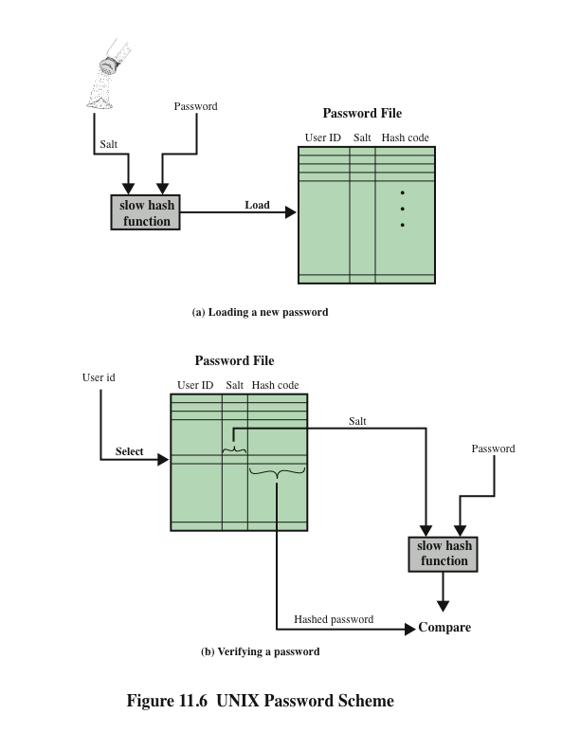
Notes:
A widely used password security technique is the use of hashed passwords and a salt
value. This scheme is found on virtually all UNIX variants as well as on a number
of other operating systems. The following procedure is employed (Figure 11.6a). To
load a new password into the system, the user selects or is assigned a password. This
password is combined with a fixed-length salt value [MORR79]. In older implementations,
this value is related to the time at which the password is assigned to the user.
Newer implementations use a pseudorandom or random number. The password
and salt serve as inputs to a hashing algorithm to produce a fixed-length hash code.
The hash algorithm is designed to be slow to execute to thwart attacks. The hashed
password is then stored, together with a plaintext copy of the salt, in the password
file for the corresponding user ID. The hashed-password method has been shown to
be secure against a variety of cryptanalytic attacks [WAGN00].
When a user attempts to log on to a UNIX system, the user provides an ID
and a password (Figure 11.6b). The operating system uses the ID to index into the
password file and retrieve the plaintext salt and the encrypted password. The salt
and user-supplied password are used as input to the encryption routine. If the result
matches the stored value, the password is accepted.
The salt serves three purposes:
• It prevents duplicate passwords from being visible in the password file. Even
if two users choose the same password, those passwords will be assigned
different salt values. Hence, the hashed passwords of the two users will
differ.
• It greatly increases the difficulty of offline dictionary attacks. For a salt of
length b bits, the number of possible passwords is increased by a factor of 2b ,
increasing the difficulty of guessing a password in a dictionary attack.
• It becomes nearly impossible to find out whether a person with passwords on
two or more systems has used the same password on all of them.
To see the second point, consider the way that an offline dictionary attack
would work. The attacker obtains a copy of the password file. Suppose first that the
salt is not used. The attacker’s goal is to guess a single password. To that end, the
attacker submits a large number of likely passwords to the hashing function. If any
of the guesses matches one of the hashes in the file, then the attacker has found a
password that is in the file. But faced with the UNIX scheme, the attacker must take
each guess and submit it to the hash function once for each salt value in the dictionary
file, multiplying the number of guesses that must be checked.
There are two threats to the UNIX password scheme. First, a user can gain
access on a machine using a guest account or by some other means and then run
a password guessing program, called a password cracker, on that machine. The
attacker should be able to check many thousands of possible passwords with little
resource consumption. In addition, if an opponent is able to obtain a copy of the
password file, then a cracker program can be run on another machine at leisure.
This enables the opponent to run through millions of possible passwords in a reasonable
period.

Slide 40
Unix implementations
Crypt(3)
  Was designed to discourage guessing attacks
  This particular implementation is now considered inadequate
  Despite its known weaknesses, this UNIX scheme is still often required for compatibility with existing account management software or in multivendor environments
MD5 secure hash algorithm
  The recommended hash function for many UNIX systems, including Linux, Solaris, and FreeBSD
  Far slower than crypt(3)
Bcrypt
  Developed for OpenBSD
  Probably the most secure version of the UNIX hash/salt scheme
  Uses a hash function based on the Blowfish symmetric block cipher
  Slow to execute
  Includes a cost variable
Notes:
Since the original development of UNIX, most implementations
have relied on the following password scheme. Each user selects a
password of up to eight printable characters in length. This is converted into a
56-bit value (using 7-bit ASCII) that serves as the key input to an encryption routine.
The hash routine, known as crypt(3), is based on DES. A 12-bit salt value is
used. The modified DES algorithm is executed with a data input consisting of a
64-bit block of zeros. The output of the algorithm then serves as input for a second
encryption. This process is repeated for a total of 25 encryptions. The resulting
64-bit output is then translated into an 11-character sequence. The modification of
the DES algorithm converts it into a one-way hash function. The crypt(3) routine
is designed to discourage guessing attacks. Software implementations of DES are
slow compared to hardware versions, and the use of 25 iterations multiplies the
time required by 25.
This particular implementation is now considered woefully inadequate. For
example, [PERR03] reports the results of a dictionary attack using a supercomputer.
The attack was able to process over 50 million password guesses in about 80 minutes.
Further, the results showed that for about $10,000 anyone should be able to
do the same in a few months using one uniprocessor machine. Despite its known
weaknesses, this UNIX scheme is still often required for compatibility with existing
account management software or in multivendor environments.
There are other, much stronger, hash/salt schemes available for UNIX. The
recommended hash function for many UNIX systems, including Linux, Solaris, and
FreeBSD (a widely used open source UNIX implementation), is based on the MD5
secure hash algorithm (which is similar to, but not as secure as SHA-1). The MD5
crypt routine uses a salt of up to 48 bits and effectively has no limitations on password
length. It produces a 128-bit hash value. It is also far slower than crypt(3). To
achieve the slowdown, MD5 crypt uses an inner loop with 1000 iterations.
Probably the most secure version of the UNIX hash/salt scheme was developed
for OpenBSD, another widely used open source UNIX. This scheme, reported
in [PROV99], uses a hash function based on the Blowfish symmetric block cipher.
The hash function, called Bcrypt, is quite slow to execute. Bcrypt allows passwords
of up to 55 characters in length and requires a random salt value of 128 bits, to
produce a 192-bit hash value. Bcrypt also includes a cost variable; an increase in
the cost variable causes a corresponding increase in the time required to perform a
Bcyrpt hash. The cost assigned to a new password is configurable, so that administrators
can assign a higher cost to privileged users.

Slide 41
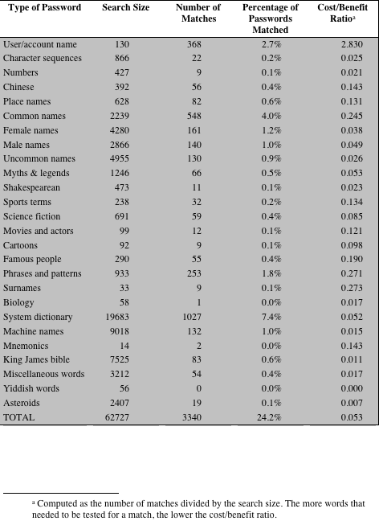
Table 11.3
Passwords Cracked from a Sample Set of 13,797 Accounts [KLEI90]
(This table can be found on page 386 in the textbook.)
* Computed as the number of matches divided by the search size. The more words that needed to be tested for a match, the lower the cost/benefit ratio.
Notes:
One demonstration of the effectiveness of guessing is reported in [KLEI90].
From a variety of sources, the author collected UNIX password files, containing
nearly 14,000 encrypted passwords. The result, which the author rightly characterizes
as frightening, is shown in Table 11.4. In all, nearly one-fourth of the passwords
were guessed. The following strategy was used:
1. Try the user’s name, initials, account name, and other relevant personal information.
In all, 130 different permutations for each user were tried.
2. Try words from various dictionaries. The author compiled a dictionary of over
60,000 words, including the online dictionary on the system itself, and various
other lists as shown.
3. Try various permutations on the words from step 2. This included making the
first letter uppercase or a control character, making the entire word uppercase,
reversing the word, changing the letter “o” to the digit “zero,” and so on. These
permutations added another 1 million words to the list.
4. Try various capitalization permutations on the words from step 2 that
were not considered in step 3. This added almost 2 million additional words
to the list.
Thus, the test involved in the neighborhood of 3 million words. Using the fastest
Thinking Machines implementation listed earlier, the time to encrypt all these
words for all possible salt values is under an hour. Keep in mind that such a thorough
search could produce a success rate of about 25%, whereas even a single hit
may be enough to gain a wide range of privileges on a system.

Slide 42
Password selection strategies
The goal is to eliminate guessable passwords while allowing the user to select a password that is memorable
Four basic techniques are in use:
User education
Users can be told the importance of using hard-to-guess passwords and can be provided with guidelines for selecting strong passwords
Computer-generated passwords
Computer-generated password schemes have a history of poor acceptance by users
Users have difficulty remembering them
Reactive password checking
A strategy in which the system periodically runs its own password cracker to find guessable passwords
Proactive password checking
A user is allowed to select his or her own password, however, at the time of selection, the system checks to see if the password is allowable and, if not, rejects it
Notes:
The lesson from the two experiments just described (Tables 11.3 and 11.4) is that,
left to their own devices, many users choose a password that is too short or too easy
to guess. At the other extreme, if users are assigned passwords consisting of eight
randomly selected printable characters, password cracking is effectively impossible.
But it would be almost as impossible for most users to remember their passwords.
Fortunately, even if we limit the password universe to strings of characters that are
reasonably memorable, the size of the universe is still too large to permit practical
cracking. Our goal, then, is to eliminate guessable passwords while allowing the user
to select a password that is memorable. Four basic techniques are in use:
• User education
• Computer-generated passwords
• Reactive password checking
• Proactive password checking
Users can be told the importance of using hard-to-guess passwords and can be
provided with guidelines for selecting strong passwords. This user education strategy
is unlikely to succeed at most installations, particularly where there is a large
user population or a lot of turnover. Many users will simply ignore the guidelines.
Others may not be good judges of what is a strong password. For example, many
users (mistakenly) believe that reversing a word or capitalizing the last letter makes
a password unguessable.
Computer-generated passwords also have problems. If the passwords are
quite random in nature, users will not be able to remember them. Even if the password
is pronounceable, the user may have difficulty remembering it and so be
tempted to write it down. In general, computer-generated password schemes have a
history of poor acceptance by users. FIPS PUB 181 defines one of the best-designed
automated password generators. The standard includes not only a description of
the approach but also a complete listing of the C source code of the algorithm. The
algorithm generates words by forming pronounceable syllables and concatenating
them to form a word. A random number generator produces a random stream of
characters used to construct the syllables and words.
A reactive password checking strategy is one in which the system periodically
runs its own password cracker to find guessable passwords. The system cancels
any passwords that are guessed and notifies the user. This tactic has a number of
drawbacks. First, it is resource intensive if the job is done right. Because a determined
opponent who is able to steal a password file can devote full CPU time to the
task for hours or even days, an effective reactive password checker is at a distinct
disadvantage. Furthermore, any existing passwords remain vulnerable until the
reactive password checker finds them.
The most promising approach to improved password security is a proactive
password checker . In this scheme, a user is allowed to select his or her own password.
However, at the time of selection, the system checks to see if the password
is allowable and, if not, rejects it. Such checkers are based on the philosophy that,
with sufficient guidance from the system, users can select memorable passwords
from a fairly large password space that are not likely to be guessed in a dictionary
attack.
The trick with a proactive password checker is to strike a balance between
user acceptability and strength. If the system rejects too many passwords, users will
complain that it is too hard to select a password. If the system uses some simple
algorithm to define what is acceptable, this provides guidance to password crackers
to refine their guessing technique. In the remainder of this subsection, we look at
possible approaches to proactive password checking.
The first approach is a simple system for rule enforcement. For example, the
following rules could be enforced:
• All passwords must be at least eight characters long.
• In the first eight characters, the passwords must include at least one each of
uppercase, lowercase, numeric digits, and punctuation marks.
These rules could be coupled with advice to the user. Although this approach is
superior to simply educating users, it may not be sufficient to thwart password
crackers. This scheme alerts crackers as to which passwords not to try but may still
make it possible to do password cracking.
Another possible procedure is simply to compile a large dictionary of possible
“bad” passwords. When a user selects a password, the system checks to
make sure that it is not on the disapproved list. There are two problems with this
approach:
• Space: The dictionary must be very large to be effective. For example, the dictionary
used in the Purdue study [SPAF92a] occupies more than 30 megabytes
of storage.
• Time: The time required to search a large dictionary may itself be large. In
addition, to check for likely permutations of dictionary words, either those
words most be included in the dictionary, making it truly huge, or each search
must also involve considerable processing.

Slide 43
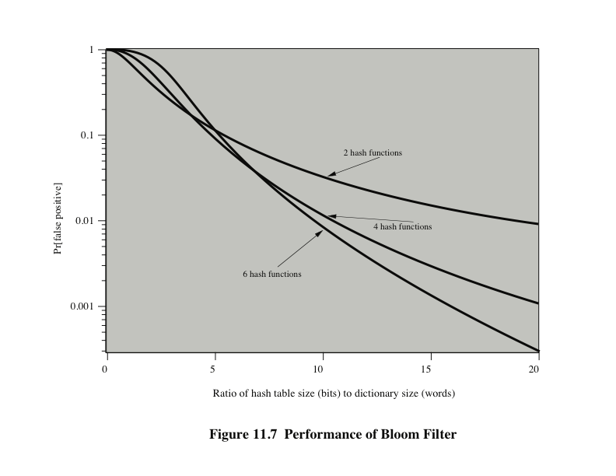
Notes:
A technique [SPAF92a, SPAF92b] for developing an effective and efficient
proactive password checker that is based on rejecting words on a list has been
implemented on a number of systems, including Linux. It is based on the use of
a Bloom filter [BLOO70].

Slide 44
Summary
Intruders
  Behavior patterns
  Intrusion techniques
Intrusion detection
  Audit records
  Statistical anomaly detection
  Rule-based intrusion detection
  The base-rate fallacy
  Distributed intrusion detection
  Honeypots
  Intrusion detection exchange format
Password management
  The vulnerability of passwords
  The use of hashed passwords
  User password choices
  Password selection strategies
  Bloom filter
Notes:
Chapter 11 summary.

