Slide 1
Slides for Chapter 5: Remote invocation
From Coulouris, Dollimore, Kindberg and Blair Distributed Systems: Concepts and Design
Edition 5, © Addison-Wesley 2012

Slide 2
Outline
Remote Invocation
5.1 Introduction
5.2 Request-reply protocols
5.3 Remote procedure call (RPC)
5.4 Remote method invocation (RMI)
5.5 Case study: Java RMI

Slide 3
Figure 5.1 Middleware layers
Applications
This chapter
(and Chapter 6)
Remote invocation, indirect communication
Middleware
Underlying interprocess communication primitives:
layers
Sockets, message passing, multicast support, overlay networks
UDP and TCP

Slide 4
Introduction
Remote Invocation Paradigms
Request-reply protocols
support 2-way exchange on top of message passing
low-level support to request execution of remote ops.
direct support for RPC and RMI
RPC
An extension of local procedure calls
transparent procedure calls: allow client programs to call procedures in server programs, generally on different computers
RMI
An extension of local method invocation in object-based programming
Transparent method invocation: communicating objects from different processes possibly on different nodes

Slide 5
Figure 5.2 Request-reply communication
Client
Server
doOperation
send request
… (waiting)
receive reply
Request
message
getRequest
select op
Reply
execute op
message
sendReply
(continuation)
Synchronous request/reply
The client process blocks until the reply arrives from the server.
resultArray = doOperation (server, opID, …);
Asynchronous request/reply (7.5.2)
doOperation()
Send the request message to invoke a remote operation
argument is the server that has it
result is a byte array that has the reply
caller blocks until reply is received
getRequest()
used by the server to get the request
sendReply()

Slide 6
Figure 5.3 Operations of the request-reply protocol
public byte[] doOperation (RemoteRef s, int operationId, byte[] arguments);
//sends a request message to the remote server and receives the reply.
//The arguments specify the remote server, the operation to be invoked
// and the arguments of that operation.
public byte[] getRequest ();
// acquires a client request via the server port.
public void sendReply (byte[] reply, InetAddress clientHost, int clientPort);
//sends the reply message reply to the client at its Internet address and port.

Slide 7
Figure 5.4 Request-reply message structure
messageType
int (0=Request, 1= Reply)
requestId
int
remoteReference
RemoteRef
operationId
int or Operation
arguments
array of bytes
A doOperation( ) in the client generates a requestId for each request message, and the server copies these IDs into the corresponding reply messages.
This enables doOperation to check that a reply message is the result of the current request, not a delayed earlier call. → anti-replay

Slide 8
Request-reply protocols (cont.)
Each message has a unique message identifier, consisting of
requestId (generated by the requester/client): increasing sequence of integers (after max is reached, reset to zero ex. 2³² -1)
id for sender process (port and IP address)
Failure model for request-reply implemented over UDP datagrams:
omission failures
no guaranteed in-order delivery
process can crash
Q: How would the client and the server handle failures?
Timeouts:
exception sent to client if result is not received within the timeout period.
Discarding duplicate request messages:
Server recognizes messages with the same messageId (i.e., requestId+senderId) and discard duplicates.
Lost reply message:
Server needs to re-execute unless results are saved (i.e., history).
An idempotent operation is an operation performed repeatedly but its results are as if it was applied once.

Slide 9
Request-reply protocols (cont.)
History
A record of (reply) messages that have been transmitted (= requestId + requesterId + the reply mesg)
history maybe used to avoid re-execution to retransmit a reply.
Overhead: memory cost to keep history, but you can only keep the last reply for a client. The problem is if you have lots of clients.
Q: How to reduce the overhead?

Slide 10
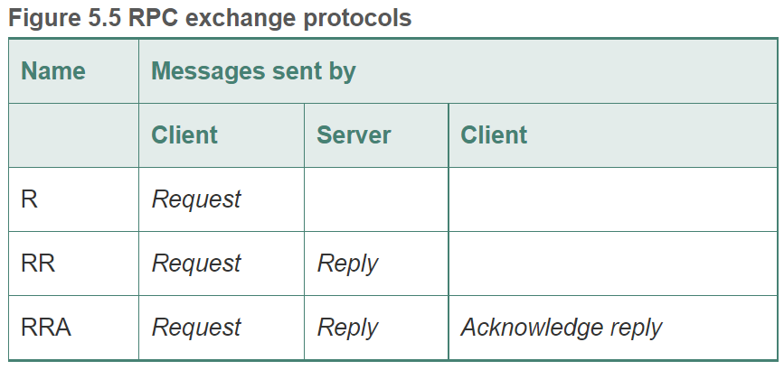
Different styles of exchange protocols:
The request only (R) type of protocols
no value returned from remote operation and client needs no confirmation of execution
The client does not block.
The request-reply (RR) type
Most client/server exchanges
The client regards the server reply as an ACK to its request; the server regards a new request from a client as an ACK to its recent reply.
The request-reply-acknowledge reply (RRA) type
Enable the server to discard entries from its history

Slide 11
Request-reply protocols (cont.)
Use of TCP streams
In UDP, buffer size has to be appropriate.
Limited-length datagrams (usu. 8 KB); arguments and result of a procedure may exceed that limit → multiple packets
Why TCP?
To avoid implementing multipacket protocols (e.g., if using UDP), TCP is used which allows arguments and results of various sizes.
Reliable delivery of TCP datagrams → reduced connection overhead, reduced ACK overhead

Slide 12
HTTP: An example of request-reply protocol
resources implemented in different ways:
data (HTML), programs (servlets, PHP, Python)
Client requests specify URL, http://<hostname>[:port#]/<resourceId>
Fixed set of methods (GET, PUT, POST, …)
password-style authentication
Content negotiation – client decides what data representation to accept.
Password-based Authentication (PBA)
HTTP1.1 and later versions use persistent connections – remain open over a series of request-reply exchanges.
Request and replies are marshalled into messages as ASCII text strings.
Data resources are supplied as MIME-like structures (Multipurpose Internet Mail Extensions) in arguments and results.
MIME type/subtype + data
text/html, image/jpeg, …

Slide 13
HTTP Messages
Request
Specifies method name, URL, protocol version, some headers and an optional body.
method
URL or pathname
HTTP version
headers
message body
GET
//www.dcs.qmw.ac.uk/index.html
HTTP/ 1.1
Reply
Specifies protocol version, status code and ‘reason’, some headers and an optional body.
HTTP version
status code
reason
headers
message body
HTTP/1.1
200
OK
resource data

Slide 14
HTTP methods
GET (a safe op)
Request the resource (give URL as argument)
If data it returns the data
If program then it runs the program on the server and returns output to the client.
Can be used to send the contents of a form to a program (as an argument)
HEAD (a safe op)
Like GET but only returns information about the data (type, size, last modification date)
POST (a safe op)
The data is supplied in the body of the request.
Action may change data on the server.
Provide data to a data handling service like servlets
Post a message to a mailing list or update member details
Extend a DB with an append operation

Slide 15
HTTP Methods cont’d
PUT (an idempotent op)
Request that the supplied data is stored with the given URL as an identifier.
Modify an existing resource or create new.
DELETE (an idempotent op)
Delete the resource identified by the URL
OPTIONS (a safe op)
Server supplies client with a list of allowed methods on a given URL
TRACE (a safe op)
Server sends back the request message (for diagnostic purposes)
Notes:
A safe operation does not change anything.

Slide 16
Remote Procedure Call (RPC)
The goal is to make programming distributed systems similar if not identical to conventional programming.
Achieve a high level of distribution transparency.
Q: What does that mean?

Slide 17
Design issues for RPC
3 important issues to understand the concept:
The style of programming promoted by RPC – programming with interfaces
The call semantics associated with RPC
The key issue of transparency and how it relates to RPC

Slide 18
Programming with Interfaces
Create Modules and explicit interfaces for each module to build communication between the modules.
information hiding in the modules
Interfaces in DSs:
modules can run as separate processes
Each server provides a set of procedures available to clients.
A Service Interface refers to the specification of the procedures offered by a server and defines their numbers and types of arguments.

Slide 19
Programming with Interfaces (cont.)
Benefits of separating the interface from the actual implementation of the procedures:
Programmer is only concerned with abstraction. → No implementation awareness
Extrapolated to heterogeneous distributed systems (different platforms)
Natural support for software evolution.
Implementation can change as long and interfaces remain the same.

Slide 20
Programming with Interfaces (cont.)
Definition of the service Interface is influenced by the distributed nature of the underlying infrastructure:
Clients can’t access variables in another process. So the service has to provide getters and setters.
Call by reference is not supported for RPC since the caller and the callee procedures are in different processes.
So a distributed program designate parameters as either input, output, or both.
Input: sent to server in the request
Output: sent in the reply
Addresses in one process can not be used in another process as it will have a different value.

Slide 21
Programming with Interfaces (cont.)
RPC can be integrated in any language that can define interfaces.
Useful to write the whole distributed application in one language.
In reality, existing useful services are written in different programming languages.
Interface Definition Language (IDL)
IDLs are designed to allow procedures implemented in different languages to invoke one another.
Provides a notation for defining interfaces in which each parameter is described as input or output in addition to having its type specified.

Slide 22
Figure 5.8 CORBA IDL example
// In file Person.idl
struct Person {
string name;
string place;
long year;
} ;
interface PersonList {
readonly attribute string listname;
void addPerson(in Person p) ;
void getPerson(in string name, out Person p);
long number();
};

Slide 23
Programming with Interfaces (cont.)
Sun XDR is an example of IDL for RPC
CORBA IDL is an example of IDL for RMI
Web Service Description Language (WSDL) designed for Internet-Wide RPC supporting web services.
Protocol Buffer used at Google for storing and interchanging structured information

Slide 24
RPC Call Semantics
doOperation() can be implemented in different ways to provide different delivery guarantees (or fault tolerance measures):
Retry/Retransmit request message – retransmit until a reply is received or server is assumed failed.
Duplicate Filtering: Controls when retransmissions are used and whether to filter out duplicate requests to server.
Retransmission of Results: Controls whether to keep a history of result messages to enable lost results to be retransmitted without re-execution.

Slide 25
RPC Call Semantics
Figure 5.9 Call semantics
Fault tolerance measures
Call
semantics
Retransmit request
Duplicate
Re-execute procedure
message
filtering
or retransmit reply
No
Not applicable
Not applicable
Maybe
Yes
No
Re-execute procedure
At-least-once
Yes
Yes
Retransmit reply
At-most-once

Slide 26
RPC Call Semantics
“Exactly Once” – used for local procedure calls.
Maybe Semantics:
maybe executed once or not at all. This arises when no fault tolerance measures are applied and can suffer from failures:
Omission failure if request or result is lost
Crash failure when server fails.
Useful when occasional failed calls are acceptable.

Slide 27
RPC Call Semantics
At-least-once semantics:
The invoker receives the result → the call was invoked once or an exception has happened.
Retransmit the request messages which masks omission failures.
This semantics suffers from the following failures:
Crash failure of the server
Arbitrary failures where the servers executes a procedure more than once causing wrong values. This can be caused by non-idempotent operations.
If all procedures are idempotent, then the at-least-once call semantics is acceptable.

Slide 28
RPC Call Semantics
At-most-once semantics
caller receives a result or an exception.
At most once can be achieved by using all the previously mentioned fault tolerance measures.

Slide 29
Transparency
Make the calls look like local calls
Hide all external data representation, marshalling details and message passing from programmer making the call.
RPC provides location and access transparency.
Location transparency means hiding the physical location of the (potentially remote) procedure
Access transparency means accessing local and remote procedures in the same way
RPCs are more vulnerable to failures than local once. (network)
Latency is several orders of magnitude more than the local ones.
Callers should be able to abort remote procedure calls due to large latency.
Consensus? Remote calls should be made transparent in the sense that the syntax of a remote call is the same as that of a local invocation, but that the difference between local and remote calls should be expressed in their interfaces.

Slide 30
Implementation of RPC
Client accessing the server has one “stub procedure” for each procedure in the service interface.
Behaves like a local procedure
Marshals the procedure identifiers and args into a request message sent to server.
When a reply message arrive it unmarshals the results.
Server contains a dispatcher with one stub procedure and one service procedure for each procedure in the service interface.
Dispatcher selects the service stub procedure according to the id in the request message.
Server stub procedure unmarshals the arguments in the request message, calls the corresponding service and marshals the return value for the reply message.

Slide 31
Figure 5.10 Role of client and server stub procedures in RPC
client process
server process
Request
Reply
client stub
server stub
procedure
procedure
client
service
program
Communication
Communication
procedure
module
module
dispatcher

Slide 32
Sun RPC
Open Network Computing (ONC) RPC.
TCP or UDP (restricted message size with UDP)
IDL called XDR
Interface compiler is called rpcgen (C prog.)
IDL
Specify a set of procedure definitions with supporting type definition.

Slide 33
Figure 5.11 Files interface in Sun XDR
const MAX = 1000;
typedef int FileIdentifier;
typedef int FilePointer;
typedef int Length;
struct Data {
int length;
char buffer[MAX];
};
struct writeargs {
FileIdentifier f;
FilePointer position;
Data data;
};
struct readargs {
FileIdentifier f;
FilePointer position;
Length length;
};
program FILEREADWRITE {
version VERSION {
void WRITE(writeargs)=1; 1
Data READ(readargs)=2; 2
}=2;
} = 9999;

Slide 34
Example
9999 is the program number
2 is the version number
READ takes as input structure with three components.
Returns a struct called Data.
WRITE has no results.
It allows constant, typedefs, and structs.
Procedures are given numbers (READ 1, WRITE 2)
rpcgen will generate a client stub, the server’s main, dispatcher and server stub.
XDR marshalling and unmarshalling procedures.

Slide 35
Sun RPC
Binding
Sun RPC runs a “port mapper” at a well-known port number on each computer to record program number, version number, and port number.
Authentication
Credentials include uid, and gid
Different protocols:
None.
UNIX style
shared key and signing RPC messages.
Kerberos.

Slide 36
Remote Method Invocation (RMI)
Like RPC but extended for distributed object-oriented programming
Invoke methods that are in a potentially remote object.
Common between RPC and RMI
both support programming with interfaces.
constructed on top of request-reply protocol
similar levels of transparency (local and remote have the same syntax)
Different between RPC and RMI
RMI is object oriented (use properties of OO)
RMI has unique object references passed as parameters which provides a richer parameter-passing semantics.
So pass the object reference instead of transmitting values across network

Slide 37
Design issues for RMI
Object Model
Object References: This is how you access object. object whose method is invoked is called target or receiver. Objects references are first-class values, so you can assign values, pass as arguments, and return result.
Interfaces: Definition of the signatures of a set of methods w/o implementation details.
Actions: Object invoking a method in another object. Receiver executes, and returns results to invoking object, this can have 3 effects:
State of the receiver may be changed.
A new object maybe instantiated.
Further invocation on methods in other objects may occur.
Exception: errors and unexpected conditions may occur.
Garbage Collection: Objects that are no longer needed can be removed.

Slide 38
Distributed Objects
May adopt the client/server architecture
Client invokes objects on servers.
Objects maybe replicated for fault tolerance.
Encapsulation is easier since each object can access its own state using its own methods.
Objects maybe access concurrently
Synchronization is needed.

Slide 39
Distributed Object Model
Each process has a collection of objects.
Objects that receive remote invocations are called remote objects.
B &F in the following figure are remote objects.
2 Fundamental Concepts at the heart of this:
Remote Object Reference – You can invoke methods of remote objects if you have their remote object reference. (identifier used throughout the DS)
Any object that receives an RMI has a remote object reference.
ex. Object A holds a remote object reference for B.
Remote Interface – Every remote object has a remote interface to specify which of its methods is to be invoked remotely.

Slide 40
Figure 5.12 Remote and local method invocations
remote
local
C
invocation
invocation
local
E
invocation
remote
B
invocation
F
A
local
invocation
D

Slide 41
Remote Object Reference (ROR) and Remote Interfaces (RI)
ROR analogous to local ones:
Remote object to receive remote invocation is specified by the invoker
Remote Object reference may be passed as arguments and results of remote method invocation.
RI
A class of a remote object implements the methods of its remote interface. (public methods in Java).
Objects in other processes can only invoke those methods that are in the interface.
In Java RMI, classes must implement the “Remote” interface.
Java RMI and CORBA support multiple interface implementation (you could view it as multiple inheritance)

Slide 42
Figure 5.13 A remote object and its remote interface
remote
object
remote
Data
interface
m4
{
m1
implementation
m2
m5
m3
of methods
m6

Slide 43
Actions in a Distributed Object System
Objects in the chain of invocation can be in different processes or different computers. Once you cross a boundary RMI is used.
When an action leads to instantiation of new object, the object will live in the process where instantiation is requested. If it has an RI then it will be a remote object with ROR.
Garbage Collection – Cooperation between local garbage collectors and an added module that does distributed garbage collection.
Exceptions – Process containing remote object may have crashed or too busy to reply, or the result message is lost.

Slide 44
Figure 5.14 Instantiation of remote objects

Slide 45
Implementation of RMI
Communication Module
Two comm. modules carry out the request-reply protocol, which transmits request and reply messages between client and server.
Also responsible for invocation semantics (like at-most-once)
On the server it selects the dispatcher for the class of the object to be invoked.
Remote Reference Module
translate between local and remote object references and create remote object references.
It has a remote object table that has:
an entry for all the remote objects held by the process.
an entry for each local proxy
Actions:
If remote object is to be passed as an argument or result for the first time, then its ROR is added to the table.
When an ROR arrives in a request or reply message, the remote ref. module is asked for the corresponding local object reference.

Slide 46
Implementation of RMI
Servants – Is an instance of a class that provides the body of a remote object.
It handles the remote requests passed by the corresponding skeletons.
The RMI Software
Layer of software between application level object and the communication and remote reference module.

Slide 47
Implementation of RMI
Role of the middleware objects (See next figure).
Proxy: make remote method invocation transparent to clients by behaving like a local object to the invoker.
Hides the details of ROR, marshalling arguments, and unmarshalling results.
Dispatcher: A server has one dispatcher and one skeleton for each class representing a remote object.
Receives request messages from comm. module.
Use operationId to select the appropriate method in the skeleton.
Skeleton: implements the methods in the remote interface.
unmarshals the arguments in the request message and invokes the corresponding servant method.
Wait for invocation to complete and marshals the result with any exceptions in a reply message to the sending proxy method.

Slide 48
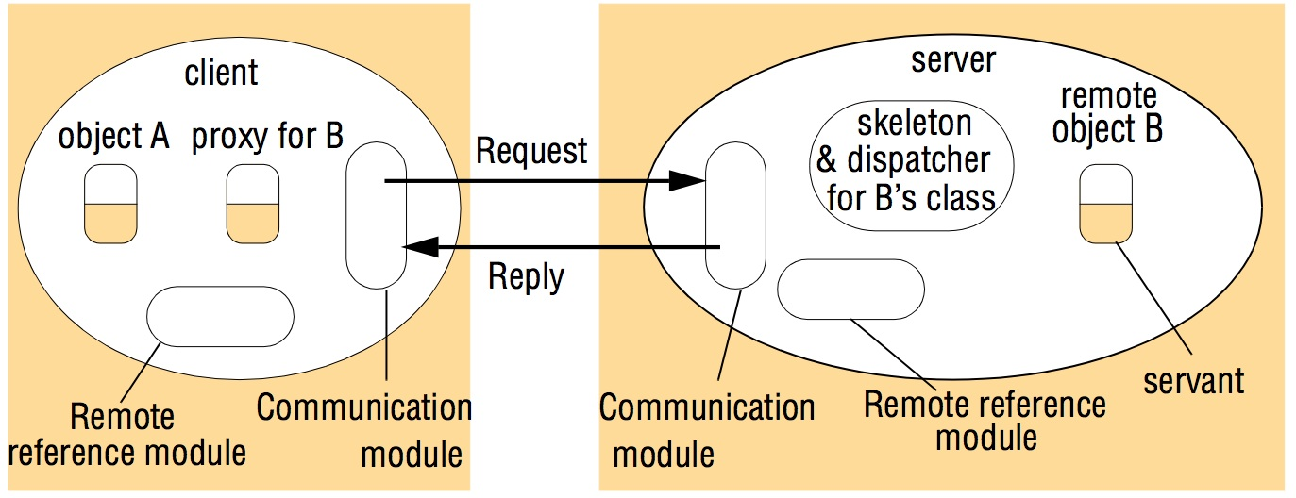
Figure 5.15 The role of proxy and skeleton in remote method invocation

Slide 49
Implementation of RMI
Generation of proxies, dispatchers and skeletons is automatic by the interface compiler.
Dynamic Invocation:
Alternative to proxies as proxies are static generated at compile-time.
What if the client receives a remote reference to an object whose remote interface was not available at compile-time. So we need another way to invoke the remote object.
Dynamic invocation gives the client access to a generic representation of a remote operation like the doOperation.
Dynamic Skeletons
Server will need to host remote objects whose interfaces were not known at compile-time.
A server with dynamic skeletons will be able to handle this.

Slide 50
Implementation of RMI
Server and Client Programs
Server contains classes for dispatchers and skeletons with implementation of all the servants it supports.
It has initialization to at least initialize one of the servants.
Client has classes of the proxies for all the remote objects it will invoke.
Factory Methods: methods that create servants
Factory Object: object with factory methods.
Remote object that needs to create new remote objects on demand for clients must provide methods in its remote interface for this purpose.

Slide 51
Implementation of RMI
The binder – separate service that maintains a table contains mappings from textual names to RORs.
Used by server to register their remote objects by name and by clients to look them up.
Server threads – To avoid execution of one remote invocation delaying the execution of another, servers generally allocate a separate thread for the execution of each remote invocation.

Slide 52
Implementation of RMI
Activation of Remote Objects
Servers can be started whenever they’re needed by the clients, not running all the time. (on-demand).
Processes that start the servers are called activators.
A remote object is called active when it is available for invocation, otherwise it is passive.
Passive Objects consist of:
implementation of its methods.
its state in the marshalled form.
Activation consists of creating an active object from a corresponding passive object by creating a new instance of its class and initializing the variables.
An Activator is responsible for:
registering passive objects available for activation.
starting named server processes and activating remote objects in them.
Keeping track of the location of the servers of remote objects.

Slide 53
Implementation of RMI
Persistent Object Store (POS)
Object that is guaranteed to live between activations of processes is called a persistent object.
Persistent objects managed by persistent object store which stores their state in marshaled form on disk.
Used for fault tolerance once they’re in a consistent state.
Two approached to decide on object persistence:
POS maintains some persistent roots, and any object reachable by the roots is persistent. If not the the garbage collector destroys them.
POS provides some classes on when persistence is based and persistent objects belong to their subclasses.

Slide 54
Implementation of RMI
Object Location
Clients making invocation require both ROR and and address to send the invocation.
Location Services help clients locate remote objects from their ROR. Uses a DB to map ROR to their location.
Distributed Garbage Collection
Distributed garbage collector works in cooperation with the local ones.
Each server process maintains a set of names of processes that hold a remote object reference. Example B.holder is the set for object B.
When a client C first receives a remote reference to a B, it makes an addRef(B) to create a proxy and C is added B.holder.
When C’s garbage collector notices that a proxy for B is no longer available it does remotRef(B).
When B.holder is empty, the server’s local garbage collector reclaims space occupied by B.

Slide 55
Case Study: JAVA RMI

Slide 56
Figure 5.16 Java Remote interfaces Shape and ShapeList
import java.rmi.*;
import java.util.Vector;
public interface Shape extends Remote {
int getVersion() throws RemoteException;
GraphicalObject getAllState() throws RemoteException; 1
}
public interface ShapeList extends Remote {
Shape newShape(GraphicalObject g) throws RemoteException; 2
Vector allShapes() throws RemoteException;
int getVersion() throws RemoteException;
}

Slide 57
Figure 5.17 The Naming class of Java RMIregistry
void rebind (String name, Remote obj)
This method is used by a server to register the identifier of a remote object by
name, as shown in Figure 15.18, line 3.
void bind (String name, Remote obj)
This method can alternatively be used by a server to register a remote object by
name, but if the name is already bound to a remote object reference an
exception is thrown.
void unbind (String name, Remote obj)
This method removes a binding.
Remote lookup(String name)
This method is used by clients to look up a remote object by name, as shown in
Figure 5.20 line 1. A remote object reference is returned.
String [] list()
This method returns an array of Strings containing the names bound in the registry.

Slide 58
Figure 5.18 Java class ShapeListServer with main method
In line 1, the server creates an instance of ShapeListServant.
Lines 2 and 3 use the method exportObject (defined on UnicastRemoteObject) to make this object available to the RMI runtime, thereby making it available to receive incoming invocations. The second parameter of exportObject specifies the TCP port to be used for incoming invocations. It is normal practice to set this to zero, implying that an anonymous port will be used (one that is generated by the RMI runtime). Using UnicastRemoteObject ensures that the resultant object lives only as long as the process in which it is created (an alternative is to make this an Activatable object that is, one that lives beyond the server instance).
Finally, line 4 binds the remote object to a name in the RMIregistry. Note that the value bound to the name is a remote object reference, and its type is the type of its remote interface – ShapeList.
So, the object stub is the remote object, which is bound to the name //Bruno.ShapeList in the RMIregistry.

Slide 59
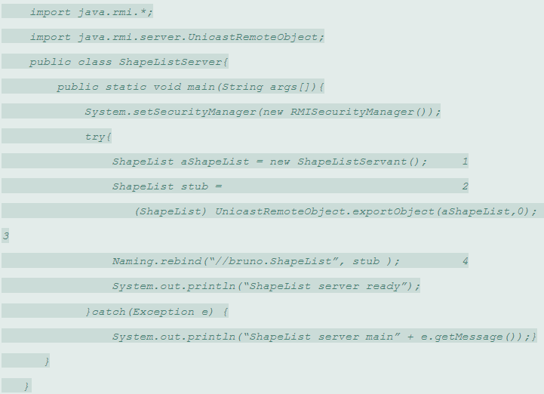

Slide 60
Figure 5.19 Java class ShapeListServant implements interface ShapeList
import java.rmi.*;
import java.rmi.server.UnicastRemoteObject;
import java.util.Vector;
public class ShapeListServant extends UnicastRemoteObject implements ShapeList {
private Vector theList; // contains the list of Shapes
private int version;
public ShapeListServant()throws RemoteException{...}
public Shape newShape(GraphicalObject g) throws RemoteException { 1
version++;
Shape s = new ShapeServant( g, version); 2
theList.addElement(s);
return s;
}
public Vector allShapes()throws RemoteException{...}
public int getVersion() throws RemoteException { ... }
}

Slide 61
Figure 5.20 Java client of ShapeList
Any client program needs to get started by using a binder to look up a remote object reference. Our client sets a security manager and then looks up a remote object reference for the remote object using the lookup operation of the RMIregistry (line 1).
Having obtained an initial remote object reference, the client continues by sending RMIs to that remote object or to others discovered during its execution according to the needs of its application. In our example, the client invokes the method allShapes in the remote object (line 2) and receives a vector of remote object references to all of the shapes currently stored in the server.
So, the object aShapeList is the remote object reference returned from the RMIregistry.
The method allShapes( ) is the remote method invoked in the remote object.

Slide 62
Figure 5.20 Java client of ShapeList
import java.rmi.*;
import java.rmi.server.*;
import java.util.Vector;
public class ShapeListClient{
public static void main(String args[]){
System.setSecurityManager(new RMISecurityManager());
ShapeList aShapeList = null;
try{
aShapeList = (ShapeList) Naming.lookup("//bruno.ShapeList") ; 1
Vector sList = aShapeList.allShapes(); 2
} catch(RemoteException e) {System.out.println(e.getMessage());
}catch(Exception e) {System.out.println("Client: " + e.getMessage());}
}
}

Slide 63
Figure 5.21 Classes supporting Java RMI
RemoteObject
RemoteServer
Activatable
UnicastRemoteObject
<servant class>

