Slide 1

Slides for Chapter 2:
System Models
From Coulouris, Dollimore, Kindberg and Blair
Distributed Systems:
Concepts and Design
Edition 5, © Addison-Wesley 2012

Slide 2
Introduction
Physical Models – types of computers and how they’re connected.
Architectural Models – describe a system in terms of computational and communicational tasks.
    Client/Server
    Peer-to-Peer
Fundamental Models – abstract perspective for solution description of individual issues.
    3 important aspects:
      interaction models via messages due to different clocks,
      failure models, and
      security models

Slide 3
Physical Models
Baseline Physical Model: computers connected by an interconnected network and pass messages.
Three generations of DS:
  Early Distributed Systems – early 70 and 80’s, small (10-100) nodes. limited connectivity
  Internet-scale Distributed Systems – larger scale, 1990’s due to growth of internet. It lead to middleware technologies like CORBA.
  Contemporary Distributed Systems
    Mobile computing
    – service discovery and spontaneous interoperations
    Ubiquitous computing
    – computers are embedded in everyday objects (IoT or Internet of Things)
    Cloud Computing
    – cluster architectures and autonomous nodes. (Google search services.
    → The emergence of a Distributed System of Systems – complex systems autonomous on their own.

Slide 4
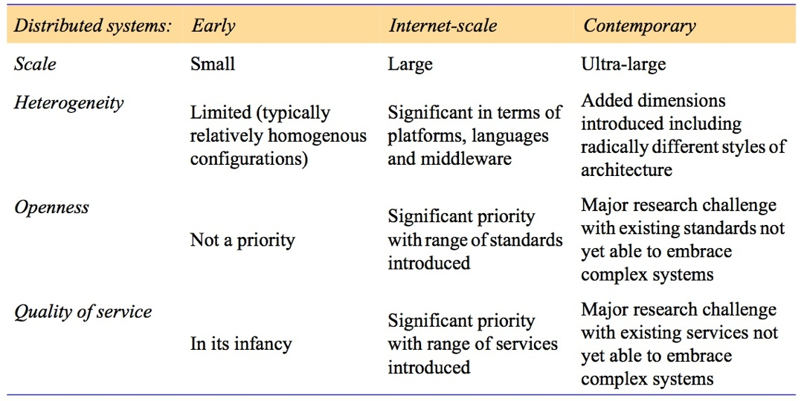
Figure 2.1
Generations of distributed systems

Slide 5
Architectural Models
Look at the underlying architectural elements and diversity of approach to DSs.
Examine composite architectural patterns that are use to build DSs.
Consider middleware platforms that support the different styles of programming.

Slide 6
Architectural Elements
4 Key questions:
  What are the communicating entities?
  How do they communicate?
  Communication Paradigms
  What roles do they have in the architecture?
  How are they mapped on the physical distributed architecture?

Slide 7
Communicating Entities
Typically they are processes.
  Two issues –
    primitive environments – no OS support so the entities are nodes.
    In most DSs they are threads.
This is not enough from a programming perspective.
  So other problem-oriented abstractions were proposed.

Slide 8
Problem-Oriented Abstractions
Objects – OO in DS
  Interacting object accesses via interfaces (IDL: Interface Definition Language)
Components
  They not only specify interfaces, but also provide the assumption they make in terms of other components and interfaces that must be present to complete a function.
    Third Party Development is encouraged.

Slide 9
Problem-Oriented Abstractions (Cont’d)
Web Services
  Closely related to objects and components
  Integrated into WWW and using web standards to present and discover services.
  They’re partially defined by the technologies they adopt.

Slide 10
Communication Paradigms
Three types:
  Inter-process Communication (IPC)
  Remote Invocation
  Indirect Communication
IPC
  message passing
  socket communication
Remote Invocation
  Remote Invocation (common, 2-way exchange)
  Request-Reply Protocols (Client/Server Model)
  RPC – Information of distribution is hidden.
  RMI – RPC with distributed objects. Invoke methods on a remote object.

Slide 11
Communication Paradigms (Cont’d)
Indirect Communication
  Group Communication – group identifier to distributed messages.
  Publish-Subscribe Model – producers/publishers distributed items of interest (events) to a large number of consumers
    Known as a distributed event-based system
  Message Queues – point-to-point service

Slide 12
Communication Paradigms (Cont’d)
Indirect Communication (cont’d)
  Distributed Shared Memory (DSM)
    An abstraction for sharing data between processes that don’t share physical memory
    High level of distribution transparency
      Programmers are presented with a familiar abstraction of reading or writing (shared) data structures as if they were in their own local address spaces.
  Tuple Spaces (a form of DSM)
    Persistent space where processes can place items of structured data (tuples), and can read/remove tuples
      Producers vs Consumers of tuples
    Processes do not need to exist at the same time → asynchronous communication
    Generative communication for parallel/distributed computing [Gelernter, 1985]

Slide 13
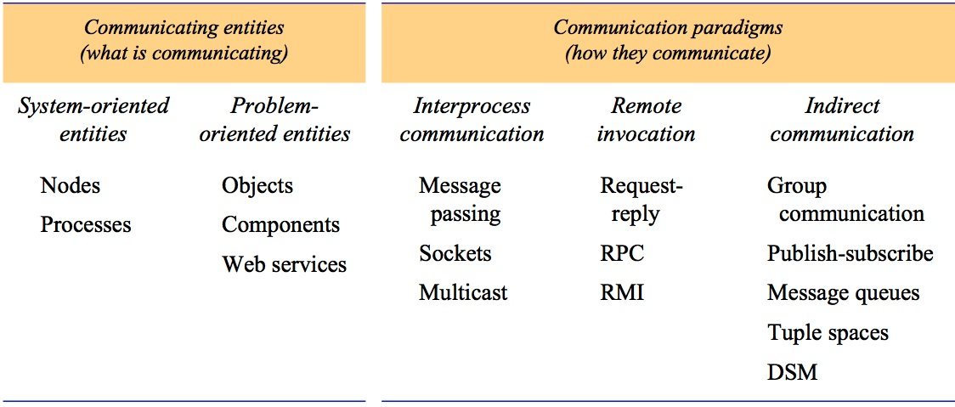
Figure 2.2
Communicating entities and communication paradigms

Slide 14
Roles and Responsibilities
Entities interact to perform a useful activity.
Two architectural styles stemming from the role of the individual processes.
  Client/Server
  Peer-to-Peer

Slide 15
Client/Server
Widely used and most important
Client processes interact with individual server processes most likely on a separate computer.
Servers may be clients of other servers.
  Client of a local file server.
  Client of DNS services.

Slide 16
Figure 2.3
Clients invoke individual servers

Slide 17
Peer-to-Peer
All processes play a similar role (peers)
Run same programs and offer the same set of interfaces.
Why peer-to-peer?
  Client/Server scales poorly due to centralized service.
Some placement strategies have been developed in response to this issue.
So, now hardware is faster and has bigger capacities, so peers can do a lot more work where hundreds of thousands of computers are connected to do work. Napster.

Slide 18
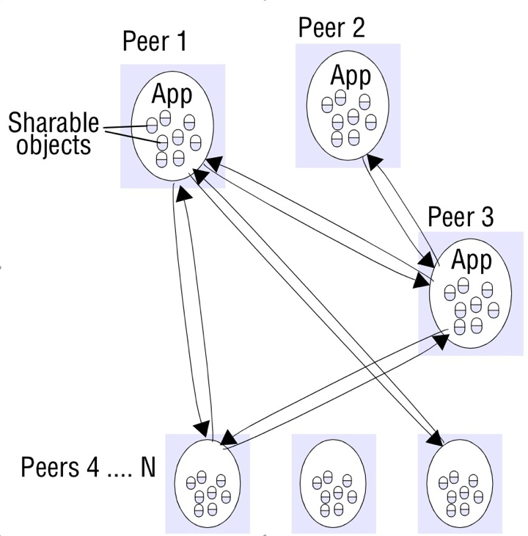
Figure 2.4a
Peer-to-peer architecture

Slide 19
Placement
How to map entities (objects, services) on to the physical infrastructure?
Issues to consider:
  patterns of communication between entities
  reliability of given machines and their current loading
  quality of communication between different machines
  …

Slide 20
Placement (Cont’d)
Different placement strategies:
  Mapping services on multiple servers
    A service may be implemented as several server processes in separate host computers interacting as necessary to provide a service (Figure 2.4b)
    May distribute data between them and possibly create replicas.
    Sun’s NIS (Network Information Service) allows authentication information to be distributed on multiple servers.
  Caching
    Store most recently used objects in caches
    Do cache replacement when new objects arrive. (Browser Cache)
  Mobile Code
    Applets, Java Script (Security threats)
  Mobile Agents
    A running program (including both code and data) that travels from one computer to another to carry out a task (e.g., collecting data).
    It eventually returns with the results.
    The worm program [1982]
    Can be used to install and maintain software, to utilize idle computers, …
    Also a security threat

Slide 21
Figure 2.4b
A service provided by multiple servers

Slide 22
Figure 2.5
Web proxy servers
- provide a shared cache of web resources for the client machines at a site or across several sites

Slide 23
Figure 2.6
Web applets
Instructor’s Guide for Coulouris, Dollimore, Kindberg and Blair, Distributed Systems: Concepts and Design Edn. 5
© Pearson Education 2012

Slide 24
Architectural Patterns
Layering
  Complex system is partitioned into a number of layers
  One layer offers service to the layer above it.
  Higher layers have higher abstractions and they’re unaware of implementation details in the underlying layers
  Platforms vs Middlewares
    Platform – lowest-level hardware and software layers (OS/Kernels/Hardware)
    Middleware – purpose is to mask heterogeneity.
      Implement communication and resource sharing in distributed applications.

Slide 25
Figure 2.7
Software and hardware service layers in distributed systems

Slide 26
Tiered Architecture
Complementary to layering
  Layering organizes services into vertical layers of abstraction.
  Tiering organizes functionality of a given layer (e.g, the application/services layer, the middleware layer) and places it into appropriate servers and on to physical nodes.
Tiering example - functional decomposition of a given application:
  Presentation Logic – Interaction and updating view of application presented to users.
  Application Logic – application-specific processing.
  Data Logic – persistent storage of the application (typically DBMS)

Slide 27
Two-Tier Architecture
All three aspects partitioned into two processes (Client and Server)
  Most commonly done by splitting the application logic is split between clients and server.
Low latency in terms of interaction (1 message exchange)
Disadvantage is the splitting of the application logic across process boundary.
  Which parts of the logic can be invoked from which parts.

Slide 28
Three-Tier Architecture
One-to-one mapping from logical elements to physical servers
  Application Logic is in one place which enhances maintainability.
  Each tier has a well-defined role
  First tier is a user interface
Drawback: Managing three servers, and network latency due to increased communication.
Generalization – n-tiered architecture (Wikipedia 60K page requests per second)
  n logical elements each mapped on a server element.

Slide 29
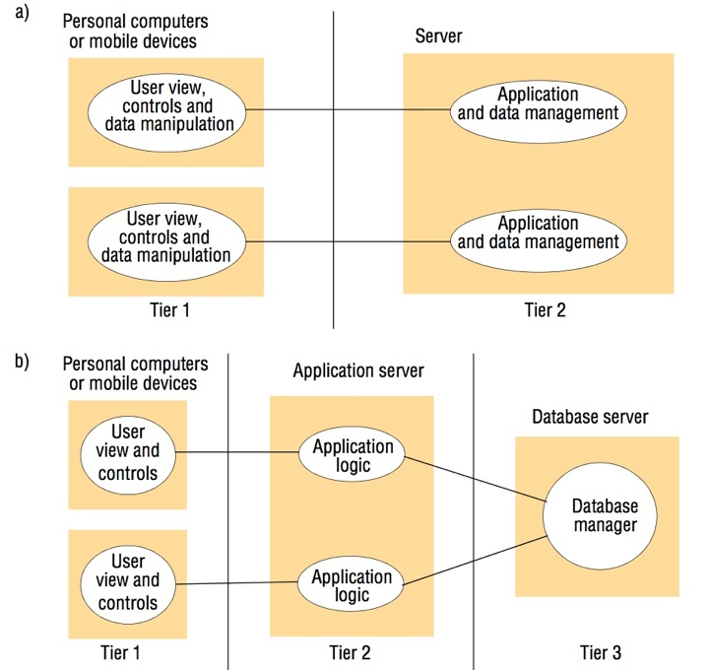
Figure 2.8
Two-tier and three-tier architectures

Slide 30
AJAX
Asynchronous Javascript And XML.
  Extension of client/server style of interaction used in WWW
  Fine grained communication between Javascript front-end running on the browser and a server back-end holing the application data.
Restriction and constrains using HTML interaction:
  Once an HTTP request is issued, user must wait before interaction with the page.
  To Update from a server, you must request an entire new page.
  Content of the page can not be updated in response to change in server’s application data.

Slide 31
AJAX (cont’d)
AJAX is the second innovative step needed to enable major interactive web applications to be developed and deployed.
AJAX is the glue that supports these applications.
Provides communication mechanisms to enable front-end components running in a browser to issue requests and receive results from back-end components running on a server.
  Google Maps (moving tiles is an AJAX call to a Google server)

Slide 32
Figure 2.9
AJAX example: soccer score updates
new Ajax.Request('scores.php?
game=Arsenal:Liverpool’,
{onSuccess: updateScore});
function updateScore(request) {
.....
( request contains the state of the Ajax request including the returned result. The result is parsed to obtain some text giving the score, which is used to update the relevant portion of the current page.)
.....
}

Slide 33
Thin Clients
The trend in Distributed Computing is to move the complexity away from the end-user device towards services in the Internet.
  The move towards Cloud Computing
Thin Client – A window-based user interface executing locally on the user’s computer, but access services on a remote computer.
Drawbacks: Interactive graphics, CAD, and Image Processing activities will experience delay due to network and OS latencies.

Slide 34
Figure 2.10
Thin clients and compute servers
Compute server
Network computer or PC
Thin
network
Application
Client
Process

Slide 35
Thin Client (cont’d)
Thin clients lead to Virtual Network Computing (VNC) (Oracle and Olivetti)
  realvnc.com is a software-based solution.
  adventiq.com is a hardware based solution.
Concept is simple: provide remote access to GUI.
  VNC client interacts with VNC server using a VNC protocol
    Citrix provided solutions for this.

Slide 36
Other Patterns
Proxy – support location transparency in RPC or RMI
Brokerage in web services can also be viewed as an architectural pattern supporting interoperability in complex distributed infrastructures.
  Pattern consists of a trio
    service provider
    service requester
    service broker (match services provided to requested)
      Registry in RM
      naming service in CORBA
Reflection
  Increasingly being used in DSs to support dynamic discovery of properties of system and ability to modify structure or behavior.

Slide 37
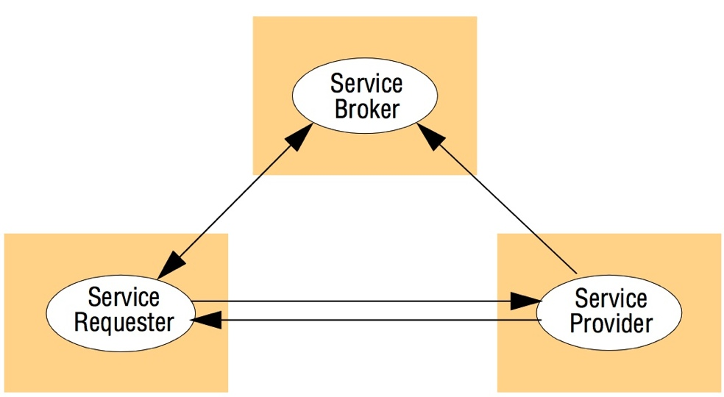
Figure 2.11
The web service architectural pattern

Slide 38
Associated Middleware Solutions
To provide higher-level programming abstraction for the development of DSs and through layering to abstract over heterogeneity in the underlying infrastructure for interoperability and portability
Categories of Middleware
  Early middleware solutions: SunRPC, and group communication systems (ISIS).
  Wider range of styles emerged recently

Slide 39
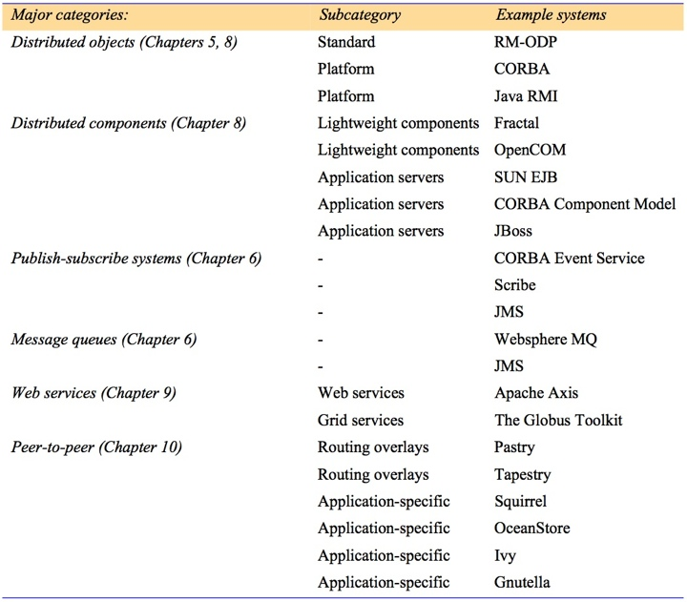
Figure 2.12
Categories of middleware

Slide 40
Fundamental Models
Interaction:
  Messages result in communication and coordination between processes.
    Delays
    Maintaining the notion of time across computers.
Failure:
  faults can occur during operations
  How fault tolerant is the system
Security
  Modular nature of a distributed system exposes it to attacks both internal and external.
  How do we handle security issues.

Slide 41
Fundamental Models
Purpose of these models:
  Make explicit all assumptions about the system we’re modeling
  Make generalization concerns about what is possible and what is impossible.
    Take into consideration provable properties.

Slide 42
Interaction Model
DS’s are composed of many processes with complex interactions
  Multiple servers cooperating
  A set of peer processes
In distributed systems the behavior is described by a “Distributed Algorithm” rather than the traditional algorithm we’re familiar with.
  Messages are going to be transmitted between steps of the processes.
  Each process has its own state.

Slide 43
Interaction Model
Two factors affect the interaction of processes in a distributed system
  Communication Performance (this is a limiting characteristic)
  Impossible to maintain a single global notion of time.

Slide 44
Performance of Communication Channels
Performance characteristics relating to latency, bandwidth, and jitter:
  Delay between start of msg transmission from a process and the beginning of its receipt on another (latency). It includes
    time taken for a string of bits to reach destination.
    delay in accessing the network.
    time taken by operating system comm. services at both ends.
  Bandwidth of a computer network – total amount of information transmitted at a given time.
  Jitter is the variation in time to deliver a series of messages. (multimedia data)
Notes:
While the overall communication speed is affected by network latency and bandwidth, the consistency of communications is affected by the jitters.

Slide 45
Computer Clocks and Timing events
Two processes will have different time on their clocks.
Clocks drift over time.
“Clock Drift Rate” is the rate at which a computer clock deviates from a perfect reference clock.
  Some solutions include radio receivers to get a reading from a GPS. (1 microsecond accuracy)

Slide 46
Two types of Interaction Models
Synchronous Distributed System. This has a strong notion of time.
  Time to execute each step has a known lower and upper bounds.
  Each transmitted message is received within a known bounded time.
  Each process’s drift rate has a known bound
Asynchronous Distributed Systems. Has a weak notion of time and has no bounds on the following:
  Process execution speed
  Message transmission delays
  Clock drift rates. They can be arbitrary

Slide 47
Event Ordering
We want to know if a communication event (send/receive) on a process has occurred before/after/concurrently to another event at another process
  Execution is described in terms of events and their order without accurate clocks.
  If clocks can be synchronized, messages can carry the time with them
    Lamport proposed the notion of a logical time to provide ordering.
    In the example (Figure 2.13) we will look at logical ordering of pairs:
      X sends m1 before Y receives m1
      Y sends m2 before X receives m2
      Also replies are sent after receiving messages, so the logical ordering is Y receives m1 before sending m2
    By assigning a number to each event corresponding to its logical ordering, later events have higher numbers than earlier ones.
      Steps 1, 2, 3, 4 in the figure.

Slide 48
Figure 2.13
Real-time ordering of events

Slide 49
Failure Model
Processes and Communication channels may fail.
Failure models provide understanding to which failures may occur to understand their effect of failure.
We have
  Omission Failure
  Arbitrary Failure
  Timing Failure

Slide 50
Omission Failure
Process or comm. channel fails to perform task.
Process Omission Failure
  crash
  Other processes can detect using timeouts.
  A process crash is called a “fail-stop” if other processes can detect the crash. Used in asynchronous/synchronous systems.
  Sending Omission Failure – loss of message between sending process and outgoing buffer
  Receiving Omission Failure – loss of message between incoming buffer and receiving process.
Communication Omission Failure
  Sender → <send> → (outgoing buffer) → … → (incoming buffer) → <receive> → Receiver
  Sending Omission Failure – loss of message between sending process and outgoing buffer
  Receiving Omission Failure – loss of message between incoming buffer and receiving process.

Slide 51
Figure 2.14
Processes and channels
Instructor’s Guide for Coulouris, Dollimore, Kindberg and Blair, Distributed Systems: Concepts and Design Edn. 5
© Pearson Education 2012

Slide 52
Arbitrary Failures
Arbitrary or Byzantine failure
  The worst possible failure semantics
  Arbitrarily omit intended steps and take unintended steps.
  Communication channels can suffer from arbitrary failures as well.
Notes:
A Byzantine fault is any fault presenting different symptoms to different observers. A Byzantine failure is the loss of a system service due to a Byzantine fault in systems that require consensus. (https://en.wikipedia.org/wiki/Byzantine_fault)

Slide 53
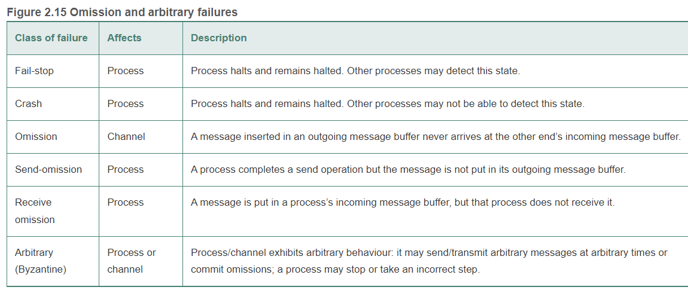

Slide 54
Timing Failures
Applicable in synchronous systems.
Unavailability within a specified time interval.
  Overloaded server may respond slowly
This is relevant in multimedia computers.

Slide 55
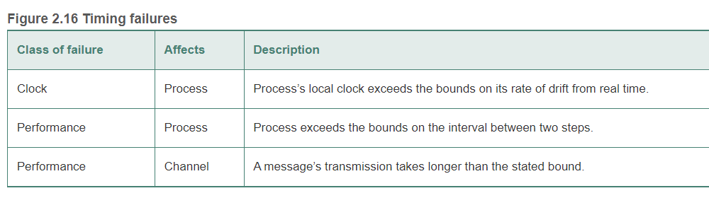

Slide 56
Masking Failures
Hide a failure
Convert it into a more acceptable failure
Replication is one way to mask failures.

Slide 57
Reliability of one-to-one Communication
Reliable communication is defined in terms of
  Validity: messages on outgoing buffer are eventually delivered to an incoming buffer.
  Integrity: messages received are identical to those sent. No messages are delivered twice.
    Integrity threats come from two sources:
      Protocols that retransmit but not reject messages arriving twice. Use seq. numbers.
      Malicious users my inject spurious messages.

Slide 58
Security Model
“Security can be achieved by securing the processes and the channels used for their interactions and by protecting the objects that they encapsulated against unauthorized access”.
So we have to:
  Protect Objects
  Secure processes and their interaction
  Defeat security threats

Slide 59
Protecting Object
  Give “access rights”
  Associate an authority with each invocation and each result (“Principal”, “entity”, “subject”)
    Principal can be a user or a process.
    Identity verification of the principal (i.e., authentication)

Slide 60
Figure 2.17
Objects and principals
Instructor’s Guide for Coulouris, Dollimore, Kindberg and Blair, Distributed Systems: Concepts and Design Edn. 5
© Pearson Education 2012

Slide 61
Securing Processes and their Interaction
Sending messages is exposed to attacks.
  Threats can be to processes and to communication channels.
Threats to Processes
  Server – can’t verify client identity.
  Clients – can’t verify if information is coming from intended server.

Slide 62
Figure 2.18
The enemy
Copy of
m
The enemy
m’
Process
p
m
Process
q
Communication channel
Instructor’s Guide for Coulouris, Dollimore, Kindberg and Blair, Distributed Systems: Concepts and Design Edn. 5
© Pearson Education 2012

Slide 63
Defeating Security threats
Cryptography and message authentication.
Secure Channel:
  4 minimum security services: Confidentiality, data Integrity, origin Integrity (aka authentication), Anti-replay (or Availability) → the CIA triad
  Each process knows the identity of the principal on whose behalf the other process is executing.
  Ensures privacy and integrity
  Each message includes a physical and logical timestamp. → anti-replay
Detailed discussions in
  CSCI 5233 Computer Security & Cryptography
  CSCI 5235 Network Security
  CSCI 5234 Web Security

Slide 64
Figure 2.19
Secure channels
Principal
A
Principal
B
Process
p
Secure channel
Process
q
Instructor’s Guide for Coulouris, Dollimore, Kindberg and Blair, Distributed Systems: Concepts and Design Edn. 5
© Pearson Education 2012

Slide 65
Other security threats
Denial of Service Attacks
Mobile Code

