Slide 1

Slides for Chapter 4:
Interprocess Communication
From Coulouris, Dollimore, Kindberg and Blair
Distributed Systems:
Concepts and Design
Edition 5, © Addison-Wesley 2012

Slide 2
IPC
IPC: Protocols for communication between processes in a distributed system
  Connectionless, e.g., UDP
  Connection oriented, e.g., TCP
  Higher-level communication services:
    Ch 5. Remote invocation
    Ch 6. Indirect communication

Slide 3
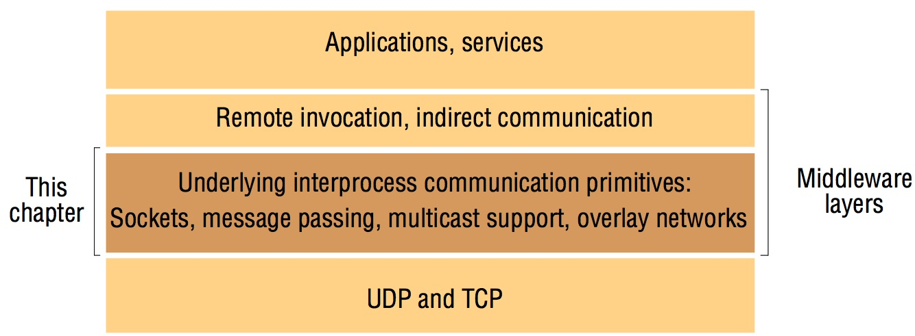
Figure 4.1
Middleware layers
Q: What layer is this?

Slide 4
outline
4.1 Introduction
4.2 The API for the Internet protocols
4.3 External data representation and marshalling
4.4 Multicast communication
4.5 Network virtualization: Overlay networks
4.6 Case study: MPI
4.7 Summary

Slide 5
Introduction
UDP – provides message passing which is the simplest form of IPC.
  Datagrams (independent packets) are sent.
  Uses sockets to specify destination.
TCP – provides the abstraction of a two-way stream between pairs of processes (producer-consumer).
  Each consumer has a data queue.
  Producer process → data queue → consumer process
  If the queue is full, the producer must wait before sending another item.
  If the queue is empty, the consumer must wait before reading another item.

Slide 6
API for the Internet Protocols
Characteristics of IPC
  Two communication operations: send, receive
    We will look at Java API, and MPI
  Synchronous and Asynchronous Communication
    A queue is associated with each message destination.
    Sending adds message to a remote queue.
    Receiving removes message from the local queue.
    Synchronous: Both send and receive are blocking operations. Analogy?
    Asynchronous: Send is non-blocking, and receive can be blocking or non-blocking.
      In today’s systems, most receives are blocking.
      If the receive is non-blocking, then it must separately receive notification the buffer has been filled (polling or interrupt). Analogy?

Slide 7
API for the Internet Protocols
Characteristics cont’d
  Message Destination
    Pairs of (Internet address, port number)
    A port cannot be shared with other processes.
    In C/S, servers generally publicize their port numbers.
    Client needs not to refer to server by a static IP address, it needs to use a name server or a binder to refer to service by name (DNS). This guarantees “location transparency”.
  Reliability
    Point to point communication is reliable if message delivery is guaranteed (validity) and not corrupted or duplicated (integrity).
  Ordering
    Some application require that messages must be delivered in sender’s order. Otherwise it is a failure.

Slide 8
The Sockets Abstraction
UDP and TCP both use sockets.
A socket is an endpoint of communication between processes.
  A socket is bound to a (IP, port#).
  Messages sent to a particular (IP, port#) can be received only by a process whose socket is associated/bound with that pair of (IP, port#).
  Messages are transmitted between a socket in one process and another socket in the other.
Packets are associated with a particular protocol (TCP or UDP).

Slide 9
Figure 4.2
Sockets and ports
any port
agreed port
socket
socket
message
client
server
other ports
Internet address = 138.37.94.248
Internet address = 138.37.88.249

Slide 10
Sockets cont’d
Java API for Internet Addresses
  class InetAddress
  Use the DNS to get the corresponding internet address.
  InetAddress aComputer = InetAddress.getByName(“bruno.dcs.qmul.ac.uk”);
Benefits of using DNS (vs static IP)?
  The interface for this class doesn’t depend on weather you have IPv4 (4 bytes) or IPv6 (16 bytes).
  It supports dynamic IP addresses.

Slide 11
UDP datagram communication
A message sent by a sender to a receiver is placed in the queue bound to the receiver’s (IP, port#).
The receive method returns the Internet address and port of the sender, in addition to the message, allowing the recipient to send a reply.
A message sent by UDP is transmitted without ACK (to the sending process) or retries.

Slide 12
UDP datagram communication
Issues relating to datagram comm.:
  If a failure occurs, the message may not arrive.
  Message size: Receiver needs to specify an array of bytes of a particular size.
    A message larger than the size of that array will be truncated.
    To avoid truncation of a large message, fragmentation may be needed.
  Blocking: non-blocking sends + blocking receives (Meaning?)
    The message is collected from the queue by an outstanding/future receive.
  Timeouts: A receive that blocks forever is only suitable for use by a server waiting for requests.
    Timeouts can be set on sockets.
    Timeout values should be larger than the required transmission time.
  Receive from any: The receive does not specify an origin for messages.

Slide 13
UDP datagram communication
Failure Model for UDP datagrams
  Integrity: Messages should not be corrupted or duplicated.
    Use checksum/hashing to reduce the probability of corrupted messages.
  Reliability: guaranteed message delivery
  UDP suffers from the following failures:
    Omission failures: Messages may be dropped occasionally, either because of a checksum error or because no buffer space is available at the source or destination.
    Ordering : messages delivered out of sender’s order.
  Applications using UDP datagrams are left to provide their own checks to achieve the quality of reliable communication they require. e.g., Acknowledgements

Slide 14
UDP datagram communication
Use of UDP
  Sometimes occasional failures are acceptable in some services.
    DNS
    VoIP
  UDP datagrams are attractive because they don’t suffer from overheads associated with guaranteed message delivery.
    The main sources of overheads are:
      need to store info at source and destination.
      transmission of extra messages.
      latency for the sender.

Slide 15
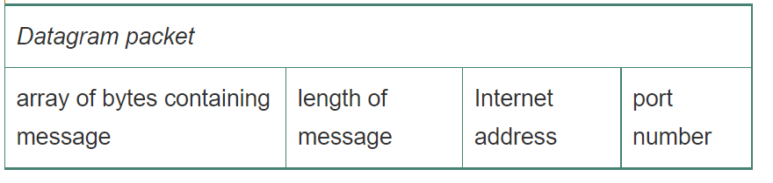
Java API form UDP datagrams
DatagramPacket
  DatagramPacket dp = new DatagramPacket (m, m.length(), aHost, serverPort);
  dp.getData( )
  dp.getPort
  dp.getAddress

Slide 16
Java API form UDP datagrams
DatagramSocket aSocket
Check the JAVA api, e.g., https://docs.oracle.com/javase/7/docs/api/java/net/DatagramSocket.html
  aSocket = new DatagramSocket(); //Constructs a datagram socket and binds it to any available port on the local host machine.
  aSocket.send (<an object of DatagramPacket>)

Slide 17
Figure 4.3
UDP client sends a message to the server and gets a reply
import java.net.*;
import java.io.*;
public class UDPClient{
public static void main(String args[]){
// args give message contents and server hostname
DatagramSocket aSocket = null;
try {
aSocket = new DatagramSocket();
byte [] m = args[0].getBytes();
InetAddress aHost = InetAddress.getByName(args[1]);
int serverPort = 6789;
DatagramPacket request = new DatagramPacket(m, m.length(), aHost, serverPort);
aSocket.send(request);
byte[] buffer = new byte[1000];
DatagramPacket reply = new DatagramPacket(buffer, buffer.length);
aSocket.receive(reply);
System.out.println("Reply: " + new String(reply.getData()));
}catch (SocketException e){System.out.println("Socket: " + e.getMessage());
}catch (IOException e){System.out.println("IO: " + e.getMessage());}
}finally {if(aSocket != null) aSocket.close();}
}
}
Instructor’s Guide for Coulouris, Dollimore, Kindberg and Blair, Distributed Systems: Concepts and Design Edn. 5
© Pearson Education 2012

Slide 18
Figure 4.4
UDP server repeatedly receives a request and sends it back to the client
import java.net.*;
import java.io.*;
public class UDPServer{
public static void main(String args[]){
DatagramSocket aSocket = null;
try{
aSocket = new DatagramSocket(6789);
byte[] buffer = new byte[1000];
while(true){
DatagramPacket request = new DatagramPacket(buffer, buffer.length);
aSocket.receive(request);
DatagramPacket reply = new DatagramPacket(request.getData(),
request.getLength(), request.getAddress(), request.getPort());
aSocket.send(reply);
}
}catch (SocketException e){System.out.println("Socket: " + e.getMessage());
}catch (IOException e) {System.out.println("IO: " + e.getMessage());}
}finally {if(aSocket != null) aSocket.close();}
}
}
Instructor’s Guide for Coulouris, Dollimore, Kindberg and Blair, Distributed Systems: Concepts and Design Edn. 5
© Pearson Education 2012

Slide 19
TCP stream communication
Provide a stream of bytes to which data maybe written or from which data may be read.
The characteristics of the network are hidden by the stream abstraction:
  Message size: The application can choose how much data it writes to a stream or read from it. On arrival, data is handed to the application as requested.
  Lost Messages: TCP uses the ACK scheme; if timeout, resend.
  Flow control: TCP tries to match the speed of sender and receiver (requires the sender to block until the receiver has consumed)
  Message duplication and ordering: A message ID is associated with each packet. Reject duplicates and reorder if necessary.
  Message Destinations: Once communication is established between two processes, it is a matter or reading from and writing to the stream (without using IP, port#).
    Connect (used by clients) and accept (used by server) are used.

Slide 20
TCP stream communication
When the server accepts a connection, a new stream socket is created for the server to communicate with a client, meanwhile retaining its socket at the server port for listening for connect requests from other clients.
The pair of sockets in the client and server are connected by a pair of streams, one in each direction.
  Two-way communication: Each socket has an input stream and an output stream.
  One of the pair of processes can send information to the other by writing to its output stream, and the other process obtains the information by reading from its input stream.

Slide 21
TCP stream communication
Outstanding issues relating to stream communication:
  Matching data items: The order of the data is important
    If sent (double then integer), you must receive (double then integer).
  Blocking: The data written to a stream is kept in a queue at the destination.
    If the queue is almost full, the sender blocks to handle flow control.
    If the queue is empty, the receiver may block until there’s data in the queue.
  Threads: A new thread at the server side to handle a new client.
    Benefits of multi-threading at the server side: The server thread can block when waiting for input, w/o delaying other clients.

Slide 22
TCP stream communication
Failure Model
  To satisfy the integrity property, TCP uses checksum to reject corrupt packets, and sequence number to reject duplicates.
  For the sake of the validity property, TCP streams use timeouts and retransmissions to deal with lost packets.
  TCP does not provide reliable communication, because it does not guarantee to deliver messages in the face of all possible difficulties.
    If connection is broken, a process using it will be notified if it attempts to read or write. This has the following effect:
      process using the connection cannot distinguish between network and process failure.
      Sending process cannot tell whether the sent message has been received or not. Q: Doesn’t TCP use ACK to detect lost messages?

Slide 23
Java API for TCP streams
ServerSocket
  Used by a server process to create a socket for listening clients’ requests
  The result of executing accept on a ServerSocket is an instance of Socket – a socket to use by the server for communicating with the client.
Socket
  Used by a pair of processes with a connection (the client and the server)
  Each socket is not only associated with a local port but also connects it to the specified remote computer and port number.
  Each socket has two streams: InputStream and OutputStream

Slide 24
Figure 4.5
TCP client makes connection to server, sends request and receives reply
import java.net.*;
import java.io.*;
public class TCPClient {
public static void main (String args[]) {
// arguments supply message and hostname of destination
Socket s = null;
try{
int serverPort = 7896;
s = new Socket(args[1], serverPort);
DataInputStream in = new DataInputStream( s.getInputStream());
DataOutputStream out =
new DataOutputStream( s.getOutputStream());
out.writeUTF(args[0]); // UTF is a string encoding see Sn 4.3
String data = in.readUTF();
System.out.println("Received: "+ data) ;
}catch (UnknownHostException e){
System.out.println("Sock:"+e.getMessage());
}catch (EOFException e){System.out.println("EOF:"+e.getMessage());
}catch (IOException e){System.out.println("IO:"+e.getMessage());}
}finally {if(s!=null) try {s.close();}catch (IOException e){System.out.println("close:"+e.getMessage());}}
}
}
Instructor’s Guide for Coulouris, Dollimore, Kindberg and Blair, Distributed Systems: Concepts and Design Edn. 5
© Pearson Education 2012
Notes:
Recall: args[0] is the first argument and args[1] the second argument following the command.
For example: Java TCPClient “Hello World” localhost //args[0] is “Hello World” and args[1] is localhost

Slide 25
Figure 4.6
TCP server makes a connection for each client and then echoes the client’s request
import java.net.*;
import java.io.*;
public class TCPServer {
public static void main (String args[]) {
try{
int serverPort = 7896;
ServerSocket listenSocket = new ServerSocket(serverPort);
while(true) {
Socket clientSocket = listenSocket.accept();
Connection c = new Connection(clientSocket);
}
} catch(IOException e) {System.out.println("Listen :"+e.getMessage());}
}
}
// this figure continues on the next slide

Slide 26
Figure 4.6 continued
class Connection extends Thread {
DataInputStream in;
DataOutputStream out;
Socket clientSocket;
public Connection (Socket aClientSocket) {
try {
clientSocket = aClientSocket;
in = new DataInputStream( clientSocket.getInputStream());
out =new DataOutputStream( clientSocket.getOutputStream());
this.start();
} catch(IOException e) {System.out.println("Connection:"+e.getMessage());}
}
public void run(){
try { // an echo server
String data = in.readUTF();
out.writeUTF(data);
} catch(EOFException e) {System.out.println("EOF:"+e.getMessage());
} catch(IOException e) {System.out.println("IO:"+e.getMessage());}
} finally{ try {clientSocket.close();}catch (IOException e){/*close failed*/}}
}
}
Instructor’s Guide for Coulouris, Dollimore, Kindberg and Blair, Distributed Systems: Concepts and Design Edn. 5
© Pearson Education 2012

Slide 27
ServerSocket, Socket
EX: Draw a diagram to illustrate the sockets used in the above TCP programs.

Slide 28
External Data Representation and Marshalling
Programs have data structures, however information in messages is a sequence of bytes.
Even primitive data types like integers and floats are stored differently in different architectures
  big-endian and little-endian orders.
Also the set of codes that are used to represent characters: ASCII, Unicode.
Two methods that allow computers to exchange information:
  values are converted to an agreed upon external format before transmission.
  Use the sender format, and let the receiver convert.

Slide 29
External Data Representation and Marshalling
To use RPC or RMI, data has to be flattened and the individual primitive data types are represented in an agreed upon format.
  So, external data representation is an agreed upon standard for the representation of data structures and primitive values.
Marshalling: is the process of taking a collection of data items and assembling them into a form suitable for transmission in a message.
Unmarshalling: is the process of disassembling them on arrival to produce an equivalent collection of data items at the destination.

Slide 30
External Data Representation and Marshalling
Three alternatives to external data representation and marshalling:
  CORBA’s common data representation which is concerned with an external representation of the structured and primitive types that can be passed as the args or results of remote method invocation in CORBA.
    Marshalling is carried out at the middleware layer
  Java’s Object Serialization which is concerned with flattening and external data representation of a single object or tree of objects.
    Marshalling is carried out at the middleware layer.
  XML (Extensible Markup Language) which defines a textual format to represent data.
Two others:
  Protocol buffer: Google uses it to capture representations of both stored and transmitted data.
  JSON (JavaScript Object Notation)

Slide 31
CORBA’s Common Data Representation (CDR)
CDR defines a representation for both big-endian and little-endian orderings. Values are transmitted in the sender’s ordering.
  Floating points follow the IEEE standard (sign, exponent, and fractional part)
Constructed types: Add the primitive values that comprise the type to a sequence of bytes in a particular order.

Slide 32
Figure 4.7
CORBA CDR for constructed types
T
y
p
e
Re
pr
e
s
e
n
ta
t
i
o
n
s
e
q
ue
n
ce
l
e
n
g
th
(
u
n
si
g
n
ed
l
o
n
g
)
fo
ll
ow
ed
b
y
el
e
m
e
nt
s
i
n
o
r
d
e
r
s
t
ri
n
g
l
e
n
g
th
(
u
n
si
g
n
ed
l
o
n
g
)
fo
ll
ow
ed
b
y
ch
a
ra
c
te
rs
i
n o
r
d
e
r
(
ca
n
al
so
ca
n
h
av
e
w
i
de
ch
a
ra
c
te
rs)
a
r
ra
y
a
rr
ay
e
le
m
e
n
t
s i
n
o
r
de
r (
n
o l
en
g
t
h s
p
e
ci
f
ie
d b
eca
us
e
i
t
is
f
i
x
e
d
)
s
t
ru
ct
i
n t
he
or
de
r o
f
de
c
la
r
at
i
o
n o
f
t
he
co
mp
o
n
e
n
t
s
e
n
u
m
e
r
a
t
e
d
u
n
s
i
g
n
e
d
l
o
n
g
(
t
h
e
v
a
l
ue
s a
re
s
pe
c
i
f
ie
d
b
y t
he
o
r
de
r d
ec
l
ar
e
d
)
u
ni
o
n
t
y
p
e
ta
g f
o
l
l
o
we
d b
y
t
h
e s
el
e
cte
d m
e
mb
er
Instructor’s Guide for Coulouris, Dollimore, Kindberg and Blair, Distributed Systems: Concepts and Design Edn. 5
© Pearson Education 2012

Slide 33
Figure 4.8
CORBA CDR message
index in
notes
sequence of bytes
4 bytes
on representation
0–3
5
length of string
4–7
"Smit"
‘Smith’
8–11
"h___"
12–15
6
length of string
16–19
"Lond"
‘London’
20-23
"on__"
24–27
1984
unsigned long
The flattened form represents a Person struct with the values: {‘smith’, ‘London’, 1948}
Unsigned Longs that occupy 4 bytes start at an index that is a multiple of 4.
Instructor’s Guide for Coulouris, Dollimore, Kindberg and Blair, Distributed Systems: Concepts and Design Edn. 5
© Pearson Education 2012

Slide 34
CORBA’s Common Data Representation (CDR)
Other examples of ext. data rep. is Sun XDR standard (1995).
  Developed by sun to exchange message in NFS.
The type of data is not given with the data rep. in either CORBA CDR or Sun XDR.

Slide 35
Marshalling in CORBA
Marshalling can be generated automatically from the specification of the types of data items to be transmitted in the message.
  Types of data structures and basic items are described in the CORBA IDL.
  struct Person {
  string name;
  string place;
  unsigned long year;
  }
  CORBA Interface compiler generated appropriate marshalling and unmarshalling operations for the args and results of remote methods from the definition of the types.

Slide 36
Java Object Serialization
This is a Java class equivalent to the Person struct in CORBA IDL.
public class Person implements Serializable {
private String name;
private String place;
private int year;
public Person(String aName, String aPlace, int aYear){
name = aName;
place = aPlace;
year = aYear;
}
// methods
}

Slide 37
Java Object Serialization
Implement the interface Serializable that has no methods.
Basically flatten the object.
Information about the class is included in the serialization.
Objects that have references will appear in the serialization as handles. In this case the references are also serialized with the object.
Serialization and deserialization are carried out automatically by the middleware.
Objects you don’t want to be serialized such as files and sockets should be declared as transient.
Reflection: is the ability to enquire about properties of a class such as the name and the type of the class. Java supports this in object serialization.
Notes:
“transient is a variables modifier used in serialization. At the time of serialization, if we don’t want to save value of a particular variable in a file, then we use transient keyword.” (https://www.geeksforgeeks.org/transient-keyword-java/)

Slide 38
Figure 4.9
Indication of Java serialized form
Serialized values
Explanation
Person
8-byte version number
h0
class name, version number
int year
java.lang.String
java.lang.String
number, type and name of
3
name:
place:
instance variables
1984
5 Smith
6 London
h1
values of instance variables
The true serialized form contains additional type markers;
h0 and h1 are handles
Instructor’s Guide for Coulouris, Dollimore, Kindberg and Blair, Distributed Systems: Concepts and Design Edn. 5
© Pearson Education 2012

Slide 39
XML
Both XML and HTML are derived from SGML (Standardized Generalized Markup Language)
Designed for writing structured documents for the web.
Designed to enable clients to communicate with web services and for defining the interfaces.
Extensible in the sense it allows users to define their own tags.
Textual documents that can be read by humans.

Slide 40
XML
Elements and Attributes:
  Elements consist of a portion of character data surrounded by matching start and end tags.
    An element can enclose another element: ex. person element encloses name element.
  Attributes: A start tag may optionally include pairs of associated attribute names and values: ex. id=“1234”
  Names: names of tags and attributes must start with a letter or underline or colon followed by letters, digits, hyphens, or underscores. (case-sensitive)
  Binary data: represented in base64 notation

Slide 41
Figure 4.10 XML definition of the Person structure
<person id="123456789">
<name>Smith</name>
<place>London</place>
<year>1984</year>
<!-- a comment -->
</person >
Instructor’s Guide for Coulouris, Dollimore, Kindberg and Blair, Distributed Systems: Concepts and Design Edn. 5
© Pearson Education 2012

Slide 42
XML
Parsing and well-formed documents
  documents must be well-formed as they must conform to rules about the structure
    Every start tag must have an end tag.
    tags are correctly nested.
    every document must have a root element.
  CDATA: If a section cannot be parsed because it has special characters, then it could be denoted as CDATA: <place> <![CDATA [King’s Cross]]></place>
    Notice the quote.
  XML Prolog: every document must have a Prolog
  <?XML version = “1.0” encoding = “UTF-8” standalone = “yes”?>
  * Unicode Transformation Format

Slide 43
XML
XML Namespaces.
  Is a set of names for a collection of element types and attributes that is referenced by a URL. Any other XML document can use a namespace by referring to its URL.
    xmlns attribute.
  Allows an application to make use of multiple sets of external definitions without the risk of name clashes.

Slide 44
Figure 4.11 Illustration of the use of a namespace in the Person structure
<person pers:id="123456789" xmlns:pers = "http://www.cdk5.net/person">
<pers:name> Smith </pers:name>
<pers:place> London </pers:place >
<pers:year> 1984 </pers:year>
</person>
Instructor’s Guide for Coulouris, Dollimore, Kindberg and Blair, Distributed Systems: Concepts and Design Edn. 5
© Pearson Education 2012

Slide 45
XML
XML Schemas:
  Define the elements and attributes that can appear in a document and how they’re nested, the order, and the number of elements.
  This allows the document to be validated by the schema to which it conforms.
  DTD (Document Type Definition) is used to define the structure of an XML document.
API for accessing XML – XML parsers and generators are available in many programming languages, most of which is Java.

Slide 46
Figure 4.12 An XML schema for the Person structure
<xsd:schema xmlns:xsd = URL of XML schema definitions >
<xsd:element name= "person" type ="personType" />
<xsd:complexType name="personType">
<xsd:sequence>
<xsd:element name = "name" type="xs:string"/>
<xsd:element name = "place" type="xs:string"/>
<xsd:element name = "year" type="xs:positiveInteger"/>
</xsd:sequence>
<xsd:attribute name= "id" type = "xs:positiveInteger"/>
</xsd:complexType>
</xsd:schema>
Instructor’s Guide for Coulouris, Dollimore, Kindberg and Blair, Distributed Systems: Concepts and Design Edn. 5
© Pearson Education 2012

Slide 47
Remote Object Reference
Applies to Java and CORBA.
A remote object reference is an identifier for a remote object that is valid throughout a distributed system.
A remote object reference is passed in the invocation message to specify which object is to be invoked.

Slide 48
Figure 4.13
Representation of a remote object reference
32 bits
32 bits
32 bits
32 bits
Internet address
port number
time
object number
interface of
remote object
Instructor’s Guide for Coulouris, Dollimore, Kindberg and Blair, Distributed Systems: Concepts and Design Edn. 5
© Pearson Education 2012

Slide 49
Multicast communication
Pairwise communication is not the best model to communicate between a group of processes.
  1 to many communication is needed.
Multicast messages provide a useful infrastructure for constructing distributed systems with the following characteristics:
  Fault tolerance based on replicated services. Client requests are multicasts.
  Discovering services in spontaneous networking. locate services.
  Better performance through replicated data.
  Propagation of event notification.

Slide 50
IP multicast
An implementation of multicast communication.
IP Multicast is built on top of the IP protocol. So, only computer to computer, the port number is at the TCP or UDP levels.
Multicast group is specified by a class D Internet address. 1110 in IPv4.
This is specific to IPv4:
  Multicast router – sender can specify the number of hops (routers to visit) using a TTL (time to live)
  Multicast address allocation –
    Local Network Control Block: 224.0.0.0 – 224.0.0.255
    Internet Control Block: 224.0.1.0 – 224.0.1.255
    Ad Hoc Control Block: 224.0.2.0 – 224.0.255.0
    Administratively scoped block: 239.0.0.0 – 239.255.255.255
  Multicast addresses can be permanent or temporary.

Slide 51
Failure Model for multicast datagrams
Omission failures.
Some but not all of the group members receive.
It is called unreliable multicast as it doesn’t guarantee all will receive the message.
NEXT:
Java API to IP Multicast.

Slide 52
Figure 4.14
Multicast peer joins a group and sends and receives datagrams
import java.net.*;
import java.io.*;
public class MulticastPeer{
public static void main(String args[]){
// args give message contents & destination multicast group (e.g. "228.5.6.7")
MulticastSocket s =null;
try {
InetAddress group = InetAddress.getByName(args[1]);
s = new MulticastSocket(6789);
s.joinGroup(group);
byte [] m = args[0].getBytes();
DatagramPacket messageOut =
new DatagramPacket(m, m.length, group, 6789);
s.send(messageOut);
// this figure continued on the next slide
Instructor’s Guide for Coulouris, Dollimore, Kindberg and Blair, Distributed Systems: Concepts and Design Edn. 5
© Pearson Education 2012

Slide 53
Figure 4.14 continued
// get messages from others in group
byte[] buffer = new byte[1000];
for(int i=0; i< 3; i++) {
DatagramPacket messageIn =
new DatagramPacket(buffer, buffer.length);
s.receive(messageIn);
System.out.println("Received:" + new String(messageIn.getData()));
}
s.leaveGroup(group);
}catch (SocketException e){System.out.println("Socket: " + e.getMessage());
}catch (IOException e){System.out.println("IO: " + e.getMessage());}
}finally {if(s != null) s.close();}
}
}
Instructor’s Guide for Coulouris, Dollimore, Kindberg and Blair, Distributed Systems: Concepts and Design Edn. 5
© Pearson Education 2012

Slide 54
Reliability and Ordering in Multicast
Datagram may be lost.
Any recipient may drop a message.
Any process may fail.
If a router fails, group members beyond the router will not receive message, but local ones will.
As for ordering, Packets may not arrive in order.

Slide 55
Examples of the effects of reliability and ordering
Fault tolerance based on replicated services –
  data replicated must either be received by all or none. But if some receive and others don’t then we run into inconsistency issues. Require all members to receive request messages in the same order.
Discovering services in spontaneous networking –
  multicast at periodic intervals. Available services listen and respond. An occasional lost request is not an issues when discovering services.
Better Performance through replicated data –
  lost messages and inconsistent ordering would depend on the method of replication and the importance of replicas.
Propagation of event notification – application determines the qualities required of multicast.

Slide 56
Network Virtualization: Overlay Networks
Construct many virtual networks over an existing network such as the Internet.
  Peer-to-peer file sharing and Skype.
  Networks co-exist with one another even though they assume different architecture but they exist over the same underlying network.

Slide 57
Overlay Networks
Virtual network consisting of nodes and virtual links that sit on top of an underlying network and offers something that is otherwise not provided:
  services that is tailored towards needs of class applications like multimedia
  more efficient operation in a given network environment like routing in ad hoc networks.
  additional features like multicast or secure communication.

Slide 58
Overlay Networks
Overlay networks have the following advantages:
  They enable new network services without requiring changing the underlying network.
  They encourage experimentation with network services and the customization of services.
  Multiple overlays can be defined and can coexist.
Disadvantages:
  An extra level of indirection which may result in performance penalties.

Slide 59
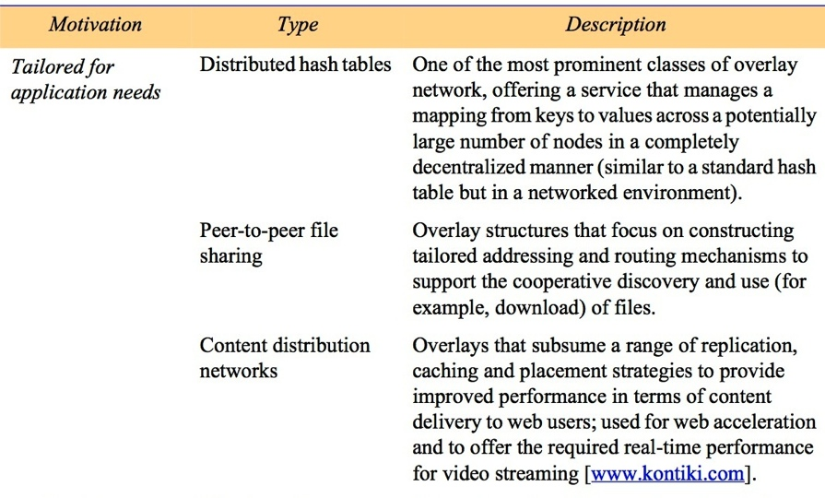
Figure 4.15
Types of overlay
table continues on the next slide
Instructor’s Guide for Coulouris, Dollimore, Kindberg and Blair, Distributed Systems: Concepts and Design Edn. 5
© Pearson Education 2012

Slide 60
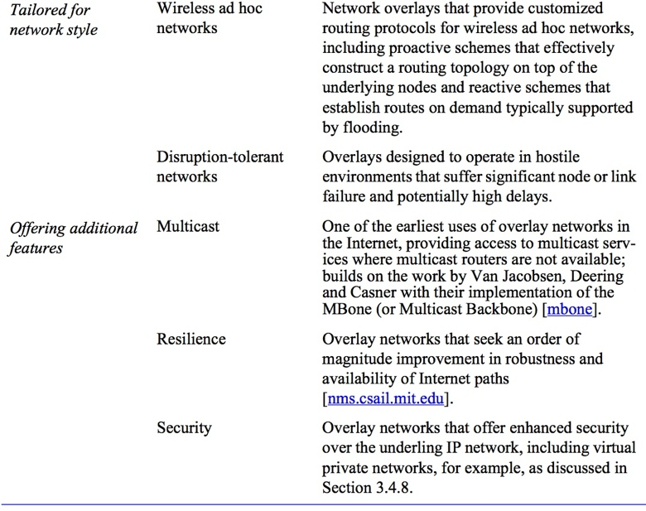
Figure 4.15 (continued)
Types of overlay
Instructor’s Guide for Coulouris, Dollimore, Kindberg and Blair, Distributed Systems: Concepts and Design Edn. 5
© Pearson Education 2012

Slide 61
Skype: Example of overlay network
Peer-to-Peer providing VoIP
Skype Architecture is based on peer-to-peer infrastructures. hosts and super nodes exist.
User connection – login server.
Search for Users – super nodes perform efficient search.
Voice connection – TCP for signaling call requests, UDP or TCP for streaming audio.

Slide 62
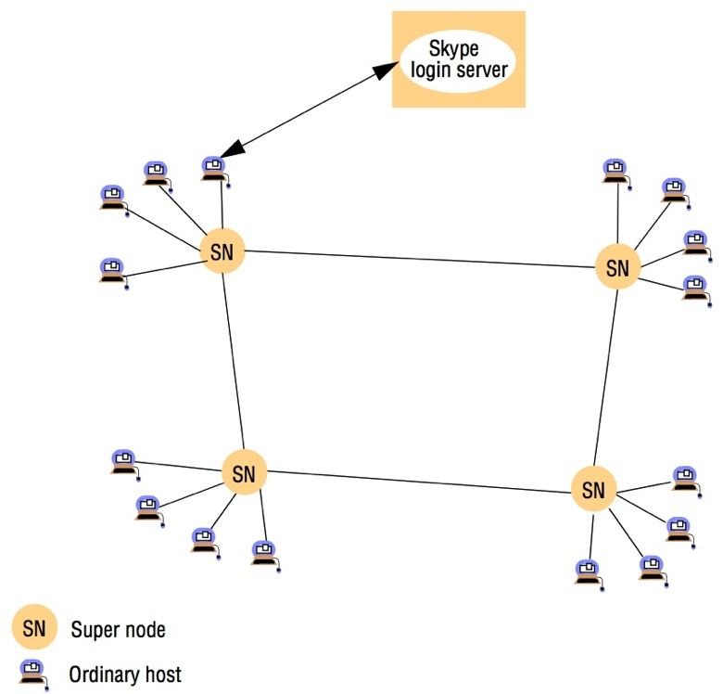
Figure 4.16
Skype overlay architecture
Instructor’s Guide for Coulouris, Dollimore, Kindberg and Blair, Distributed Systems: Concepts and Design Edn. 5
© Pearson Education 2012

Slide 63
MPI
Exchange messages using send and receive operations.
Used in high performance computing.
Grid Computing (GridMPI)

Slide 64
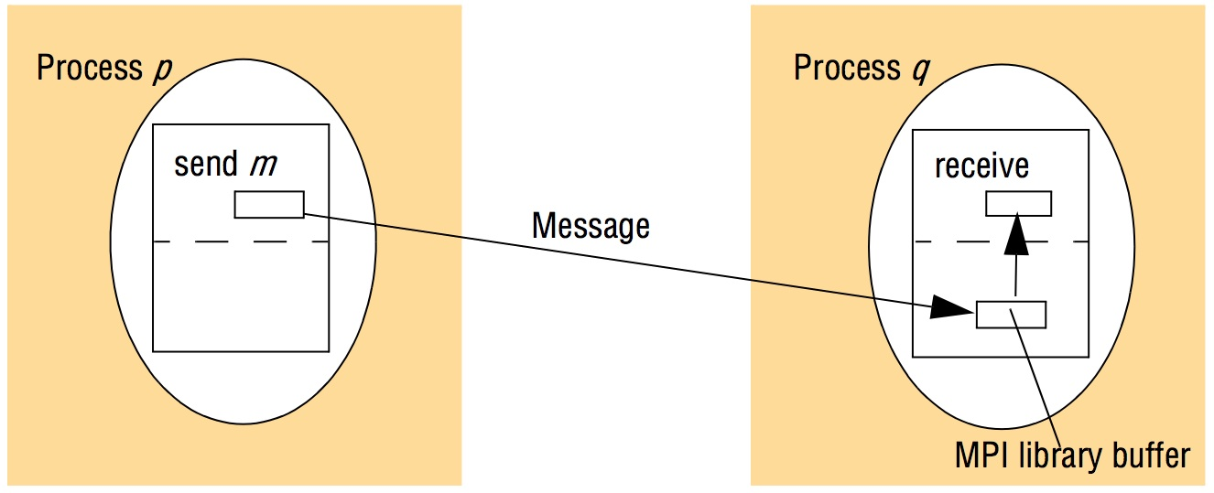
Figure 4.17
An overview of point-to-point communication in MPI
Instructor’s Guide for Coulouris, Dollimore, Kindberg and Blair, Distributed Systems: Concepts and Design Edn. 5
© Pearson Education 2012

Slide 65
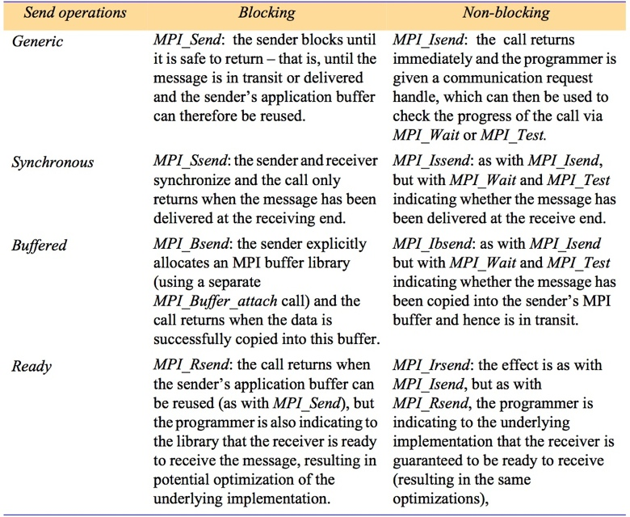
Figure 4.18
Selected send operations in MPI
Instructor’s Guide for Coulouris, Dollimore, Kindberg and Blair, Distributed Systems: Concepts and Design Edn. 5
© Pearson Education 2012

