Slide 1

Slides for Chapter 7:
Operating System support
From Coulouris, Dollimore, Kindberg and Blair
Distributed Systems:
Concepts and Design
Edition 5, © Addison-Wesley 2012

Slide 2
Introduction
OS:
  The operating system facilitates the encapsulation and protection of resources inside a computer.
    The processors, memory, networks, storage media, etc.
  It supports the mechanisms required to access these resources, including communication and scheduling.
Network operating systems are operating systems that have networking capabilities built into them and so can be used to access remote resources.
  Examples: Windows, UNIX, …
  Access to network resources is network-transparent for some, but not all, types of resources.

Slide 3
Introduction (cont.)
A distributed operating system is an operating system that produces a single system image for all resources in a distributed system.
  That is, access to network resources is network transparent for all type of resources.
There is really no distributed operating systems in general use, but a combination of middleware and network operating systems provide it.
  This creates a balance between system autonomy and transparent resource access.
Middleware is supported by the operating system facilities at the nodes of a distributed system.
  Operating System is below the middleware layer. (Figure 1)

Slide 4
Figure 7.1 System layers

Slide 5
Introduction (cont.)
Recall:
  Applications (in the form of clients) and services (in the form of resource managers) use the middleware layer for their interactions.
  Middleware enables remote communication between objects or processes at the nodes of a distributed system.
    Interprocess messaging
    Remote Procedure Call
    Remote Method Invocation
This chapter: How the remote communication between nodes is supported by the OS.

Slide 6
Outline
7.1 Introduction
7.2 The operating system layer
7.3 Protection
7.4 Processes and threads
7.5 Communication and invocation
7.6 Operating system architecture
7.7 Virtualization at the operating system level

Slide 7
The OS Layer
Users will only be satisfied if their middleware-OS combination has good performance.
The OS running on a node provides its own flavor of abstraction of local hardware resource processing.
Middleware uses these resources to implement its mechanisms for remote invocations between objects or processes at the nodes.
The goal of this chapter is to examine the impact of particular OS mechanisms on the middleware’s ability to deliver distributed resource sharing to users.

Slide 8
Figure 7.1 System layers

Slide 9
OS Layer cont’d
Kernels and server processes are the components that manage resources. So, we need them to have:
  Encapsulation – Full service interface to their resources.
  Protection – Protect against illegitimate access.
  Concurrent Processing – Clients may share resources and access them concurrently.
Clients access resources by making, for example, remote method invocations to a server object, or system calls to a kernel.
invocation mechanisms: a means for the clients to access encapsulated resources
Combination of libraries, kernels, and server may do the following invocation-related tasks:
  Communication: pass operation parameters and results over a network or within a computer
  Scheduling: When an operation is invoked, its processing must be scheduled within the kernel or server.

Slide 10
Figure 7.2
Core OS functionality
Process manager: Creation of and operations upon processes.
Thread manager: Thread creation, synchronization and scheduling.
Communication manager: Communication between threads attached to different processes on the same computer.
Memory manager: Management of physical and virtual memory.
Supervisor: Dispatching of interrupts, system call traps and other exceptions; control of memory management unit and hardware caches; processor and floating-point unit register manipulations.

Slide 11
Figure 7.2
Core OS functionality
Q1: What’s the relationship between process and thread?
Q2: What is the relationship between the different layers in this figure?

Slide 12
Protection
Resources require protection from illegitimate accesses.
  Threats to a system’s integrity do not come only from maliciously contrived code.
    e.g., A malware has gained access to a file.
    e.g., A malware is able to exploit a weakness in a program to cause a buffer overflow attack.
  Benign code that contains a bug or that has unanticipated behavior may cause part of the rest of the system to behave incorrectly.
    e.g., A user has only read right over a file is able to write to it.
    e.g., A user process accidentally write into another user process’s memory address.

Slide 13
Protection (cont.)
Kernel and Protection
  The kernel is a process that remains loaded in the system, and has complete access privileges to physical resources (via device drivers).
  The kernel process executes with the processor in supervisor/privileged mode; the kernel arranges other processes to execute in user/unprivileged mode.
  A process cannot access memory outside its own address space.
    The kernel sets up address spaces to protect itself and other processes from the accesses of an aberrant process.

Slide 14
Protection (cont.)
Kernel and Protection (cont.)
  When a process executes application code, it executes in a distinct user-level address space for that application; when the same process executes kernel code, it executes in the kernel’s address space.
  A process can switch from user-level address space to the kernel-level address space via an exception (e.g., interrupt or a system call trap).
  Price to pay?
    Switching (often called context switching of processes) between address spaces may take many processor cycles, and a system call trap is a more expensive operation than a simple procedure or method call.

Slide 15
Processes and Threads
A process originally represented the execution of a single activity/task; later, it was enhanced to be associated with multiple activities.
  A process consists of an execution environment together with one or more threads.
  A thread is the OS abstraction of an activity. (‘thread of execution’)
  An execution environment is the unit of resource management: a collection of kernel-managed resources to which its threads have access.
    A multi-threaded process can maximize the degree of concurrent execution between operations within that process.

Slide 16
Processes and Threads (cont.)
An execution environment consists of:
  an address space
  thread synchronization and communication resources such as semaphores and sockets
  Higher-level resources such as files and windows
An execution environment represents the protection domain in which its threads execute.
  An execution environment provides protection from threads outside of it, so that the data and other resources contained in it are by default inaccessible to threads residing in other execution environments.
  Threads can be created and destroyed automatically, as needed.

Slide 17
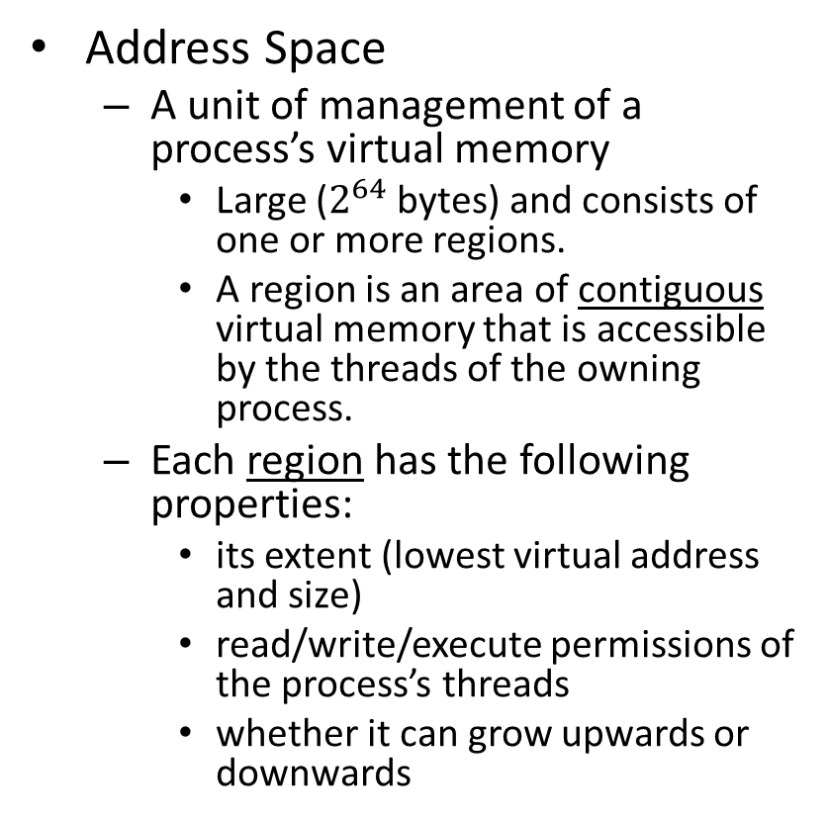
Processes and Threads (cont.)
Address Space
  A unit of management of a process’s virtual memory
    Large ($2^{64}$ bytes) and consists of one or more regions.
    A region is an area of contiguous virtual memory that is accessible by the threads of the owning process.
  Each region has the following properties:
    its extent (lowest virtual address and size)
    read/write/execute permissions of the process’s threads
    whether it can grow upwards or downwards

Slide 18
Processes and Threads (cont.)
Address Space cont’d:
  Page-oriented model (i.e., equal-sized memory units called pages) is used, so regions may eventually overlap when extended.
  Gaps are left between regions to allow for growth.
    A heap, part of which is initialized by values stored in the program’s binary file, and which is extensible towards higher virtual addresses; and a stack, which is extensible towards lower virtual addresses.
Notes:
“Paging splits the address space into equal sized units called pages. While segmentation splits the memory into unequal units that may have sizes more meaningful or appropriate to the program.” (https://cseweb.ucsd.edu/classes/sp16/cse120-a/applications/ln/lecture11and12.html)

Slide 19
Processes and Threads (cont.)
Address Space cont’d:
  An indefinite number of regions: Reasons?
    To support a separate stack for each thread
      possible to detect attempts to exceed stack limit
    To allow for mapping files/objects onto the address space
      A mapped file is a file that is accessed as an array of bytes in memory.
    To share memory between processes, or between processes and the kernel
      A shared memory region (or shared region for short) is one that is backed by the same physical memory as one or more regions belonging to other address spaces.
Notes:
“Paging splits the address space into equal sized units called pages. While segmentation splits the memory into unequal units that may have sizes more meaningful or appropriate to the program.” (https://cseweb.ucsd.edu/classes/sp16/cse120-a/applications/ln/lecture11and12.html)

Slide 20
Processes and Threads (cont.)
Shared Memory
  Processes can access identical memory contents in the regions that are shared, while their non-shared regions remain protected.
  Uses:
    Libraries: A single copy of library code can be shared between multiple processes that need it.
    Kernel: The kernel code and data are often mapped into every address space at the same location.
      When a system call or an exception happens, no need to switch to a new set of address mappings.
    Data Sharing and Communication: Between two cooperating processes, shared data can be mapped as regions in both address spaces.
      More efficient than passing the shared data as messages

Slide 21
Processes and Threads (cont.)
Creation of a new process on a host
  e.g., fork and exec in UNIX
Creation of a new process in a distributed system
- 2 aspects to consider:
    The choice of a target host where the new process will reside;
    The creation of an execution environment and its initial thread.

Slide 22
Processes and Threads (cont.)
Creation of a new process in a DS: (cont.)
  Choice of process host (based on policies)
    2 policies for load sharing:
      transfer policy – situate the new process locally or remotely depending on the load of the local host.
      location policy – determine which node should host the new process selected for transfer.
        Again the relative load of each host is considered.
    Load-sharing systems can be:
      centralized (load manager)
      decentralized (nodes exchange information to make allocation decision)
      hierarchical (several managers in a tree structure)

Slide 23
Processes and Threads (cont.)
Creation of a new process in a DS (cont.)
  Load-sharing algorithms
    Sender-initiated load-sharing algorithms – The transfer decision is made by the process that requires a new process to be created (because its load crosses a threshold).
    Receiver-initiated load-sharing algorithms – The nodes whose load is below a threshold advertise their existence to other nodes.
    Migratory load-sharing system
      Shift load any time from a node to another
      Process migration: The transfer of an executing process from one node to another

Slide 24
Processes and Threads (cont.)
Creation of a new process in a DS: (cont.)
  Creation of a new execution environment
    A new process requires an execution environment consisting of an address space with initialized contents.
    Two approaches:
      The address space is of statically defined format.
        A program text region, heap region and stack region ( created from a list specifying their extent).
      The address space is defined with respect to an existing execution environment.
      e.g., fork in UNIX: new child shares parent’s text, heap and stack regions)
        An inherited region may be shared or logically copied from the parent’s region.

Slide 25
Processes and Threads (cont.)
Creation of a new execution environment (cont.)
  When an inherited region is copied from the parent:
    Apply optimization called copy-on-write
      The region is copied, but no physical memory copying takes place by default.
      Both processes share the page frames of the inherited region.
      A page in the region is only physically copied when one or another process attempts to modify it.
    Copy-on-write is a general technique.
      it is also used in copying large messages.
    Example: regions RA and RB whose memory is shared via copy-on-write between processes A and B. RA is to be inherited by B (child) to create region RB in B.

Slide 26
Figure 7.4 Copy-on-write
Process A’s address space
Process B’s address space
RB copied
RA
from RA
RB
Kernel
Shared
frame
A's page
B's page
table
table
a) Before write
b) After write

Slide 27
Processes and Threads (cont.)
Copy-on-write (cont’d)
  Pages belonging to A are in memory.
  Initially all page frames are shared.
  At hardware level all pages are write-protected.
  If a thread from A or B tries to modify the data, a hardware exception “page fault” occurs.
  If B attempts to write
    page fault handler allocates a new frame for B and copies the original frame.
    The old frame number is replaced by a new one.
    Two pages at A and B are now writable at the hardware level.
    Now process B’s modifying instructions can proceed.

Slide 28
Processes and Threads (cont.)
- Threads
Q: What are the benefits of multi-threading in the client and the server processes?
  Assumptions:
    Each request sent to the server takes 2 ms for processing plus 8 ms for I/O delay.
    No caching of data
    Threads are independently schedulable.
  If a single thread performs all processing then
    The turnaround time is 10 ms per request, so this server can handle 100 client requests per second. (the server’s throughput)
  What if the server pool has two threads?
    One thread can be scheduled when the other blocks for I/O.
    The threads may be blocked behind the single disk drive, so if all disk requests are serialized and take 8 ms each, then
      max throughput is 1000/8 = 125 requests per second.

Slide 29
Figure 7.5
Client and server with threads
Thread 2 makes
requests to server
Receipt &
Input-output
Thread 1
queuing
generates
results
T1
Requests
N threads
Client
Server

Slide 30
Threads
Suppose disk block caching is introduced.
  Server keeps data it needs in a buffer, and the cache hit rate is 75%, then (0.75*0 + 0.25*8 = 2 ms and this increases the theoretical throughput to 500 requests per second.
  If because of caching the average process time for requests has increased to 2.5 ms, then the max throughput is now 1000/2.5 = 400 requests per second.

Slide 31
Threads
Multi-threaded server architecture
  Multi-threading enables servers to maximize their throughput.
  Various ways to map requests to threads within a server
  Figure 7.5 shows one of the possible threading architectures, the worker pool architecture.
    The server, when it starts up, creates a fixed pool of worker threads to process the requests.
  Figure 7.6 = Figure 7.5 + multiple priority queues

Slide 32
Figure 7.6
Alternative server threading architectures (see also Figure 7.5)

Slide 33
Threads
thread-per-request architecture
  The I/O thread spawns a new worker thread for each request.
  That worker thread destroys itself after processing.
    high throughput because of no shared queue.
    overhead of thread creation and destruction
thread-per-connection architecture
  Associate a thread with each client connection
    The server creates a new worker thread when a client makes a connection and destroys the thread after closing the connection.
      Client may make many requests over that thread.
thread-per-object architecture
  Associate a thread with each remote object
    The I/O thread receives requests and queues them on a per object queue.
In the last two
  low thread management overhead, compared to (a)
  but clients may be delayed while a worker thread handles outstanding requests.

Slide 34
Threads
Multi-threaded clients
  Two threads in a client process:
    One thread generates results to be passed to server
    The other does RMI
    The first thread places results in a buffer; the second thread empties it.
  Another example: A web browser making multiple concurrent requests for web pages

Slide 35
Threads
Threads vs. multiple processes:
  Processes have their separate execution environments.
  Threads share an execution environment belonging to a process.
  Comparison between processes and threads:
    Creating a thread is cheaper than creating a process.
    Switching to a thread within the same process is cheaper than switching between threads belonging to different processes.
    Threads within a process may share data and other resources conveniently.
    But, threads are not protected from one another.

Slide 36
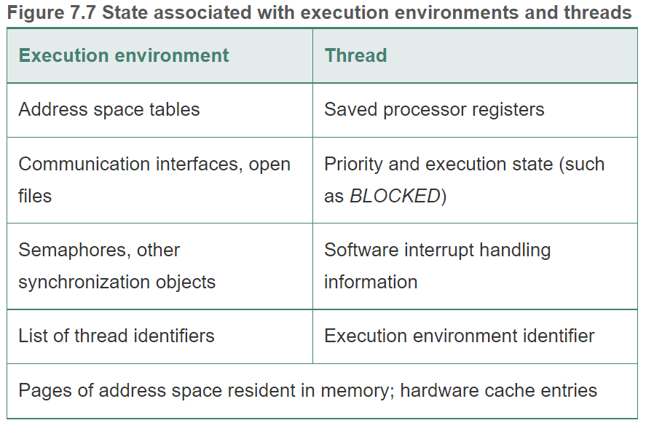

Slide 37
Threads vs Processes
The overheads associated with creating a process are in general considerably greater than those of creating a new thread.
  [Anderson et al. 1991] about 11 ms to create a new UNIX process versus about 1 ms to create a thread on the same computer
Switching between threads sharing the same execution environment is considerably cheaper than switching between threads belonging to different processes. Why?
The advantage and the danger of using multi-threaded processes:
  The convenience and efficiency of access to shared data is an advantage.
  Threads that share an address space and that are not written in a type-safe language are not protected from one another.
  An errant thread can arbitrarily alter data used by another thread, causing a fault.
  If protection is required, then either a type-safe language should be used or it may be preferable to use multiple processes instead of multiple threads.

Slide 38
Threads
Thread Programming
  C (pthreads) and Java handle threads very well.
  Java’s implementation is seen in the next two figures.

Slide 39
Figure 7.8
Java thread constructor and management methods
Thread(ThreadGroup group, Runnable target, String name)
Creates a new thread in the SUSPENDED state, which will belong to group and be identified as name; the thread will execute the run() method of target.
setPriority(int newPriority), getPriority()
Set and return the thread’s priority.
run()
A thread executes the run() method of its target object, if it has one, and otherwise its own run() method (Thread implements Runnable).
start()
Change the state of the thread from SUSPENDED to RUNNABLE.
sleep(int millisecs)
Cause the thread to enter the SUSPENDED state for the specified time.
yield()
Causes the thread to enter the READY state and invoke the scheduler.
destroy()
Destroy the thread.

Slide 40
Figure 7.9
Java thread synchronization calls
thread.join(int millisecs)
Blocks the calling thread for up to the specified time until thread has terminated.
thread.interrupt()
Interrupts thread: causes it to return from a blocking method call such as sleep().
object.wait(long millisecs, int nanosecs)
Blocks the calling thread until a call made to notify() or notifyAll() on object wakes the thread, or the thread is interrupted, or the specified time has elapsed.
object.notify(), object.notifyAll()
Wakes, respectively, one or all of any threads that have called wait() on object.

Slide 41
Threads
Thread lifetimes:
  A new thread is created on the same JVM as it’s created in the SUSPENDED state.
  After it is made RUNNABLE with the start() method, it will execute the run() method.
Thread synchronization
  Race conditions can occur when threads are manipulating data concurrently.
  Synchronized keyword to designate the monitor for thread coordination.
  Designate worker’s thread methods addTo() and removeFrom() as synchronized methods.

Slide 42
Threads
Thread Scheduling
  Preemptive scheduling: thread maybe suspended any time to make way for another thread.
  Non-preemptive scheduling: run until it makes a call to the threading system.
  yield() method allows other threads to be scheduled and make progress.

Slide 43
Threads
Thread implementation:
  Many kernels provide native support for multithreaded processes. Creation and management system calls.
  A thread would block a process and all threads within it if it makes a blocking system call. So the asynchronous (non-blocking) I/O of the underlying kernel are exploited.
  If there’s no kernel support for multithreading. User-level threads suffer from the following:
    Threads within the processor cannot take advantages of multiprocessors.
    A thread that takes a page fault blocks all threads of the process along with the entire process.
    Threads within different processes cannot be scheduled according to a single scheme of relative prioritization.

Slide 44
Threads
Implementation
  User level threads have significant advantages over kernel-level threads.
    Thread operations are less costly (switching between threads)
    Thread scheduling module is implemented outside the kernel, so it can be customized to suite an application.
    Many more user-level threads can be supported than could reasonably be provided by default by a kernel.
  Possible to combine the advantages of both kernel-level and user-level threads
    Mach kernel: enables user level code to provide hints to the kernel’s thread scheduler.
    Solaris 2: Each process creates one or more kernel level threads “lightweight processes”. User level threads are also available.
      Thread creation and switching at the user-level while taking advantage of the multiprocessor.
      However if a thread blocks the kernel, then all user-level threads assigned to it are prevented from running regardless ready or not.

Slide 45
Threads
Hierarchical Scheduling
  Developed to provide greater efficiency and flexibility.
    User-level threads require the kernel to notify them with events that are relevant to scheduling decisions.
  FastThreads package is an implementation of the hierarchical approach.
    Kernel running on a computer with ≥ 1 processor and a set of application programs running on it.
    Each application has a user-level scheduler
    Kernel allocates virtual processors to processes.

Slide 46
Figure 7.10 Scheduler activations
Example of a 3 processor machine. Proc. A has a lower priority than B so it gets 1 virtual processor. Number of virtual processors assigned to a process can vary.
Processes can give back the virtual processor when not needed or request when needed
B. Shows a process notifying the Kernel when either of two types of events occur:
Virtual Processor is idle and no longer needed.
Extra virtual processor is required.
This figure also shows that kernel notifies process when any of 4 events occur.

Slide 47
Four Types of Events that the kernel notifies the user-level scheduler
Virtual Processor Allocated – First time slice where the schedule can load the SA with a context of READY thread.
SA Blocked – An SA blocked in the kernel, kernel is using a fresh SA to notify the scheduler. Corresponding thread is now BLOCKED, and scheduler allocates a READY thread to notify SA.
SA Unblocked – ready to execute at user level again. Scheduler returns corresponding thread to READY list.
SA Preempted – Kernel has taken away the specified SA from the process. Scheduler places preempted thread in READY list.

Slide 48
Outline
7.1 Introduction
7.2 The operating system layer
7.3 Protection
7.4 Processes and threads
7.5 Communication and invocation
7.6 Operating system architecture
7.7 Virtualization at the operating system level

