Slide 1
Chapter 6 Overview of Query Processing
Author: “Team-1”
Bansariben Thummar, 1809568
Ujjaval Desai, 1856383
Mahavir Chhasatiya, 1800725
Instructor: Dr. Andrew Yang
Department: Computer Science
Course: CSCI 5533 Distributed Information Systems

Slide 2
Outline
Query Processing Problem
Objective of Query Processing
Complexity of Relational Algebra Operations
Characterization of Query Processors
Layers of Query Processing
Conclusion

Slide 3
Overview of Query Processing
What is Query ?
A query is a statement requesting the retrieval of information.
The portion of a DML (Data Manipulation Language) that involves information retrieval is called a query language.

Slide 4
Overview of Query Processing
Alternative ways of evaluating a given query
Equivalent expressions
Different algorithms for each operation
An evaluation plan defines exactly what algorithm is used for each operation, and how the execution of the operations is coordinated.

Slide 5
Overview of Query Processing
What is Query Processor?
In relational database technology, users perform the task of data processing and data manipulation with the help of high level non-procedural language (e.g. SQL).
This high-level query hides the low-level details from the user about the physical organization of the data and presents such an environment so that the user can handle the tasks of even complex queries in an easy, concise and simple fashion.
The inner procedure of query-task is performed by a DBMS module called a Query Processor. Hence the users are relieved from query optimization which is a time consuming task that is actually performed by the query processor.

Slide 6
Overview of Query Processing
What is Query Processor?
Understanding Query processing in distributed database environments is very difficult instead of centralized database, because there are many elements or parameters involved that affect the overall performance of distributed queries. Moreover, in distributed environment, the query processor may have to access in many sites. Thus, query response time may become very high.
That is why, Query processing problem is divided into several sub-problems/ steps which are easier to solve individually.

Slide 7
Overview of Query Processing
Query Processing Problem
Main Function/Objective of a Query Processor
Main function of a query processor is to transform a highlevel-query (also called calculus query) into an equivalent lower-level query (also called algebraic query).
The conversion must be correct and efficient. The conversion will be correct if low-level query has the same semantics as the original query, i.e. if both queries produce the same result.

Slide 8
Overview of Query Processing
Main Problems of Query Processing
Main problem of query processing is query optimization.
It is a time consuming task, because many execution strategies are involved to minimize (optimize) computer recourse consumption.
Total cost also affects query processing. Cost depends on the time required for processing operations of the query at various sites, utilization of various computer resources etc, time needed for exchanging data between sites participating in the execution of the query etc.
Time and space required to process the query is also an important factor for the performance of the query processing.

Slide 9
Overview of Query Processing
Example 1: Subset of the engineering database schema.
SELECT ENAME
FROM EMP,ASG
WHERE EMP.ENO = ASG.ENO
AND RESP = "Manager"
Strategy 1
Π_{ENAME}(σ_{RESP=“Manager”∧EMP.ENO=ASG.ENO}(EMP×ASG))
Strategy 2
Π _{ENAME}(EMP ⋈_{ENO} (σ_{RESP=“Manager”} (ASG))
Strategy 2 avoids Cartesian product, so may be “better”

Slide 10
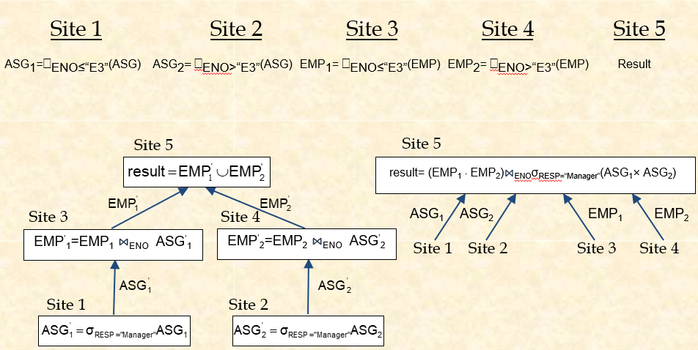
Overview of Query Processing
Example 2: The importance of site selection and communication for a relational algebra query against a fragmented database.

Slide 11
Overview of Query Processing
Cost of Alternatives
Assume
size(EMP) = 400, size(ASG) = 1000
tuple access cost = 1 unit; tuple transfer cost = 10 units
Strategy 1
produce ASG': (10+10) ∗ tuple access cost 20
transfer ASG' to the sites of EMP: (10+10) ∗ tuple transfer cost 200
produce EMP': (10+10) ∗ tuple access cost ∗ 2 40
transfer EMP' to result site: (10+10) ∗ tuple transfer cost 200
Total Cost 460

Slide 12
Overview of Query Processing
Strategy 2
transfer EMP to site 5: 400 ∗ tuple transfer cost 4,000
transfer ASG to site 5: 1000 ∗ tuple transfer cost 10,000
produce ASG': 1000 ∗ tuple access cost 1,000
join EMP and ASG': 400 ∗ 20 ∗ tuple access cost 8,000
Total Cost 23,000

Slide 13
Overview of Query Processing
Objectives of Query Processing
Minimize a cost function
I/O cost + CPU cost + communication cost
These might have different weights in different distributed environments
Wide area networks
communication cost may dominate or vary much
Bandwidth
Speed
high protocol overhead
Local area networks
communication cost not that dominant
total cost function should be considered
Can also maximize throughput

Slide 14
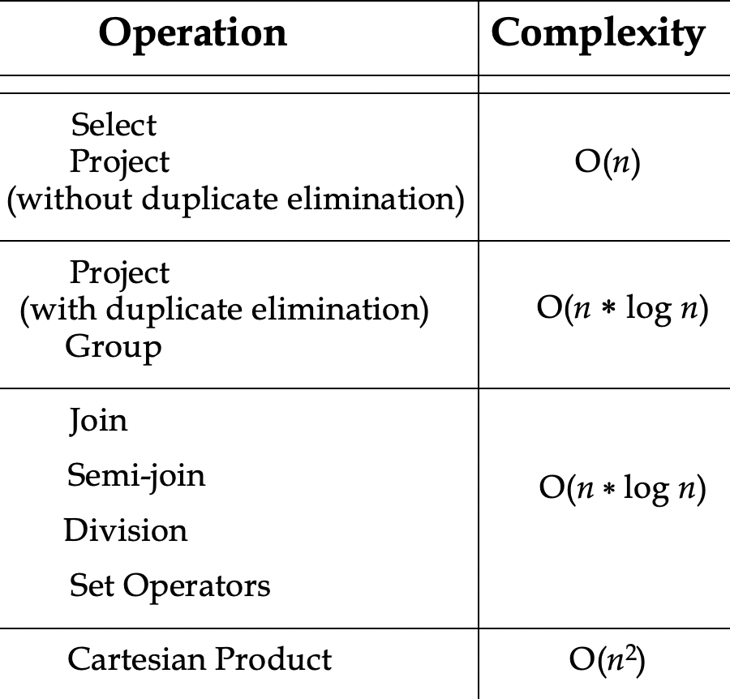
Overview of Query Processing
Complexity of Relational Operations
Complexity is relative to relation cardinalities.
Complexity is O(n) for unary operators and O(nlogn) for binary operators, where n denotes the relation cardinality.
Selection should be performed first which will reduce the cardinalities.
Operators should be ordered by increasing complexity so that cartesian products can be avoided or delayed

Slide 15
Overview of Query Processing
Characterization of Query Processors
Characteristics hold for both centralized and distributed query processors.
Languages
Types of Optimizers
Optimization Timing
Statistics
Characteristics particular to distributed query processors.
Decision Sites
Exploitation of the Network Topology
Exploitation of Replicated Fragments
Use of Semijoins

Slide 16
Overview of Query Processing
Characteristics of Query Processor: Languages
Input language to the query processor is based on high-level relational DBMS, i.e. input is in Relational Calculus query.
On the other hand, output language is based on lower-level relational DMBS, i.e. output is in Relational Algebraic query.
The operations of the output language are implemented directly in the computer system.
Query processing must perform efficient mapping from the input language to the output language.

Slide 17
Overview of Query Processing
Query processing steps:

Slide 18
Overview of Query Processing
Characteristics of Query Processor: Types Of Optimizers
Goal of Optimizer: It aims to choose the “best” point in the solution
space of all possible execution strategies in terms of time and space
complexity.
Problem to tackle:
Solution space can be large.
Similar strategies due to small number of relations.
The problem becomes worse as the number of relations or fragments increases.
Role of Optimizer:
To search the solution space.
Exhaustively predict the cost of each strategy.
Select the strategy with minimum cost.
Two types of optimization:
Cost based optimization
Heuristics optimization (Logical)

Slide 19
Overview of Query Processing
Characteristics of Query Processor: Types Of Optimizers (cont.)
Cost based optimization
Based on the cost of the query.
This method mainly uses the statistics like record size, number of records, number of records per block, number of blocks, table size etc.
Advantage: Consistently chooses the best solution
Disadvantage: Exponential time and space complexity owing to the large solution space.
Algorithm paradigms used in cost based optimization.
Dynamic Programming, Left Deep Trees etc.

Slide 20
Overview of Query Processing
Characteristics of Query Processor: Types Of Optimizers (cont.)
Heuristic Optimization (Logical)
This method is also known as rule based optimization.
This is based on the equivalence rule on relational expressions; hence the number of combination of queries get reduces here. Hence the cost of the query too reduces.
Advantage: Polynomial time and space complexity better than Cost based optimization.
Disadvantage: These algorithms do not necessarily produce the best query plan.

Slide 21
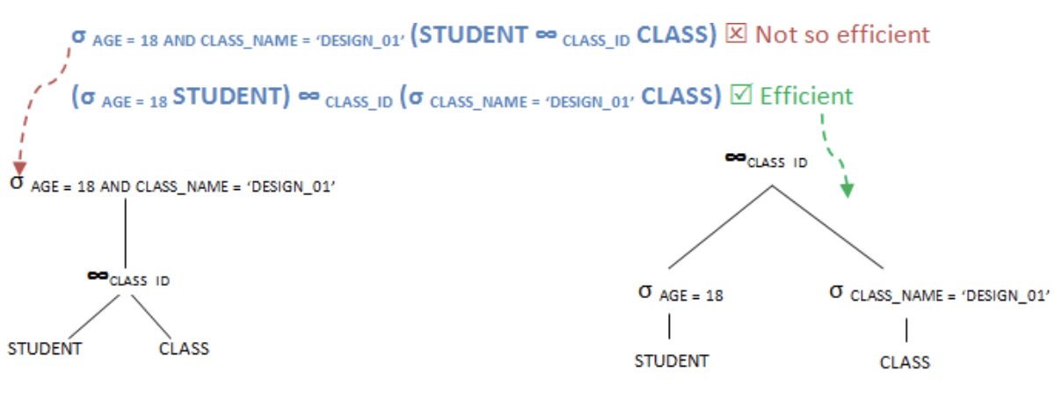
Overview of Query Processing
Characteristics of Query Processor: Types Of Optimizers (cont.)
Rule-1: Perform the selection operation first. By doing so, we can reduce the number of records involved in the query, rather than using the whole tables throughout the query.

Slide 22
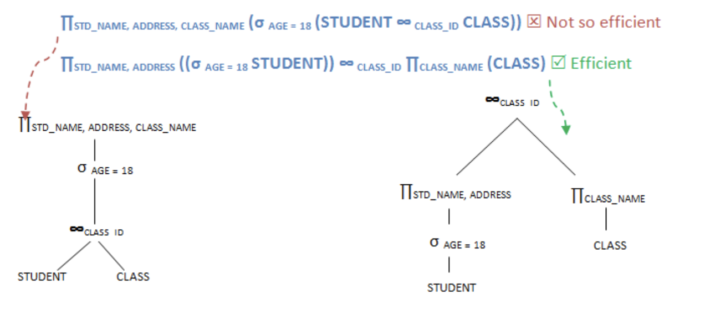
Overview of Query Processing
Characteristics of Query Processor: Types Of Optimizers (cont.)
Rule-2: Perform all the projection as early as possible in the query. This is similar to selection but will reduce the number of columns in the query.

Slide 23
Overview of Query Processing
Characteristics of Query Processor: Types Of Optimizers (cont.)
Rule-3: Perform most restrictive joins and selection operations. When we say most restrictive joins and selection means, select those set of tables and views which will result in comparatively less number of records.
Inefficient way:
∏STD_NAME, ADDRESS, AGE, CLASS_NAME, TEACHER_NAME ((STUDENT ∞ _{CLASS_ID} CLASS)∞ _{TECH_ID}TEACHER)
Efficient way:
∏STD_NAME, ADDRESS, AGE, CLASS_NAME, TEACHER_NAME (STUDENT ∞ _{CLASS_ID} (CLASS∞ _{TECH_ID}TEACHER))

Slide 24
Overview of Query Processing
Characteristics of Query Processor: Optimization Timing
The actual time required to optimize the execution of a query is an important factor. If less time is required, then it is the best solution for query processing.
Optimized at different times relative to the actual time of query execution.
Static
Optimization can be done before executing the query.
Determines the estimated size of the intermediate relations of a strategy.
Sizes of the intermediate relations of a strategy are estimated using database statistics.
Not always accurate, there might be estimation errors.
Appropriate for the exhaustive search method.

Slide 25
Overview of Query Processing
Characteristics of Query Processor: Optimization Timing (cont.)
Dynamic
Optimization can be done at query execution time.
Determines the actual size of the intermediate relations of a strategy.
Sizes of the intermediate relations of a strategy are NOT estimated using database statistics.
Main advantage over static optimization is actual sizes of intermediate relations are available to the query processor
Appropriate for the ad-hoc queries.
Hybrid
Uses both static and dynamic optimization.
By default static optimization is used.
If the error in Estimated size > Actual size, reoptimize dynamically.

Slide 26
Overview of Query Processing
Characteristics of Query Processor: Statistics
The effectiveness of query optimization relies on statistical information of the database, i.e. how many fragments query will be needed, which operation should be done first, size and number of distinct values of each attribute of the relation, histograms of the attributes for minimizing probability error etc.
Table statistics
Number of rows, Number of blocks, Average row length.
Column statistics
Number of distinct values (NDV) in column, Number of nulls in column, Data distribution (histogram).
System statistics
I/O performance and utilization, CPU performance and utilization.
Common assumptions
Independence between different attribute values
Uniform distribution of attribute values within their domain

Slide 27
Overview of Query Processing
Characteristics of Query Processor: Decision Sites
In a distributed database, several sites may participate for answering the query. Most systems use centralized decision approach, in which a single site generates the strategy. However, the decision process could be distributed among various sites.
Centralized
Single site determines the “best” schedule
Simple
Need knowledge about the entire distributed database
Distributed
Cooperation among sites to determine the schedule
Need only local information
Cost of cooperation
Hybrid
One site determines the global schedule
Each site optimizes the local subqueries

Slide 28
Overview of Query Processing
Characteristics of Query Processor: Exploitation of Network Topology
Distributed query processor uses computer network, so its performance depends also on which topology it is using. The cost function, speed, utilization of various network resources are important factors for executing query processor in a distributed environment.
Wide area networks (WAN) – point-to-point
Characteristics
Low bandwidth
Low speed
High protocol overhead
Communication cost will dominate; ignore all other cost factors
Global schedule to minimize communication cost
Local schedules according to centralized query optimization

Slide 29
Overview of Query Processing
Characteristics of Query Processor: Exploitation of Network Topology (cont.)
Local area networks (LAN)
Communication cost is not dominant.
Total cost function should be considered.
Broadcasting can be exploited (joins).
Special algorithms exist for star networks.

Slide 30
Overview of Query Processing
Characteristics of Query Processor: Exploitation of Replicated Fragments
A distributed relation is usually divided into relation fragments.
Distributed queries expressed on global relations are mapped into queries on physical fragments of relations by translating relations into fragments. We call this process localization because its main function is to localize the data involved in the query.
For higher reliability and better read performance, it is useful to have fragments replicated at different sites.

Slide 31
Overview of Query Processing
Characteristics of Query Processor: Use of Semi-join operation
In distributed system, it is better to use semi-join operation instead of join operation for minimizing data communication.
Advantage:
Reduces the size of the operand relation.
Disadvantage:
Increase in number of messages and local processing time.
Use :
Wide area networks makes extensive use of semijoins.
R* which assume faster networks does not employ semijoins as joins has lower local processing cost.

Slide 32
Overview of Query Processing
Characteristics of Query Processor: Use of Semi-join operation (cont.)
Semi-Join Example Query: A class list of each course is to be prepared.
At Site1: STUDENT(std_id, std_name)
At Site2: REGISTRATION(std_id, course_id)
Steps of Semi-join:
1. At Site2, project REGISTRATION on std_id. X=∏std_id(REGISTRATION)
2. Transmit X to Site1.
3. At Site1, perform semi-join on STUDENT and X.
Y= STUDENT |X REGISTRATION
4. Send Y to Site2 and then Join with REGISTRATION.
Finally, we get the complete final result i.e. the class list of all students on a particular course.

Slide 33
Overview of Query Processing
Characteristics of Query Processor: Use of Semi-join operation (cont.)

Slide 34
Overview of Query Processing
Main layers of Query Processing
Calculus Query on Global Relations
Query Decomposition
Global
Schema
Algebraic Query on Global Relations
Control Site
Data Localization
Fragment Schema
Algebraic Query on Fragments
Global Optimization
Allocation Schema
Distributed Query Execution Plan
Local Sites
Distributed Execution
Fig. Generic Layering Scheme for Distributed Query Processing

Slide 35
Overview of Query Processing
Main layers of Query Processing
The input is a query on global data expressed in relational calculus. This query is posed on global (distributed) relations, meaning that data distribution is hidden.
The first three layers map the input query into an optimized distributed query execution plan. They perform the functions of query decomposition, data localization, and global query optimization.
Query decomposition and data localization correspond to query rewriting.
The first three layers are performed by a central control site and use schema information stored in the global directory.
The fourth layer performs distributed query execution by executing the plan and returns the answer to the query. It is done by the local sites and the control site.

Slide 36
Overview of Query Processing
Query Decomposition
The first layer decomposes the calculus query into an algebraic query on global relations. The information needed for this transformation is found in the global conceptual schema describing the global relations.
Both input and output queries refer to global relations, without knowledge of the distribution of data. Therefore, query decomposition is the same for centralized and distributed systems.
Query decomposition can be viewed as four successive steps:
1) Normalization, 2) Analysis,
3) Elimination of redundancy, and 4) Rewriting.

Slide 37
Overview of Query Processing
Query Decomposition
First, the calculus query is rewritten in a normalized form that is suitable for subsequent manipulation. Normalization of a query generally involves the manipulation of the query quantifiers and of the query qualification by applying logical operator priority.
Second, the normalized query is analyzed semantically so that incorrect queries are detected and rejected as early as possible. Typically, they use some sort of graph that captures the semantics of the query.

Slide 38
Overview of Query Processing
Query Decomposition
Third, the correct query is simplified. One way to simplify a query is to eliminate redundant predicates.
Fourth, the calculus query is restructured as an algebraic query. Several algebraic queries can be derived from the same calculus query, and that some algebraic queries are “better” than others. The quality of an algebraic query is defined in terms of expected performance.

Slide 39
Overview of Query Processing
Normalization
The input query may be arbitrarily complex.
It is the goal of normalization to transform the query to a normalized form to facilitate further processing.
With relational languages such as SQL, the most important transformation is that of the query qualification (the WHERE clause), which may be an arbitrarily complex, quantifier-free predicate, preceded by all necessary quantifiers (∀or ∃).
There are two possible normal forms for the predicate, one giving precedence to the AND (^) and the other to the OR (˅). The conjunctive normal form is a conjunction (^ predicate) of disjunctions (˅ predicates) as follows:
(p₁₁ ˅ p₁₂ ˅ . . . ˅ p_{1n}) ^ . . . . ^ (p_{m1} ˅ p_{m2} ˅ . . . ˅ p_{mn})
where pi j is a simple predicate.

Slide 40
Overview of Query Processing
Normalization
A qualification in disjunctive normal form, on the other
hand, is as follows:
(p₁₁ ^ p₁₂ ^ . . . ^ p_{1n}) ˅ . . . . ˅ (p_{m1} ^ p_{m2} ^ . . . ^ p_{mn})
The transformation is straightforward using the well-known
equivalence rules for logical operations (^, ˅ and ¬):
1. p₁ ^ p₂ ⇔p₂ ^ p₁
2. p₁ ˅ p₂ ⇔p₂ ˅ p₁
3. p₁ ^ (p₂ ^ p₃)⇔(p₁ ^ p₂) ^ p₃
4. p₁ ˅ (p₂ ˅ p₃)⇔(p₁ ˅ p₂) ˅ p₃
5. p₁ ^ (p₂ ˅ p₃)⇔(p₁ ^ p₂) ˅ (p₁ ^ p₃)
6. p₁ ˅ (p₂ ^ p₃) ⇔(p₁ ˅ p₂) ^ (p₁ ˅ p₃)
7. ¬ (p ^ p ) ⇔¬ p ˅ ¬ p
1
2
1
2
⇔¬ p ^ ¬ p
8. ¬ (p ˅ p )
1 2
1
2
9. ¬ (¬ p)⇔p

Slide 41
Overview of Query Processing
Example: Let us consider the following query on the
engineering database that we have been referring to:
“Find the names of employees who have been working on project P1 for 12 or 24 months”
Engineering Database:
EMP(ENO, ENAME, TITLE) PROJ(PNO, PNAME, BUDGET). SAL(TITLE, AMT) ASG(ENO, PNO, RESP, DUR)
;SAL=Salary, AMT=Amount
; Employees assigned to projects
; RESP=Responsibility, DUR=Duration

Slide 42
Overview of Query Processing
Example: Let us consider the following query on the
engineering database that we have been referring to:
“Find the names of employees who have been working on project P1 for 12 or 24 months”
The query expressed in SQL is
SELECT FROM WHERE
ENAME EMP, ASG
EMP.ENO = ASG.ENO
AND ASG.PNO = "P1"
AND DUR = 12 OR DUR = 24

Slide 43
Overview of Query Processing
Example: Let us consider the following query on the
engineering database that we have been referring to:
“Find the names of employees who have been working on project P1 for 12 or 24 months”
The qualification in conjunctive normal form is
EMP.ENO = ASG.ENO ^ ASG.PNO = “P1” ^ (DUR = 12 ˅ DUR = 24)
The qualification in disjunctive normal form is
(EMP.ENO = ASG.ENO ^ ASG.PNO = “P1” ^ DUR = 12) ˅
(EMP.ENO = ASG.ENO ^ ASG.PNO = “P1” ^ DUR = 24)

Slide 44
Overview of Query Processing
Analysis
Query analysis enables rejection of normalized queries for which further processing is either impossible or unnecessary.
The main reasons for rejection are that the query is type
incorrect or semantically incorrect.
A query is type incorrect if any of its attribute or relation names are not defined in the global schema, or if operations are being applied to attributes of the wrong type.
The technique used to detect type incorrect queries is similar
to type checking for programming languages.

Slide 45
Overview of Query Processing
Analysis
Example: The following SQL query on the engineering database is type incorrect for two reasons. First, attribute E# is not declared in the schema. Second, the operation “>200” is incompatible with the type string of ENAME.
SELECT E#
FROM EMP
WHERE ENAME > 200

Slide 46
Overview of Query Processing
Analysis
A query is semantically incorrect if its components do not contribute in any way to the generation of the result.
This is based on the representation of the query as a graph, called a query graph or connection graph.
In a query graph, one node indicates the result relation, and any other node indicates an operand relation. An edge between two nodes one of which does not correspond to the result represents a join, whereas an edge whose destination node is the result represents a project.
An important subgraph of the query graph is the join graph, in which only the joins are considered.

Slide 47
Overview of Query Processing
Analysis
Example: Let us consider the following query:
“Find the names and responsibilities of programmers who have been working on the CAD/CAM project for more than 3 years.”
The query expressed in SQL is
SELECT FROM WHERE
ENAME, RESP EMP, ASG, PROJ
EMP.ENO = ASG.ENO
AND ASG.PNO = PROJ.PNO AND PNAME = "CAD/CAM" AND DUR ≥ 36
AND TITLE = "Programmer“

Slide 48
Overview of Query Processing
Analysis
Query Graph:
DUR ≥ 36
ASG
ASG.PNO = PROJ.PNO
EMP.ENO = ASG.ENO
RESP
PROJ
EMP
TITLE=
“Programmer”
ENAME
PNAME = “CAD/CAM”
RESULT
Fig.: Query Graph

Slide 49
Overview of Query Processing
Analysis
Join Graph:
ASG
ASG.PNO = PROJ.PNO
EMP.ENO = ASG.ENO
PROJ
EMP
Fig.: Corresponding Join Graph

Slide 50
Overview of Query Processing
Analysis
A query is semantically incorrect if its query graph is not
connected.
Example: Let us consider the following SQL query:
SELECT FROM WHERE
AND AND
AND
ENAME, RESP EMP, ASG, PROJ
EMP.ENO = ASG.ENO PNAME = "CAD/CAM" DUR _ 36
TITLE = "Programmer"

Slide 51
Overview of Query Processing
Analysis
It’s query graph, shown below is disconnected, which tells us
that the query is semantically incorrect.
DUR ≥ 36
ASG
EMP.ENO = ASG.ENO
PROJ
EMP
RESP
TITLE = “Programmer” _{ENAME}
PNAME = “CAD/CAM”
RESULT
Fig.: Query Graph

Slide 52
Overview of Query Processing
Elimination of Redundancy
Simplify the query by eliminating redundancies, e.g.,
redundant predicates.
Redundancies are often due to semantic integrity constraints expressed in the query language.
Transformation rules are used:

Slide 53
Overview of Query Processing
Elimination of Redundancy
Example:
SELECT FROM WHERE
TITLE EMP
(NOT (TITLE = "Programmer")
AND (TITLE = "Programmer" OR TITLE = "Elect. Eng.")
AND NOT (TITLE = "Elect. Eng.")) OR ENAME = "J. Doe"

Slide 54
Overview of Query Processing
Elimination of Redundancy
Example:
Can be simplified using the previous rules to become
SELECT FROM WHERE
TITLE EMP
ENAME = "J. Doe“
The simplification proceeds as follows: Let p₁ be TITLE = “Programmer”,
p₂ be TITLE = “Elect. Eng.”, and
p₃ be ENAME = “J. Doe”.
The query qualification is:
(¬ p₁ ^ (p₁ ˅ p₂) ^ ¬ p₂) ˅ p₃

Slide 55
Overview of Query Processing
Elimination of Redundancy
The disjunctive normal form for this qualification is obtained by
applying rule 5 which yields:
(¬ p₁ ^ ((p₁ ^ ¬ p₂) ˅ (p₂ ^ ¬ p₂))) ˅ p₃ and then rule 3 yields:
(¬ p₁ ^ p₁ ^ ¬ p₂) ˅ (¬ p₁ ^ p₂ ^ ¬ p₂) ˅ p₃
By applying rule 7, we obtain
(false ^ ¬ p₂) ˅ (¬ p₁ ^ false) ˅ p₃
By applying the same rule, we get
(false ˅ false) ˅ p₃
which is equivalent to p₃ by rule 4.

Slide 56
Overview of Query Processing
Rewriting
The last step of query decomposition rewrites the query in
relational algebra.
For the sake of clarity it is customary to represent the relational algebra query graphically by an operator tree.
An operator tree is a tree in which a leaf node is a relation stored in the database, and a non-leaf node is an intermediate relation produced by a relational algebra operator. The sequence of operations is directed from the leaves to the root, which represents the answer to the query.

Slide 57
Overview of Query Processing
Rewriting
The transformation of a tuple relational calculus query into an
operator tree can easily be achieved as follows:
First, a different leaf is created for each different tuple variable (corresponding to a relation). In SQL, the leaves are immediately available in the FROM clause.
Second, the root node is created as a project operation involving the result attributes. These are found in the SELECT clause in SQL.
Third, the qualification (SQL WHERE clause) is translated into the appropriate sequence of relational operations (select, join, union, etc.) going from the leaves to the root. The sequence can be given directly by the order of appearance of the predicates and operators.

Slide 58
Overview of Query Processing
Rewriting
Example:
“Find the names of employees other than J. Doe who worked on the CAD/CAM project for either one or two years” whose SQL expression is:
SELECT ENAME
FROM PROJ, ASG, EMP WHERE ASG.ENO = EMP.ENO
AND ASG.PNO = PROJ.PNO
AND ENAME != "J. Doe"
AND PROJ.PNAME = "CAD/CAM" AND (DUR = 12 OR DUR = 24)

Slide 59
Overview of Query Processing
Rewriting
Operator Tree:
^{Π}ENAME
Project
^{σ}DUR=12 ˅ DUR=24
^{σ}PNAME=”CAD/CAM”
Select
^{σ}ENAME≠”J. Doe”
PNO
ENO
Join
PROJ
ASG
EMP
Fig: Operator tree

Slide 60
Overview of Query Processing
Localization of Distributed Data
Output of the first layer is an algebraic query on distributed relations which is input to the second layer.
The main role of this layer is to localize the query’s data
using data distribution information.
We know that relations are fragmented and stored in disjoint subsets, called fragments where each fragment is stored at different site.

Slide 61
Overview of Query Processing
Localization of Distributed Data
This layer determines which fragments are involved in the query and transforms the distributed query into a fragment query.
A naive way to localize a distributed query is to generate a query where each global relation is substituted by its localization program. This can be viewed as replacing the leaves of the operator tree of the distributed query with subtrees corresponding to the localization programs. We call the query obtained this way the localized query.

Slide 62
Overview of Query Processing
Global Query Optimization
The input to the third layer is a fragment algebraic query.
The goal of this layer is to find an execution strategy for the algebraic fragment query which is close to optimal.
Query optimization consists of
Finding the best ordering of operations in the fragment query,
Finding the communication operations which minimize
a cost function.

Slide 63
Overview of Query Processing
Global Query Optimization
The cost function refers to computing resources such as disk space, disk I/Os, buffer space, CPU cost, communication cost, and so on.
Query optimization is achieved through the semi-join
operator instead of join operators.

Slide 64
Overview of Query Processing
Distributed Execution
The last layer is performed by all the sites having fragments involved in the query.
Each subquery, called a local query, is executing at one site. It is then optimized using the local schema of the site.

Slide 65
Thank you

Slide 66
Class Exercise Questions
Which of the characteristic is not hold by both centralized and distributed query processors?
Database Statistics
Types of Optimizers
Decision Sites
Optimization Timing
2) Which operation is performed for reducing cardinalities to the least
extent?
Projection
Selection
Group
Semi-Join
3) Which of the following is not the function of optimizer?
Searching in the solution space.
Predicting the cost of each strategy.
Mapping the results with each strategy.
Selecting the strategy with minimum cost.

Slide 67
Class Exercise Questions
4) Which of the following is one of the rule of Heuristic Optimization?
Perform the selection operation first and projection operation last.
Perform the selection operation last and projection operation first.
Perform projection operation as early as possible.
None
5) Which of the following is the common assumption in database statistics? A) No dependency between different attribute values.
B) Dependency between different attribute values.
C) Distinct values of each attribute of the relation.
D) Histograms of the attributes for minimizing probability error.

