Slide 1
Multidatabase Query Processing
by:
Kay Kay Chetty
Jason Eversole

Slide 2
Table of Contents
Issues in Multidatabase Query Processing
Multidatabase Query Processing Architecture
Query Rewriting Using Views
Query Optimization and Execution
Query Translation and Execution
Conclusion

Slide 3
Introduction
This chapter will focus on query processing that provides interoperability among a set of DBMSs.
This is only one part of the more general interoperability problem.
Distributed applications pose major requirements regarding the databases they access
In particular, the ability to access legacy data as well as the newly developed databases.
So, providing integrated access to multiple distributed databases and other heterogeneous data sources has become a major topic and focus.

Slide 4
Issues in Multidatabase Query Processing
The autonomy of the component DBMSs poses problems. So, we define this autonomy along three main dimensions.
  Communication: This means that a component DBMS communicates with others at its own discretion. It may terminate its services at anytime.
  Design: This may restrict the availability and accuracy of cost information that is needed for query optimization.
  Execution: It is difficult to apply some of the query optimization strategies that have been previously discussed. Problems arise because communication with component DBMSs occur at a high level of the DBMS API.

Slide 5
Issues in Multidatabase Query Processing
In distributed DBMSs query processors have to deal only with data distribution across multiple sites.
In a distributed multidatabase environment data is distributed not only across sites but also across multiple databases.
This difference increases the parties involved in processing the query from two in the distributed DBMS to three in the distributed multidatabase environment.

Slide 6
Multidatabase Query Processing Architecture
Mediator/Wrapper Architecture
  Each component database has a wrapper that exports source schema, data and query processing capabilities
  A mediator centralizes information from the wrappers in a unified view of available data, this is stored in a global data dictionary
  The mediator also preforms query processing using the wrappers to access the component DBMSs.
  The data model used by the mediator can be:
      Relational
      Object-Oriented
      Semi-Structured

Slide 7
Multidatabase Query Processing Architecture
Mediator/Wrapper Architecture has several advantages
  The specialized components allow various concerns of different kinds of users to be handled separately
  Mediators typically specialize in a related set of component databases with similar data
  These lead to a flexible and extensible distributed system
  It allows seamless integration of different data stored in very different components

Slide 8
Multidatabase Query Processing Architecture
Three main layers are involved in multidatabase query processing
  The first two layers map input query into an optimized distributed query execution plan (QEP)
  They also perform the functions of query rewriting, query optimization and some query processing
  The third layer performs query translation and execution using the wrappers

Slide 9
Query Rewriting Using Views
Query rewriting reformulates the input query that is expressed on global relations into one on local relations
Since the global schema is used the query must be rewritten using views
Rewriting techniques differ depending on the database integration approach used:
  Global-as-view (GAV)
  Local-as-view (LAV)
Datalog, a logic-based database language, is used for query rewriting using views

Slide 10
Datalog Terminology
Datalog can be viewed as an in-line version of domain relational calculus
Conjunctive queries (select-project-join queries):
  Q(T): -R1(T1), … , Rn(Tn)
    Q(T) is the head of the query and denotes the result relation
    R1(T1), … , Rn(Tn) are the subgoals in the body and denote database relations
    Q and R1, … , Rn are predicate names and correspond to relation names
    T, T1, … , Tn refer to relation tuples and contain variables or constants

Slide 11
Datalog Terminology
Consider relations EMP(ENO, ENAME, TITLE, CITY) and ASG(ENO, PNO, DUR)
Assume ENO is the primary key of EMP and (ENO, PNO) is of ASG
SQL Query:
SELECT ENO, TITLE, PNO FROM EMP, ASG
WHERE EMP.ENO = ASG.ENO AND TITLE = “Programmer” or DUR = 24
Query in Datalog:
Q(ENO, TITLE, PNO): - EMP(ENO, ENAME, “Programmer”, CITY),
ASG(ENO, PNO, DUR)
Q(ENO, TITLE, PNO): - EMP(ENO, ENAME, TITLE, CITY),
ASG(ENO, PNO, 24)

Slide 12
Rewriting in GAV
Is this approach, the global schema is expressed in terms of the data sources
Each global relation is defined as a view over the local relation
The rewriting technique that will be used is called unfolding
It replaces each global relation invoked with it’s corresponding view
This is done by applying the view definition rules to the query and producing a union of conjunctive queries
Unfolding can however generate redundant queries that need to be eliminated

Slide 13
Rewriting in LAV
The global schema is expressed independent of the local databases
Each local relation is defined as a view over the global relations
This enables considerable flexibility for defining local relations
Algorithms for rewriting a query using views essentially try to reduce the number of rewrites that must be considered.
Three algorithms:
  The bucket algorithm
  The inverse rule algorithm
  MinCon algorithm

Slide 14
Rewriting in LAV
The bucket algorithm considers each predicate of the query independently to select only the views that are relevant to that predicate.
Given a query Q, the algorithm proceeds in two steps
One: bucket b is built for each subgoal q of Q that is not a comparison predicate
b is inserted into the heads of the views that are relevant to answer q
Mapping that unifies q with subgoal v in view V must be there to determine whether a view V should be in b
Two: for each view V of the Cartesian product of the non-empty buckets

Slide 15
Rewriting in LAV
The algorithms produces a conjunctive query and checks whether it is contained in Q
If it is contained in Q it is kept to represent one way to answer part of Q from V.
So, this rewritten query is a union of conjunctive queries.

Slide 16
Rewriting in LAV
By considering the query globally and considering how each predicate in the query interacts with the views the MinCon algorithm addresses the limitations of the bucket algorithm.
One: views are selected that contain subgoals corresponding to the subgoals of query Q
Finds a mapping that unifies a subgoal q of Q with a subgoal v in view V
It then considers the join predicates in Q and finds the minimum set of additional subgoals of Q
These must be mapped to subgoals in V
This set of subgolas of Q is captured by a MinCon description (MCD) associated with V

Slide 17
Rewriting in LAV
Two: a rewritten query is produced by combining the different MCDs.
Because of how the MCDs were created it is guaranteed that the resulting rewritings will be contained in the original query.

Slide 18
Query Optimization and Execution
There are three main problems of query optimization in multidatabase systems
  Heterogeneous Cost Modeling
  Heterogeneous Query Optimization
  Adaptive Query Processing

Slide 19
Heterogeneous Cost Modeling
The global cost function definition and the associated problem of obtaining cost-related information from component DBMSs is the most studied of the three problems.
Primarily interested in determining the cost of the lower levels of a query execution tree
This corresponds to the parts of the query executed at component DBMSs
Three approaches:
  Black Box Approach
  Customized Approach
  Dynamic Approach

Slide 20
Black Box Approach
This approach treats each component DBMS as a block box, running some test queries against it and then determines the necessary cost information
Cost functions are expressed logically rather than on the basis of physical characteristics.
The cost function for component DBMSs is expressed as:
Cost = initialization cost + cost to find qualifying tuples + cost to process selected tuples

Slide 21
Black Box Approach
The individual terms of this formula will differ for different operators.
The difficulty is determining the coefficients is the formula since they will change with different component DBMSs.
The major drawback of this approach is that the cost model is common for all component DBMSs and may not capture their individual specifics.
So, it might fail to accurately estimate the cost of a query executed at a component DBMS that exposes unforeseen behavior.

Slide 22
Customized Approach
Uses previous knowledge about the component DBMSs and their external characteristics to subjectively determine the cost information
The basis is that the query processors of the component DBMSs are too different to be represented by a unique cost model
Assumes that the ability to accurately estimate the cost of local subqueries will improve global optimization.
Provides framework to integrate the component DBMSs cost model into the mediator query optimizer.
Extends the wrapper interface such that the mediator gets some specific cost information from each of the wrappers
The wrapper developer is free to provide a cost model, partially or entirely

Slide 23
Customized Approach
This poses a challenge to integrate this cost description into the mediator query optimizer.
Two main solutions:
One: Provide the logic within the wrapper to compute three cost estimates
  The time to initiate the query process and receive the first result item (reset_cost)
  The time to get the next item (advance_cost)
  The result cardinality
This makes the total query cost:
  Total_access_cost = reset_cost +(cardinality – 1) * advance_cost

Slide 24
Customized Approach
Two: Is to use a hierarchical generic cost model
This is where each node represents a cost rule that associates a query pattern with a cost function for various cost parameters.
The five cost rules are:
  Default-scope rules
  Wrapper-scope rules
  Collection scope rules
  Predicate-scope rules
  Query specific rules

Slide 25
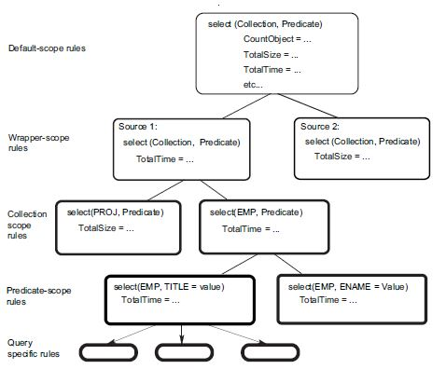
Customized Approach

Slide 26
Dynamic Approach
This monitors the run-time behavior of component DBMSs and dynamically collects the cost information
In most cases execution environment factors are constantly changing
Three classes of environmental factors based on dynamicity:
  First class (frequently changing, every second to every minute) are CPU load, I/O throughput and available memory
  Second class (slowly changing, every hour to every day) are DBMS configuration parameters, physical data organization on disk and database schema.
  Third class (almost stable, every month to every year) are DBMS type, database location, and CPU speed

Slide 27
Dynamic Approach
One approach is to extend the sampling method and consider user queries as new samples for environments where network connection, data storage and available memory change over time.
Query response time is measured to adjust the cost model parameters at run time for subsequent queries.
This avoids the overhead of processing queries periodically
However, it still requires heavy computation to solve the cost model equations and does not guarantee that the cost model’s precision improves over time

Slide 28
Dynamic Approach
Qualitative is a better solution.
This defines are system contention level as a combined effect of frequently changing factors on query cost.
System contention level is divided into discrete categories:
    High
    Medium
    Low
    No system contention

Slide 29
Dynamic Approach
These distinctions allow for defining a multi-category cost model that provides accurate cost estimates all while the dynamic factors vary.
Cost model is initially calibrated using probing queries
Current system contention level is computed over time
Assumes query executions are short, so environmental factors remain pretty constant during query execution

Slide 30
Heterogeneous Query Optimization
One component DBMS may support only simple select operations while another may support complex queries involving join and aggregate.
Depending on how the wrappers export such capabilities, query processing at the mediator level can be more or less complex.
1---Query based:
The wrappers support the same query capability,
e.g., a subset of SQL, which is translated to the capability of the component DBMS.
2---Operator based:
The wrappers export the capabilities of the component DBMSs through compositions of relational operators.
Thus, there is more flexibility in defining the level of functionality between the mediator, any functionality that may not be supported by component DBMSs (e.g., join) will need to be implemented at the mediator.

Slide 31
Query-based Approach
DBMSs appear homogeneous to the mediator, one approach is to use a distributed cost-based query optimization algorithm with a heterogeneous cost model
extensions are needed to convert the distributed execution plan into subqueries
Hybrid two-step optimization technique
static plan is produced by a centralized cost-based query optimizer
At startup time, an execution plan is produced by carrying out site selection and allocating the subqueries to the sites.

Slide 32
Cost-based query optimizer : first generate a left linear join tree, and then convert it to a bushy tree.
A hybrid algorithm that concurrently performs a bottom-up and top-down sweep of the left linear join execution tree, transforming it, step-by-step, to a bushy tree.
The algorithm has two pointers
Bottom UAN (Upper Anchor Nodes)
Is set to the grandparent of the leftmost root node
Top UAN
Is set to the root
For each UAN the algorithm selects a lower anchor node (LAN)

Slide 33
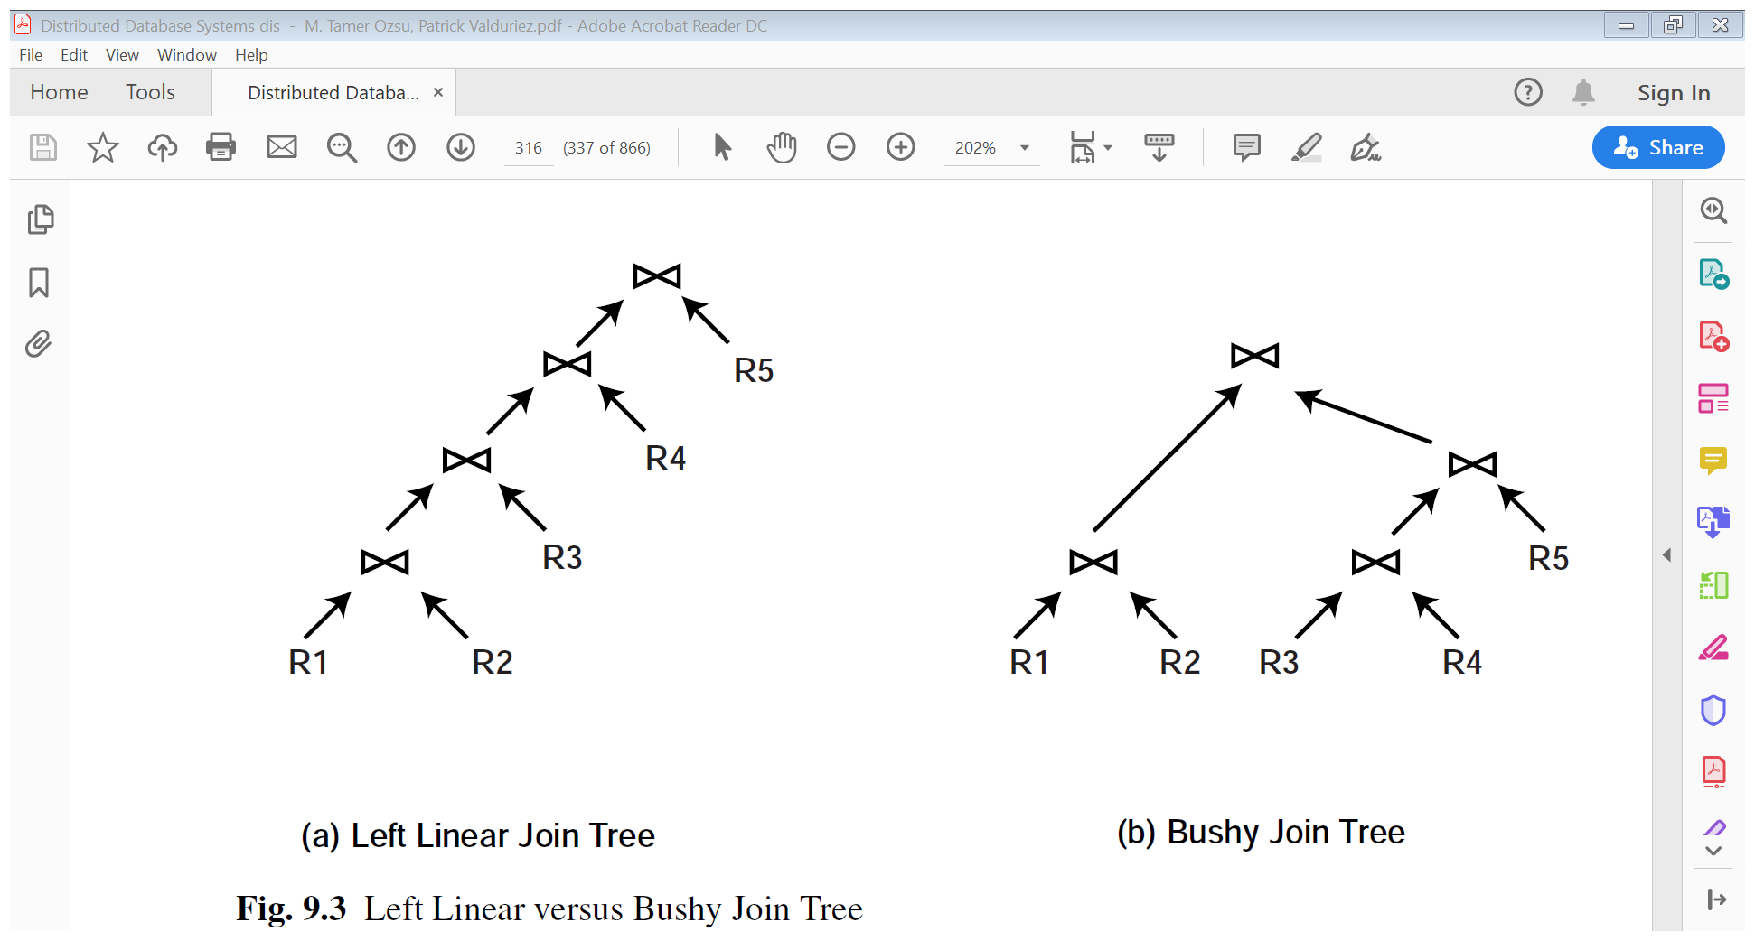
The LAN is chosen such that its right child subtree’s response time is close to the corresponding UAN’s right child subtree’s response time.
This helps in keeping the transformed bushy tree balanced, which reduces the response time.

Slide 34
Choose UANB if the response time of its left child subtree is smaller than that of UANT ’s subtree; otherwise choose UANT .
If the response times are the same, choose the one with the more unbalanced child subtree. End of transformation UANB and UANT are adjusted
when UANB = UANT -→ Terminates ( no further transformations are possible) And the result is balanced join execution tree.
*response time is reduced due to parallel execution of the joins.

Slide 35
Operator-based Approach
Expressing the capabilities of the component DBMSs through relational operators allows tight integration of query processing between mediator and wrappers.
In this approach, the capabilities of the component DBMSs are expressed by the wrappers as planning functions that can be directly called by a centralized query optimizer.
-------Consider the following SQL query submitted to mediator m:
SELECT ENAME, PNAME, DUR
FROM EMPASG
WHERE CITY = "Paris" AND DUR > 24
the GAV approach, the global view EMPASG(ENAME, CITY, PNAME,DUR) is
EMPASG = (db1.EMP 1 db2.ASG) db3.EMPASG

Slide 36
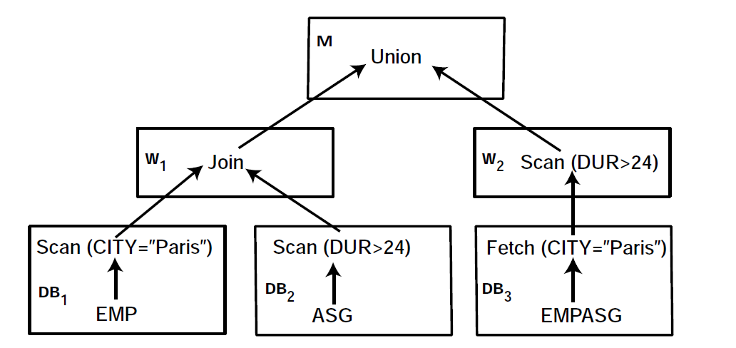
Used to model non-relational data sources such as web sites.
The operator-based approach has also been successfully used in DISCO,
a multi-DBMS designed to access multiple databases over the web

Slide 37
1. Search space generation:
The query is decomposed into a number of QEPs, which constitutes the search space for query optimization.
The search space is generated using a traditional search strategy such as dynamic programming.
2. QEP decomposition
Each QEP is decomposed into a forest of n wrapper QEPs and a composition QEP.
Each wrapper QEP is the largest part of the initial QEP that can be entirely executed by the wrapper.
Operators that cannot be performed by a wrapper are moved up to the composition QEP.
The composition QEP combines the results of the wrapper QEPs in the final answer, typically through unions and joins of the intermediate results produced by the wrappers.

Slide 38
Eddy Approach:
Eddy is a general framework for adaptive query processing. It was developed in the context of the Telegraph project with the goal of running queries on large volumes of online data with unpredictable input rates and fluctuations in the running environment.
A QEP can be modeled as a tupleQ = <D,P,C>, where
D is a set of data sources,
P is a set of query predicates withassociated algorithms, and
C is a set of ordering constraints that must be followed during execution

Slide 39

Querry
second join can only be an index join over T
p is an expensive predicate
Under these assumptions, the QEP is defined

Slide 40
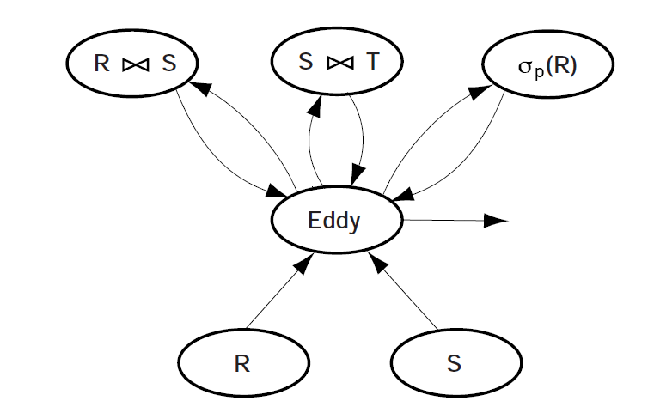
A Query Execution Plan with Eddy.
The flexibility of choosing the currently available data source is obtained by
relaxing the fixed order of predicates in a QEP. In Eddy, there is no fixed QEP and
each tuple follows its own path through predicates according to the constraints in the plan and its own history of predicate evaluation.

Slide 41
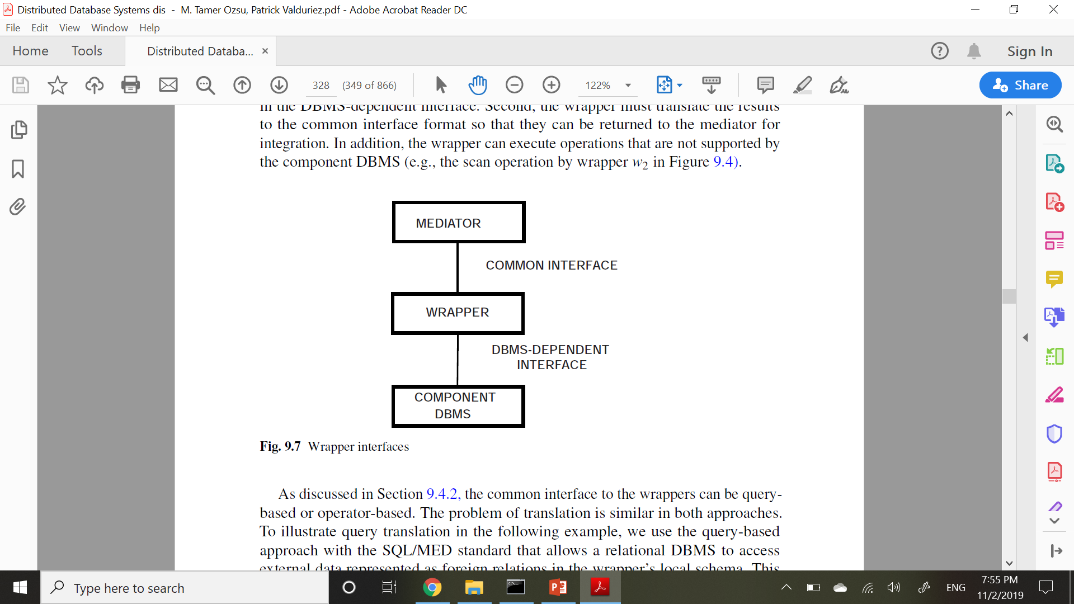
Query Translation and Execution
Query translation and execution is performed by the wrappers using the component
DBMSs. A wrapper encapsulates the details of one or more component databases,
each supported by the same DBMS (or file system). It also exports to the mediator
the component DBMS capabilities and cost functions in a common interface. One
of the major practical uses of wrappers has been to allow an SQL-based DBMS to
access non-SQL databases
Wrapper interfaces

Slide 42
The main function of a wrapper is conversion between the common interface and the DBMS-dependent interface.
Second, the wrapper must translate the results to the common interface format so that they can be returned to the mediator for integration.
In addition, the wrapper can execute operations that are not supported by the component DBMS

Slide 43
Consider the relation EMP(ENO, ENAME, CITY) stored in a very simple component database, in server Component DB, built with Unix text files. Each
EMP tuple can then be stored as a line in a file, e.g., with the attributes separated by “:”. In SQL/MED, the definition of the local schema for this relation together with the mapping to a Unix file can be declared as a foreign relation with the following
statement:
CREATE FOREIGN TABLE
EMP ENO INTEGER, ENAME VARCHAR(30), CITY VARCHAR(20)
SERVER ComponentDB
OPTIONS (Filename ’/usr/EngDB/emp.txt’, Delimiter ’:’)
Then, the mediator can send the wrapper supporting access to this relation SQL statements. For instance, the query:

Slide 44
SELECT ENAME FROM EMP
can be translated by the wrapper using the following Unix shell command to extract the relevant attribute:
cut -d: -f2 /usr/EngDB/emp
Additional processing, e.g., for type conversion, can then be done using programming code.
Wrappers are mostly used for read-only queries, which makes query translation and wrapper construction relatively easy.
Wrapper construction typically relies on CASE tools with reusable components to generate most of the wrapper code

Slide 45
Problem:
The main problem of updating through a wrapper is to guarantee component database consistency by rejecting all updates that violate integrity constraints, whether they are explicit or implicit.
Solution:
A software engineering solution to this problem uses a CASE tool with
reverse engineering techniques to identify within application code the implicit integrity constraints which are then translated into validation code in the wrappers

Slide 46
Conclusion
Query processing in multidata-base systems is significantly more complex than in tightly-integrated and homogeneous distributed DBMSs.
In addition to being distributed , component databases may be autonomous, have different database languages and query processing capabilities, and exhibit varying behavior.
In particular, component databases may range from full-fledged SQL databases to very simple datasources
(e.g., text files).

